Slide 1

^{LESSON 5: OCTOBER 4}

Slide 2
Radical Commitment to God’s Way
Focus Scripture: Joshua 24:18-27
Key Verse: (Joshua said,) “Put away the gods that your ancestors served beyond the River and in Egypt and serve the Lord.” Joshua 24:14b

Slide 3
Joshua 24:18-27 (NRSV UE)
18 “…and the Lord drove out before us all the peoples, the Amorites who lived in the land. Therefore we also will serve the Lord, for he is our God.”
19 But Joshua said to the people, “You cannot serve the Lord, for he is a holy God. He is a jealous God; he will not forgive your transgressions or your sins.
20 If you forsake the Lord and serve foreign gods, then he will turn and do you harm and consume you, after having done you good.”
21 And the people said to Joshua, “No, we will serve the Lord!”
22 Then Joshua said to the people, “You are witnesses against yourselves that you have chosen the Lord, to serve him.” And they said, “We are witnesses.”
23 He said, “Then put away the foreign gods that are among you, and incline your hearts to the Lord, the God of Israel.”
24 The people said to Joshua, “The Lord our God we will serve, and him we will obey.”
25 So Joshua made a covenant with the people that day and made statutes and ordinances for them at Shechem.
26 Joshua wrote these words in the book of the law of God, and he took a large stone and set it up there under the oak in the sanctuary of the Lord.

Slide 4
27 Joshua said to all the people, “See, this stone shall be a witness against us, for it has heard all the words of the Lord that he spoke to us; therefore it shall be a witness against you if you deal falsely with your God.”

Slide 5
Key Terms
Rebellion – Revolt, insurgence, or mutiny. In biblical context, it is considered the willful defiance, stubbornness, and rejection of God’s authority and commands.
Shechem – Derived from the Hebrew noun “shekem” meaning “shoulder/shoulder blade” or the upper part of the back. It is believed to be a city named for its location in a narrow valley between the shoulders of Mount Gerizim and Mount Ebal. Considered a monumental theological crossroad.
Your title here

Slide 6


Slide 7
As the closing chapter, Joshua 24 operates as the intense as well as prophetic conclusion to the book describing Moses’ successor. The early verses feature Joshua’s farewell address at Shechem where he challenges Israel to make a binding pledge to serve God solely. Joshua provides a final lesson on God’s historical faithfulness, accompanied by warnings against the people entering idolatry practices.

Slide 8


Slide 9
Joshua, the prophet, the warrior, the leader of the people into the Promised Land, has grown old. His final days are focusing on continuing the legacy that Moses had begun while recalling the lessons and laws of the past. It is reminiscent of the transition of leadership that is presented in multiple biblical passages (Num. 27:12-23; Deut. 31:1-8; Josh. 1:1-9). The wisdom that is exhibited is equally grounded in concern for these people who historically lacked compliance and adherence to these precious words.
A wonderful serenity has taken possession

Slide 10


Slide 11
Commit your work to the Lord, and your plans will be established. (Proverbs 16:3)
A wonderful serenity has taken possession

Slide 12


Slide 13
Current data from 2026 indicates a distinct rise in rebellious behavior across the United States, manifesting through large-scale political resistance, shifting social attitudes, and disruptive youth trends. Society is increasingly viewing rebellion as a positive “skill” rather than a negative trait. Over 57% of Americans now consider being rebellious a skill, viewing it as a means of personal empowerment and a tool to reshape traditional career paths and workplace norms.

Slide 14


Slide 15
With the multitude of demands that intrude in one’s life it may become difficult to keep commitments. Even more challenging are the streams of temptations that bombard every individual in life. Videos, posts, and images constantly pop up on computers, tablets, and phones. Not to mention the inappropriate and disrespectful behavior seen in public.

Slide 16


Slide 17
What can you and your church community do to promote spiritual growth and commitment to the Lord?

Slide 18
2. What spiritual battles are you and your community currently facing that require a recommitment to the Lord?

Slide 19
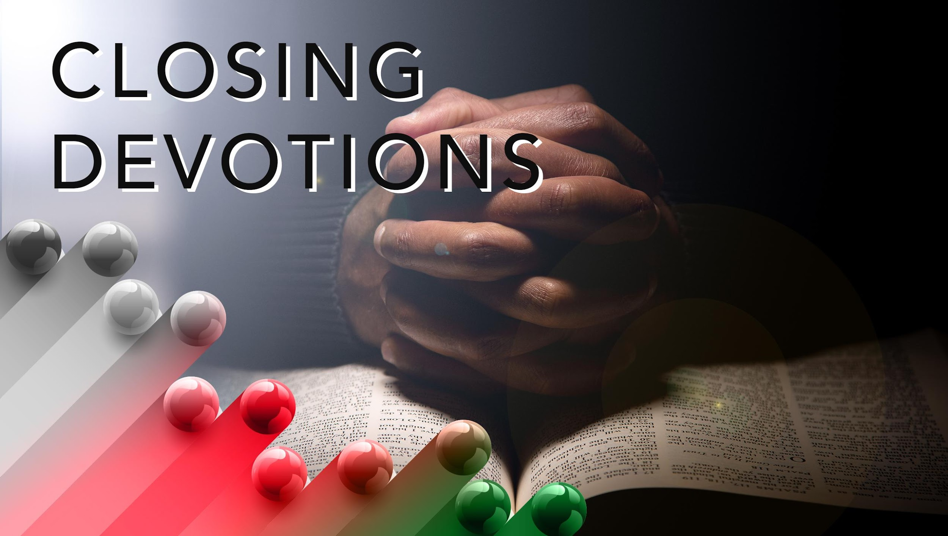

Slide 20
Closing Hymn: African American Heritage Hymnal #461, “Give Me a Clean Heart”
Closing Prayer: Precious Lord, take my hand, lead me on, let me stand, I am tired, I am weak, I am worn. Through the storm, through the night, lead me unto the light. Take my hand, precious Lord, and lead me home. May your Spirit strengthen me to commit fully to you, to follow you wherever you lead with joyful anticipation of your plan in my life. Thank you, Lord, for forgiveness and the redemptive power of Jesus Christ. Hallelujah, thank you, Jesus. Amen!

