Slide 1
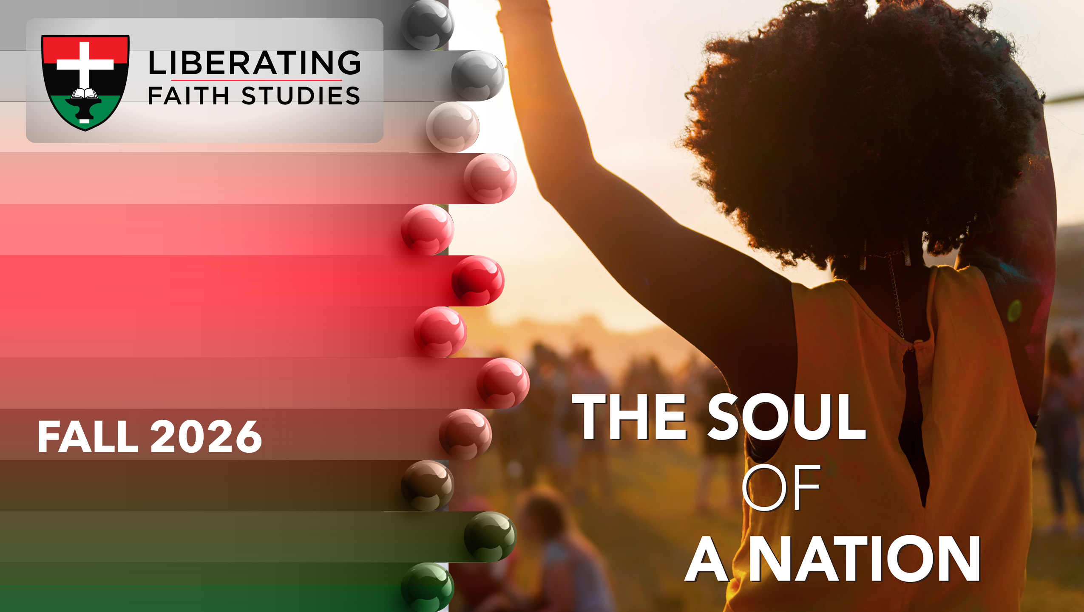
^{LESSON 4: SEPTEMBER 27}

Slide 2
God’s Compassion for Rahab
Focus Scripture: Joshua 2:8-13; 6:16-17
Key Verse: “The city and all in it shall be devoted to the Lord for destruction. Only Rahab the prostitute and all who are with her in her house shall live because she hid the messengers we sent.” Joshua 6:17

Slide 3
Joshua 2:8-13; 6:16-17 (NRSV UE)
Joshua 2:8-13
8 Before they went to sleep, she came up to them on the roof
9 and said to the men, “I know that the Lord has given you the land and that dread of you has fallen on us and that all the inhabitants of the land melt in fear before you.
10 For we have heard how the Lord dried up the water of the Red Sea before you when you came out of Egypt and what you did to the two kings of the Amorites who were beyond the Jordan, to Sihon and Og, whom you utterly destroyed.
11 As soon as we heard it, our hearts melted, and there was no courage left in any of us because of you. The Lord your God is indeed God in heaven above and on earth below.
12 Now then, since I have dealt kindly with you, swear to me by the Lord that you in turn will deal kindly with my family. Give me a sign of good faith

Slide 4
13 that you will spare my father and mother, my brothers and sisters, and all who belong to them and deliver our lives from death.”
6:16-17
16 And at the seventh time, when the priests had blown the trumpets, Joshua said to the people, “Shout! For the Lord has given you the city.
17 The city and all that is in it shall be devoted to the Lord for destruction. Only Rahab the prostitute and all who are with her in her house shall live because she hid the messengers we sent.”

Slide 5
Key Terms
Inhabitants – Those who occupied the land at that time; best interpreted as the “rulers” of the land.
Spy – To gain advantage by discovering secrets about an enemy’s plans or defenses. Other stories of spies are found in Numbers 13, Joshua 8:2-3, Judges 18:2-16.
Prostitute – A person who engages in sexual activity for money, sexual desire, or survival, predominantly viewed negatively as immoral under Mosaic law.
Your title here

Slide 6


Slide 7
This portion of the narrative specifically highlights the significance of Rahab, a woman, a prostitute, and a Gentile, who otherwise would be considered expendable and of no importance. Yet God has designed this segment of Israel’s history to use an incredibly brave and clever woman to not only protect and deliver her family from harm, but to be the ancestor of the Messiah.

Slide 8


Slide 9
The kingdoms of Sihon and Og in central and northern Transjordan had already been conquered under Moses’ leadership (Numbers 21; Deut.1–2). Spies, espionage, and a reinforced Jericho wall present the imagery of the strategies for any impending battle or attempted takeover.
A wonderful serenity has taken possession

Slide 10


Slide 11
Women of color have redefined the identity of women through the lens of Womanist Theology. Womanist Theology is a theological framework rooted in the experiences, voices, and agency of black women, analyzing how race, gender, and class create a “triple oppression.”
A wonderful serenity has taken possession

Slide 12


Slide 13
The list of the black heroines that are dimly highlighted throughout history are sadly too numerous. However, they must be acknowledged. Examples, of course, include the heroine and Underground Railroad engineer Harriet Tubman. But, many are unaware of other skillful and brave women who placed their lives in jeopardy for the good of their country and their people.

Slide 14


Slide 15
When reading about Canaanites (Matthew 15:22), there is speculation whether the ancient Israelites committed genocide by killing all of the inhabitants of Canaan. As African Methodists, there is a responsibility to carefully analyze scripture through a social justice lens. We must not respond to Joshua’s conquest narrative as a sign of God’s disregard of select people nor support the modern-day acts of aggression and war that threaten to eradicate civilizations.

Slide 16


Slide 17
1. What would you consider the best method(s) to assess whether a person is suited for leadership in the church? Do the requirements differ if a person seeks leadership in a secular role?

Slide 18
2. Are people too dependent on images of heroic leadership rather than considering the strengths and contributions of everyday individuals in their midst?

Slide 19
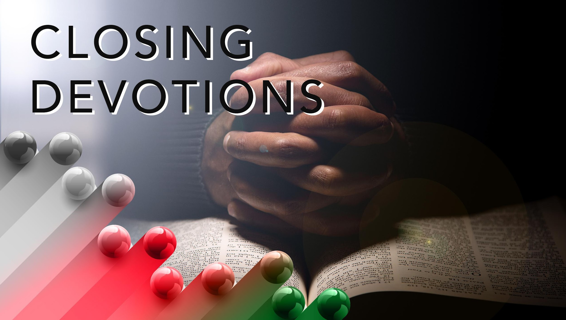

Slide 20
Closing Hymn: AMEC Hymnal # 378, “Lead Me, Guide Me”
Closing Prayer: Dear God, Heavenly Father, creator and sustainer of heaven and earth, we praise and glorify your holy name and thank you for your continued grace and mercy. Thank you, Lord, that you see the potential in us when others may not. Thank you, that you gave your Son for all of us and that you have no respect of persons. You see each of us as what we become through your grace and mercy and aligned with your purpose. Reveal your plan for us and strengthen us for the work you have assigned to each of us, man, woman, or child. May your Holy Spirit strengthen us to break down walls and build new bridges towards your kingdom. May your mercy abound and your promises be revealed through our obedience and faith in Jesus Christ. This we pray in Jesus’ name. Amen.

