Slide 1

^{LESSON 3: SEPTEMBER 20}

Slide 2
God’s Complicated Promise
Focus Scripture: Joshua 11:6-9, 16-23
Key Verse: It was the Lord’s doing to harden their hearts so that they would come against Israel in battle, in order that they might be utterly destroyed and might receive no mercy but be exterminated, just as the Lord had commanded Moses. Joshua 11:20

Slide 3
Joshua 11:6-9, 16-23 (NRSV UE)
Joshua 11:6-9
6 And the Lord said to Joshua, “Do not be afraid of them, for tomorrow at this time I will hand over all of them, slain, to Israel; you shall hamstring their horses and burn their chariots with fire.”
7 So Joshua came suddenly upon them with all his fighting force, by the waters of Merom, and fell upon them.
8 And the Lord handed them over to Israel, who attacked them and chased them as far as Great Sidon and Misrephoth-maim and eastward as far as the valley of Mizpeh. They struck them down until they had left no one remaining.
9 And Joshua did to them as the Lord had commanded him;

Slide 4
he hamstrung their horses and burned their chariots with fire.
16-23
16 So Joshua took all that land: the hill country and all the Negeb and all the land of Goshen and the lowland and the Arabah and the hill country of Israel and its lowland,
17 from Mount Halak, which rises toward Seir, as far as Baal-gad in the valley of Lebanon below Mount Hermon. He took all their kings, struck them down, and put them to death.
18 Joshua made war a long time with all those kings.
19 There was not a town that made peace with the Israelites except the Hivites, the inhabitants of Gibeon; all were taken in battle.
20 For it was the Lord’s doing to harden their hearts so that they would come against Israel in battle, in order that they might be utterly destroyed and might receive no mercy but be exterminated, just as the Lord had commanded Moses.
21 At that time Joshua came and wiped out the Anakim from the hill country, from Hebron, from Debir, from Anab, and from all the hill country of Judah, and from all the hill country of Israel; Joshua utterly destroyed them with their towns.

Slide 5
22 None of the Anakim was left in the land of the Israelites; some remained only in Gaza, in Gath, and in Ashdod.
23 So Joshua took the whole land, according to all that the Lord had spoken to Moses, and Joshua gave it for an inheritance to Israel according to their tribal allotments. And the land had rest from war.

Slide 6
Key Terms
Jericho – The first city the Israelites encountered and conquered after crossing the Jordan River into the Promised Land. Its miraculous fall served as a definitive demonstration of divine power over human strength.
Inheritance – The passing of physical property/land within families and the spiritual blessings, promises, and covenantal rights bestowed by God upon his people.
Plunder (shalal, bizah) – Goods, livestock, or people taken by force during war or conquest, representing both material spoils and divine judgment.
Allotment – A division of the conquered land of Canaan among the tribes of Israel as an inheritance.
Your title here

Slide 7


Slide 8
This chapter serves as a significant crux in the book, transitioning from the phase of military conquest to the phase of permanent tribal settlement. Israel is now a nation. What was once a community who wandered in the wilderness is no longer simply a populous collection of migrants. They have become a governed people possessing a mighty army comprised of the twelve tribes of Israel.

Slide 9


Slide 10
The Israelite people encamp east of the Jordan River in a region known as the plains of Moab. This position gives them the perspective of overlooking the northern end of the Dead Sea and the Southern Jordan Valley. They have accomplished the military victory over Jericho (chapter 6), which is interpreted as God’s authorizing act. But the narrator also reveals the turmoil that followed.
A wonderful serenity has taken possession

Slide 11


Slide 12
Continuous victories may lead to arrogance and conceit, sloppy behavior, and disregard for discipline. Most people see fighting wars and battling in competition as the natural order of survival. Encouraging a spirit of competition, winners and losers, is perceived as training and preparation for life.
A wonderful serenity has taken possession

Slide 13


Slide 14
Throughout history, the loss of human life due to mass conflicts is incalculable. Reflecting on the costs of war over the past century is daunting and immeasurable when recognizing the wholescale global impact on ethnicities, societies, economies, and the environment.

Slide 15


Slide 16
There is significant concern of the messaging from Christian leaders who reject or avoid opportunities to promote peace and welfare for all people. The ideology of having a “Christian” nation has no biblical foundation. Jesus often corrected the disciples to understand that the Messiah is not a military leader, but a God-inhabited Savior, spreading a message of love and understanding for all people.

Slide 17


Slide 18
1 What are the greatest concerns surrounding wars in the 21st century?

Slide 19
2 What messages (if any) should the church share in the 21st century regarding human rights and welfare?

Slide 20
3 How can the church become a stronger advocate for human rights, especially in times of war?

Slide 21
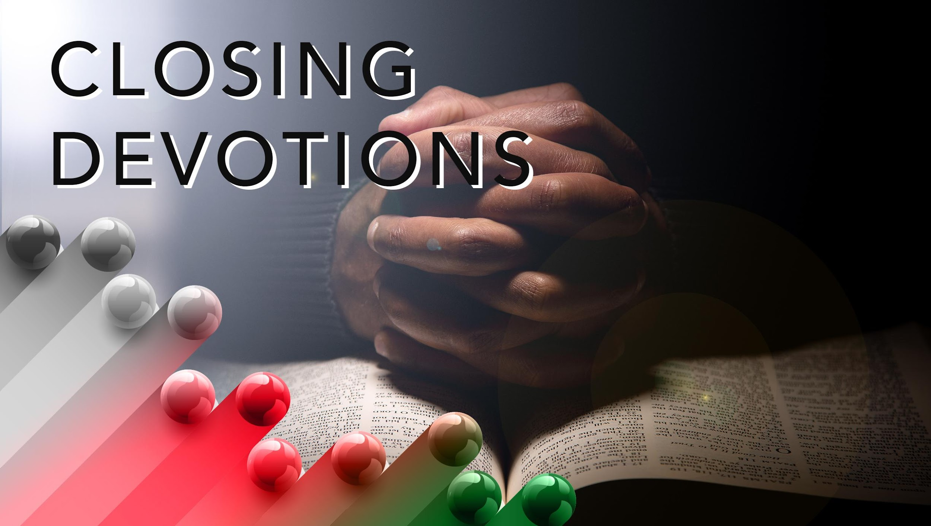

Slide 22
Closing Hymn: AMEC Hymnalal #453, “I Trust in God”
Closing Prayer: Dear Lord, we humbly come before you this day with grateful hearts, thanking you for our basic needs being met and for the protection you provided that has kept us from harm. But we know that everyone does not experience the same blessings. We pray now for those who are in harm’s way, facing war and conflict, sickness and disease. We pray for healing of the land, for righteous and honorable leadership, for peace and prosperity to replace disease, death, and despair. Heal our land, oh Lord. This we pray in Jesus’ name. Amen.

