Slide 1
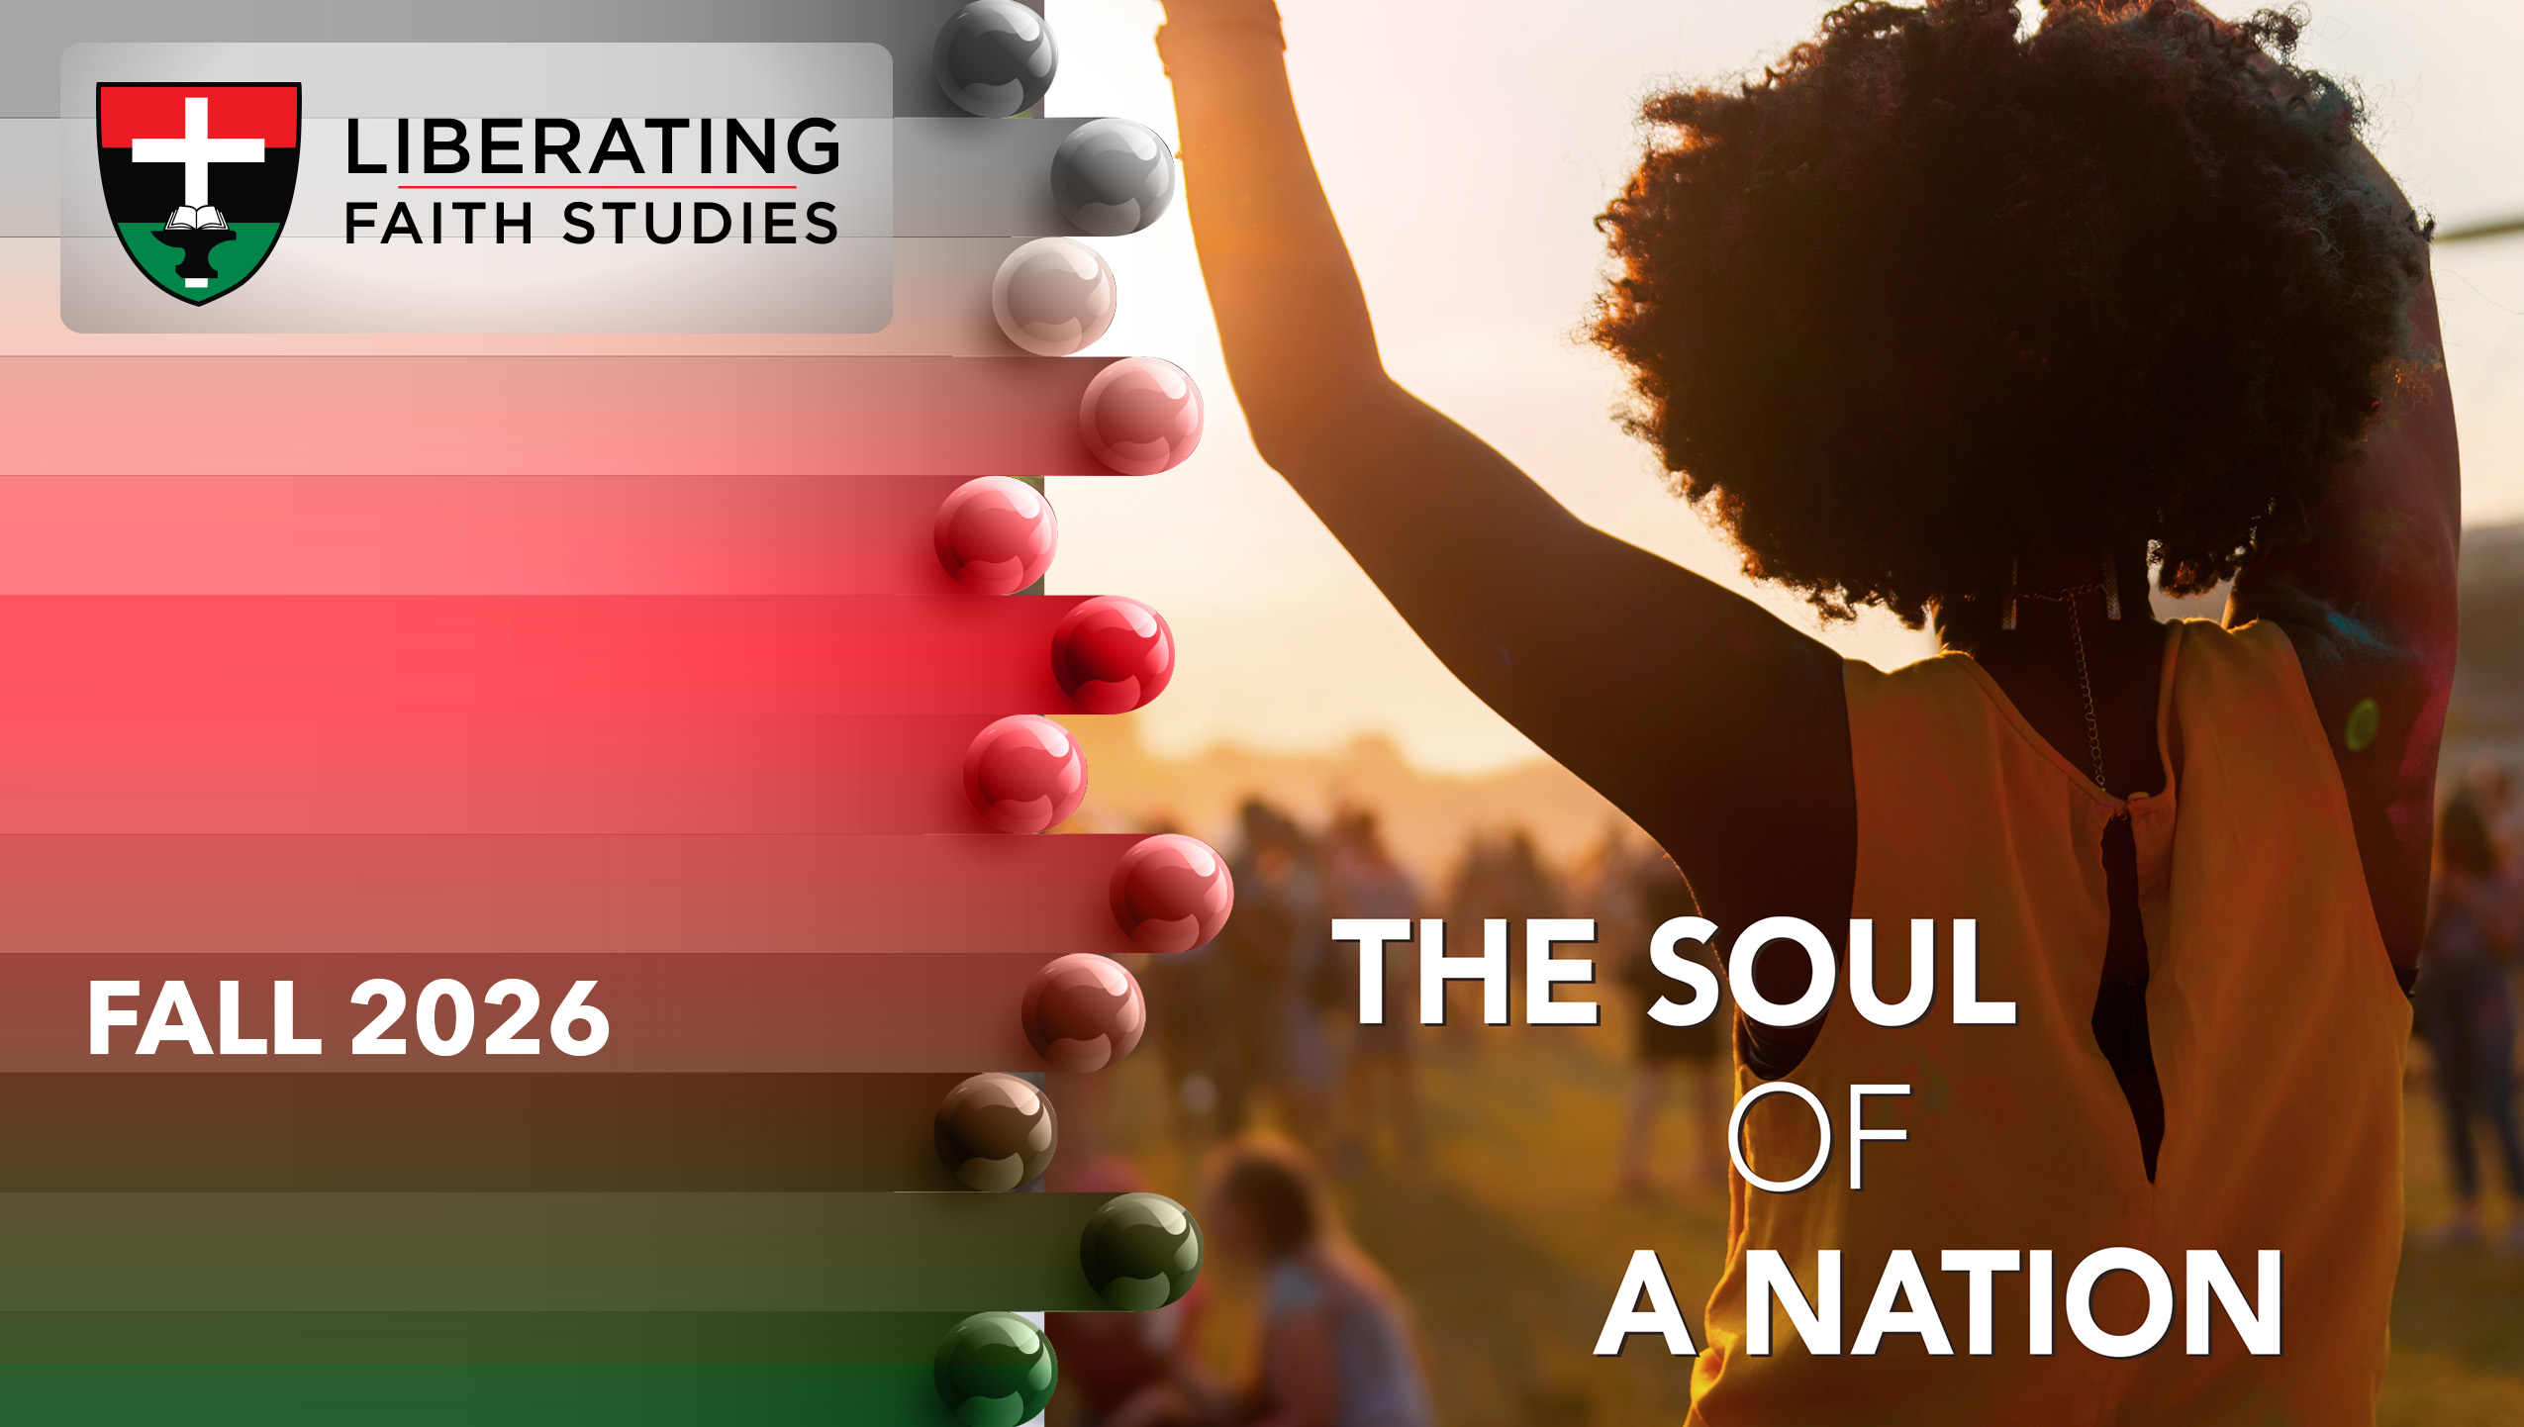
LESSON 2: SEPTEMBER 13

Slide 2
Remember God’s Actions
Focus Scripture: Joshua 4:14-24
Key Verses: (Joshua said) “When your children ask their parents in time to come, ‘What do these stones mean?’ then you shall let your children know, ‘Israel crossed over the Jordan here on dry ground.’” Joshua 4:21b-22 (NRSV UE)

Slide 3
Joshua 11:6-9, 16-23 (NRSV UE)
On that day the Lord exalted Joshua in the sight of all Israel, and they stood in awe of him, as they had stood in awe of Moses all the days of his life.
The Lord said to Joshua,
“Command the priests who bear the ark of the covenant to come up out of the Jordan.”
Joshua therefore commanded the priests, “Come up out of the Jordan.”
When the priests bearing the ark of the covenant of the Lord came up from the middle of the Jordan and the soles of the priests’ feet touched dry ground, the waters of the Jordan returned to their place and overflowed all its banks, as before.
The people came up out of the Jordan on the tenth day of the first month, and they camped in Gilgal on the east border of Jericho.
Those twelve stones that they had taken out of the Jordan, Joshua set up in Gilgal,
saying to the Israelites, “When your children ask their parents in time to come, ‘What do these stones mean?’
then you shall let your children know, ‘Israel crossed over the Jordan here on dry ground.’

Slide 4
For the Lord your God dried up the waters of the Jordan for you until you crossed over, as the Lord your God did to the Red Sea, which he dried up for us until we crossed over,
so that all the peoples of the earth may know that the hand of the Lord is mighty and so that you may fear the Lord your God forever.”

Slide 5
Key Terms
Ark of the Covenant – The Ark of the Covenant, Ark of God, or “chest of the covenant,” was a sacred, gold-plated wooden chest holding the tablets of the Ten Commandments given to Moses by God on Mount Sinai. It also symbolized God’s presence and represented the moral laws that bound God’s relationship with Israel.
Gilgal – Served as the Israelites’ first campsite in the Promised Land and acted as their primary military and spiritual headquarters during the conquest of Canaan.
Your title here

Slide 6


Slide 7
In the Bible, the Levitical priests were the male descendants of Aaron from the tribe of Levi. They were specifically set apart by divine command to serve as mediators between God and the people of Israel.

Slide 8


Slide 9
This migratory moment of the Israelites served as validation of Joshua’s leadership (Josh. 4:14). The miracles performed through the Ark’s priestly procession through the Jordan River served to promote Joshua in the eyes of the people, confirming that God was with him as he had been with Moses.
A wonderful serenity has taken possession

Slide 10


Slide 11
Inanimate objects and relics often serve as reminders of important events and future commitments. This practice appears throughout the Bible and continues today. One common example in the Old Testament is the use of stones. In Joshua, stones marked significant events, symbolized promises or vows (Josh. 24:7), and commemorated God’s miraculous acts (Josh. 4:7).
A wonderful serenity has taken possession

Slide 12


Slide 13
Placing the names of trustees on the cornerstones of African Methodist Episcopal (AME) churches is a long-standing tradition. It is rooted in the necessity of compliance to doctrine and discipline, establishment of legal authority, and recognition of community leadership. It also serves as a reminder of the historical struggle of African Americans to secure property rights. Trustees in the AME tradition are the legal custodians of church property, holding deeds and titles “in trust” for the denomination.

Slide 14


Slide 15
Joshua’s rise to leadership and his actions that followed presents an image of balancing vision, action, and deep spiritual dependence on God. His example offers a model for leadership in any context, whether in the ministry or secular environments. There are times when we face barriers and daunting obstacles that suggest the vision is unattainable. Yet, the Bible presents the faith found in Joshua, who is called by God to carry out the work begun by his predecessor and mentor, Moses.

Slide 16


Slide 17
1. Reflect on the great achievements of family members, ministry leaders, political figures, or historical figures who had to follow a great leader. What positive aspects stand out in their leadership role?

Slide 18
2. What has God called you to do in the past, and is sending you out to do in the future that requires faith and obedience?

Slide 19
3. What spiritual battles do you expect to face in the future and how are you equipping yourself for them?

Slide 20
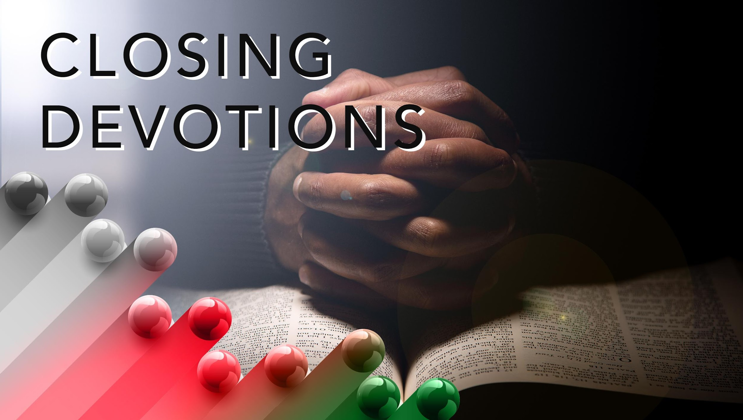

Slide 21
Closing Hymn: AMEC Hymnalal #513, “Time Is Filled with Swift Transition”
Closing Prayer: Dear Lord, we your people are often faced with overwhelming odds against us. Whether we face them in our homes, our jobs, our communities, and our countries, we need you to guide us through. These are times when we must rely on your presence and your power to take us through troubled waters and unknown destinations. But just as you have led those before us, we trust you, God, to lead us through to the promises you gave our ancestors and the destiny you promised to all of us. May our hearts align with your Word, your commandments, and be enhanced and revealed in truth through the Gospel of Jesus the Christ. All this we pray in Jesus’ matchless and precious name. Amen.

