Slide 1

^{LESSON 13: NOVEMBER 29}

Slide 2
David’s Coronation and Capture of Jerusalem
Focus Scripture: 2 Samuel 5:1-12
Key Verses: David then perceived that the Lord had established him king over Israel and that he had exalted his kingdom for the sake of his people Israel. 2

Slide 3
2 Samuel 5:1-12 (NRSV UE)
1 Then all the tribes of Israel came to David at Hebron and said, “Look, we are your bone and flesh.
2 For some time, while Saul was king over us, it was you who led out Israel and brought it in. The Lord said to you, ‘It is you who shall be shepherd of my people Israel, you who shall be ruler over Israel.’”
3 So all the elders of Israel came to the king at Hebron, and King David made a covenant with them at Hebron before the Lord, and they anointed David king over Israel.
4 David was thirty years old when he began to reign, and he reigned forty years.
5 At Hebron he reigned over Judah seven years and six months, and at Jerusalem he reigned over all Israel and Judah thirty-three years.
6 The king and his men marched to Jerusalem against the Jebusites, the inhabitants of the land, who said to David, “You will not come in here; even the blind and the lame will turn you back,” thinking, “David cannot come in here.”
7 Nevertheless, David took the stronghold of Zion, which is now the city of David.
8 David had said on that day, “Whoever would strike down the Jebusites, let him get up the water shaft to attack the lame and the blind, those whom David hates.” Therefore

Slide 4
it is said, “The blind and the lame shall not come into the house.”
9 David occupied the stronghold and named it the city of David. David built the city all around from the Millo inward.
10 And David became greater and greater, for the Lord of hosts was with him.
11 King Hiram of Tyre sent messengers to David, along with cedar trees and carpenters and masons who built David a house.
12 David then perceived that the Lord had established him king over Israel and that he had exalted his kingdom for the sake of his people Israel.

Slide 5
^{Key Terms}
Hiram – Translates to exalted brother or my brother is exalted. It is derived from the Hebrew word for brother (ah) and a root meaning to be high or lofty (rum).
Millo – Interpreted as the landfill, rampart, storage facility, or filling. It represents a filled-in embankment or fortification.
Hebron – Means association, alliance, or friendship, to join; derived from the Hebrew root ḥbr; one of the oldest and most significant cities in the Old Testament, functioning as a major spiritual and political hub in Judea, famously serving as Abraham’s burial place and King David’s first capital.
Zion – Holds many meanings, first as a geographical location and synonym for Jerusalem as well as for the land of Israel; evolved to symbolize God’s presence and Israel’s spiritual heart; the New Testament interpretation as the new Jerusalem where God’s ethnically diverse people live in his presence.
Your title here

Slide 6


Slide 7
The fifth chapter of 2 Samuel marks a pivotal moment in the history of Israel, which continued to shape the soul of this nation. It is a foundational text that highlights David’s achievements. This final lesson chronicles David’s ascent to rule over a unified nation and his establishment of Jerusalem as the political and spiritual center.

Slide 8


Slide 9
David’s military achievements are central to this passage. He captured Jerusalem by overcoming the Jebusite defenses that had resisted earlier attacks. The account describes his strategic use of the water shaft, highlighting both ingenuity and determination. These victories strengthened David’s reputation as a formidable leader and secured his rule over all Israel.
A wonderful serenity has taken possession

Slide 10


Slide 11
The conclusion of this quarter presents a story of the once enslaved people from a state of wandering in wilderness settings, through the instability of uncertain leadership and volatile existence in foreign hands, to a place of prestige and power. Despite the tumultuous events of conflict, the Israelites become stable in their land of promise as a sovereign nation, under the rule of God’s chosen king.
A wonderful serenity has taken possession

Slide 12


Slide 13
The basic needs of human beings are food, water, clothing, and shelter. These are the basic requirements for nourishment and sustainability of life. Yet, the expansion and extravagance of these basic needs become a symbol of a person’s wealth and power. Examples are massive feasts, elaborate clothing, and expansive buildings and estates which are used to display a person’s status.

Slide 14


Slide 15
David’s victories and his growing reputation with other nations led to the tradition of building a royal home with the grandeur of a palace. However, palaces throughout the world are used for more than a basic dwelling place. These structures and estates display the splendor and power of royalty.

Slide 16


Slide 17
1. How has the church successfully aided those in need? With rising prices and lack of affordable housing, do you think the church has done enough?

Slide 18
2. Discuss untapped opportunities your local church can pursue to provide shelter to displaced people in your community.

Slide 19
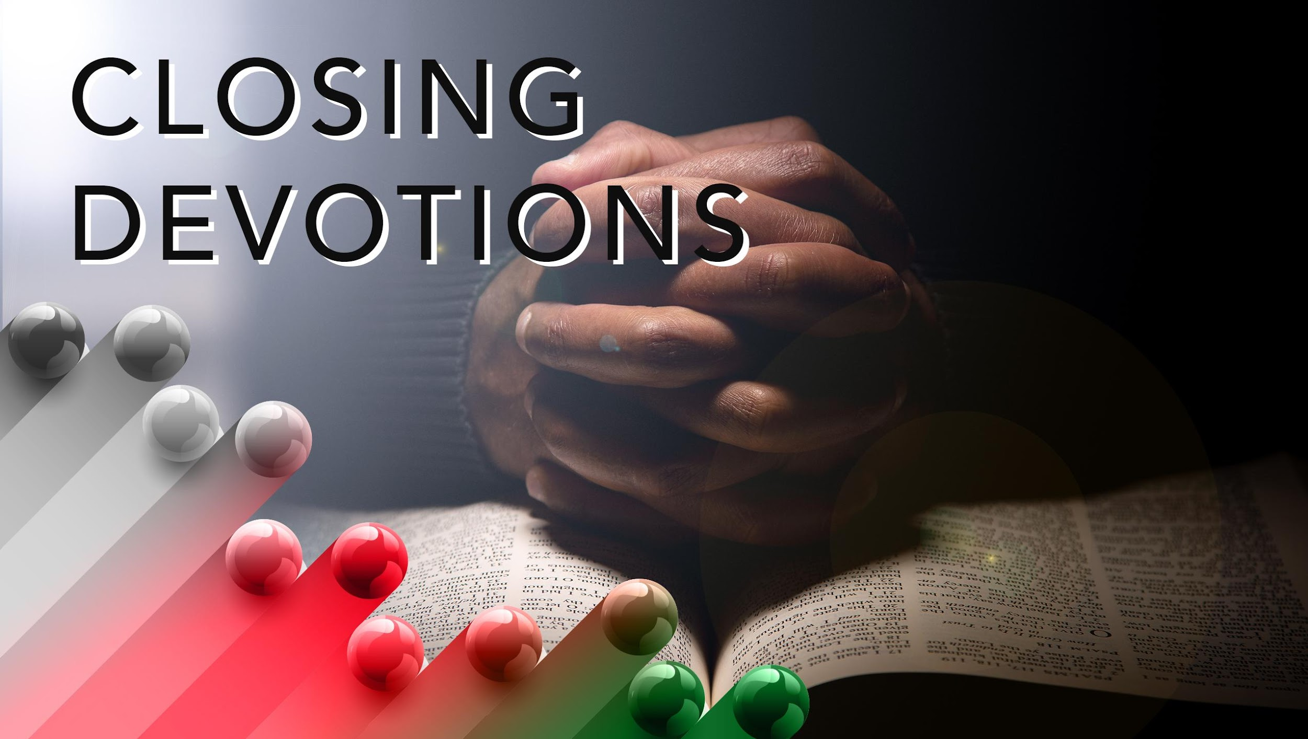

Slide 20
Closing Hymn of Praise or Praise Song: “How Great Is Our God”
Closing Prayer: Dear Lord, our God, how excellent is thy name above all the earth. The earth, cosmos, and all of creation within it serve to display the opulence and magnificence of your glory. May the children of God be diligent in honoring the beauty of your creation while also expressing heartfelt appreciation for the blessings of our homes, food, and clothing. We pray for godly wisdom and revelation in ways that we can help our brothers and sisters in the world who require assistance in any of these needs. May our hearts be filled with compassion and our minds be strategic in building paths to provide the means for those in distress to receive God’s love and blessings through the transformative ministries of the AME Church. This we pray in the name of Jesus our Lord. Amen.

