Slide 1
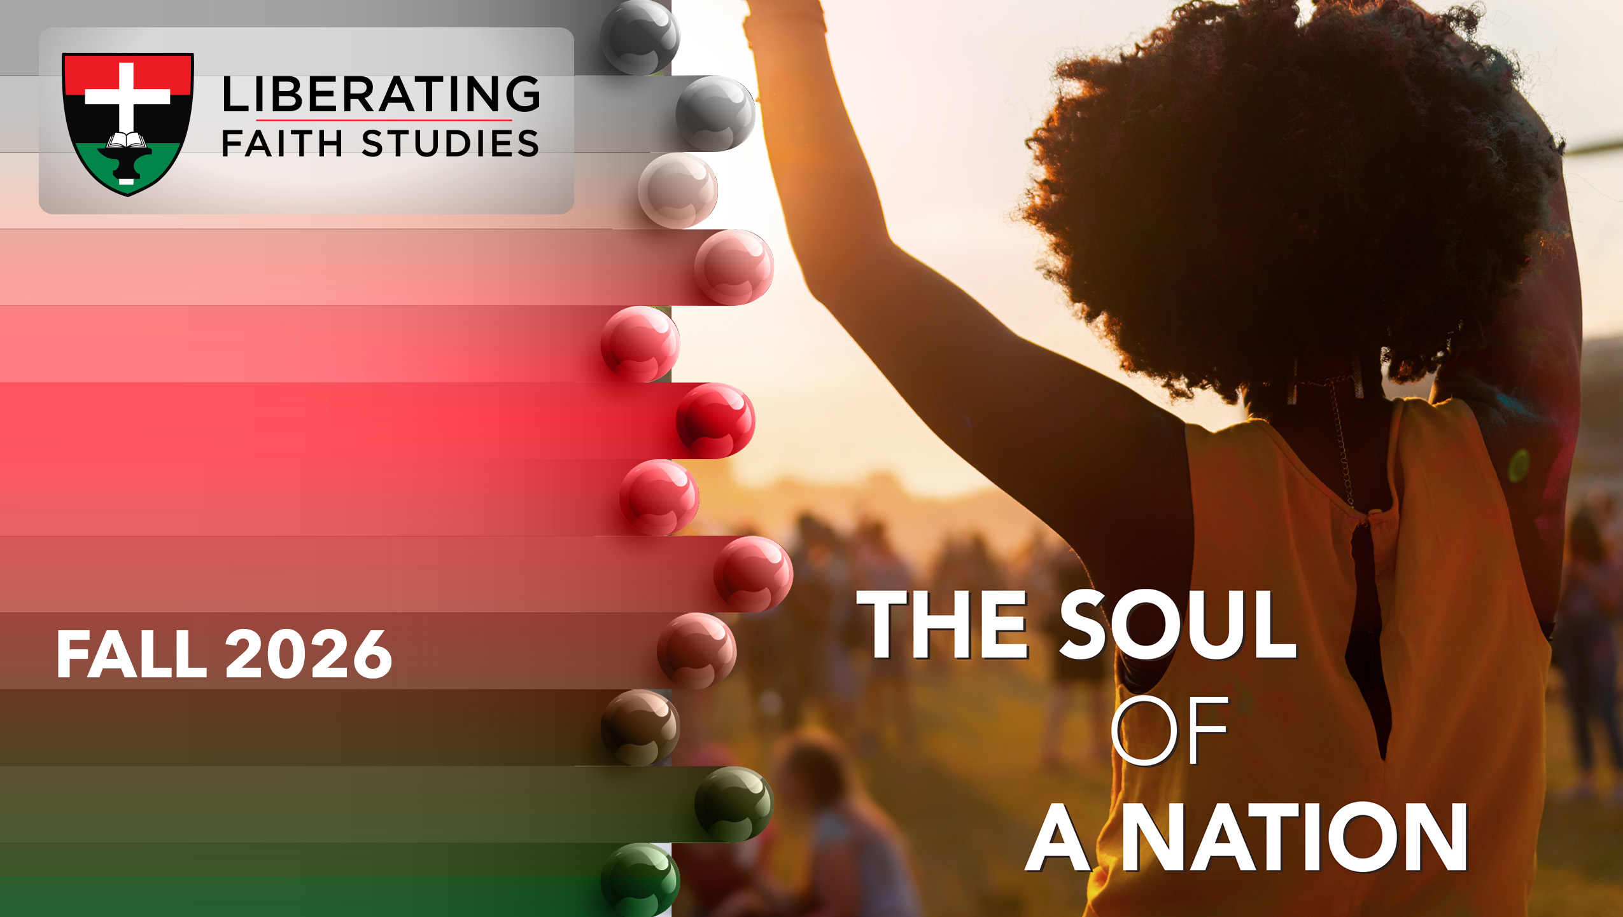
^{LESSON 12: NOVEMBER 22}

Slide 2
Samuel, a King Maker
Focus Scripture: 1 Samuel 16:4-13
Key Verse: (Jesse) sent and brought (David) in. Now he was ruddy and had beautiful eyes and was handsome. The Lord said, “Rise and anoint him, for this is the one.” 1 Samuel 16:12

Slide 3
1 Samuel 16:4-13 (NRSV UE)
4 Samuel did what the Lord commanded and came to Bethlehem. The elders of the city came to meet him trembling and said, “Do you come peaceably?”
5 He said, “Peaceably. I have come to sacrifice to the Lord; sanctify yourselves and come with me to the sacrifice.” And he sanctified Jesse and his sons and invited them to the sacrifice.
6 When they came, he looked on Eliab and thought, “Surely his anointed is now before the Lord.”
7 But the Lord said to Samuel, “Do not look on his appearance or on the height of his stature, because I have rejected him, for the Lord does not see as mortals see; they look on the outward appearance, but the Lord looks on the heart.”
8 Then Jesse called Abinadab and made him pass before Samuel. He said, “Neither has the Lord chosen this one.”
9 Then Jesse made Shammah pass by. And he said, “Neither has the Lord chosen this one.”

Slide 4
10 Jesse made seven of his sons pass before Samuel, and Samuel said to Jesse, “The Lord has not chosen any of these.”
11 Samuel said to Jesse, “Are all your sons here?” And he said, “There remains yet the youngest, but he is keeping the sheep.” And Samuel said to Jesse, “Send and bring him, for we will not sit down until he comes here.”
12 He sent and brought him in. Now he was ruddy and had beautiful eyes and was handsome. The Lord said, “Rise and anoint him, for this is the one.”
13 Then Samuel took the horn of oil and anointed him in the presence of his brothers, and the spirit of the Lord came mightily upon David from that day forward. Samuel then set out and went to Ramah.

Slide 5
Key Terms
Anoint – To rub or pour sacred oil on a person; a ceremonial act to distinguish an individual for a divine assignment, calling, and purpose.
Abinidab – From (1) the noun, father in a social context rather than biological, and (2) the verb which means to give indicating nobility and volunteerism. Another holding this name is found in 1 Samuel 7:1.
Shimea – Third-born son of Jesse and brother of David; the name Shimea primarily translates to fame, renown, or he (God) has heard.
Your title here

Slide 6


Slide 7
The 16th chapter of 1 Samuel records a pivotal moment in biblical history, with several critical facets. The saga unfolds with the rejection of Saul’s dynasty, following Saul’s disobedient act of preserving a portion of the Amalekite spoils (1 Sam.15:20). Saul falls from God’s grace and is tormented by insecurity and fear, knowing his reign is coming to an end. This sets the stage for a new leader, who will be faithful to God. God demonstrates sovereign selection over the discriminatory human expectations of leadership comprised of birth order, appearance, or perceived livelihoods.

Slide 8


Slide 9
When Samuel arrives in Bethlehem, he enters a small, ancient town that would later become famous as the birthplace of Jesus the Messiah. At this moment in Israel’s history, Bethlehem is a quiet agricultural community. The elders are fearful when Samuel arrives, likely because his presence could signal judgment or trouble. This was understandable in reflecting the uncertainty and anxiety of the times (1 Sam. 16:4).
A wonderful serenity has taken possession

Slide 10


Slide 11
“…From everyone to whom much has been given, much will be required…” (Luke 12:48 (NRSV))
A wonderful serenity has taken possession

Slide 12


Slide 13
There are several theories in psychology that suggest that the birth order of children determines the family dynamics and interactions which in turn will also impact the personality traits, life perspectives, and other factors in a child’s life. This hypothesis is called “Birth Order Theory” and was introduced by Alfred Adler in the early 20th century.

Slide 14
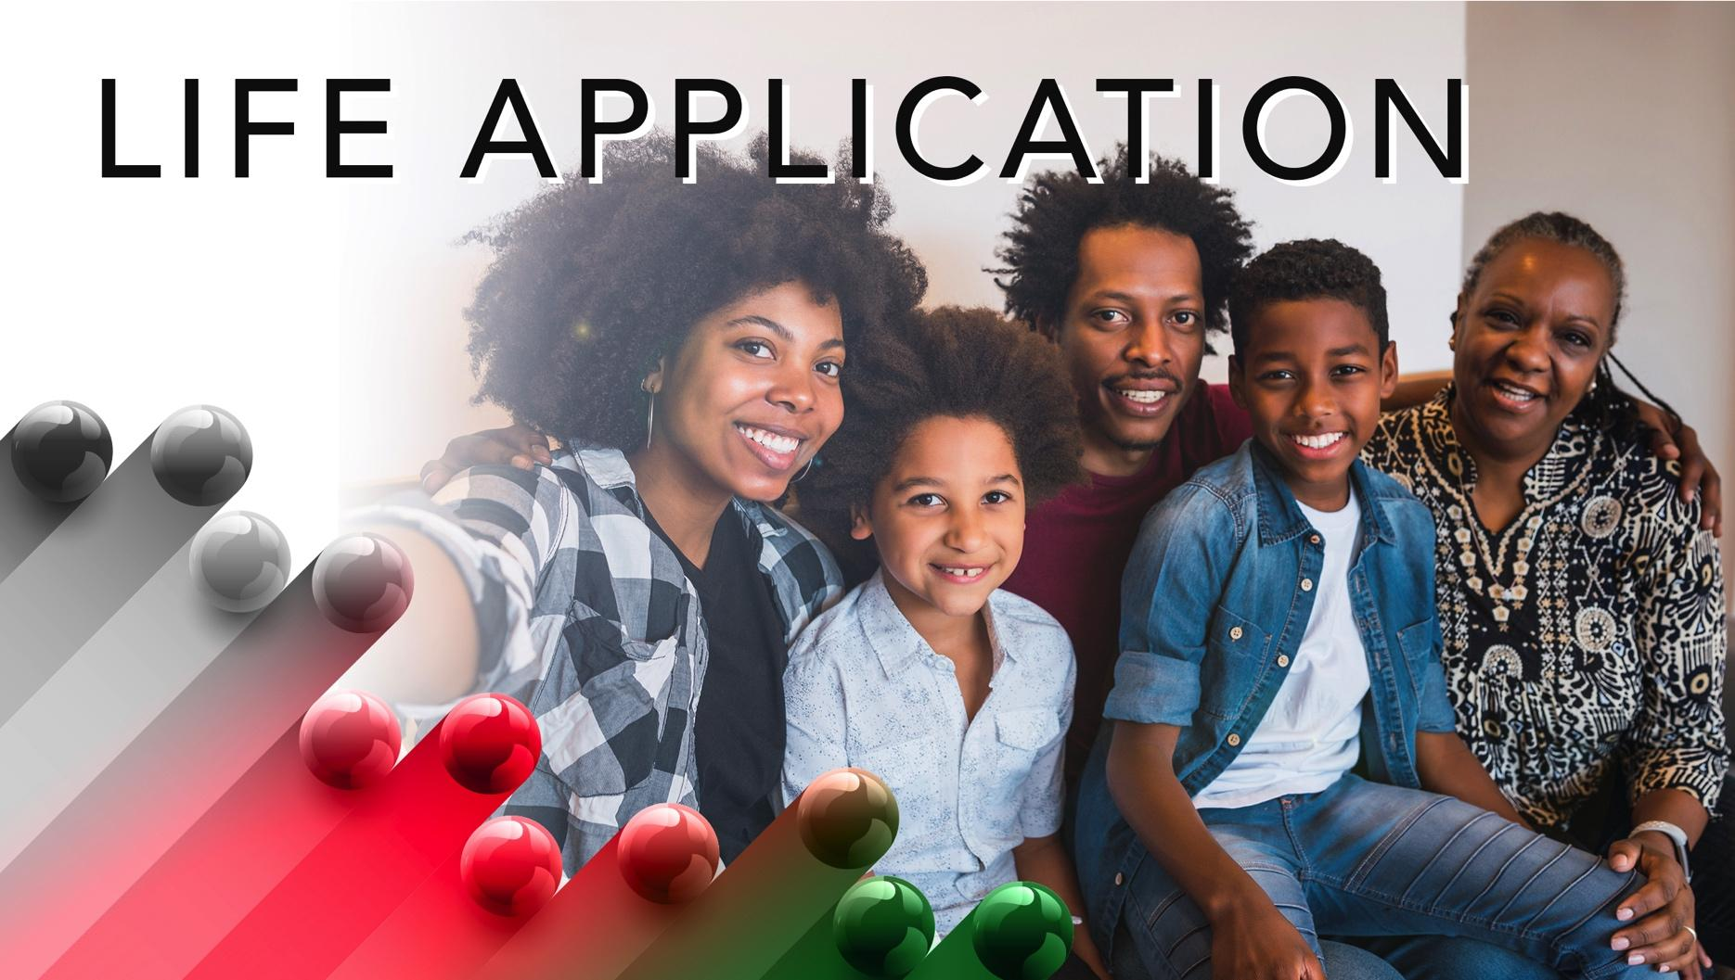

Slide 15
The story of David can be an inspiration to anyone who has faith in God. David was not perceived as a potential ruler of Israel by his family or the community. Yet his love for the Lord and dedication to his humble responsibility as a shepherd elevated him to the noble and critical role as king.

Slide 16


Slide 17
1. Discuss ways to recognize and honor people in your church who often go unnoticed and forgotten.

Slide 18
2. How can the AME Church provide platforms to highlight and celebrate the ministries of smaller or less noticeable churches in the connection?

Slide 19
3. How can the church celebrate the gifts of younger people and recognize their potential to build the kingdom of God? Discuss opportunities through your church’s Young People’s Department (YPD) and your church’s Youth Ministry.

Slide 20
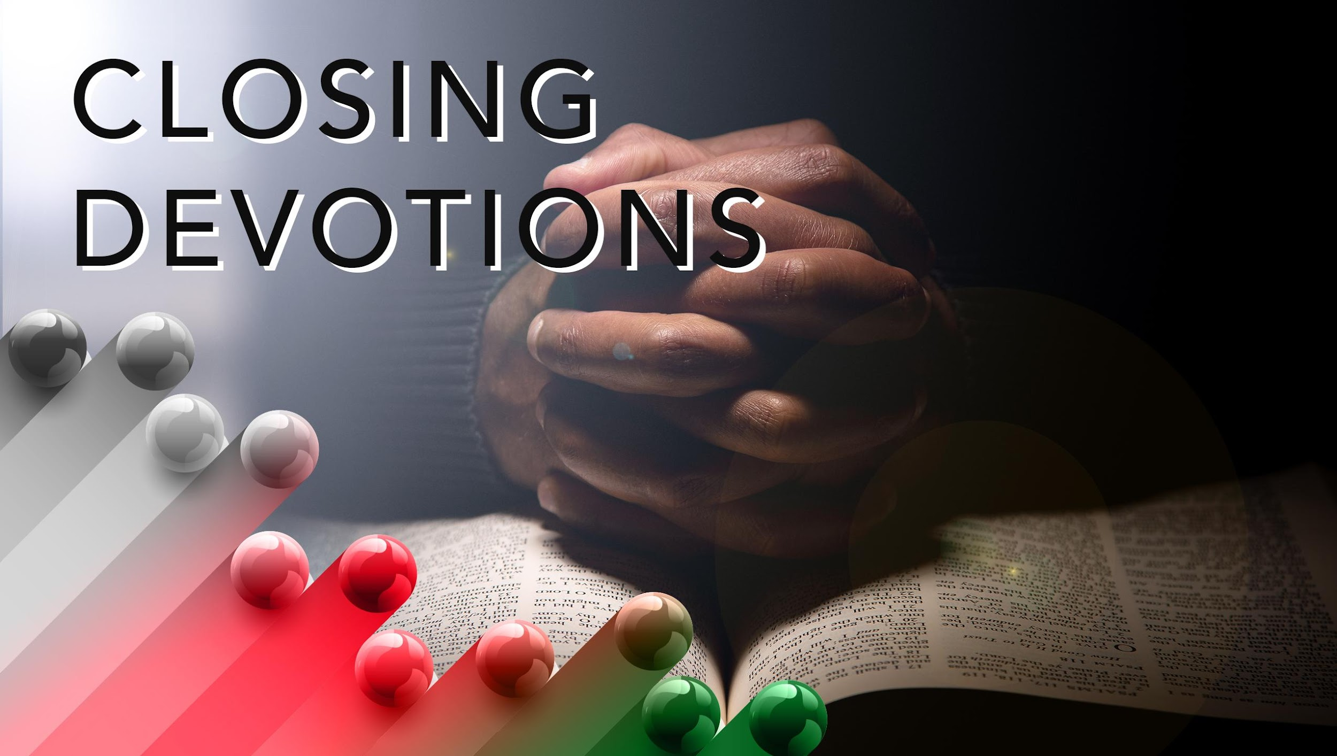

Slide 21
Closing Hymn: African American Heritage Hymnal #318, “Anointing”
Closing Prayer: Heavenly Father, we are truly grateful for your abounding grace and your fresh new mercy that met us in the dawning of this day. We extol you, dear Lord, for being God and displaying your sovereign wisdom that establishes the pathway of your divine plan. We pray that we are not led simply by human thoughts and desires, earthly judgment and assessments, but rather through contemplative, reflective, and diligent prayer, seeking to rest in your heart of forgiveness and Spirit of love. May your Holy Spirit speak to our hearts that we may be receptive to your call in our lives and excited for the positions you assign to others. May the church be an example of unity for the world to see in us. In Jesus’ name we pray. Amen.

