Slide 1
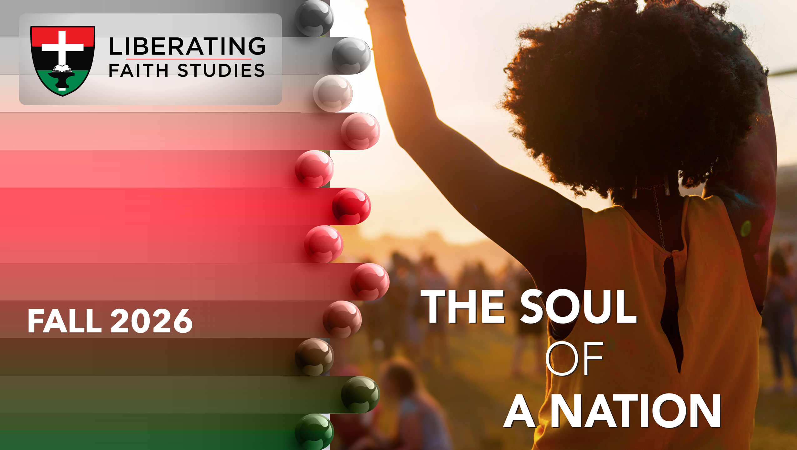
^{LESSON 11: NOVEMBER 15}

Slide 2
Samuel, God’s Prophet and Judge
Focus Scripture: 1 Samuel 7:3-11, 15-17
Key Verses: Samuel judged Israel all the days of his life. 1 Samuel 7:15

Slide 3
1 Samuel 7:3-11, 15-17 (NRSV UE)
3 Then Samuel said to all the house of Israel, “If you are returning to the Lord with all your heart, then put away the foreign gods and the Astartes from among you. Direct your heart to the Lord and serve him only, and he will deliver you out of the hand of the Philistines.”
4 So Israel put away the Baals and the Astartes, and they served the Lord only.
5 Then Samuel said, “Gather all Israel at Mizpah, and I will pray to the Lord for you.”
6 So they gathered at Mizpah and drew water and poured it out before the Lord. They fasted that day and said, “We have sinned against the Lord.” And Samuel judged the Israelites at Mizpah.
7 When the Philistines heard that the Israelites had gathered at Mizpah, the lords of the Philistines went up against Israel. And when the Israelites heard of it, they were afraid of the Philistines.

Slide 4
8 The Israelites said to Samuel, “Do not cease to cry out to the Lord our God for us, and pray that he may save us from the hand of the Philistines.”
9 So Samuel took a sucking lamb and offered it as a whole burnt offering to the Lord; Samuel cried out to the Lord for Israel, and the Lord answered him.
10 As Samuel was offering up the burnt offering, the Philistines drew near to attack Israel, but the Lord thundered with a mighty voice that day against the Philistines and threw them into confusion, and they were routed before Israel.
11 And the men of Israel went out of Mizpah and pursued the Philistines and struck them down as far as beyond Beth-car.
15-17
15 Samuel judged Israel all the days of his life.
16 He went on a circuit year by year to Bethel, Gilgal, and Mizpah, and he judged Israel in all these places.
17 Then he would come back to Ramah, for his home was there; he administered justice there to Israel and built there an altar to the Lord.

Slide 5
^{Key Terms}
Mizpah – A Hebrew word meaning watchtower or lookout; original biblical context was one of mutual suspicion.
Beth-car – Mentioned once in the Bible in 1 Samuel 7:11. It is described as the geographical limit of a decisive military pursuit. Hebrew: Bêyth Kar literally translates to House of the Lamb.
Ebenezer – A stone placed by Samuel meaning Stone of Help; considered a proclamation that God is our help.
Ramah – High place, lofty; also used to mean a high level, as in excellence. Ramah in the area of Benjamin was the birthplace and burial site of Samuel.
Reconciliation – A restorative process of rebuilding trust, acknowledging harm, and fostering repentance.
Your title here

Slide 6


Slide 7
In the initial verses of 1 Samuel chapter 7, the children of Israel are without the Ark, experiencing the grief of losing God’s presence for over 20 years (1 Sam. 7:1-2). But through the leadership of Samuel, the people are convicted of their sins against God and their nation is revived.

Slide 8


Slide 9
In verses 3 and 4, Samuel confronts the people about their idolatry. He commands them to put away the Baals and Ashtaroth and serve the Lord alone. He then instructs them to gather at Mizpah and seek the Lord’s forgiveness. In verse 5, they draw water, pour it out, and fast as signs of repentance, humility, and complete surrender to God.
A wonderful serenity has taken possession

Slide 10


Slide 11
“All this is from God, who reconciled us to himself through Christ and gave us the ministry of reconciliation: that God was reconciling the world to himself in Christ, not counting people’s sins against them” (2 Corinthians 5:18-19)
A wonderful serenity has taken possession

Slide 12


Slide 13
The human condition found in many nations and societies is often filled with conflict and discord, particularly when resources are scarce. Poverty can abound when limits are applied to a specific race, ethnicity, gender, or class and particularly, when these same groups are exploited.

Slide 14


Slide 15
The themes of 1 Samuel 7 resonate with modern believers facing challenges and uncertainties. Just as Israel needed to recenter their lives around God’s presence, we are reminded to seek him in times of trouble and spiritual dryness. The victory over the Philistines encourages us to reinforce our prayer life and build up our faith, trusting that God can overcome any problem we face.

Slide 16


Slide 17
1. What can the church do to encourage a spirit of reconciliation within families and a community?

Slide 18
2. Share your thoughts on reparations and specific cases where it could be applied.

Slide 19
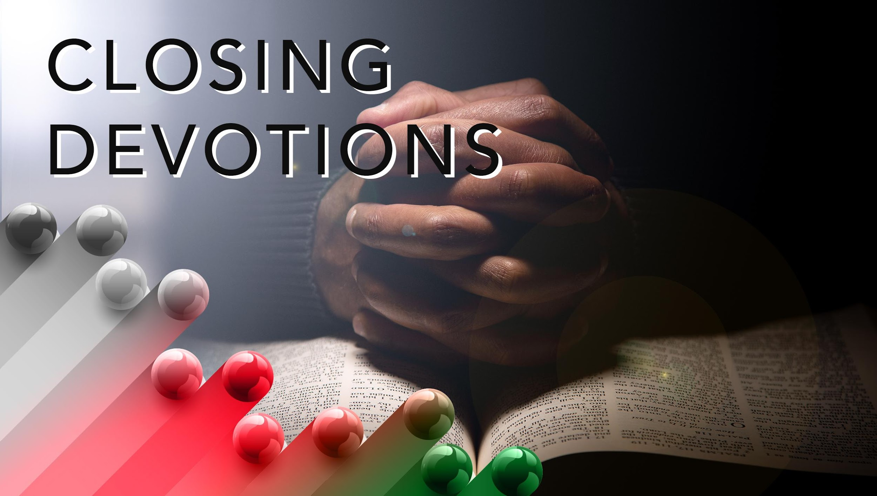

Slide 20
Closing Hymn: AMEC Hymnal #82, “O for a Closer Walk with God”
Closing Prayer: “O Thou, in whose presence my soul takes delight. On whom in affliction I call. My comfort by day and my song in the night. My hope, my salvation, my all!” As we consider the sins of humanity and rebellious actions against you, Lord, we confess our wrongs and pray for forgiveness. In our wounds we respond with pain and need the healing balm of forgiveness and reconciliation to restore us and make us whole. Let us recommit ourselves to you, oh Lord, with joy and gladness, trusting in your holy plan and drawing near to you in faith through Jesus Christ. This we pray in his name. Amen.
AMEC Hymnalal #93 – “O Thou, in Whose Presence”

