Slide 1

LESSON 9: AUGUST 2

Slide 2
Thomas, the Honest Doubter
Focus Scripture: John 11:14-16; 14:5-8; 20:24-29; 21:1-2
Key Verse: (Jesus) said to Thomas, “Put your finger here and see my hands. Reach out your hand and put it in my side. Do not doubt but believe.” John 20:27

Slide 3
John 11:14-16; 14:5-8; 20:24-29; 21:1-2
(NRSV UE)
John 11:14-16
14 Then Jesus told them plainly, “Lazarus is dead.
15 For your sake I am glad I was not there, so that you may believe. But let us go to him.”
16 Thomas, who was called the Twin, said to his fellow disciples, “Let us also go, that we may die with him.”
14:5-8
5 Thomas said to him, “Lord, we do not know where you are going. How can we know the way?”
6 Jesus said to him, “I am the way and the truth and the life. No one comes to the Father except through me.
7 If you know me, you will know my Father also. From now on you do know him and have seen him.”
8 Philip said to him, “Lord, show us the Father, and we will be satisfied.”
20:24-29
24 But Thomas (who was called the Twin), one of the twelve, was not with them when

Slide 4
Jesus came.
25 So the other disciples told him, “We have seen the Lord.” But he said to them, “Unless I see the mark of the nails in his hands and put my finger in the mark of the nails and my hand in his side, I will not believe.”
26 A week later his disciples were again in the house, and Thomas was with them. Although the doors were shut, Jesus came and stood among them and said, “Peace be with you.”
27 Then he said to Thomas, “Put your finger here and see my hands. Reach out your hand and put it in my side. Do not doubt but believe.”
28 Thomas answered him, “My Lord and my God!”
29 Jesus said to him, “Have you believed because you have seen me? Blessed are those who have not seen and yet have come to believe.”
21:1-2
1 After these things Jesus showed himself again to the disciples by the Sea of Tiberias, and he showed himself in this way.
2 Gathered there together were Simon Peter, Thomas called the Twin, Nathanael of Cana in Galilee, the sons of Zebedee, and two others of his disciples.

Slide 5
Key Terms
Atheist – A person who doubts the existence of God.
Hoax – An intentional lie or ploy designed to mislead or deceive people.
Apologist – A person who defends or explains a belief or doctrine.
Your title here

Slide 6


Slide 7
Because we live in a world with uncertainty and frail humans, we will encounter uncertainty and doubt at various stages of life. In religious circles, different groups see doubt through different lenses. Some encourage people to bring their doubts into the open so they can be addressed. Others discourage addressing doubt, viewing it as a sign of rebellion and a challenge to authority.

Slide 8


Slide 9
Thomas’ name in Christian circles is associated with one impression: doubting and unbelief. Traditionally, this has a negative tone. But can that be all there is to Thomas? Could it be that Thomas should be given credit for having the boldness to express his reservation? Other persons in scripture expressed doubts when faced with issues they could not understand, and God responded to explain those concerns.
A wonderful serenity has taken possession

Slide 10


Slide 11
The traditional view of Thomas led many church members to believe that asking for clarification on issues or expressing doubt is a negative trait. This is so wrong. The story of Lee Strobel demonstrates how dealing with doubt can lead to a red-hot conviction that ignites faith in others.
A wonderful serenity has taken possession

Slide 12


Slide 13
Doubt is not always bad. Indeed, Hank Davis, Ph.D., explained in an issue of Psychology Today, “Why a Little Doubt is Good for You.” A point he made is how doubt promotes critical thinking. Look at it this way. When doubt surfaces, it helps us to suspend judgment and seek evidence.

Slide 14


Slide 15
In the text, Thomas voiced his concerns, so they could be addressed. Unfortunately, this is not the course some Christians take. They drag secret doubts through life for years, allowing the fear of looking stupid to block them from putting their concerns in the sunlight for answers.

Slide 16
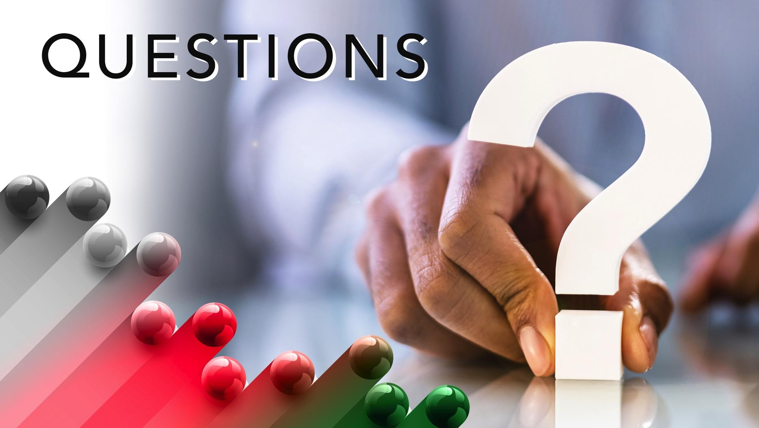

Slide 17
1. Have you ever questioned something and was glad you did?

Slide 18
2. Did anything good come out of Thomas’ doubt?

Slide 19
3. How do you respond to the assertions that doubt and questions signal rebellion?

Slide 20
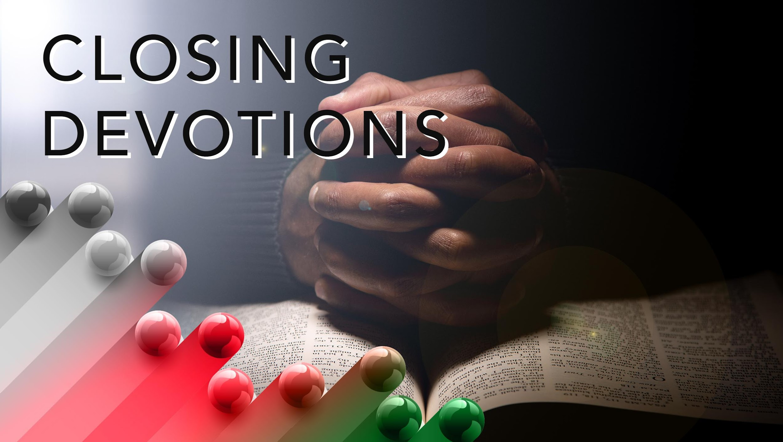

Slide 21
Closing Song: “The Blood That Jesus Shed for Me” (AMECH #137)
Closing Prayer: Dear Father, help me to find answers for the things that I question and protect my mind from deception so I can serve you in truth. In Jesus’ name. Amen.

