Slide 1
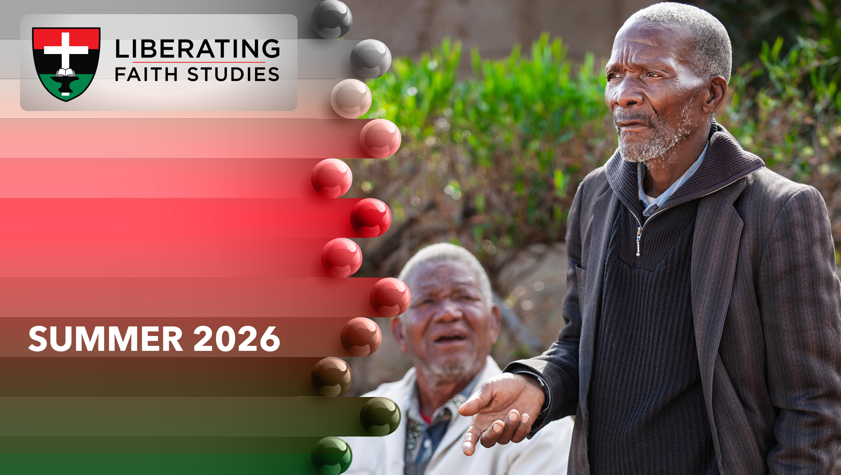
^{LESSON 6: JULY 19}

Slide 2
Simon Peter, From Weakness to Strength
Focus Scripture: Mark 8:27-29; Luke 22:31-34; John 18:25-27; 21:15-17
Key Verse: (Jesus) said to him the third time, “Simon, son of John, do you love me?” Peter felt hurt because he said to him the third time, “Do you love me?” And he said to him, “Lord, you know everything; you know that I love you.” Jesus said to him, “Feed my sheep.” John 21:17

Slide 3
Mark 8:27-29; Luke 22:31-34; John 18:25-27; 21:15-17 (NRSV UE)
Mark 8:27-29
27 Jesus went on with his disciples to the villages of Caesarea Philippi, and on the way he asked his disciples, “Who do people say that I am?”
28 And they answered him, “John the Baptist; and others, Elijah; and still others, one of the prophets.”
29 He asked them, “But who do you say that I am?” Peter answered him, “You are the Messiah.”
Luke 22:31-34
31 “Simon, Simon, listen! Satan has demanded to sift all of you like wheat,
32 but I have prayed for you that your own faith may not fail, and you, when once you have turned back, strengthen your brothers.”
33 And he said to him, “Lord, I am ready to go with you to prison and to death!”
34 Jesus said, “I tell you, Peter, the cock will not crow this day until you have denied three times that you know me.”

Slide 4
John 18:25-27
25 Now Simon Peter was standing and warming himself. They asked him, “You are not also one of his disciples, are you?” He denied it and said, “I am not.”
26 One of the slaves of the high priest, a relative of the man whose ear Peter had cut off, asked, “Did I not see you in the garden with him?”
27 Again Peter denied it, and at that moment the cock crowed.
21:15-17
15 When they had finished breakfast, Jesus said to Simon Peter, “Simon son of John, do you love me more than these?” He said to him, “Yes, Lord; you know that I love you.” Jesus said to him, “Feed my lambs.”
16 A second time he said to him, “Simon son of John, do you love me?” He said to him, “Yes, Lord; you know that I love you.” Jesus said to him, “Tend my sheep.”
17 He said to him the third time, “Simon son of John, do you love me?” Peter felt hurt because he said to him the third time, “Do you love me?” And he said to him, “Lord, you know everything; you know that I love you.” Jesus said to him, “Feed my sheep.”

Slide 5
Key Terms
Messiah/Christ – The person set aside by God, specially anointed, for the specific purpose of liberating people spiritually.
Martin Luther – The famous church reformer who challenged church corruption, emphasized salvation by faith, and sparked the Protestant Reformation.
Revelation – A disclosure of a fact or truth previously hidden or misunderstood.
Your title here

Slide 6


Slide 7
A minister once remarked that, as Christians, we often judge each other more harshly than God judges us. Based on the comments we hear from time to time, our attitude seems to be, “Once a thief, always a thief; once a betrayer, always a betrayer.”

Slide 8


Slide 9
Peter is one of those disciples (later apostles) about whom we have quite a bit of information scattered throughout the Gospels. From the text, we see that Peter was passionate, a natural leader, strong-willed, and impulsive. He was a family man and a business partner in the fishing industry. With all this detail, we think we have a good grasp on who Peter was. Still, one detail is missing. Not that it needs to be stated; just understood and remembered. Peter was human. That is the quality around which this study revolves.
A wonderful serenity has taken possession

Slide 10


Slide 11
Peter’s denial of Christ, to save his skin, was the first such denial history records. But it certainly was not the only instance. Historical records show that the same thing happened under Emperor Decius (A.D. 250). Christians were ordered to sacrifice publicly to Roman gods. Refusal could mean death. People who complied with the edict received certificates of compliance (libellus) to show they had obeyed.
A wonderful serenity has taken possession

Slide 12


Slide 13
Despite his many outstanding mission successes, Peter is remembered sadly as the disciple who denied Christ. Not a glowing badge under any light. In sobering moments, we may even feel sorry for Peter. “Do you know him; are you one of his disciples?” the people asked.

Slide 14


Slide 15
Peter’s denial of Christ opens the door for us to examine our mindset toward ministers, or others in the church, who stumble in ministry. Some people hold the harsh view that a minister (using the widest sense of the word) who stumbles was never a minister in the first place. Pushed to its outer limits, this attitude denies restoration to such a fallen or wounded brother or sister.

Slide 16


Slide 17
1. Why is forgiveness a teaching of Christ that is so hard for Christians to practice?

Slide 18
2. Jesus knew in advance that Peter would deny him, yet he called him. Why?

Slide 19
3. After his restoration, Peter openly identified with Christ. What made the difference?

Slide 20


Slide 21
Closing Song: “Just as I Am” (AMECH #257)
Closing Prayer: Dear forgiving Lord, strengthen me to stand firm in my faith even in times of pressure. Amen.

