Slide 1
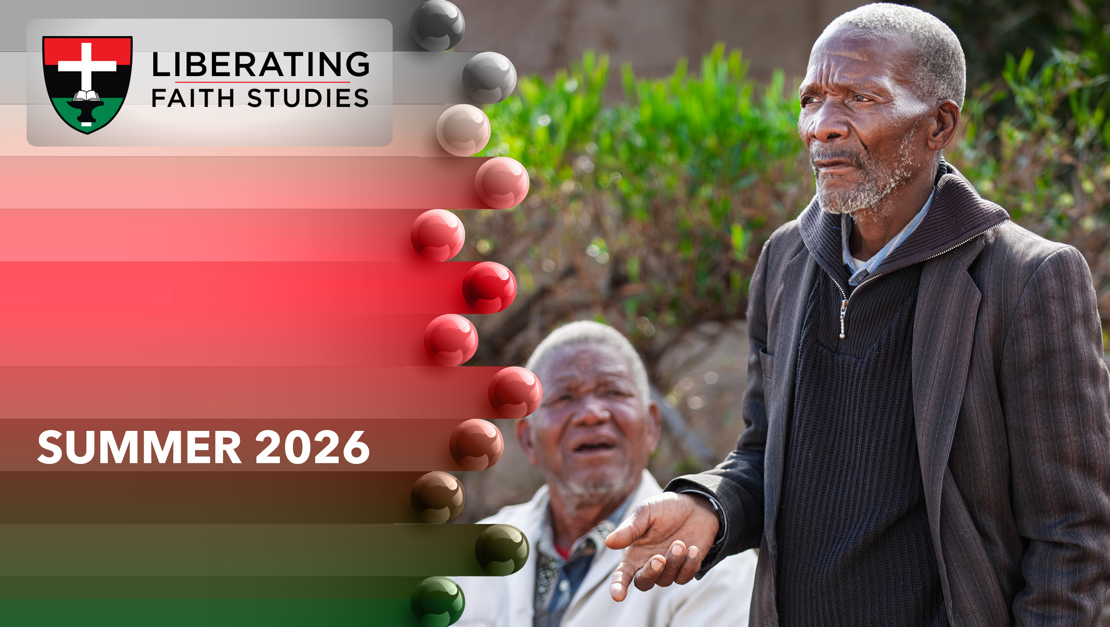
^{LESSON 4: JUNE 28}

Slide 2
Amos, a Herdsman Called of God to Be a Prophet
Focus Scripture: Amos 1:1; 2:11-12; 3:7-8; 7:10-15
Key Verse: “The Lord took me from following the flock, and the Lord said to me, ‘Go, prophesy to my people Israel.’” Amos 7:15

Slide 3
Amos 1:1; 2:11-12; 3:7-8; 7:10-15(NRSV UE)
Amos 1:1
1 The words of Amos, who was among the shepherds of Tekoa, which he saw concerning Israel in the days of King Uzziah of Judah and in the days of King Jeroboam son of Joash of Israel, two years before the earthquake.
2:11-12
11 And I raised up some of your children to be prophets and some of your youths to be nazirites. Is it not indeed so, O people of Israel? says the Lord.
12 But you made the nazirites drink wine and commanded the prophets, saying, “You shall not prophesy.”
3:7-8
7 Surely the Lord God does nothing without revealing his secret to his servants the prophets.
8 The lion has roared; who will not fear? The Lord God has spoken; who can but prophesy?
7:10-15
10 Then Amaziah, the priest of Bethel, sent to King Jeroboam of Israel, saying, “Amos

Slide 4
has conspired against you in the very center of the house of Israel; the land is not able to bear all his words.
11 For thus Amos has said, ‘Jeroboam shall die by the sword, and Israel must go into exile away from his land.’”
12 And Amaziah said to Amos, “O seer, go, flee away to the land of Judah, earn your bread there, and prophesy there,
13 but never again prophesy at Bethel, for it is the king’s sanctuary, and it is a temple of the kingdom.”
14 Then Amos answered Amaziah, “I am no prophet nor a prophet’s son, but I am a herdsman and a dresser of sycamore trees,
15 and the Lord took me from following the flock, and the Lord said to me, ‘Go, prophesy to my people Israel.’”

Slide 5
Key Terms
Sovereign Lord – A term that highlights God’s almighty position and authority over all other gods or authorities.
Atrocities – An extremely evil event causing widespread suffering and death.
Tension – A situation causing worry or stress; a worrying conflict.
Your title here

Slide 6


Slide 7
In this lesson, we focus on Amos’ multiple witnesses of what God does through people. Firstly, both in ancient Israel and even today, God has a habit of bypassing the highly trained officials and choosing ordinary, humble people to carry his messages to the nation. And as we know only too well, God’s messages are not always well received by persons in positions of authority. So, carrying God’s messages to them can be risky.

Slide 8
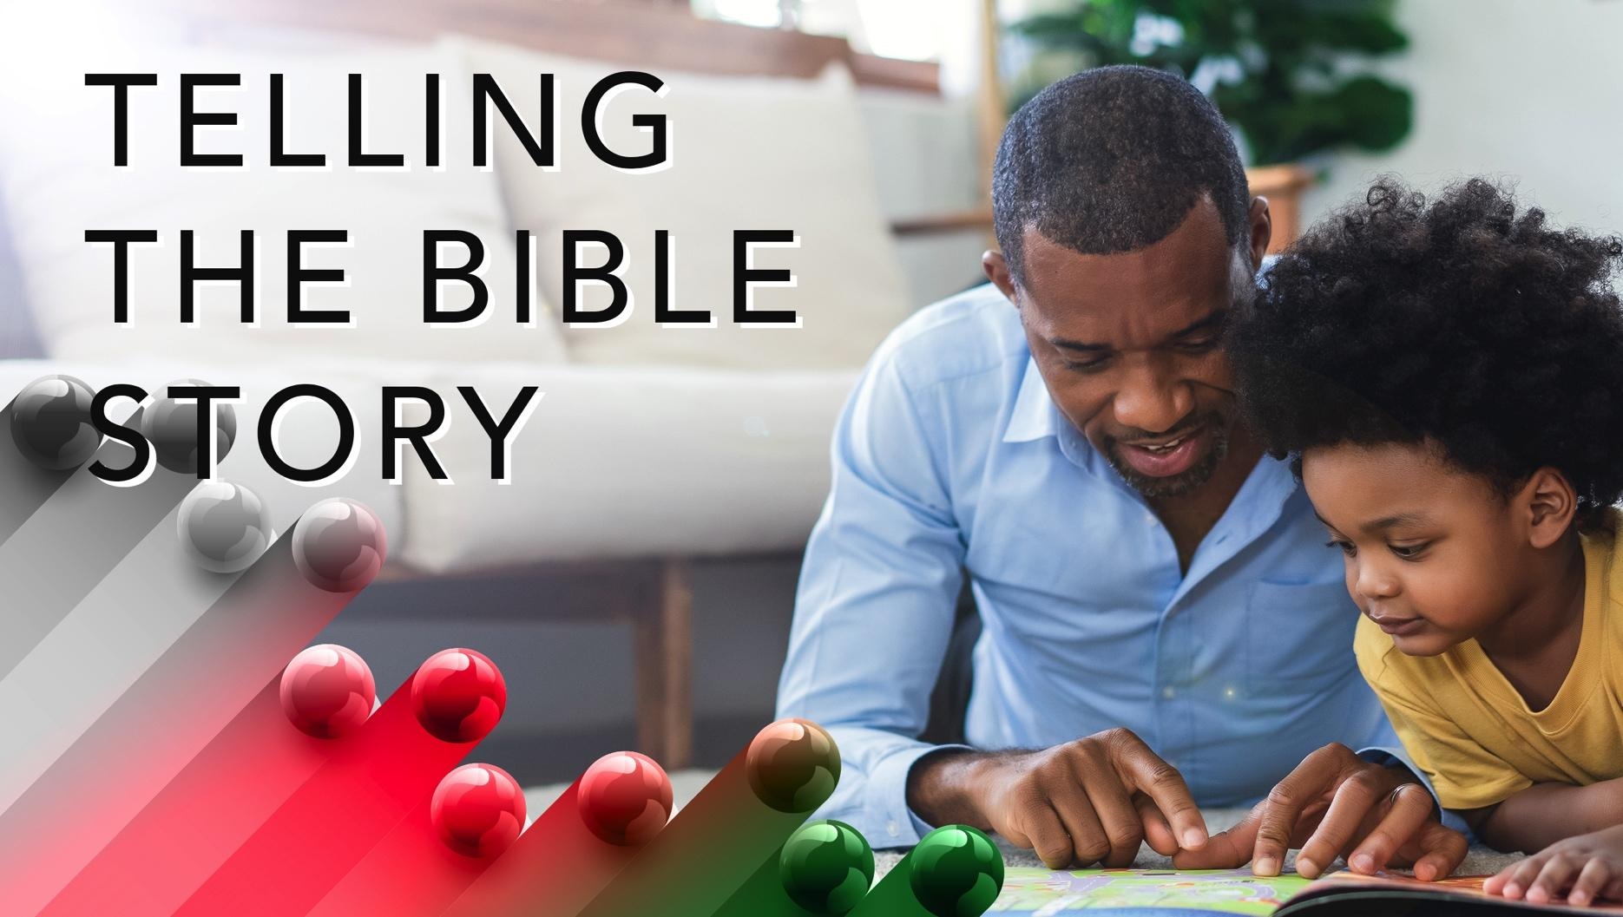

Slide 9
The message that God called Amos to take to the religious elite in Israel was a hard message. It accused them of approving false worship and validating political and economic systems that exploited the poor and vulnerable. Pushback against Amos was certain.
A wonderful serenity has taken possession

Slide 10


Slide 11
Maybe we don’t call him a prophet, but Frederick Douglass spoke with the same prophetic voice of Amos on the issue of slavery. And just as Amos came under attack from the Amaziah’s of his day, Douglass’ position was contrary to the American church at that time, which quoted scripture to justify the practice of slavery, including its atrocities.
A wonderful serenity has taken possession

Slide 12


Slide 13
To get a sense of what the tension between Amos (the prophet) and Amaziah (the political priest) was like, please study Frederick Douglass’ speech, “What to the Slave Is the Fourth of July?” of July 5, 1852.

Slide 14
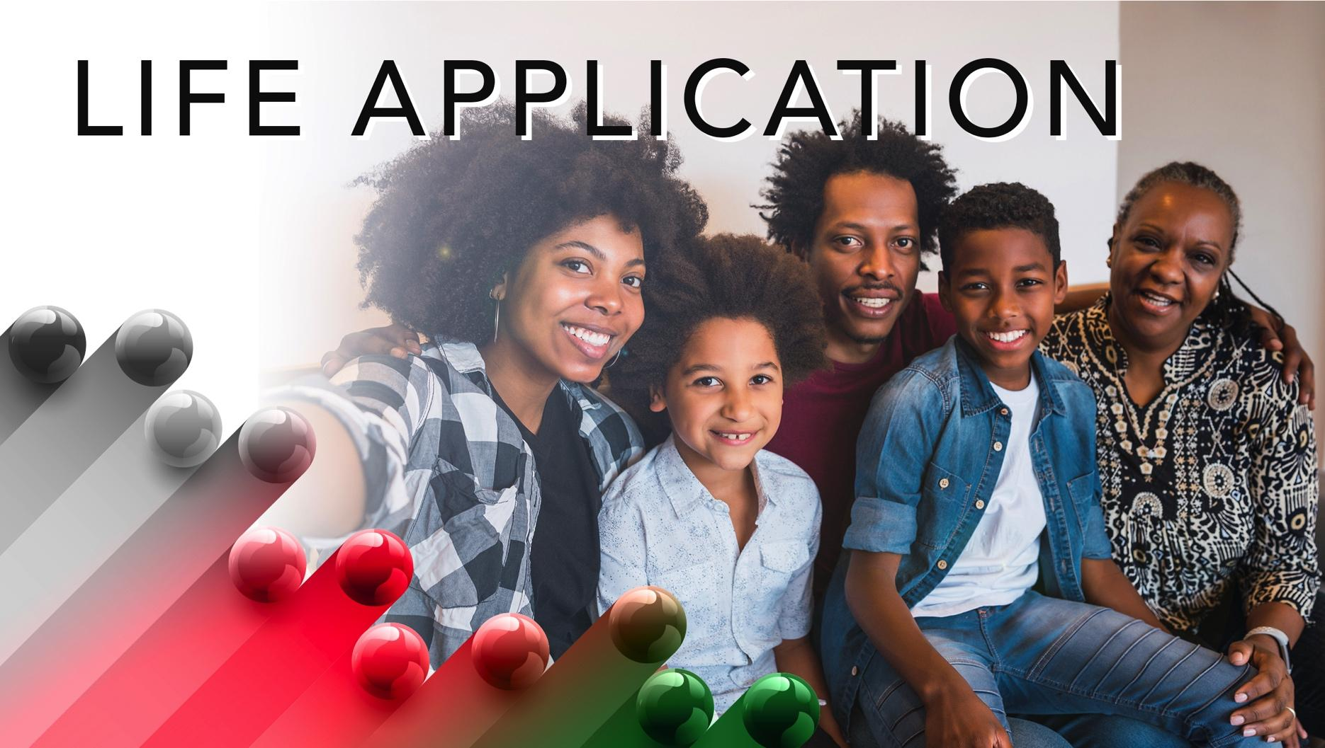

Slide 15
As you look around the current society, what do you see entrenched in the way we live that lights righteous anger in you? We are sure you have your list. But let me share one with you that most probably is not on your list. There is a concern about how willingly we allow those in commercial and political power to confuse us about who we are, our family structure and relations, and our appreciation of the things that are culturally and religiously sacred to us.

Slide 16


Slide 17
1. How can you know when a prophetic word is really from God?

Slide 18
2. What injustices do you see in the present society, and how can we address them?

Slide 19
3. As a Christian, what can you contribute to building a more just society for the masses?

Slide 20
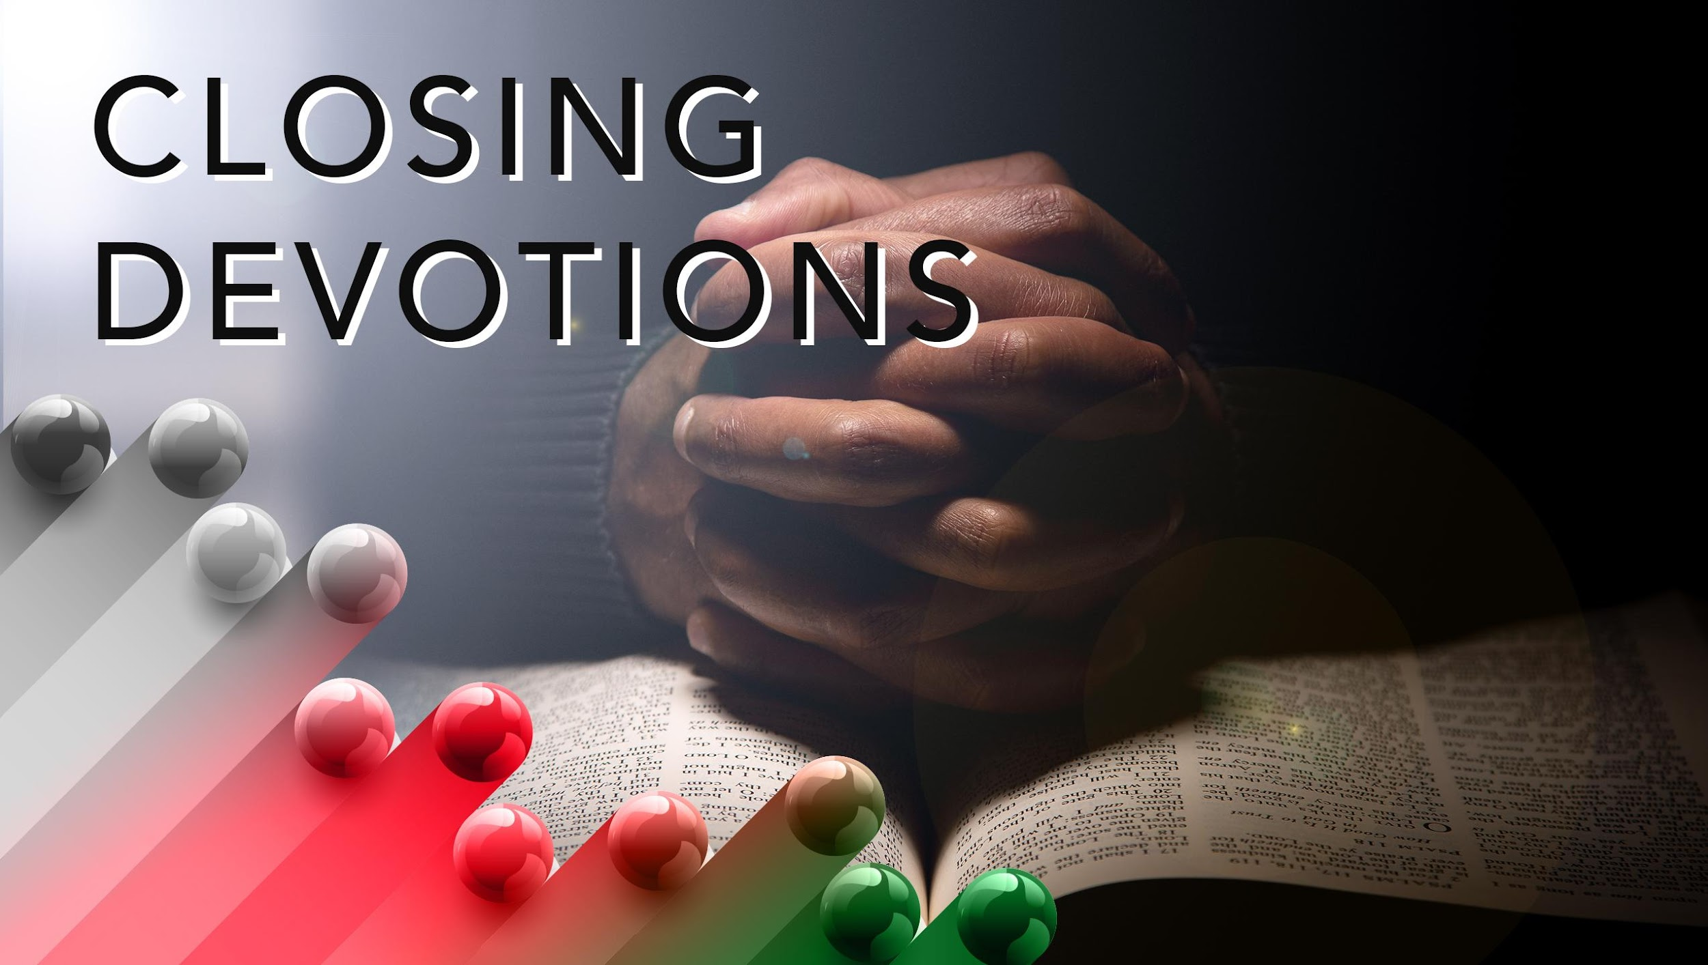

Slide 21
Closing Song: “Oh God of Earth and Altar”
Closing Prayer: Dear Father, guide me to hear your words of justice and help me to live them, even when they make me or those around me uncomfortable. In Jesus’ name. Amen.

