Slide 1

^{LESSON 3: JUNE 21}

Slide 2
Jonathan and David, a Noble Friendship
Focus Scripture: 1 Samuel 18:1-4; 20:16-17, 32-34, 42; 2 Samuel 1:26-27; 21:7
Key Verse: Jonathan said to David, “Go in peace, since both of us have sworn in the name of the Lord, saying, ‘The Lord shall be between me and you and between my descendants and your descendants forever.’” 1 Samuel 20:42

Slide 3
1 Samuel 18:1-4; 20:16-17, 32-34, 42; 2 Samuel 1:26-27; 21:7 (NRSV UE)
1 Samuel 18:1-4
1 When David had finished speaking to Saul, the soul of Jonathan was bound to the soul of David, and Jonathan loved him as his own soul.
2 Saul took him that day and would not let him return to his father’s house.
3 Then Jonathan made a covenant with David because he loved him as his own soul.
4 Jonathan stripped himself of the robe that he was wearing and gave it to David and his armor and even his sword and his bow and his belt.
20:16-17
16 Thus Jonathan made a covenant with the house of David, saying, “May the Lord seek out the enemies of David.”
17 Jonathan made David swear again by his love for him, for he loved him as he loved his own life.
32-34
32 Then Jonathan answered his father Saul, “Why should he be put to death? What has he done?”

Slide 4
33 But Saul threw his spear at him to strike him, so Jonathan knew that it was the decision of his father to put David to death.
34 Jonathan sprang up from the table in fierce anger and ate no food on the second day of the month, for he was grieved for David and because his father had disgraced him.
42
42 Then Jonathan said to David, “Go in peace, since both of us have sworn in the name of the Lord, saying, ‘The Lord shall be between me and you and between my descendants and your descendants forever.’” He got up and left, and Jonathan went into the city.
2 Samuel 1:26-27
26 “Jonathan lies slain upon your high places. I am distressed for you, my brother Jonathan; greatly beloved were you to me; your love to me was wonderful, passing the love of women.
27 How the mighty have fallen, and the weapons of war perished!”
21:7
7 But the king spared Mephibosheth, the son of Saul’s son Jonathan, because of the oath of the Lord that was between them, between David and Jonathan son of Saul.

Slide 5
Key Terms
No Holds Barred – Without restrictions or conditions; total freedom in speaking.
Posterity – Future generations.
Tanzania – A country of about 70 million people in Eastern Africa.
Your title here

Slide 6


Slide 7
In lessons 1 and 2, we saw the faithfulness of God expressed through two individuals (Deborah and Hannah) to achieve great outcomes. The witness now turns to an expression of friendship between two friends. Throughout the centuries, this relationship has drawn serious attention from theologians, Bible commentators, and even critics and haters of the scriptures and religion.

Slide 8


Slide 9
As noted above, the hesed feature is clear at three points in the text: 1 Samuel 20:8, 20:14, and 20:15. The bonds of friendship were so strong that Jonathan shifted loyalties from his natural father to David. Some commentators read this shift in loyalties as springing from Jonathan’s conviction that God had moved the kingly anointing from King Saul to David. The text does not explicitly state this, but passages like 1 Samuel 18:1-4 shout it.
A wonderful serenity has taken possession

Slide 10


Slide 11
The deep friendship between David and Jonathan helped to shape the history of Israel. A similar (political) friendship between Julius Nyerere and Rashidi Kawawa (1950’s to 1980’s) likewise shaped the history of modern Tanzania. This friendship of mutual support and respect shaped Tanzania’s independence, and the economic and social policies it followed thereafter.
A wonderful serenity has taken possession

Slide 12


Slide 13
We saw above the value of strong friendships in setting the course of nations. But what about setting economic freedom for individuals? The establishment and phenomenal growth of FUBU – the urban clothing company – shows what strong personal friendships can achieve.

Slide 14
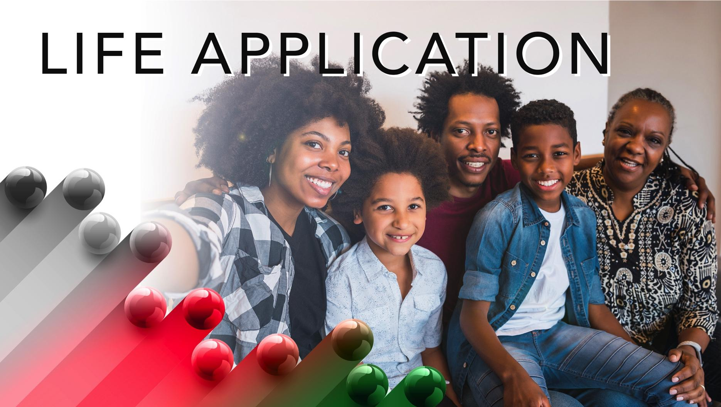

Slide 15
Because of a few bad life experiences – some lived, many imagined – some people take pride in having no friends, or only one or two. Usually, this is a self-protective measure. But it is not one we encourage. A person without friends robs themselves of one of the joys of being human. Of course, interactions with other people can bring seasons of distress and pain. Yet, from wholesome friendships spring crucial emotional support, better mental health, and opportunities to relish the joys of sharing. Friendships satisfy that deep human craving for belonging.

Slide 16


Slide 17
1. Why did Jonathan sacrifice his chance to be king for a friendship with David?

Slide 18
2. Apart from Ruth and Naomi, do you know of another such friendship?

Slide 19
3. Is it necessary to be vulnerable in a close friendship?

Slide 20
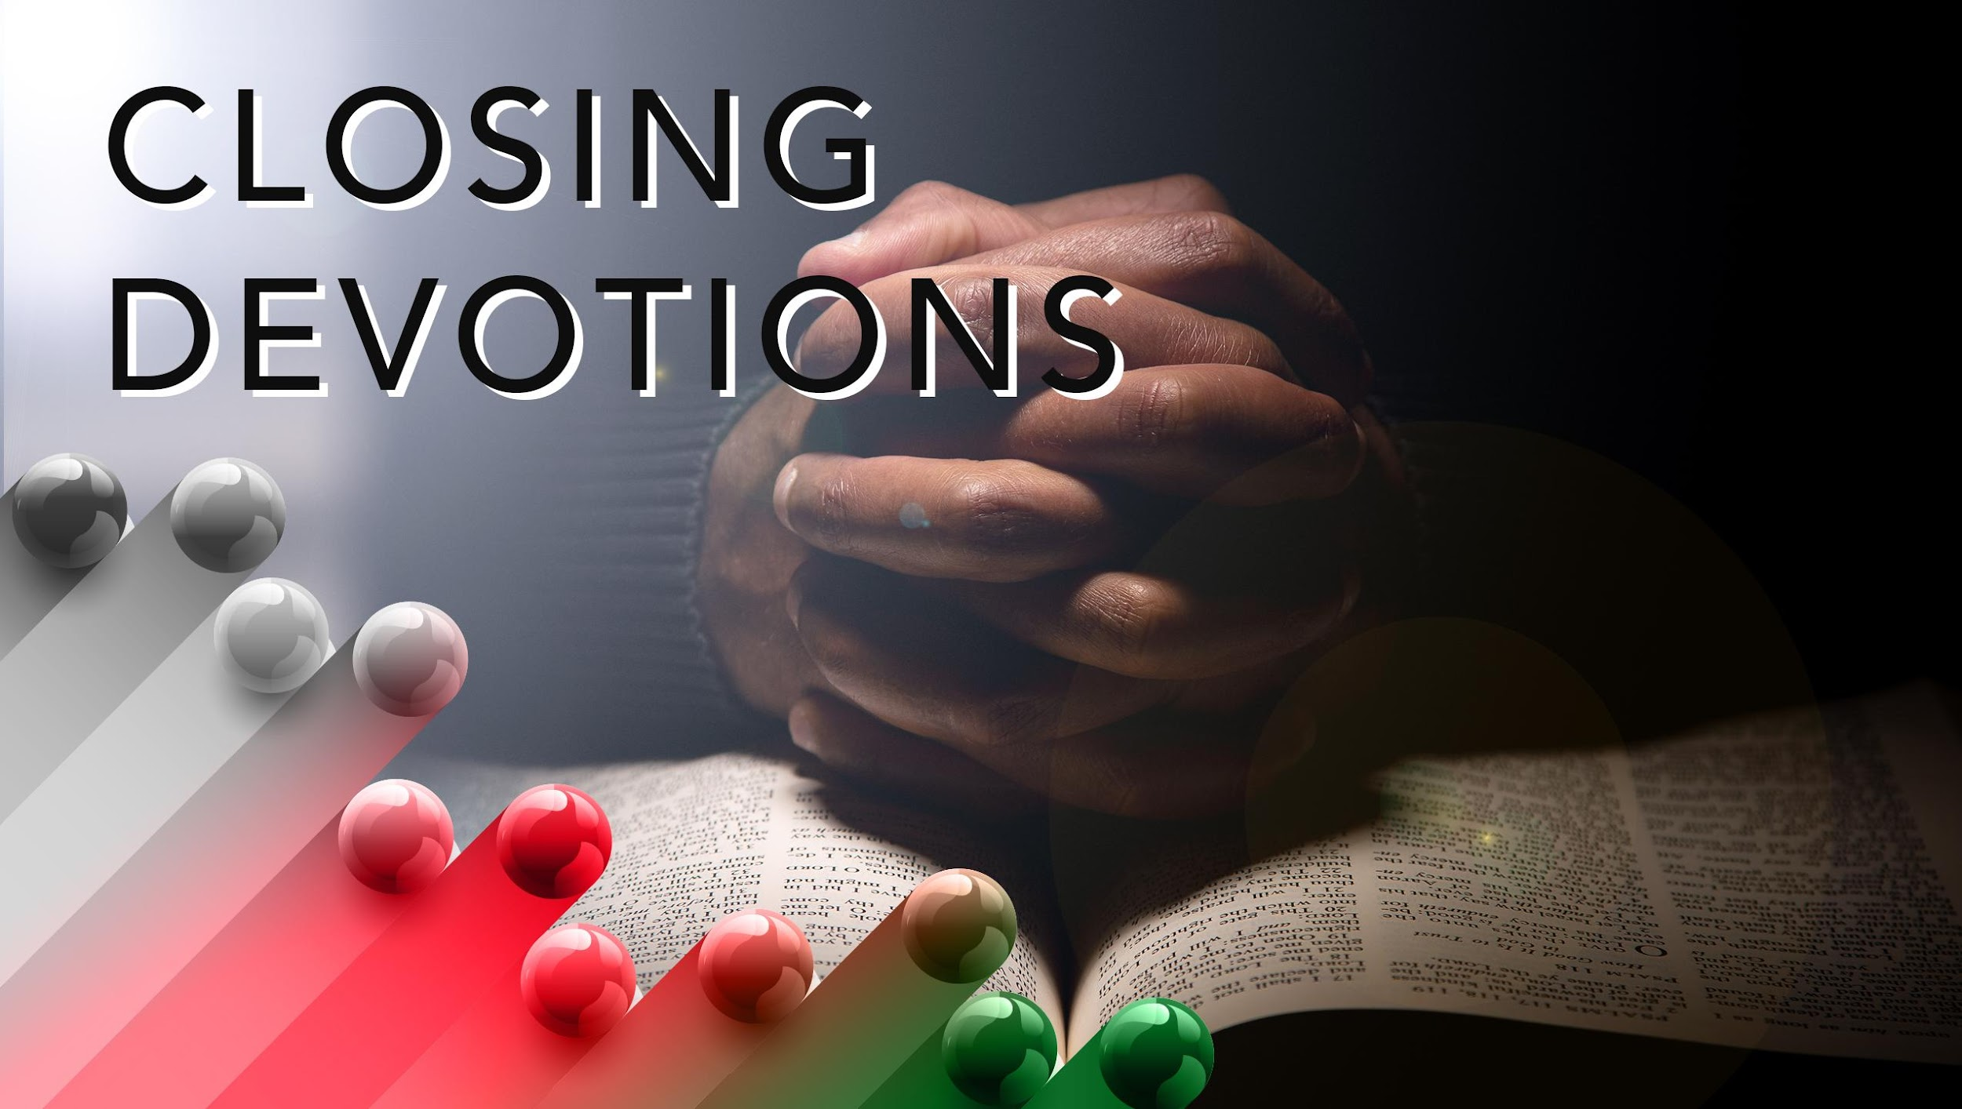

Slide 21
Closing Song: “What a Friend We Have in Jesus” (AMECH #325)
Closing Prayer: Dear Father, help me to know my friends so we can deal effectively with the enemies. And Lord, help me to heal from the trauma of past hurtful relationships. Amen.

