Slide 1

^{LESSON 13: AUGUST 30}

Slide 2
Lydia, Judged to Be Faithful
Focus Scripture: Acts 16:11-15, 40
Key Verse: When she and her household were baptized, she urged us, saying, “If you have judged me to be faithful to the Lord, come and stay at my home.” And she prevailed upon us. Acts 16:15

Slide 3
Acts 16:11-15, 40 (NRSV UE)
Acts 16:11-15
11 We therefore set sail from Troas and took a straight course to Samothrace, the following day to Neapolis,
12 and from there to Philippi, which is a leading city of the district of Macedonia and a Roman colony. We remained in this city for some days.
13 On the Sabbath day we went outside the gate by the river, where we supposed there was a place of prayer, and we sat down and spoke to the women who had gathered there.
14 A certain woman named Lydia, a worshiper of God, was listening to us; she was from the city of Thyatira and a dealer in purple cloth. The Lord opened her heart to listen eagerly to what was said by Paul.
15 When she and her household were baptized, she urged us, saying, “If you have judged me to be faithful to the Lord, come and stay at my home.” And she prevailed upon us.
40
40 After leaving the prison they went to Lydia’s home, and when they had seen and encouraged the brothers and sisters there, they departed.

Slide 4
^{Key Terms}
Ethnicity – Related to a person’s or people’s race and identity.
Speculation – Guess at a reason for a thing or event; an opinion.
Hospitality – Friendly and generous reception and care for guests.
Immigration – The act of moving from one country to live in another.
Your title here

Slide 5


Slide 6
The story of Lydia is one of those open-ended stories that allows anyone with a particular agenda to use the story to support that agenda. But here is what that story says in its generic sense. God’s favor is never restricted by ethnicity, social status, location, or gender factors.

Slide 7


Slide 8
Paul went to Macedonia because of a vision. This naturally prompts the question of what a vision is and how it differs from a mere dream. For John Calvin, a vision is an experience where God (by visual imprint) “sealed his truth by clear revelation.” Unlike mere dreams, visions have a clear meaning that is always consistent with scripture. Visions call for obedience to the revelation given.
A wonderful serenity has taken possession

Slide 9


Slide 10
For a non-Bible Lydia, Rebecca Protten (1718 - 1780) fits the profile. She was born on the Caribbean island of Antigua, kidnapped as a child, and enslaved on the island of St. Thomas. Around age 12, when her slave master died, she got her freedom.
A wonderful serenity has taken possession

Slide 11


Slide 12
One of the tragedies of modern Christian witness is that too often church members can only see events through the lens of their denomination or the opinions of preachers they like. This is unfortunate because the core messages of the Bible have no denominational tint, racial or gender paint.

Slide 13


Slide 14
The issue of immigration – legal and illegal – and how the church community should treat immigrants, is currently before us. Without dancing around the core matters, what is your opinion on this issue? Sure, it is a multifaceted issue. But you must settle down around the issue at some point.

Slide 15


Slide 16
1. How could Lydia have been a worshiper before she met Paul?

Slide 17
2. How could Lydia have been a worshiper before she met Paul?

Slide 18
3. What, if anything, about Lydia’s life could you adopt and practice today?

Slide 19
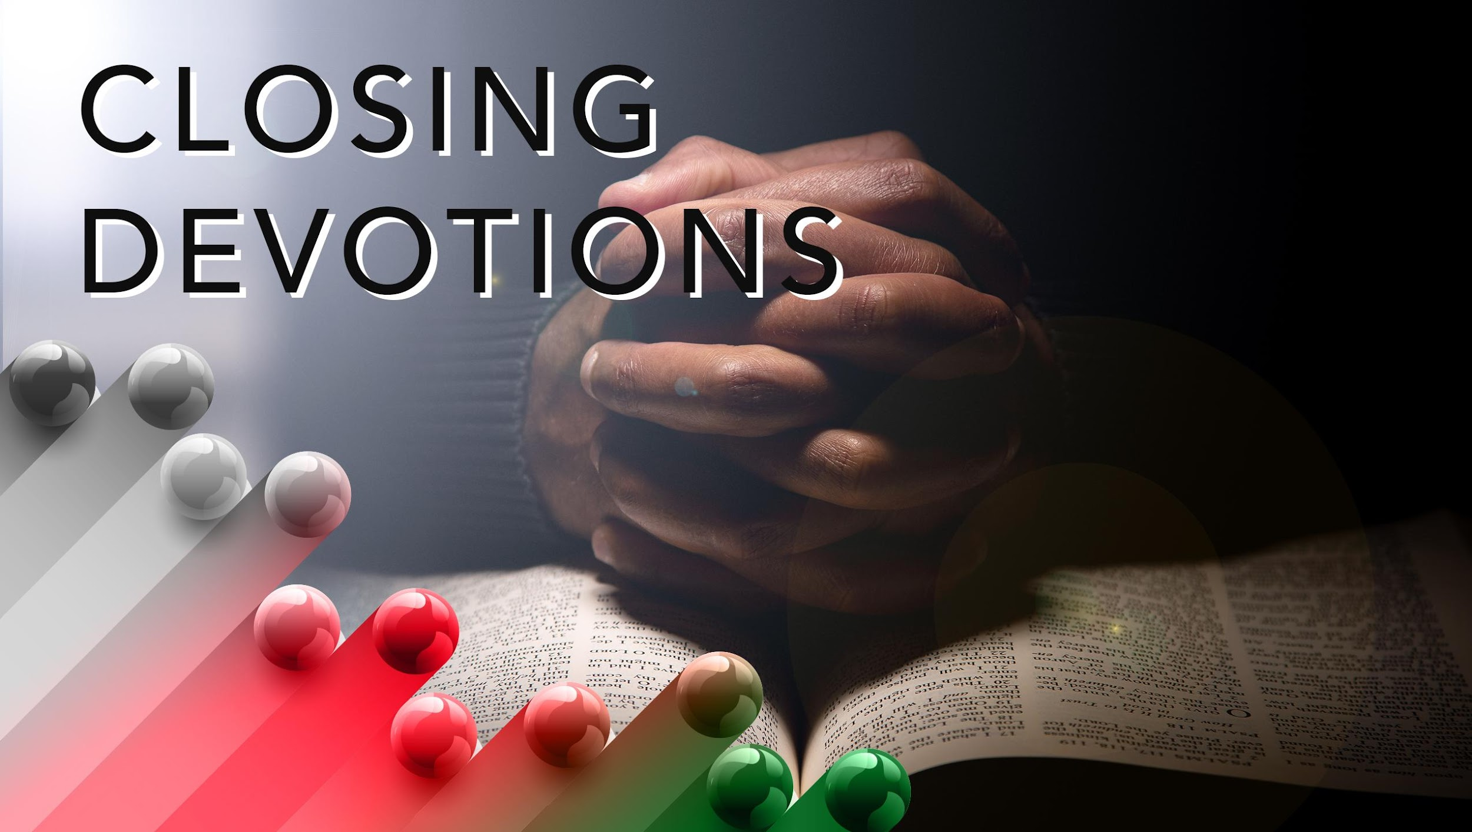

Slide 20
Closing Song: “Lead Us, Heavenly Father, Lead Us” (AMECH #547)
Closing Prayer: Lord God almighty, help me to develop the accommodating spirit that is right for the ministry of your love. Amen.

