Slide 1

^{LESSON 11: AUGUST 16}

Slide 2
Saul of Tarsus, How a Pharisee Became a Christian
Focus Scripture: Acts 22:3-15
Key Verses: (Ananias) said, “The God of our ancestors has chosen you to know his will, to see the Righteous One, and to hear his own voice, for you will be his witness to all the world of what you have seen and heard.” Acts 22:14-15

Slide 3
Acts 22:3-15 (NRSV UE)
3 “I am a Jew born in Tarsus in Cilicia but brought up in this city at the feet of Gamaliel, educated strictly according to our ancestral law, being zealous for God, just as all of you are today.
4 I persecuted this Way up to the point of death by binding both men and women and putting them in prison,
5 as the high priest and the whole council of elders can testify about me. From them I also received letters to the brothers in Damascus, and I went there in order to bind those who were there and to bring them back to Jerusalem for punishment.
6 While I was on my way and approaching Damascus, about noon a great light from heaven suddenly shone about me.
7 I fell to the ground and heard a voice saying to me, ‘Saul, Saul, why are you persecuting me?’
8 I answered, ‘Who are you, Lord?’ Then he said to me, ‘I am Jesus of Nazareth whom you are persecuting.’
9 Now those who were with me saw the light but did not hear the voice of the one who was speaking to me.

Slide 4
10 I asked, ‘What am I to do, Lord?’ The Lord said to me, ‘Get up and go to Damascus; there you will be told everything that has been assigned to you to do.’
11 Since I could not see because of the brightness of that light, those who were with me took my hand and led me to Damascus.
12 A certain Ananias, who was a devout man according to the law and well spoken of by all the Jews living there,
13 came to me, and standing beside me, he said, ‘Brother Saul, regain your sight!’ In that very hour I regained my sight and saw him.
14 Then he said, ‘The God of our ancestors has chosen you to know his will, to see the Righteous One, and to hear his own voice,
15 for you will be his witness to all the world of what you have seen and heard.’”

Slide 5
^{Key Terms}
Heresy – Teaching as truth a lie that undermines the core beliefs of a faith (system).
Excommunication – Being officially barred/removed from a faith community.
Seismic – A huge, disruptive, transforming event; producing dramatic change.
Your title here

Slide 6


Slide 7
We hear among some Christians a mistaken belief that once God has called them to a task or mission, all will go well. After all, the almighty God who called them, or approved their mission, can clear their path of all hurdles and hindrances. That theory goes through the window when we hit passages like the selected text. For if we accept that Apostle Paul was chosen and anointed as a special evangelist to the Gentiles, we are at a loss, under that theory, to explain the hardships he suffered from both Jews and Gentiles.

Slide 8


Slide 9
Read Acts 21:40 to 23:35 as Paul’s spirited defense against the charges made against him by the Jews from Asia. It was a three-count indictment: that he was preaching against the people of Israel (treason), against the law (heresy and blasphemy), and also, he had defiled the sacred temple (sacrilege) by taking Greeks into the holy place (verse 21:28). A guilty verdict on any of these carried a sentence of a severe beating, long imprisonment, or death. Hence the length and depth of Paul’s defense.
A wonderful serenity has taken possession

Slide 10


Slide 11
It is easy to see the events involving Paul’s attacks and threats of death as remote. However, when a new revelation or approach arises in church doctrines, accusations of heresy and unrest follow. Such was the case with Martin Luther after his Ninety-Five Theses.
A wonderful serenity has taken possession

Slide 12


Slide 13
The issue for which Paul was arrested and tried, coming within inches of death, was seismic in Christian theology. It was the dramatic shift from the law to grace-centered theology.

Slide 14


Slide 15
Above, we mentioned that some Christians have an “easy street” approach to ministry. They see everything falling smoothly into place, without periods of stress and struggle. This is your invitation to look at your view of working for God. Look again at Paul’s life and the hardships he endured. Is that picture consistent with your idea of what working for God looks like?

Slide 16


Slide 17
1. When you hear that a person is anointed for ministry, what images come to mind?

Slide 18
2. Some hold that Paul suffered because he harassed Christians before. Comment.

Slide 19
3. To what extent would you endure hardship for your faith?

Slide 20
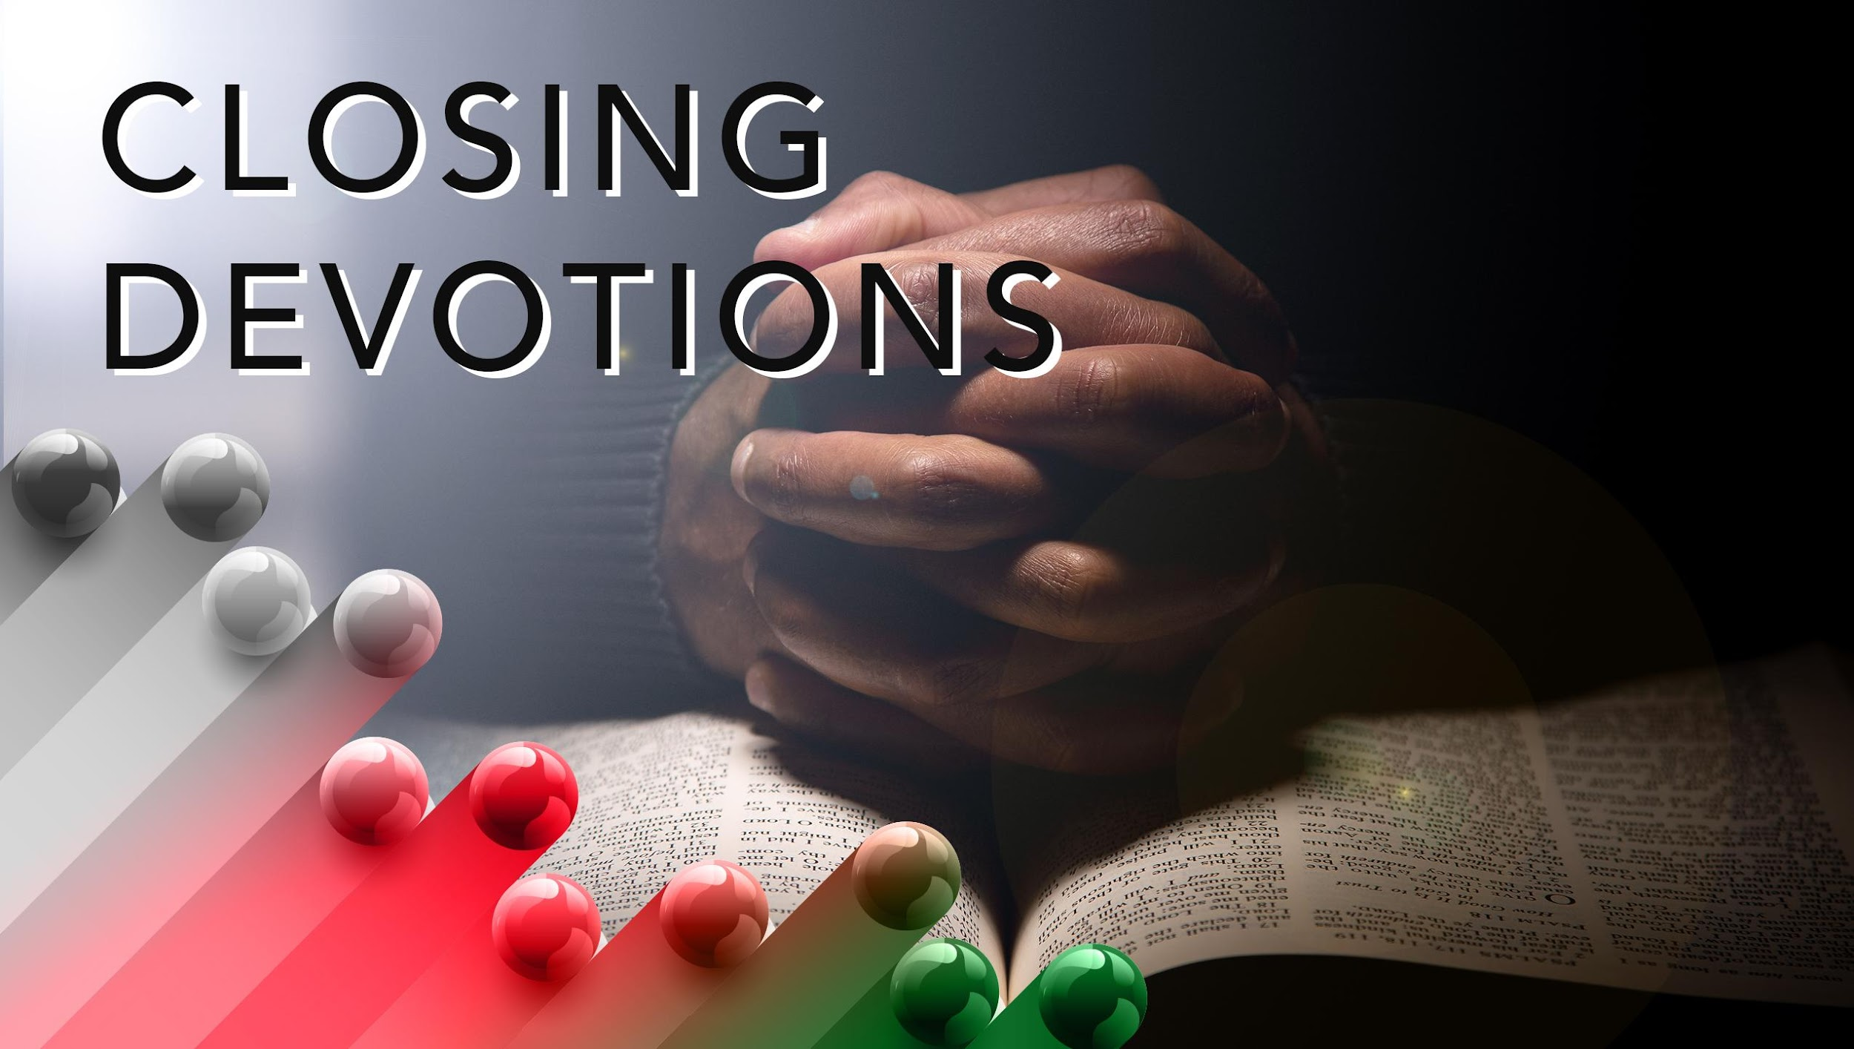

Slide 21
Closing Song: “A Mighty Fortress Is Our God” (AMECH #54)
Closing Prayer: Dear God, lead me not into temptation and deliver me from all evil. Amen.

