Slide 1

^{LESSON 10: AUGUST 9}

Slide 2
Stephen, an Early Interpreter of Christianity
Focus Scripture: Acts 6:7-10; 7:54-60
Key Verse: Stephen, full of grace and power, did great wonders and signs among the people. Acts 6:8

Slide 3
Acts 6:7-10; 7:54-60 (NRSV UE)
Acts 6:7-10
7 The word of God continued to spread; the number of the disciples increased greatly in Jerusalem, and a great many of the priests became obedient to the faith.
8 Stephen, full of grace and power, did great wonders and signs among the people.
9 Then some of those who belonged to the synagogue of the Freedmen (as it was called), Cyrenians, Alexandrians, and others of those from Cilicia and Asia, stood up and argued with Stephen.
10 But they could not withstand the wisdom and the Spirit with which he spoke.
7:54-60
54 When they heard these things, they became enraged and ground their teeth at Stephen.
55 But filled with the Holy Spirit, he gazed into heaven and saw the glory of God and Jesus standing at the right hand of God.
56 “Look,” he said, “I see the heavens opened and the Son of Man standing at the right hand of God!”
57 But they covered their ears, and with a loud shout all rushed together against him.

Slide 4
58 Then they dragged him out of the city and began to stone him, and the witnesses laid their coats at the feet of a young man named Saul.
59 While they were stoning Stephen, he prayed, “Lord Jesus, receive my spirit.”
60 Then he knelt down and cried out in a loud voice, “Lord, do not hold this sin against them.” When he had said this, he died.

Slide 5
^{Key Terms}
Orthodox Jews – Believe in and practice traditional Jewish (religious) laws.
Martyrdom – A person suffering physical harm or murder for their faith beliefs.
Blasphemers – People who treat the sacred as trivial, false, or with mockery.
Your title here

Slide 6


Slide 7
At times, we wonder why Christians don’t take a more aggressive stance against the ills in society. We demand a doctrinal statement from the bishops every time we hear a position that seems to violate our cherished Christian beliefs and practices. So, we ask why there is a reluctance to speak truth to power.

Slide 8


Slide 9
All we know for certain about Stephen is from Acts 6 and 7. But reading between the lines, Stephen was offering much more than an administrator in the community food program. The speech he gave in Acts 7 shows he was religiously mature, versed in the scriptures, and a good debater. He not only knew Israel’s history but also understood it and how God saw the nation. Act 6:8 showed he was also an anointed teacher.
A wonderful serenity has taken possession

Slide 10


Slide 11
Today, in the western world where laws protect freedom of speech and religion, it is often difficult to feel what Christians in other parts of the world must undergo to practice their faith. According to reports from organizations like Open Doors, which follow Christian persecution cases, Christians in many parts of the world suffer greatly for their faith. One reported case is from Nigeria about a pastor named Emmanuel Na’aliah.
A wonderful serenity has taken possession

Slide 12


Slide 13
For anyone interested in the sad stories of Christian persecution and martyrdom, sites like opendoors.org give useful reports. According to one report, over 300 million Christians around the world face persecution and martyrdom for their faith. Based on the reported statistics, one in five persons in Africa and two in five in Asia face religious discrimination, violence, and martyrdom. As a fellow believer, does this concern you?

Slide 14


Slide 15
It is easy to think that as individuals, we can do little to help Christians facing persecution for their faith. But is that really the case? As members of a Connectional fellowship, we must have links to locations where Christians find life harsh. A greeting card with an encouraging message can do wonders for people living under the threat of the sword or the bullet.

Slide 16


Slide 17
1. Against verses like Isaiah 41:10, how do we explain Stephen’s martyrdom?

Slide 18
2. What message is Paul conveying in Philippians 1:21 – to live is Christ, to die is gain?

Slide 19
3. In what ways can we assist Christians living under the threat of death for their faith?

Slide 20
4. Considering global AME connection and experiences, how might your church more fully embody Baptism and the Lord’s Supper in mission and service?

Slide 21
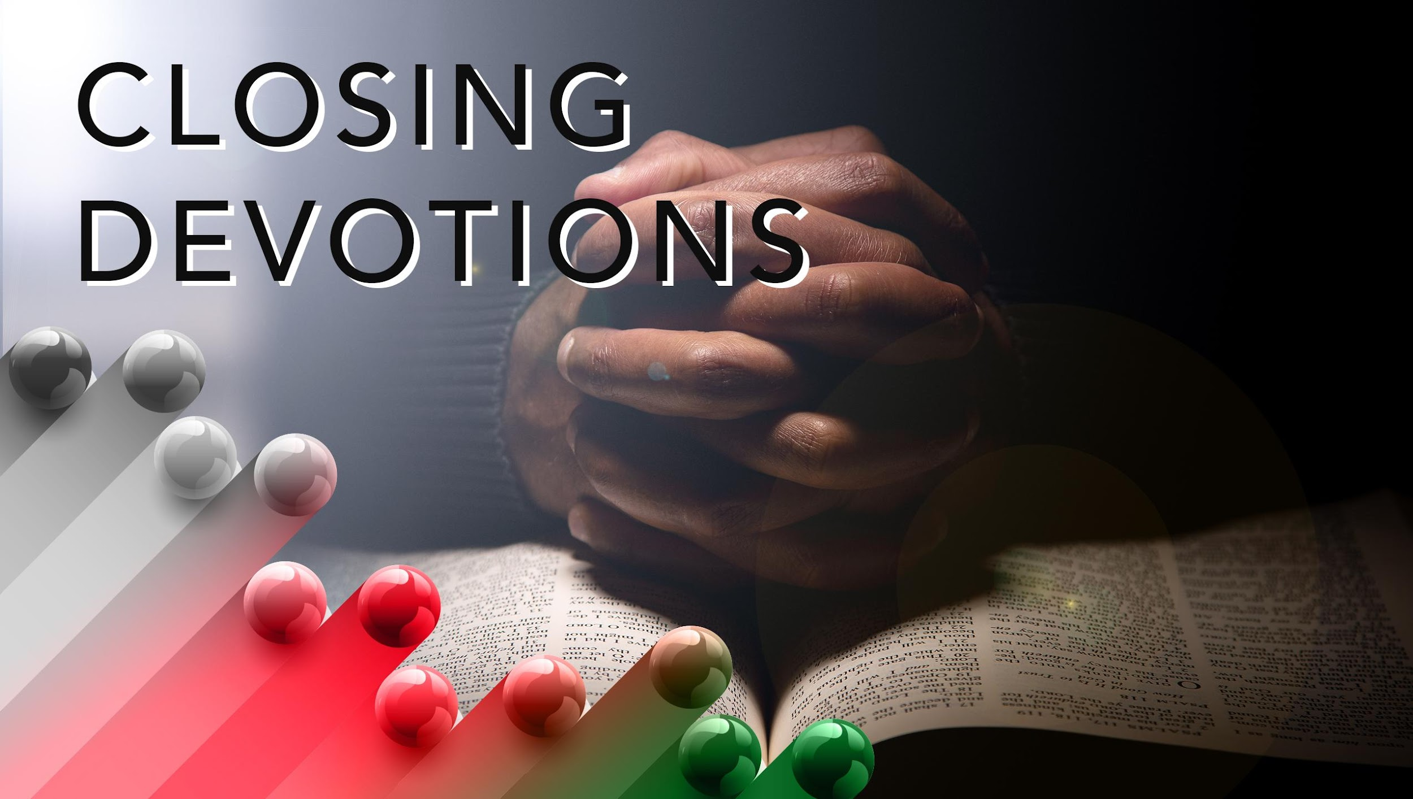

Slide 22
Closing Song: “Great Is Thy Faithfulness” (AMECH #84)
Closing Prayer: Dear Father, open my heart and eyes to ways I can encourage myself and others to live our Christian faith boldly in hostile environments. Asking in the name of Jesus. Amen.

