Slide 1

^{LESSON 1: JUNE} ¹

Slide 2
Deborah, a Leader in a National Emergency
Focus Scripture: Judges 4:4-10, 14, 21-2
Key Verse: At that time Deborah, a prophet, wife of Lappidoth, was judging Israel. She used to sit under the palm of Deborah between Ramah and Bethel in the hill country of Ephraim, and the Israelites came up to her for judgment. Judges 4:4-5 (NRSV)

Slide 3
Judges 4:4-10, 14, 21-22 (NRSV UE)
28 One of the scribes came near and heard them disputing with one another, and 4 At that time Deborah, a prophet, wife of Lappidoth, was judging Israel.
5 She used to sit under the palm of Deborah between Ramah and Bethel in the hill country of Ephraim, and the Israelites came up to her for judgment.
6 She sent and summoned Barak son of Abinoam from Kedesh in Naphtali and said to him, “The Lord, the God of Israel, commands you, ‘Position yourself at Mount Tabor, taking ten thousand from the tribe of Naphtali and the tribe of Zebulun.
7 I will draw out Sisera, the general of Jabin’s army, to meet you by the Wadi Kishon with his chariots and his troops, and I will give him into your hand.’ ”
8 Barak said to her, “If you will go with me, I will go, but if you will not go with me, I will not go.”
9 And she said, “I will surely go with you; nevertheless, the road on which you are going will not lead to your glory, for the Lord will sell Sisera into the hand of a woman.” Then Deborah got up and went with Barak to Kedesh.

Slide 4
10 Barak summoned Zebulun and Naphtali to Kedesh, and ten thousand warriors went up behind him, and Deborah went up with him.
14
14 Then Deborah said to Barak, “Up! For this is the day on which the Lord has given Sisera into your hand. Has not the Lord gone out before you?” So Barak went down from Mount Tabor with ten thousand warriors following him.
21-22
21 But Jael wife of Heber took a tent peg and took a hammer in her hand and went softly to him and drove the peg into his temple, until it went down into the ground—he was lying fast asleep from weariness—and he died.
22 Then, as Barak came in pursuit of Sisera, Jael went out to meet him and said to him, “Come, and I will show you the man whom you are seeking.” So he went into her tent, and there was Sisera lying dead, with the tent peg in his temple.

Slide 5
^{Key Terms}
Witness – A person who can give a firsthand account relating to a person or event from what they saw, heard, or felt.
Syncretism – Mixing elements of Christianity with aspects of traditional African spiritualism.
Angola – A nation of 40 million people on the west coast of Africa.
Your title here

Slide 6


Slide 7
In this series, the keyword is witness. Keep before you who is a witness, the purpose a witness serves, and how this concept of witnessing can inform our spiritual growth and daily Christian walk. Like the witnesses in scripture, we, too, can give effective Christian witness.

Slide 8


Slide 9
Keeping with the theme of witnesses, note that different witnesses are called to testify to varying points of law or evidence. In this first lesson about Deborah’s role as a judge and warrior, mark how the text makes clear what God was doing and why God wanted a witness at this time. Judges 3:1-2 spells it out clearly. God wanted to teach Israel discipline and the art of warfare. But Deborah is a woman! She was not supposed to be a warrior. Still, isn’t that just like God: to step outside ordinary patterns to do the extraordinary?
A wonderful serenity has taken possession

Slide 10


Slide 11
When we think of Deborah, we see a woman of great wisdom and faith who God used for national liberation. The same can be said for Nzinga Mbande (1583-1663) from the nation known today as Angola. Nzinga was born into royalty. This allowed her to be trained in skills that were normally reserved for men: diplomacy, languages, and statecraft. These skills proved useful when she represented the king (her brother) in negotiations about liberation from the Portuguese colonizers.
A wonderful serenity has taken possession

Slide 12


Slide 13
The religious life of Nzinga Mbande provides an interesting case study which challenges us to examine some of the key assumptions we make about who Jehovah God blesses and uses. In our discussion about Deborah, we regard her as an Israelite – a member of God’s chosen people. But that description pushes the envelope outside the historical range of truth. At Deborah’s time, there was no kingdom of Judah, nor a Jewish ethnic-religious identity.

Slide 14


Slide 15
Above, we noted that the people God used to bring deliverance to nations did not fit neatly in traditional or religious boxes. How about putting to the test your acceptance of this position?

Slide 16


Slide 17
1. In your opinion, why did Israel go through cycles of rebellion and deliverance?

Slide 18
2. Are such cycles inevitable even today in the lives of believers, and why?

Slide 19
3. Can you identify any religious boxes in your mind that frame how you assess people?

Slide 20
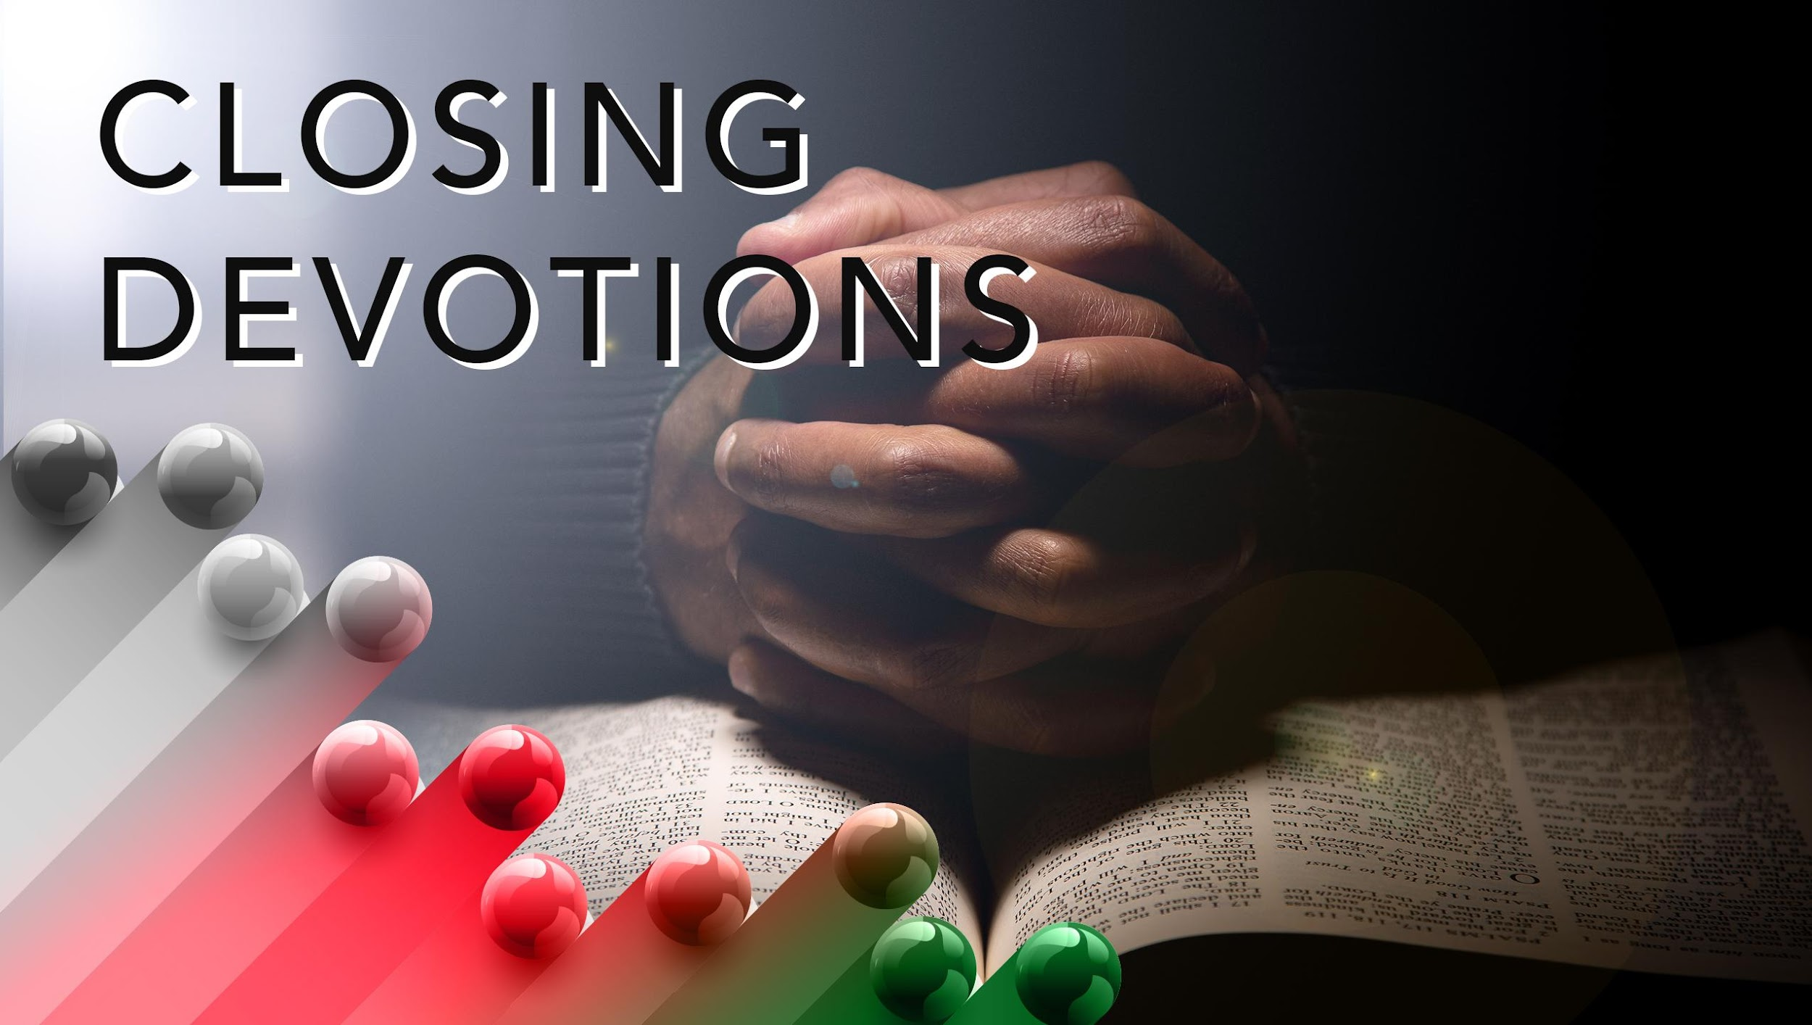

Slide 21
Closing Song: “Guide Me, O Thou Great Jehovah” (AMECH #52)
Closing Prayer: Dear God, help me open my heart to all that you are doing around me, irrespective of who you are doing it through. In Jesus’ name. Amen.

