Slide 1

LESSON 8: APRIL 19

Slide 2
The Child in a Christian World
Focus Scripture: Mark 9:36-37, 42; 10:13-16
Key Verse: “Truly I tell you, whoever does not receive the kingdom of God as a little child will never enter it.” Mark 10:15

Slide 3
Mark 9:36-37, 42; 10:13-16 (NRSV UE)
Mark 9:36-37
36 Then he took a little child and put it among them, and taking it in his arms he said to them,
37 “Whoever welcomes one such child in my name welcomes me, and whoever welcomes me welcomes not me but the one who sent me.”
42
42 “If any of you cause one of these little ones who believe in me to sin, it would be better for you if a great millstone were hung around your neck and you were thrown into the sea.”
10:13-16
13 People were bringing children to him in order that he might touch them, and the disciples spoke sternly to them.
14 But when Jesus saw this, he was indignant and said to them, “Let the children come to me; do not stop them, for it is to such as these that the kingdom of God belongs.
15 Truly I tell you, whoever does not receive the kingdom of God as a little child will never enter it.”
16 And he took them up in his arms, laid his hands on them, and blessed them.

Slide 4
Key Terms
Capernaum – Located on the northwest shore of the Sea of Galilee; served as the home base for Jesus’ ministry.
Greco-Roman – Defined by Merriam-Webster as having characteristics that are partly Greek and partly Roman.
Your title here

Slide 5


Slide 6
How do you define “greatness,” and what does it mean to you? Because we live in both the world and God’s kingdom, this can be a difficult question. The world often associates greatness with wealth and power, but Jesus disagrees with this idea. In God’s kingdom, greatness comes from being like children – valued not for status, but for our relationship with him. In Mark 10:17-21, Jesus makes this clear when the rich young ruler asks how to inherit eternal life.

Slide 7


Slide 8
Jesus and the disciples are in Capernaum. He holds a private teaching session with them because, while he was trying to discuss his impending crucifixion and death on the cross, he noticed that they started arguing about who was the greatest among them (Mark 9:35).
A wonderful serenity has taken possession

Slide 9


Slide 10
Where in our history do we find teachings and experiences that reflect today’s scriptures?
A wonderful serenity has taken possession

Slide 11


Slide 12
Michael Jordan exemplifies a remarkable form of greatness. He is a highly successful African American athlete and businessman, renowned for his exceptional athletic abilities, astute business acumen, and generous spirit. Born in Brooklyn in 1963 and raised in a family that valued hard work, education, and discipline, Jordan’s upbringing shaped his legendary career.

Slide 13


Slide 14
As we’ve discussed in this lesson, the apostle James reminds us that faith without action is dead (James 2:26). When we reflect on the scriptures and the founding of the AME Church, we should feel a clear call to action. While scripture acknowledges that poverty will always exist (Matthew 26:11, Mark 14:7, John 12:8), today we’re witnessing a troubling trend – poverty and vulnerability are being criminalized. Children are being separated from their families for political reasons, often without any follow-up or reunification plans. Abuse and injustice have become so common that, without strong intervention, they risk becoming normalized.

Slide 15


Slide 16
1. What new political or civic commitments do you feel motivated to make after this lesson?

Slide 17
2. What are your honest feelings about praying for people who mistreat those who are less able or less inclined to defend themselves?

Slide 18
3. What shortcomings do you see in the church’s activism that is designed to advance liberation, equity, and inclusion – especially for children?

Slide 19
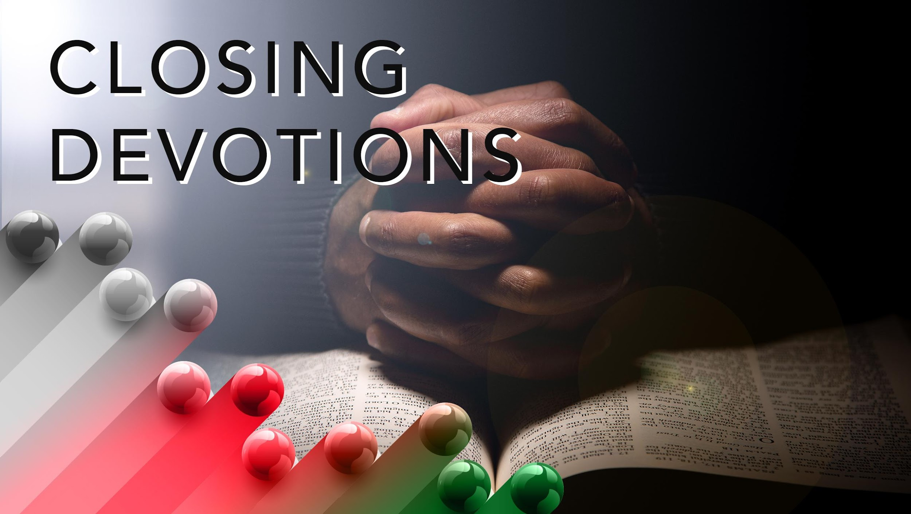

Slide 20
Closing Song: “What a Friend We Have in Jesus,” AME Hymnal #325
Closing Prayer: Father God, all power is in your hands. You are our maker and creator, and you know the plans you have for each of us. As we humbly submit ourselves to you, please give us a deeper awareness and understanding of your presence in our lives. Strengthen our minds, bodies, and spirits to help us hear from you, obey you, and align our lives with the teachings and examples Jesus Christ provides. In Jesus’ name, we pray. Amen.

