Slide 1

^{LESSON 7: APRIL 12}

Slide 2
Respect for Rightful Authority
Focus Scripture: Mark 12:17; Romans 13:1, 6-8; 1 Peter 2:13-17
Key Verse:
Jesus said to them, “Give to Caesar the things that are Caesar’s and to God the things that are God’s.” And they were utterly amazed at him. Mark 12:17

Slide 3
Mark 12:17; Romans 13:1, 6-8; 1 Peter 2:13-17 (NRSV UE)
Mark 12:17
17 Jesus said to them, “Give to Caesar the things that are Caesar’s and to God the things that are God’s.” And they were utterly amazed at him.
Romans 13:1
1 Let every person be subject to the governing authorities, for there is no authority except from God, and those authorities that exist have been instituted by God.
6-8
6 For the same reason you also pay taxes, for the authorities are God’s agents, busy with this very thing.
7 Pay to all what is due them: taxes to whom taxes are due, revenue to whom revenue is due, respect to whom respect is due, honor to whom honor is due.
8 Owe no one anything, except to love one another, for the one who loves another has fulfilled the law.

Slide 4
1 Peter 2:13-17
13 For the Lord’s sake be subject to every human authority, whether to the emperor as supreme
14 or to governors as sent by him to punish those who do wrong and to praise those who do right.
15 For it is God’s will that by doing right you should silence the ignorance of the foolish.
16 As servants of God, live as free people, yet do not use your freedom as a pretext for evil.
17 Honor everyone. Love the family of believers. Fear God. Honor the emperor.

Slide 5
Key Terms
Caesar – The family name of Julius Caesar, which subsequent emperors also adopted as a title and a synonym for civil authority.
Emperor Worship – A common worship practice in some ancient cultures, including Rome, Japan, and China. Rulers, especially emperors, were worshiped like gods or divine figures. Worship honoring them included prayers, rituals, and offerings to demonstrate loyalty and reinforce the authority of the emperors.
Revenue – A term used by the apostle Paul (Romans 13:7) to refer to money that people are required to pay the government, such as taxes or fees, to support public services or authorities.
Your title here

Slide 6


Slide 7
When you hear the word authority, what comes to mind? In light of recent, fast-paced, and disruptive government policies, the term is likely to carry negative connotations. Many are frustrated and concerned about growing government interference, the damage it may cause, and its impact on future generations. Like the prophet Habakkuk, we turn to God with questions – why are injustices allowed to continue, how long will they go unchecked, and why does he permit them at all? Here’s a more concise version:

Slide 8


Slide 9
We will explore three scriptures (see printed text above) in this lesson. A fundamental intertwining principle that will guide our study is the fact that we hold dual citizenship in both an earthly government and heavenly rule. Both belong to God. Although different settings and teachers are involved, all three of our scripture references – Romans 13:1, 6-8; 1 Peter 2:13-17, and Mark 12:17 – teach us that Christians are not exempt from their responsibilities as citizens of the earth, such as obeying laws, paying taxes, respecting authorities, and so forth. Obedience to both is essential unless obedience compromises our convictions or leads to disobedience to God.
A wonderful serenity has taken possession

Slide 10


Slide 11
Many clear parallels exist between today’s scriptures and black history. From slavery to civil rights, black history in America is a legacy of persistent struggle, reflecting tensions between the black community’s efforts to stay faithful to God while also resisting being chained or shackled by injustice. For example, consider the following: (a) The abolition movement, with leaders like Frederick Douglass and Sojourner Truth; (b) The civil rights movement, with leaders like Dr. Martin Luther King and Mrs. Rosa Parks; and (c) Contemporary experiences rooted in liberating faith, taught and endorsed by the African Methodist Episcopal (AME) Church.
A wonderful serenity has taken possession

Slide 12


Slide 13
“Sit-ins” are a common form of non-violent protest familiar to most of us. Merriam-Webster defines sit-ins in two ways: 1) as “an act of occupying seats in a racially segregated establishment in organized protest against discrimination,” and 2) as an act of sitting in the seats or on the floor of an establishment as a means of organized protest. We have seen examples of both definitions, especially in the 1960s when primarily African American students used sit-ins, and in 2016, when (the late) Congressman John Lewis led other members of the United States Congress in a sit-in on the floor of the U.S. House of Representatives’ Chambers.

Slide 14


Slide 15
Many scriptures remind us that receiving and storing knowledge isn’t enough. Obedience requires action! This action applies to our obedience, faithfulness, and accountability. Luke 12:48 puts it plainly: “To whom much is given, much will be required.”

Slide 16


Slide 17
1. What new insights do you have about when and how Christians should speak up for themselves and others in response to discrimination and other dehumanizing situations?

Slide 18
2. Considering current events that are hurting the lives of people, especially those who are marginalized and vulnerable, what actions do you believe God may be calling you to take?

Slide 19
3. Given the same circumstances as mentioned above, what roles and actions do you think our churches should be taking?

Slide 20
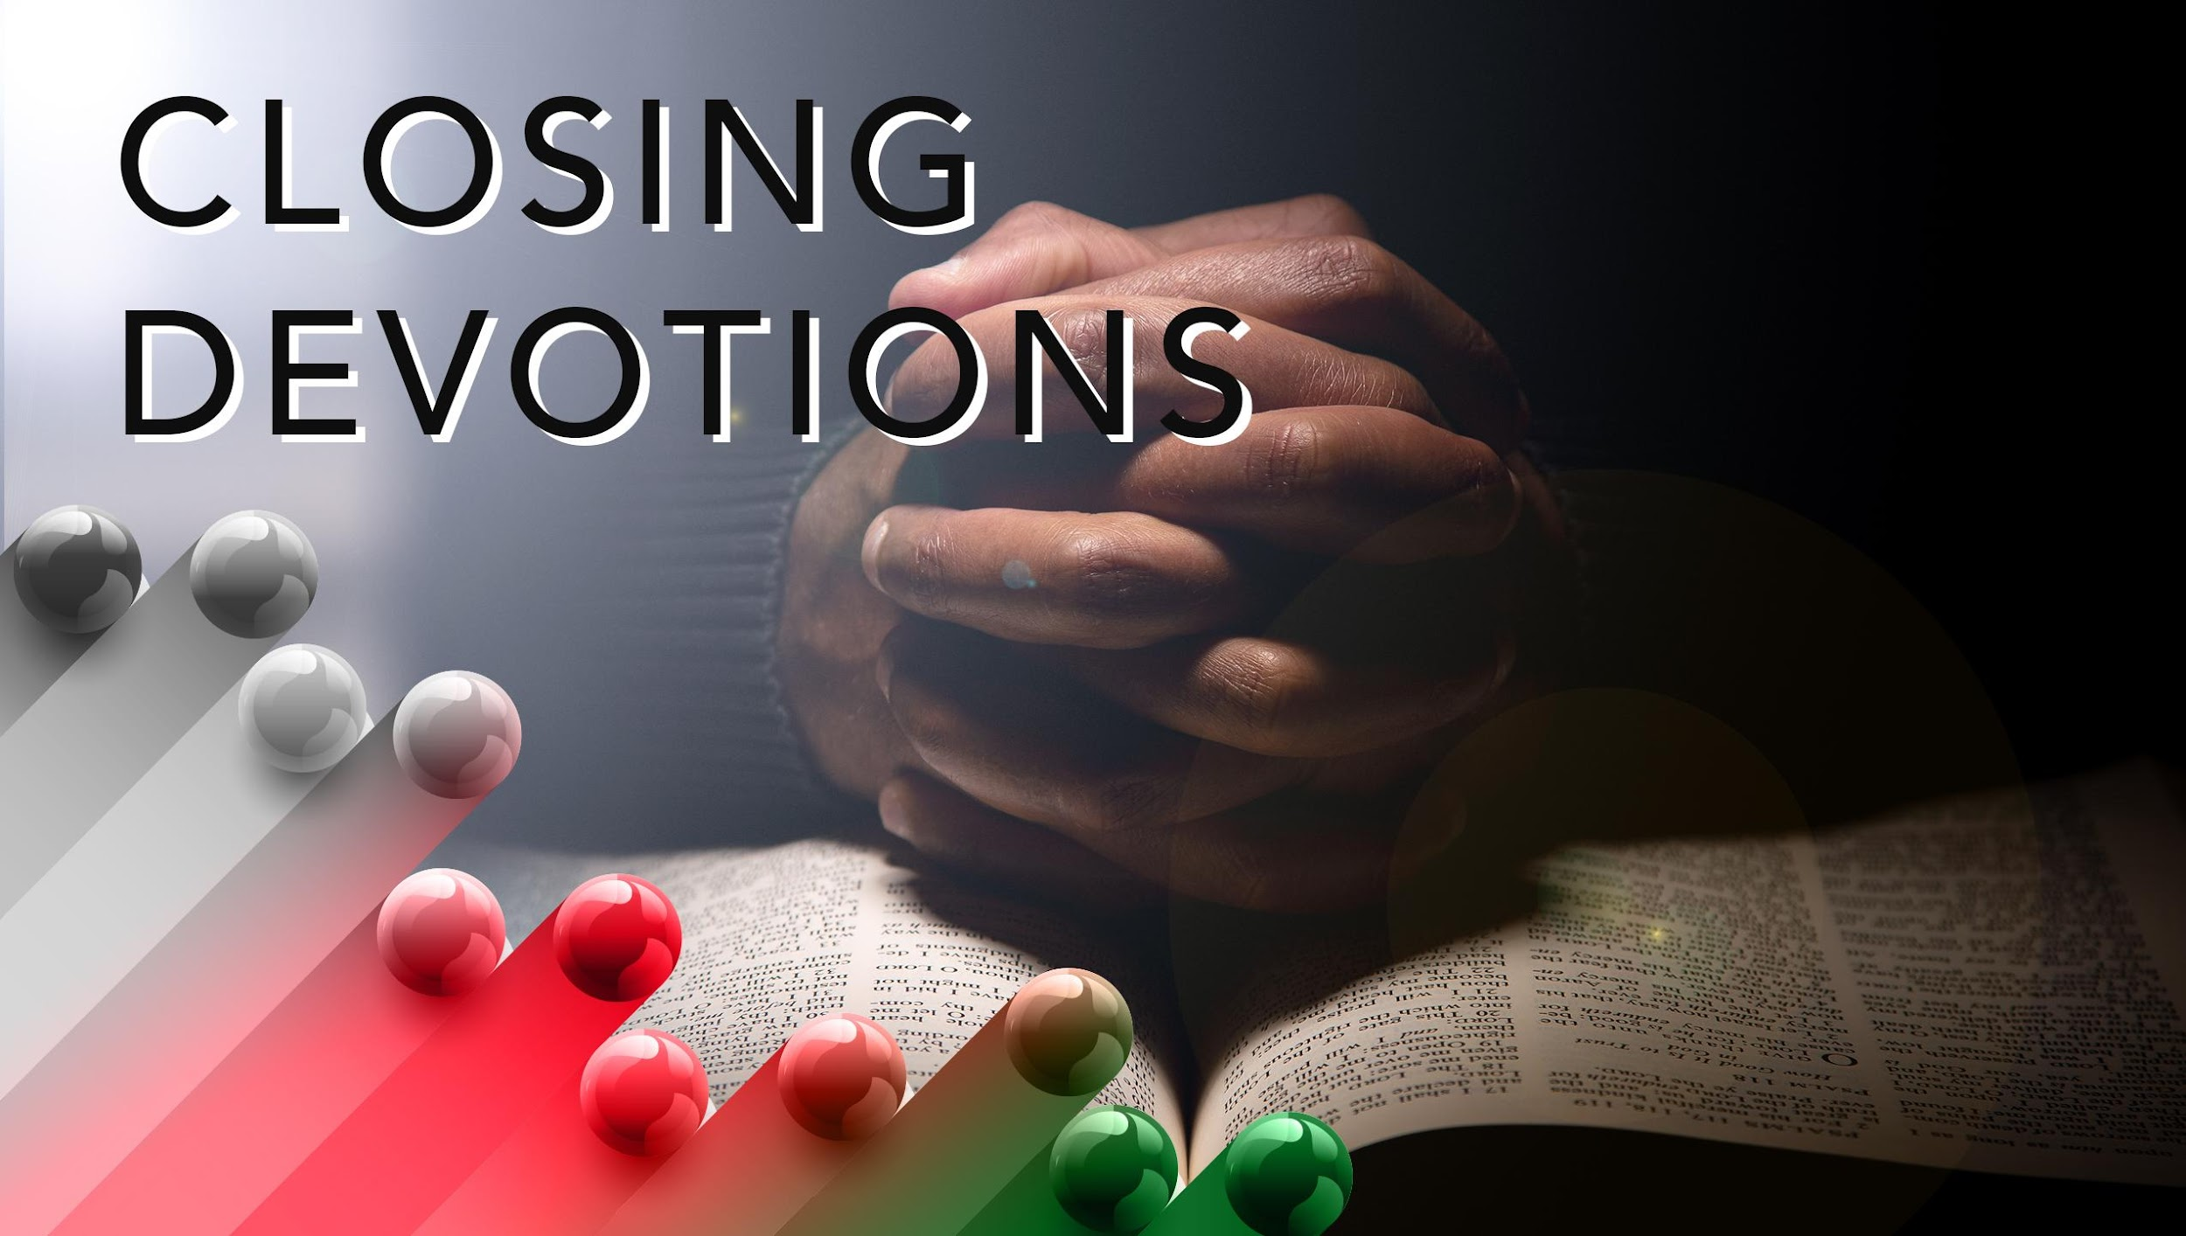

Slide 21
Closing Song: “This Is My Father’s World,” AMEC Hymnal #47
Closing Prayer: Father God, Jesus warned that we would have trouble in this world. We thank you that he has shown us how to respond in ways that demonstrate faith and commitment to you, so that others may come to know and believe in you. Please forgive our sins and help us to love and be responsible to you and others as Jesus taught. In the name of Jesus, we pray. Amen.

