Slide 1
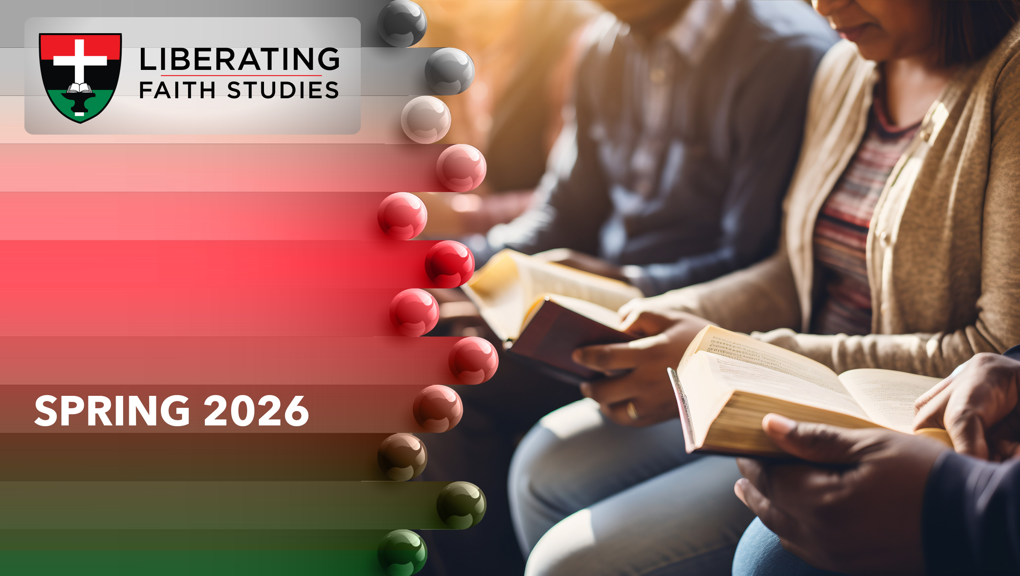
^{LESSON 6: APRIL 5}

Slide 2
The Future Life
Focus Scripture: 1 Corinthians 15:13-20, 51-58
Key Verse: In fact Christ has been raised from the dead, the first fruits of those who have died. 1 Corinthians 15:20

Slide 3
1 Corinthians 15:13-20, 51-58 (NRSV UE)
1 Corinthians 15:13-20
13 If there is no resurrection of the dead, then Christ has not been raised,
14 and if Christ has not been raised, then our proclamation is in vain and your faith is in vain.
15 We are even found to be misrepresenting God, because we testified of God that he raised Christ—whom he did not raise if it is true that the dead are not raised.
16 For if the dead are not raised, then Christ has not been raised.
17 If Christ has not been raised, your faith is futile, and you are still in your sins.
18 Then those also who have died in Christ have perished.
19 If for this life only we have hoped in Christ, we are of all people most to be pitied.
20 But in fact Christ has been raised from the dead, the first fruits of those who have died.
51-58
51 Look, I will tell you a mystery! We will not all die, but we will all be changed,
52 in a moment, in the twinkling of an eye, at the last trumpet. For the trumpet will sound, and the dead will be raised imperishable, and we will be changed.

Slide 4
53 For this perishable body must put on imperishability, and this mortal body must put on immortality.
54 When this perishable body puts on imperishability and this mortal body puts on immortality, then the saying that is written will be fulfilled:“Death has been swallowed up in victory.”
  55 “Where, O death, is your victory? Where, O death, is your sting?”
  56 The sting of death is sin, and the power of sin is the law.
  57 But thanks be to God, who gives us the victory through our Lord Jesus Christ.
  58 Therefore, my beloved brothers and sisters, be steadfast, immovable, always excelling in the work of the Lord because you know that in the Lord your labor is not in vain.

Slide 5
Key Terms
First Fruits – In 1 Corinthians 15:20, the term is used as a metaphor, referring to Jesus’ bodily resurrection to be the first of its kind, guaranteeing the future resurrection of believers.
Hope – Biblically, hope is not defined by circumstances; instead, it is confident expectation based on trust in God’s promises.
Immortality – Refers to eternal life/living forever beyond death; a future gift for believers.
Mystery – As used by apostle Paul, this concept refers to a previously hidden truth that God has now revealed through Jesus Christ.
Your title here

Slide 6


Slide 7
Today is Easter, or Resurrection Sunday, one of the most important days on the Christian calendar. It celebrates Jesus Christ’s resurrection after three days in the tomb, a central event in the New Testament and in God’s plan of salvation. All four Gospels highlight its importance, each providing detailed, unique accounts. Our lesson today demonstrates how highly the apostle Paul valued the resurrection, not just as an event, but as the foundation of Christianity and the anchor of salvation for humanity.

Slide 8


Slide 9
During his second missionary journey, Paul spent about 18 months in Corinth, a wealthy and diverse city known for immorality and religious pluralism. There, he established a church made up of both Jews and Gentiles from different social backgrounds, united by their belief in Jesus, his sacrifice, death, and resurrection. Despite their differences, they embraced Paul’s teachings and shared a common faith. After Paul left, he learned of problems within the church, including divisions, immorality, and theological confusion.
A wonderful serenity has taken possession

Slide 10


Slide 11
Nothing compares to the resurrection of Jesus Christ, but it also shares powerful parallels with the civil rights movement. Both represent periods of intense suffering that eventually led to renewed hope and purpose. Good Friday seemed like the end for Jesus’ followers, just as decades of segregation, violence, and injustice made equality seem unreachable for African Americans facing brutality and dehumanization that robbed many of hope, until change began to appear.
A wonderful serenity has taken possession

Slide 12


Slide 13
Dr. Martin Luther King often compared the suffering of African Americans to the sorrow of Jesus’ crucifixion, describing lynchings and police brutality as a “crucifixion” of black dignity. He spoke about the pain and despair that reflected what Jesus’ disciples experienced on the day of his death. In his 1965 Easter sermon, he stated, “Easter is a time to be reminded that truth crushed to earth will rise again… that love is stronger than hate.” Dr. King powerfully linked Jesus’ resurrection to the rise of oppressed people, urging them to see themselves as part of God’s redemptive story, not defined by sorrow, but by hope and purpose.

Slide 14
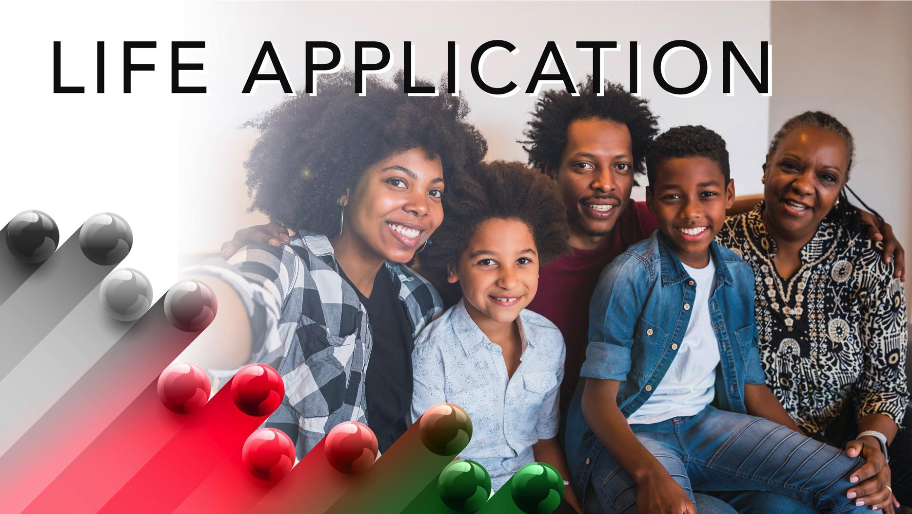

Slide 15
What are your priorities this Resurrection Sunday? Will you honor Jesus’ sacrifice or get distracted by Easter baskets, outfits, and other secular activities? We have a choice, to pursue a deeper spiritual path that brings us closer to God and God’s promises of eternal life.

Slide 16


Slide 17
1. How would you explain the resurrection to someone seeking to understand it?

Slide 18
2. How would you respond if people either downplayed or dismissed the importance of Jesus’ resurrection?

Slide 19
3. What new insights do you have about Jesus Christ’s “Victory Over Death?”

Slide 20
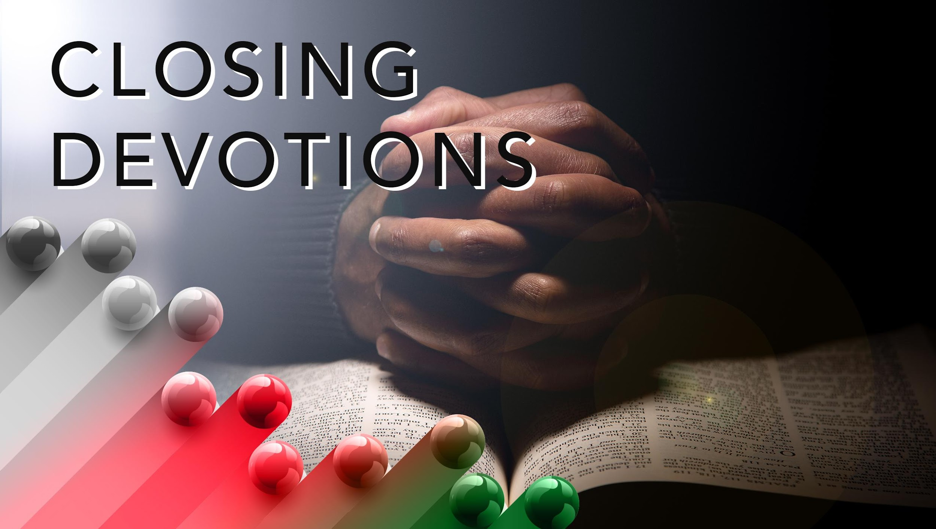

Slide 21
Closing Song: “He Arose,” AME Hymnal #170
Closing Prayer: Father God, we believe Jesus rose from the dead, and because he rose, we believe in his promise that we can also rise and have eternal life. Thank you for sending Jesus to die for our sins, despite our unworthiness. Please forgive our sins and strengthen our commitment to serve you as we celebrate Resurrection Sunday. In Jesus’ name, we pray. Amen.

