Slide 1

^{LESSON 3: MARCH 15}

Slide 2
Helping Neighbors in Need
Focus Scripture: Deuteronomy 15:4-11; Matthew 25:42-45
Key Verse: “Since there will never cease to be some in need on the earth, I therefore command you, ‘Open your hand to the poor and needy neighbor in your land.” Deuteronomy 15:11

Slide 3
Deuteronomy 15:4-11; Matthew 25:42-45 (NRSV UE)
Deuteronomy 15:4-11
4 “There will, however, be no one in need among you, because the Lord is sure to bless you in the land that the Lord your God is giving you as a possession to occupy,
5 if only you will obey the Lord your God by diligently observing this entire commandment that I command you today.
6 When the Lord your God has blessed you, as he promised you, you will lend to many nations, but you will not borrow; you will rule over many nations, but they will not rule over you.
7 If there is among you anyone in need, a member of your community in any of your towns within the land that the Lord your God is giving you, do not be hard-hearted or tight-fisted toward your needy neighbor.
8 You should rather open your hand, willingly lending enough to meet the need, whatever it may be.
9 Be careful that you do not entertain a mean thought, thinking, ‘The seventh year, the year of remission, is near,’ and therefore view your needy neighbor with hostility and give

Slide 4
nothing; your neighbor might cry to the Lord against you, and you would incur guilt.
10 Give liberally and be ungrudging when you do so, for on this account the Lord your God will bless you in all your work and in all that you undertake.
11 Since there will never cease to be some in need on the earth, I therefore command you, ‘Open your hand to the poor and needy neighbor in your land.’”
Matthew 25:42-45
42 “…for I was hungry and you gave me no food, I was thirsty and you gave me nothing to drink,
43 I was a stranger and you did not welcome me, naked and you did not give me clothing, sick and in prison and you did not visit me.’
44 Then they also will answer, ‘Lord, when was it that we saw you hungry or thirsty or a stranger or naked or sick or in prison and did not take care of you?’
45 Then he will answer them, ‘Truly I tell you, just as you did not do it to one of the least of these, you did not do it to me.’”

Slide 5
Key Terms
Deuteronomy – The fifth book of the Old Testament; from the Greek translation, it means “the Second law.”
Economy – Refers to the systems through which goods and services are produced, distributed, and consumed to meet the needs and wants of people living and working within a specific geographic area.
Your title here

Slide 6


Slide 7
News reports and credible data on wealth and poverty in the United States reveal deep and growing disparities among the people. A small percentage of the population holds most of the wealth, while millions struggle with basic needs such as housing, healthcare, and education. These gaps raise serious questions about justice, policy, and equal access to opportunity.

Slide 8


Slide 9
As our story in Deuteronomy begins, the Israelites are on the plains of Moab, across from Jericho, preparing for their second attempt to enter the promised land. After 40 years of wandering due to rebellion and lack of faith, a new generation is ready to cross into Canaan. Since Moses is not permitted to enter, he delivers final instructions on how to live according to God’s will. Deuteronomy 15:4-11 reveals God’s economy, centered on justice, generosity, and shared responsibility.
A wonderful serenity has taken possession

Slide 10


Slide 11
Reparations are not a new idea! In Leviticus 25, the Year of Jubilee brought about social and economic fairness every 50 years – liberating the enslaved, canceling debts, and restoring land ownership. Similarly, when the Israelites left Egypt, they received silver and clothing from the Egyptians because of God’s favor (Exodus 12:35-36). These same biblical principles shape today’s call for reparations for descendants of the African diaspora. While the United States has provided reparations to some groups for human rights abuses, Africans have largely been excluded. Resources like “The Case for Reparations” by Ta-Nehisi Coates offer valuable insights.
A wonderful serenity has taken possession

Slide 12


Slide 13
NBA Hall of Famer David Robinson and his wife, Valerie, demonstrate wealth-sharing aligned with God’s purposes. In 2001, they founded The Carver Academy to offer quality education for underserved students in East San Antonio. What started as a private PK–8 school has grown into a tuition-free charter school under the IDEA, now a network with campuses across Texas. Robinson has contributed more than money; he remains actively involved and serves on IDEA’s board.

Slide 14


Slide 15
Poverty, as referenced in Matthew 26:11 and John 12:8, remains a persistent reality – but its inevitability does not justify ignoring the poor. Deuteronomy 15:4-11 urges God’s people to be generous with each other, especially during the sabbatical year, when debts were forgiven. This passage reminds us to use our blessings to aid others, stay humble, and dedicate all we have to God. Sadly, today’s poor are often dehumanized and blamed for their difficulties. Yet Matthew 25:42-45 makes it clear: how we treat the vulnerable reflects how we treat Jesus himself. We must recognize the humanity and the image of God in every person.

Slide 16


Slide 17
1. What are your thoughts about the enforcement of current immigration laws in this country?

Slide 18
2. Using this lesson as a contextual lens, how much and what actions do you feel should be taken to ensure that we empower others and not enable dependency?

Slide 19
3. How comfortable are you with whether you are exemplifying God’s call to be a conduit for his blessing?

Slide 20
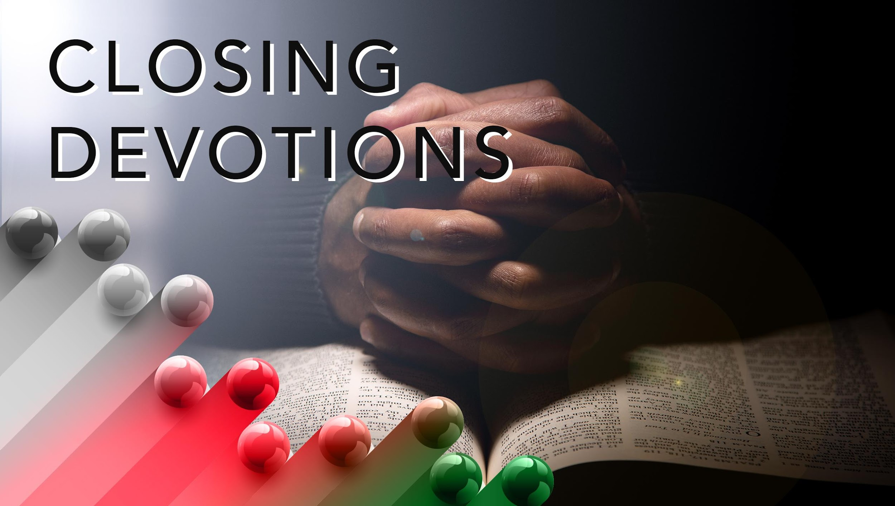

Slide 21
Closing Song: “More About Jesus Would I Know,” AME Hymnal #21
Closing Prayer: Father God, in the name of Jesus, we bow in deepest humility before you, and we praise you because of who you are! Thank you for teaching me how to live in ways that please you. We want to serve and please you, Lord. So, please forgive our sins and transgressions, and continue to bless us with a desire to study and learn more about Jesus, knowing that as we do, we will be increasingly empowered to love and obey you. In the name of Jesus, we pray. Amen.

