Slide 1

^{LESSON 11: MAY 10}

Slide 2
Useful Work as Christian Duty
Focus Scripture: Genesis 2:15; Exodus 20:9; John 5:17; Acts 20:33-35; 2 Thessalonians 3:6-12
Key Verse: “In all this I have given you an example that by such work we must support the weak, remembering the words of the Lord Jesus, for he himself said, ‘It is more blessed to give than to receive.’” Acts 20:35

Slide 3
Genesis 2:15; Exodus 20:9; John 5:17; Acts 20:33-35; 2 Thessalonians 3:6-12 (NRSV UE)
Genesis 2:15
15 The Lord God took the man and put him in the garden of Eden to till it and keep it.
Exodus 20:9
9 Six days you shall labor and do all your work.
John 5:17
17 But Jesus answered them, “My Father is still working, and I also am working.”
Acts 20:33-35
33 “I coveted no one’s silver or gold or clothing.
34 You know for yourselves that I worked with my own hands to support myself and my companions.
35 In all this I have given you an example that by such work we must support the weak, remembering the words of the Lord Jesus, for he himself said, ‘It is more blessed to give than to receive.’”

Slide 4
2 Thessalonians 3:6-12
6 Now we command you, brothers and sisters, in the name of our Lord Jesus Christ, to keep away from every brother or sister living irresponsibly and not according to the tradition that they received from us.
7 For you yourselves know how you ought to imitate us; we were not irresponsible when we were with you,
8 and we did not eat anyone’s bread without paying for it, but with toil and labor we worked night and day so that we might not burden any of you.
9 This was not because we do not have that right but in order to give you an example to imitate.
10 For even when we were with you, we gave you this command: anyone unwilling to work should not eat.
11 For we hear that some of you are living irresponsibly, mere busybodies, not doing any work.
12 Now such persons we command and exhort in the Lord Jesus Christ to do their work quietly and to earn their own living.

Slide 5
^{Key Terms}
Idleness – A term used in many scriptures to describe inappropriate lifestyles for God’s people. In this lesson, it refers to laziness and neglecting to work to meet one’s own needs.
Sabbath – A concept based on God’s actions during creation. He formed the world in six days and rested on the seventh. It is a day dedicated to rest, worship, and reflection on our Sovereign God.
Your title here

Slide 6


Slide 7
How do you feel about the work you do each week? Whether it’s at home, school, a job, or volunteering, work means different things to different people. Often, it’s more than just tasks. It’s part of how we define ourselves.

Slide 8


Slide 9
God revealed God’s plan for people to work from the very beginning. In Exodus 20:9, we learn that God expects us to work six days and rest on the seventh. In John 5:17 and John 9:4, Jesus affirms God’s plan for us to work by explaining that both he and the Father are always working, and he urges his disciples to work diligently. The apostle Paul also encouraged believers to work earnestly, avoid laziness, and seize opportunities to help others (2 Thessalonians 3 and Acts 20).
A wonderful serenity has taken possession

Slide 10


Slide 11
We’ve reflected on scriptures that change our view of work, from something simply secular to a sacred calling, as expressed in our theme: “Useful Work as Christian Duty.” A powerful example of this truth is seen in the lives of Bishop Richard Allen and Reverend Absalom Jones during the 1793 Yellow Fever Epidemic in Philadelphia, which was then the U.S. capital. As the disease killed nearly 5,000 people and caused many to flee, essential services broke down.
A wonderful serenity has taken possession

Slide 12


Slide 13
Her Excellency Ellen Johnson Sirleaf’s life and leadership reflect our theme: “Useful Work as Christian Duty.” Her work, marked by perseverance, service, and empowerment, was not about politics or personal gain, but about faithfully serving her people and honoring God through rebuilding a nation. Born in Monrovia, Liberia, on October 29, 1938, she became Africa’s first female head of state, serving as president of Liberia from 2006 to 2018. Before her presidency, she endured both exile and imprisonment for speaking out against authoritarianism.

Slide 14


Slide 15
We’ve examined scriptures and examples that show God’s perspective on work, not as punishment or pointless labor, but as a way to add purpose to our lives and help others. Whether at home, in the workplace, at school, or in our communities, meaningful work becomes a spiritual act when we serve God through it.

Slide 16


Slide 17
1. How has this study shaped your understanding of work in God’s eyes?

Slide 18
2. What concerns do you have about helping the weak through your work? Should there be limits?

Slide 19
3. How might this lesson impact your church’s view on personal responsibility and acts of benevolence?

Slide 20
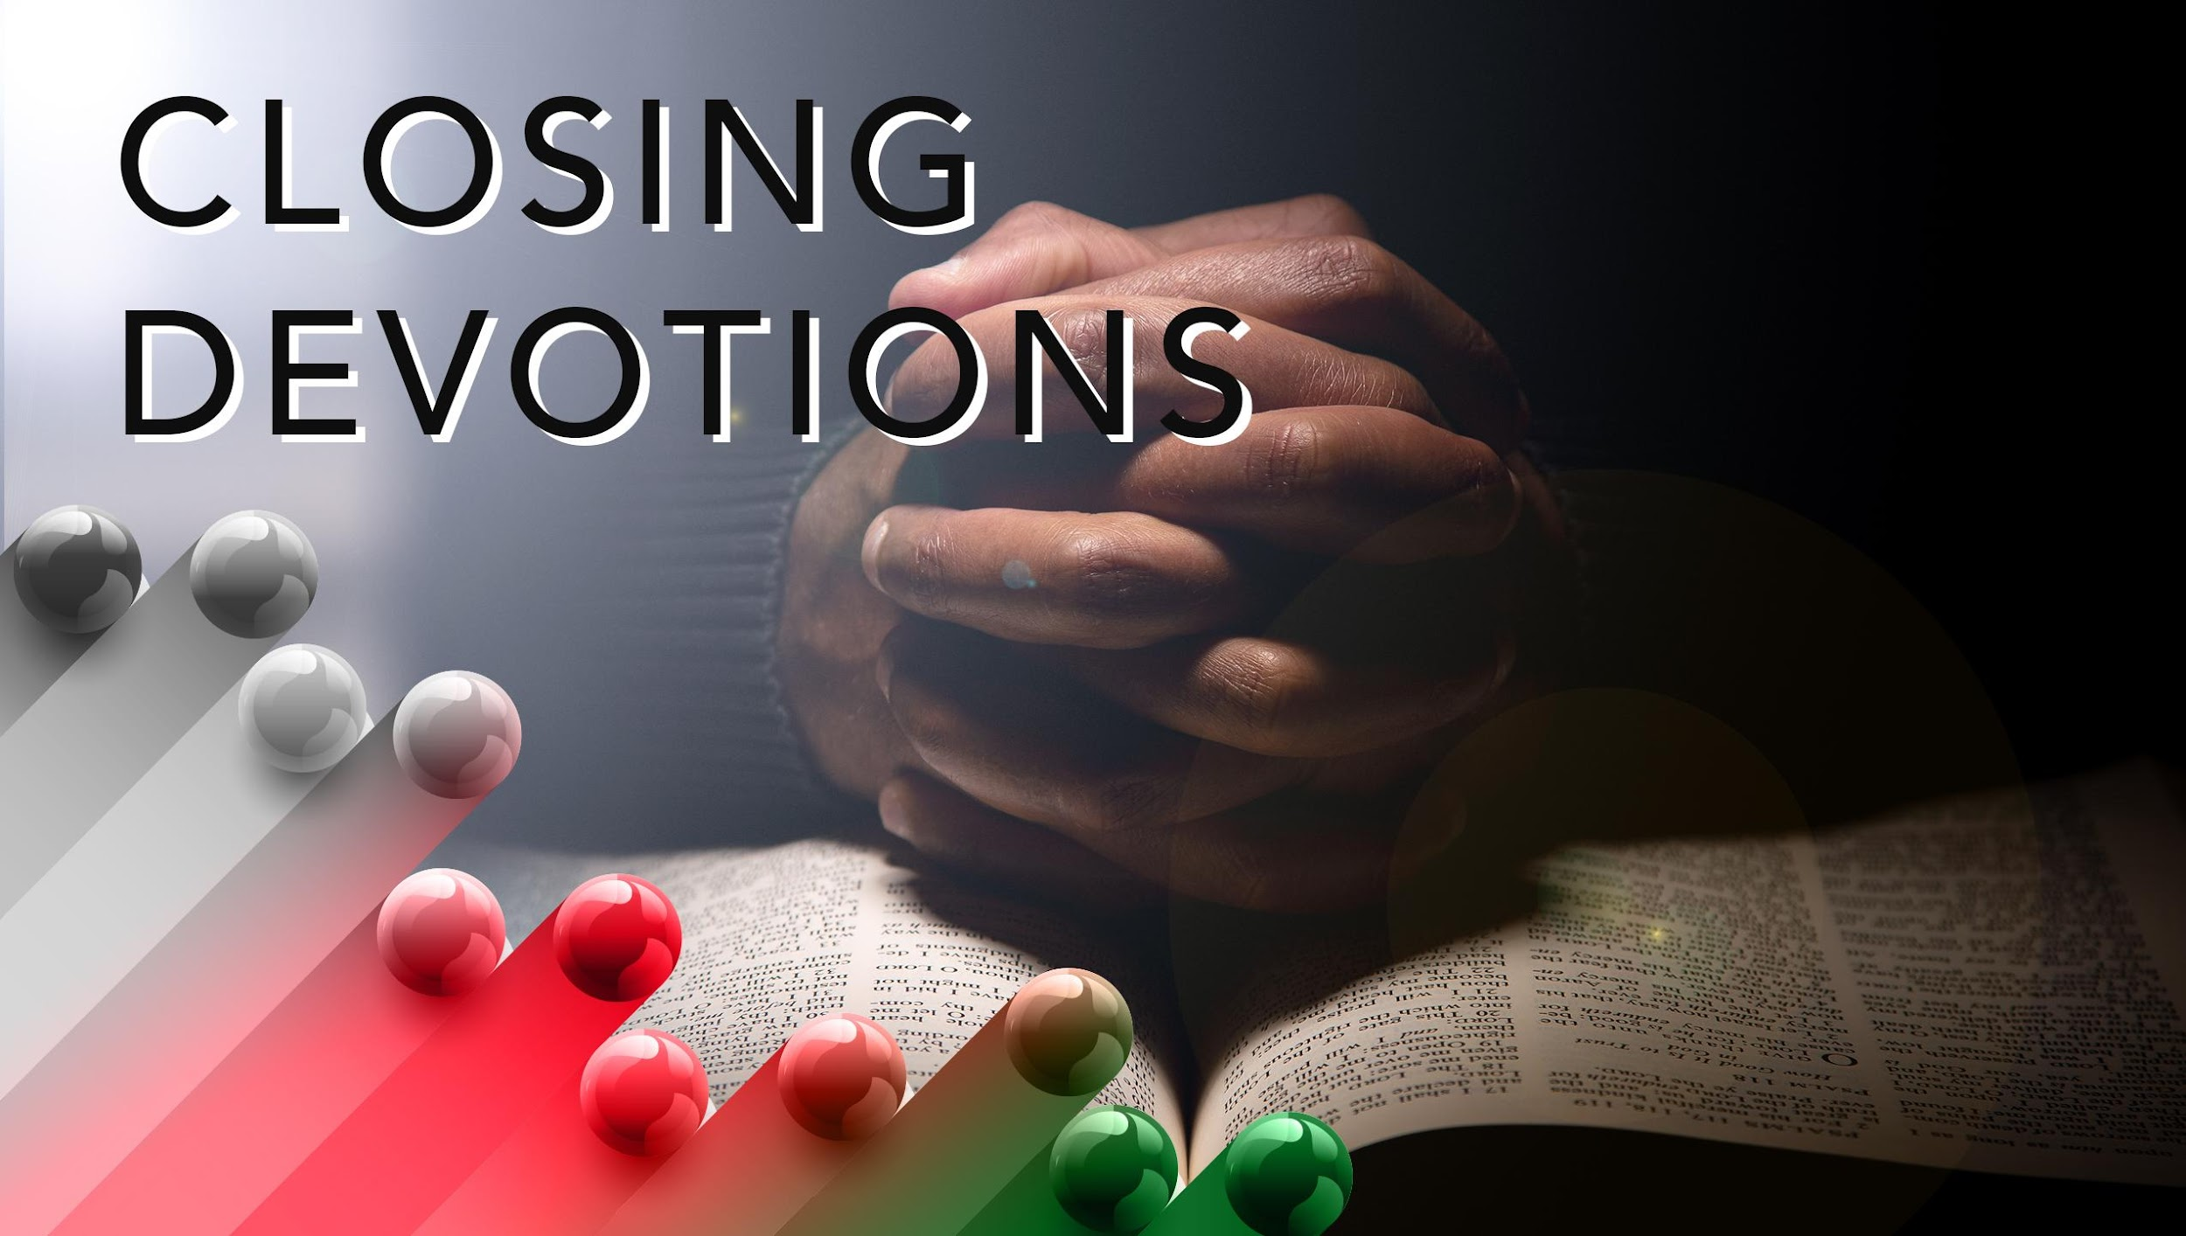

Slide 21
Closing Song: “When We Walk with the Lord,” AME Hymnal #377
Closing Prayer: Unto thee, O Lord, we bow. We ask for your care and guidance. Please forgive our sins and help us to live according to your holy Word. Thank you for being so patient as we grow in understanding your plans for our lives. In Jesus’ name, we thank you and praise your holy name. Amen.

Slide 22
Oh, bless me now, my Savior, I come to Thee.
Prayer: Dear Lord, help us to hear your voice and heed warnings. Let us not assume that our religious buildings or items will save us from your wrath. Allow us to understand that we are your examples on earth and that our words and behaviors tell others that you are the Lord. In Jesus’ name we pray. Amen.

