Slide 1

^{LESSON 10: MAY 3}

Slide 2
The Higher Patriotism
Focus Scripture: Jonah 1:1-3; 3:1-5; 4:6-11
Key Verses: The Lord said, “You are concerned about the bush, for which you did not labor and which you did not grow; it came into being in a night and perished in a night. And should I not be concerned about Nineveh…?” Jonah 4:10-11a

Slide 3
Jonah 1:1-3; 3:1-5; 4:6-11 (NRSV UE)
Jonah 1:1-3
1 Now the word of the Lord came to Jonah son of Amittai, saying,
2 “Go at once to Nineveh, that great city, and cry out against it, for their wickedness has come up before me.”
3 But Jonah set out to flee to Tarshish from the presence of the Lord. He went down to Joppa and found a ship going to Tarshish; so he paid his fare and went on board, to go with them to Tarshish, away from the presence of the Lord.
3:1-5
1 The word of the Lord came to Jonah a second time, saying,
2 “Get up, go to Nineveh, that great city, and proclaim to it the message that I tell you.”
3 So Jonah set out and went to Nineveh, according to the word of the Lord. Now Nineveh was an exceedingly large city, a three days’ walk across.
4 Jonah began to go into the city, going a day’s walk. And he cried out, “Forty days more, and Nineveh shall be overthrown!”
5 And the people of Nineveh believed God; they proclaimed a fast, and everyone, great and small, put on sackcloth.

Slide 4
4:6-11
6 The Lord God appointed a bush and made it come up over Jonah, to give shade over his head, to save him from his discomfort, so Jonah was very happy about the bush.
7 But when dawn came up the next day, God appointed a worm that attacked the bush, so that it withered.
8 When the sun rose, God prepared a sultry east wind, and the sun beat down on the head of Jonah so that he was faint and asked that he might die. He said, “It is better for me to die than to live.”
9 But God said to Jonah, “Is it right for you to be angry about the bush?” And he said, “Yes, angry enough to die.”
10 Then the Lord said, “You are concerned about the bush, for which you did not labor and which you did not grow; it came into being in a night and perished in a night.
11 And should I not be concerned about Nineveh, that great city, in which

Slide 5
there are more than a hundred and twenty thousand persons who do not know their right hand from their left and also many animals?”

Slide 6
^{Key Terms}
Nationalism – Strong feelings of pride and loyalty toward one’s own nation or country, often with beliefs that the nation is better than others, which can lead to an “us vs. them” attitude.
Nineveh – An enemy city to which God called the prophet Jonah; also, the capital of the ancient Assyrian Empire, known for its size, power, and wickedness.
Patriotism – Love or loyalty to one’s country, often shown through pride, service, and a desire for it to uphold core values like freedom, equality, democracy, and human rights.
Your title here

Slide 7


Slide 8
Jesus commanded us to “love (our) enemies and pray for those who persecute (us)” (Matthew 5:44). Do you ever struggle to follow this commandment, especially when the person has deeply hurt you and might do so again? Jesus didn’t just teach this; he lived it. As he was dying, he prayed, “Father, forgive them, for they know not what they do” (Luke 23:34). Is there someone you need to ask God to soften your heart toward, so you can pray like Jesus did?

Slide 9


Slide 10
The prophet Jonah, who lived in the 8th century B.C., struggled with a form of nativism, resisting God’s call to help people he saw as outsiders. This same mindset has appeared throughout African American history. While nativism is often viewed as anti-immigrant, African Americans have long been treated as outsiders in their own country. From the Founding Era through Reconstruction, the Great Migration, and into the 21st century, nativist attitudes have driven laws and practices that kept black Americans from full participation in American society.
A wonderful serenity has taken possession

Slide 11


Slide 12
Articles of Religion Related to Baptism and Holy Communion
Many AME congreg- ations will observe Founder’s Day today. One of the founding and clarifying sets of doctrine for the church is the Articles of Religion, adapted from the Methodist Church and the Anglican Church before that.
A wonderful serenity has taken possession

Slide 13


Slide 14
Christian Nationalism and Nativism
Christian nationalism combines political and cultural beliefs that present Christianity as the core of American identity, asserting that the U.S. is fundamentally a Christian nation that should be guided by Christian values. This ideology often reflects nativist ideas by defining national identity in exclusive terms, prioritizing native-born citizens and marginalizing immigrants and perceived “outsiders,” as discussed in Sankofa.

Slide 15


Slide 16
Jonah’s story offers powerful lessons. Although he was a faithful prophet, he resisted God’s call to go to Nineveh. He chose to run away and later even asked to die. Here are some key takeaways:

Slide 17


Slide 18
1. Do you find yourself getting angry at leaders, especially those who seem to believe they are superior to people unlike them or members of their social groups?

Slide 19
2. Has God ever called you to a task in the past that you hesitated to complete? What was the outcome?

Slide 20
3. Among all the lessons from Jonah’s experience, which one resonates most with you? Why?

Slide 21
4. Considering global AME connection and experiences, how might your church more fully embody Baptism and the Lord’s Supper in mission and service?

Slide 22
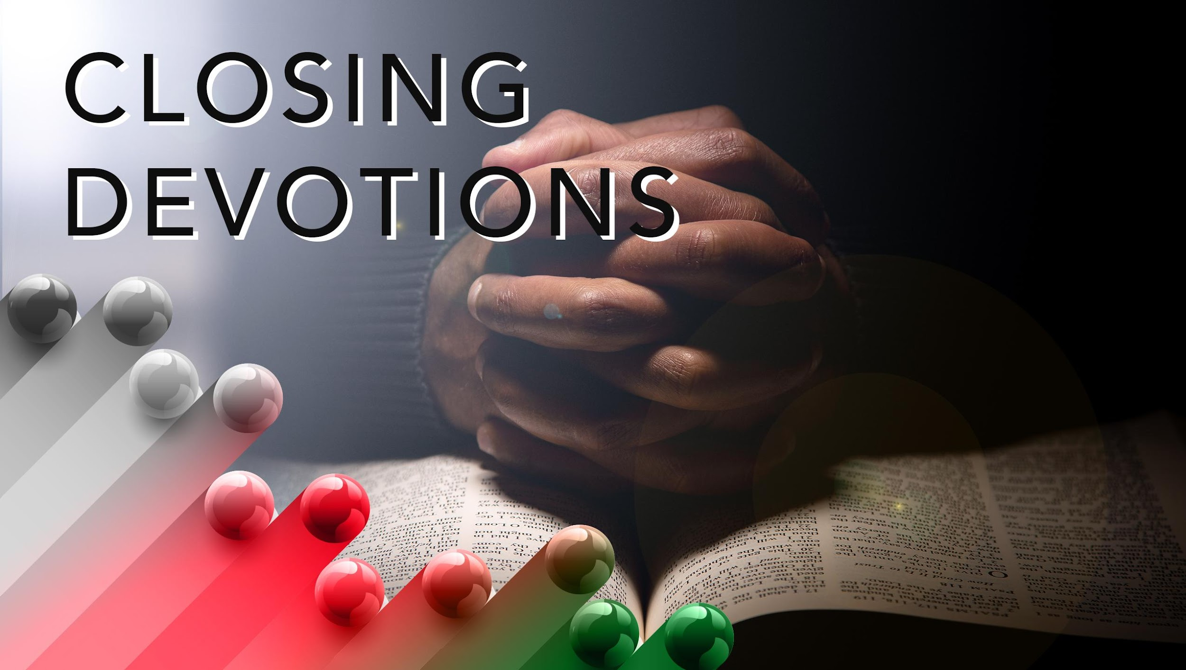

Slide 23
Closing Song: “Have Thine Own Way, Lord,” AME Hymnal #345
Closing Prayer: Father God, please give us clean hearts and willing spirits to do your will. Grant us peace and bless us to love and show compassion like you did for the Ninevites. We thank you and give you praise and honor, in the name of Jesus. Amen.

