Slide 1

LESSON 9: FEBRUARY 1

Slide 2
The Christian Church
Focus Scripture: Mark 4:26-32; Ephesians 4:4-6, 11-18
Key Verses: Speaking the truth in love, we must grow up in every way into him who is the head, into Christ, from whom the whole body, joined and knit together by every ligament with which it is equipped, as each part is working properly, promotes the body’s growth in building itself up in love. Ephesians 4:15-16 (NRSV UE)

Slide 3
Mark 4:26-32; Ephesians 4:4-6, 11-18(NRSV UE)
Mark 4:26-32
26 He also said, “The kingdom of God is as if someone would scatter seed on the ground
27 and would sleep and rise night and day, and the seed would sprout and grow, he does not know how.
28 The earth produces of itself first the stalk, then the head, then the full grain in the head.
29 But when the grain is ripe, at once he goes in with his sickle because the harvest has come.”
30 He also said, “With what can we compare the kingdom of God, or what parable will we use for it?
31 It is like a mustard seed, which, when sown upon the ground, is the smallest of all the seeds on earth,
32 yet when it is sown it grows up and becomes the greatest of all shrubs and puts forth large branches, so that the birds of the air can make nests in its shade.”

Slide 4
Ephesians 4:4-6
4 …there is one body and one Spirit, just as you were called to the one hope of your calling,
5 one Lord, one faith, one baptism,
6 one God and Father of all, who is above all and through all and in all.
11-18
11 He himself granted that some are apostles, prophets, evangelists, pastors and teachers
12 to equip the saints for the work of ministry, for building up the body of Christ,
13 until all of us come to the unity of the faith and of the knowledge of the Son of God, to maturity, to the measure of the full stature of Christ.
14 We must no longer be children, tossed to and fro and blown about by every wind of doctrine by people’s trickery, by their craftiness in deceitful scheming;
15 but speaking the truth in love, we must grow up in every way into him who is the head, into Christ,
16 from whom the whole body, joined and knit together by every ligament with which it is equipped, as each part is working properly, promotes the body’s

Slide 5
growth in building itself up in love.
17 Now this I affirm and insist on in the Lord: you must no longer walk as the gentiles walk, in the futility of their minds;
18 they are darkened in their understanding, alienated from the life of God because of their ignorance and hardness of heart.

Slide 6
Key Terms
Spiritual Gifts (charismata) – Special abilities given by the Holy Spirit to equip the church for ministry.
Unity (henosis) – The state of being joined together in Christ, despite diversity of gifts.
Mustard Seed – Symbol of small beginnings growing into great outcomes (Mark 4:30-32).
Body of Christ – The church as a unified organism where each member contributes to growth.
Agape – Selfless love, often expressed in communal meals and fellowship in the early church.
Your title here

Slide 7


Slide 8
The church faces countless challenges that threaten unity, from personal conflicts to societal divisions. Yet Christ equips each believer with unique gifts to strengthen and grow the community. In this lesson, we explore how the church can thrive through cooperation, spiritual maturity, and the exercise of diverse gifts.

Slide 9


Slide 10
In this lesson, the pairing of the Gospel passage and epistle gives us views of the kingdom (kindom) of God and the church of Jesus Christ.
A wonderful serenity has taken possession

Slide 11


Slide 12
Week of Prayer for Christian Unity
The Week of Prayer for Christian Unity is an annual ecumenical observance that began in 1908, encouraging Christians from different denominations to pray and work together for unity. In the northern hemisphere, the Week of Prayer for Christian Unity is celebrated on January 18-25; in the southern hemisphere celebrations take place around Pentecost, a symbolic date for the unity of the church.
A wonderful serenity has taken possession

Slide 13


Slide 14
Ecumenical Movement and Interdenominational Cooperation
The conciliar ecumenical movement emerged in the 20th century as churches around the world sought to promote dialogue, cooperation, and reconciliation among Christian denominations. Organizations such as the World Council of Churches, World Methodist Council, All African Conference of Churches, and various regional and national councils facilitated conversations that emphasized shared beliefs, mutual respect, and joint mission work, while addressing historical divisions rooted in culture, theology, and colonial histories.

Slide 15


Slide 16
Living out the call to unity and maturity in the body of Christ requires intentional reflection and action in both our congregations and broader communities. Consider situations that have previously hindered spiritual growth within our churches, reflecting on how God may have used these challenges as opportunities for transformation and deeper connection.

Slide 17


Slide 18
1. How can our church grow spiritually while embracing diversity? What does embracing diversity look like?

Slide 19
2. Which small actions might produce “mustard seed” growth in your life or community?

Slide 20
3. What is one concrete step you can take this week to serve the unity of the church?

Slide 21
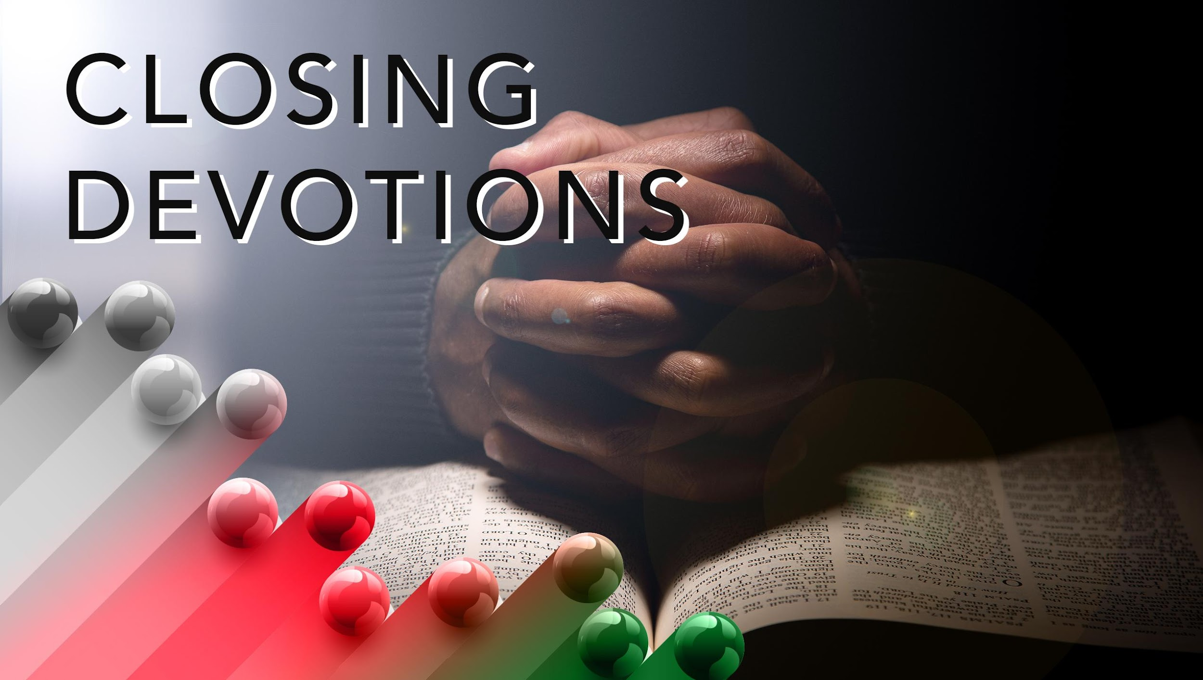

Slide 22
Hymn: “Blest Be the Tie That Binds,” AMECH #522
Prayer: Lord, unite us in your Spirit. Help us recognize and honor the gifts in ourselves and others. May we speak the truth in love, grow in faith, and serve with humility. Strengthen our church, our families, and our communities. In Jesus’ name, Amen.

