Slide 1
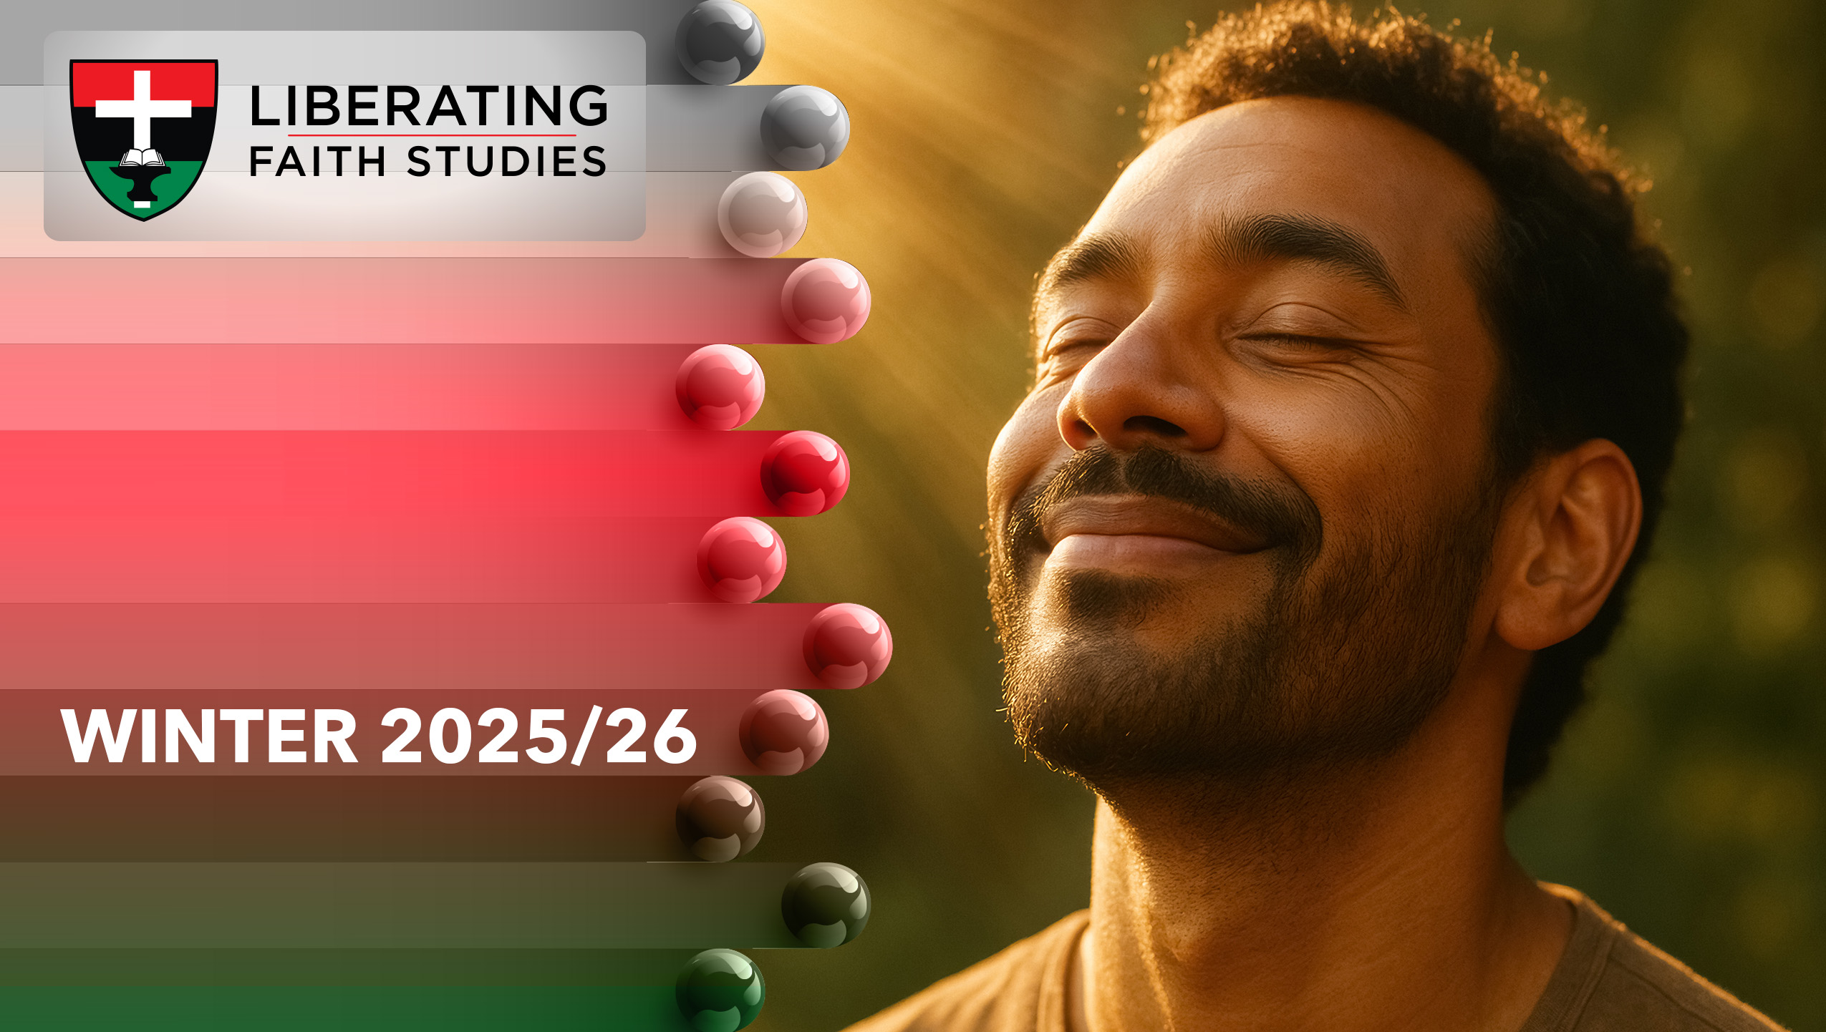
LESSON 8: JANUARY 25

Slide 2
Christian Growth
Focus Scripture: Matthew 4:18-20; 16:16-18; John 21:15-18; 2 Peter 3:14-15, 18
Key Verse: [Jesus] said to him the third time, “Simon son of John, do you love me?” Peter felt hurt because he said to him the third time, “Do you love me?” And he said to him, “Lord, you know everything; you know that I love you.” Jesus said to him, “Feed my sheep.” John 21:17

Slide 3
Matthew 4:18-20; 16:16-18; John 21:15-18; 2 Peter 3:14-15, 18 (NRSV UE)
Matthew 4:18-20
18 As he walked by the Sea of Galilee, he saw two brothers, Simon, who is called Peter, and Andrew his brother, casting a net into the sea—for they were fishers.
19 And he said to them, “Follow me, and I will make you fishers of people.”
20 Immediately they left their nets and followed him.
16:16-18
16 Simon Peter answered, “You are the Messiah, the Son of the living God.”
17 And Jesus answered him, “Blessed are you, Simon son of Jonah! For flesh and blood has not revealed this to you but my Father in heaven.
18 And I tell you, you are Peter, and on this rock I will build my church, and the gates of Hades will not prevail against it.”
John 21:15-18
15 When they had finished breakfast, Jesus said to Simon Peter, “Simon son of

Slide 4
John, do you love me more than these?” He said to him, “Yes, Lord; you know that I love you.” Jesus said to him, “Feed my lambs.”
16 A second time he said to him, “Simon son of John, do you love me?” He said to him, “Yes, Lord; you know that I love you.” Jesus said to him, “Tend my sheep.”
17 He said to him the third time, “Simon son of John, do you love me?” Peter felt hurt because he said to him the third time, “Do you love me?” And he said to him, “Lord, you know everything; you know that I love you.” Jesus said to him, “Feed my sheep.
18 Very truly, I tell you, when you were younger, you used to fasten your own belt and to go wherever you wished. But when you grow old, you will stretch out your hands, and someone else will fasten a belt around you and take you where you do not wish to go.”
2 Peter 3:14-15
14 Therefore, beloved, while you are waiting for these things, strive to be found by him at peace, without spot or blemish,
15 and regard the patience of our Lord as salvation. So also our beloved brother Paul wrote to you according to the wisdom given him,…

Slide 5
18
18 But grow in the grace and knowledge of our Lord and Savior Jesus Christ. To him be the glory both now and to the day of eternity. Amen.

Slide 6
Key Terms
Disciple – A learner or follower, particularly of Jesus Christ.
Perseverance – Steadfastness in doing something despite difficulty or delay in achieving success.
Grace – Unmerited favor or love from God.
Stumble – To falter or fail in a moral or spiritual sense; to make a mistake.
Agape (ah-GAH-pay) – Selfless, unconditional love.
Phileo (FEE-lay-oh) – Brotherly love or affection.
Your title here

Slide 7


Slide 8
Growth in faith is rarely linear. Even the most committed disciples can falter, yet God’s patience and guidance remain steadfast. Peter’s life exemplifies the human tension between ambition and failure, love and doubt, courage and fear. From being a fisherman called to follow Jesus, to declaring Christ as the Messiah, to denying him three times, and later being restored, Peter’s journey offers a model for all Christians.

Slide 9


Slide 10
The four short passages of scripture which make up our lesson focus collectively show the various stages of spiritual growth for the disciple Peter.
A wonderful serenity has taken possession

Slide 11


Slide 12
The Story of John Newton and “Amazing Grace”
John Newton was born in 1725 in England and went to sea at a young age. As a young sailor, he became involved in the Atlantic slave trade, serving on slave ships and even captaining one. He witnessed firsthand the suffering, cruelty, and injustice inflicted upon enslaved Africans. Despite his moral blindness at the time, Newton’s life took a dramatic turn after a violent storm at sea in 1748, during which he cried out to God for mercy. That moment marked the beginning of his spiritual awakening.
A wonderful serenity has taken possession

Slide 13


Slide 14
Grit for Growth and Leadership
Consider the story of John Stephen Akhwari, a Tanzanian marathon runner who, during the 1968 Olympic Games, fell and severely injured his knee but refused to quit. Despite the pain and exhaustion, he got up and finished the race, placing last – but earning global admiration for his perseverance. His grit, determination, and refusal to abandon the journey exemplify how setbacks can be transformed into powerful testimonies of endurance and faith.

Slide 15


Slide 16
Peter’s journey from bold confession to denial, and finally to restoration, offers a model for how Christians can grow through setbacks and still serve faithfully. Just as Jesus reaffirmed Peter’s calling, we too are invited to continue growing in faith, love, and service, even when we falter. In our own lives, this may look like mentoring younger disciples in the church, offering encouragement to those struggling with their faith, or creating spaces where others can learn from both successes and mistakes.

Slide 17


Slide 18
1. In what ways have you experienced God’s patience during personal failures?

Slide 19
2. How does Peter’s story inspire you to continue growing in faith despite setbacks?

Slide 20
3. How can your experience of faith and growth serve others in your family, church, or community?

Slide 21
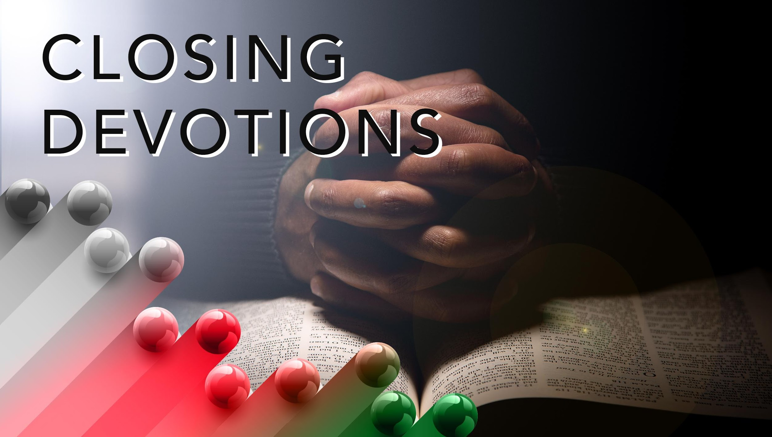

Slide 22
Hymn: “Amazing Grace,” AMECH #226
Prayer: Gracious and loving God, we thank you for the gift of this day and the wisdom you have shared with us. Like Peter, we stumble and fall, yet you lift us up and restore us with your boundless love. Help us to grow in knowledge, love, and service, trusting your patience in our journeys. May our hearts remain open to your guidance, our hands ready to serve others, and our spirits strengthened to persevere in faith. Forgive us for our failings, encourage us in our doubts, and remind us that every step, whether forward or backward, can draw us closer to you. As we leave this place, may we carry your grace into our homes, our communities, and the world. In the name of Jesus Christ, our teacher and redeemer, we pray. Amen.

