Slide 1
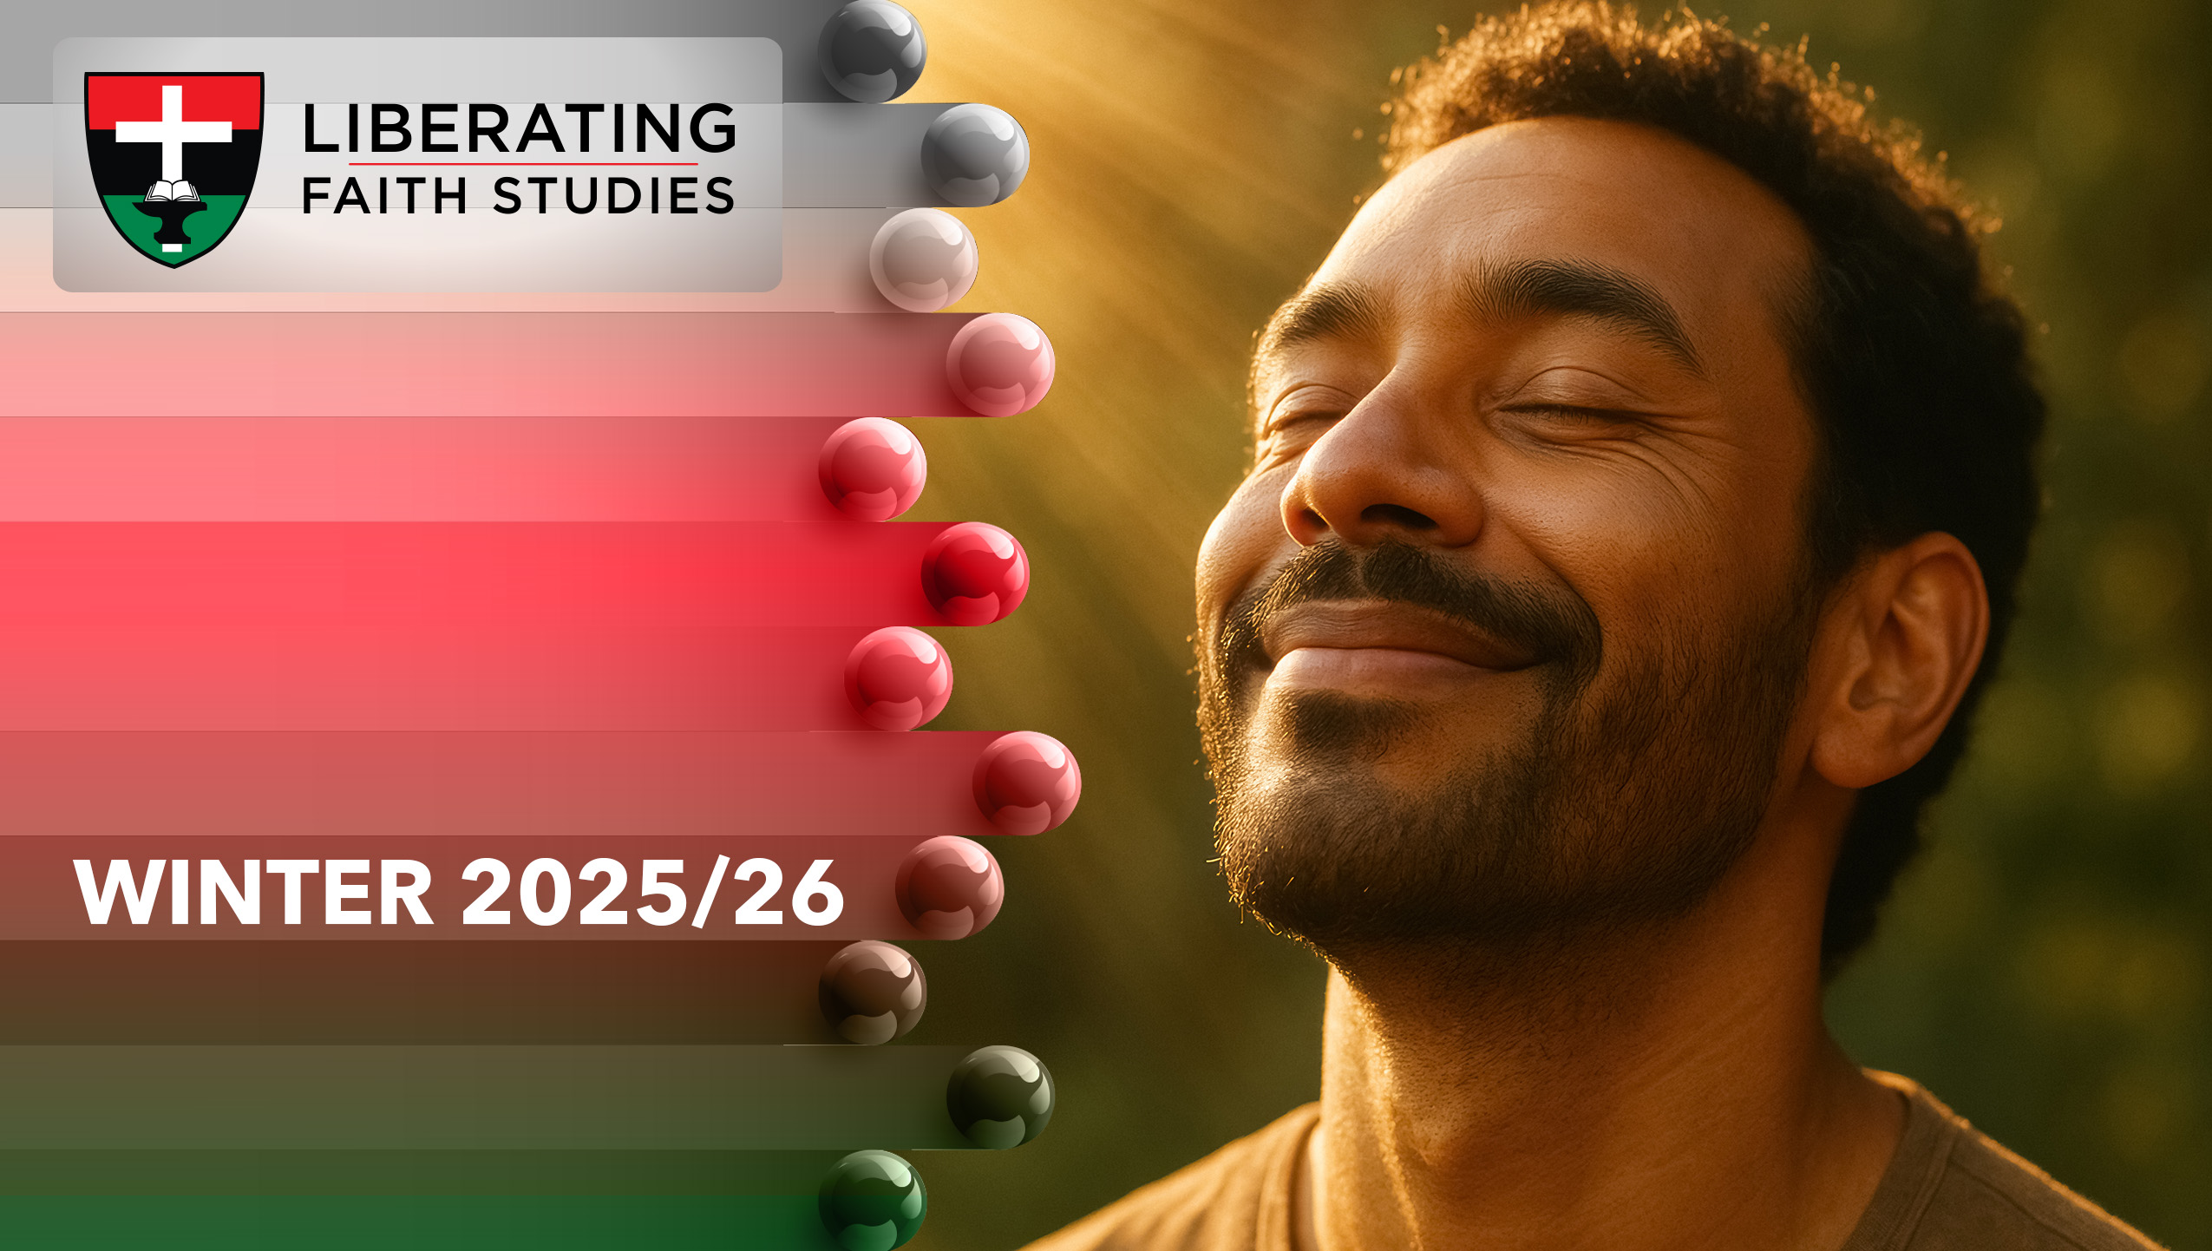
^{LESSON 7: JANUARY 18}

Slide 2
PRAYER
Focus Scripture: Genesis 18:25-27; Luke 18:9-14; 1 John 5:14-15
Key Verse: “I tell you, this man went down to his home justified rather than the other, for all who exalt themselves will be humbled, but all who humble themselves will be exalted.” Luke 18:14 (NRSV UE)

Slide 3
Genesis 18:25-27; Luke 18:9-14; 1 John 5:14-15(NRSVUE)
Genesis 18:25-27
25 “Far be it from you to do such a thing, to slay the righteous with the wicked, so that the righteous fare as the wicked! Far be that from you! Shall not the Judge of all the earth do what is just?”
26 And the Lord said, “If I find at Sodom fifty righteous in the city, I will forgive the whole place for their sake.”
27 Abraham answered, “Let me take it upon myself to speak to my lord, I who am but dust and ashes.”
Luke 18:9-14
9 He also told this parable to some who trusted in themselves that they were righteous and regarded others with contempt:
10 “Two men went up to the temple to pray, one a Pharisee and the other a tax collector.

Slide 4
11 The Pharisee, standing by himself, was praying thus, ‘God, I thank you that I am not like other people: thieves, rogues, adulterers, or even like this tax collector.
12 I fast twice a week; I give a tenth of all my income.’
13 But the tax collector, standing far off, would not even lift up his eyes to heaven but was beating his breast and saying, ‘God, be merciful to me, a sinner!’
14 I tell you, this man went down to his home justified rather than the other, for all who exalt themselves will be humbled, but all who humble themselves will be exalted.”
1 John 5:14-15
14 And this is the boldness we have in him, that if we ask anything according to his will, he hears us.
15 And if we know that he hears us in whatever we ask, we know that we have obtained the requests made of him.

Slide 5
Key Terms
Boldness (Audacity in Prayer) – Acting with confidence in approaching God, asking for God’s intervention.
Humility – Recognizing our dependence on God; approaching prayer with repentance and gratitude.
Self-Righteousness – Prideful assurance in one’s own moral standing compared to others.
Intercession – Praying on behalf of others.
Your title here

Slide 6


Slide 7
Prayer is a dynamic conversation with God. Sometimes we approach God with boldness, like Abraham negotiating for Sodom, or with humility, like the tax collector in Jesus’ parable. This lesson explores how our posture in prayer reflects both our trust in God and our awareness of our human limitations.

Slide 8


Slide 9
Genesis 18:25-27 – Abraham’s Bold Intercession
In the Hebrew Bible (Old Testament) portion of our lesson, found in Genesis, God informs Abraham about the impending destruction of Sodom. Abraham boldly questions God, appealing for the righteous. His words reflect a deep understanding of God’s justice and a willingness to speak on behalf of others. Abraham has this deep knowledge of God because he has a long and close relationship with God. Abraham’s prayer shows that God listens to those who courageously engage in dialogue, even questioning divine action.
A wonderful serenity has taken possession

Slide 10


Slide 11
his weekend, many will celebrate the life and ministry of Rev. Dr. Martin Luther King, Jr. Dr. King exemplified the intersection of boldness and humility in prayer. During the civil rights movement, King often prayed publicly and privately for justice, reconciliation, and protection for those risking their lives. In his “Letter from Birmingham Jail,” King’s writing mirrors Abraham’s approach, boldly calling out injustice while appealing to God’s righteousness.
A wonderful serenity has taken possession

Slide 12


Slide 13
The Scientific Benefits of Prayer
Prayer is not only a spiritual practice but also a subject of increasing scientific interest. Studies in psychology, neuroscience, and medicine have explored how consistent prayer can impact physical, emotional, and social well-being. For example, research shows that prayer can reduce stress, lower blood pressure, improve heart health, and even enhance immune function. A study published in Psychosomatic Medicine found that individuals who engaged in regular prayer reported greater emotional resilience, reduced anxiety, and higher overall life satisfaction.

Slide 14


Slide 15
The scriptures invite us to bring both boldness and humility into our daily lives through prayer and action. We can approach God confidently like Abraham, advocating for justice and interceding for others, while also recognizing our limitations and approaching God humbly like the tax collector.

Slide 16


Slide 17
1. When have you experienced both bold and humble approaches in prayer? Which was more effective?

Slide 18
2. How does comparing ourselves to others distort our relationship with God?

Slide 19
3. How can your prayer life contribute to justice in your community?

Slide 20
4. What can we learn from King and Abraham about advocating for the vulnerable?

Slide 21
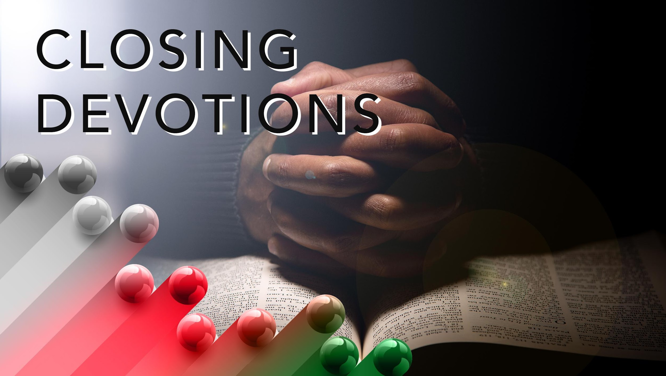

Slide 22
Hymn: “Precious Lord, Take My Hand,” AMECH #393
Prayer: God of justice and mercy, we thank you for guiding us in prayer today. Help us to approach you with boldness and humility, trusting your care for all people. May our prayers strengthen our hearts, shape our actions, and inspire us to serve others with love and courage. Keep us faithful, O Lord, as we seek to live your Word each day. Amen.

