Slide 1
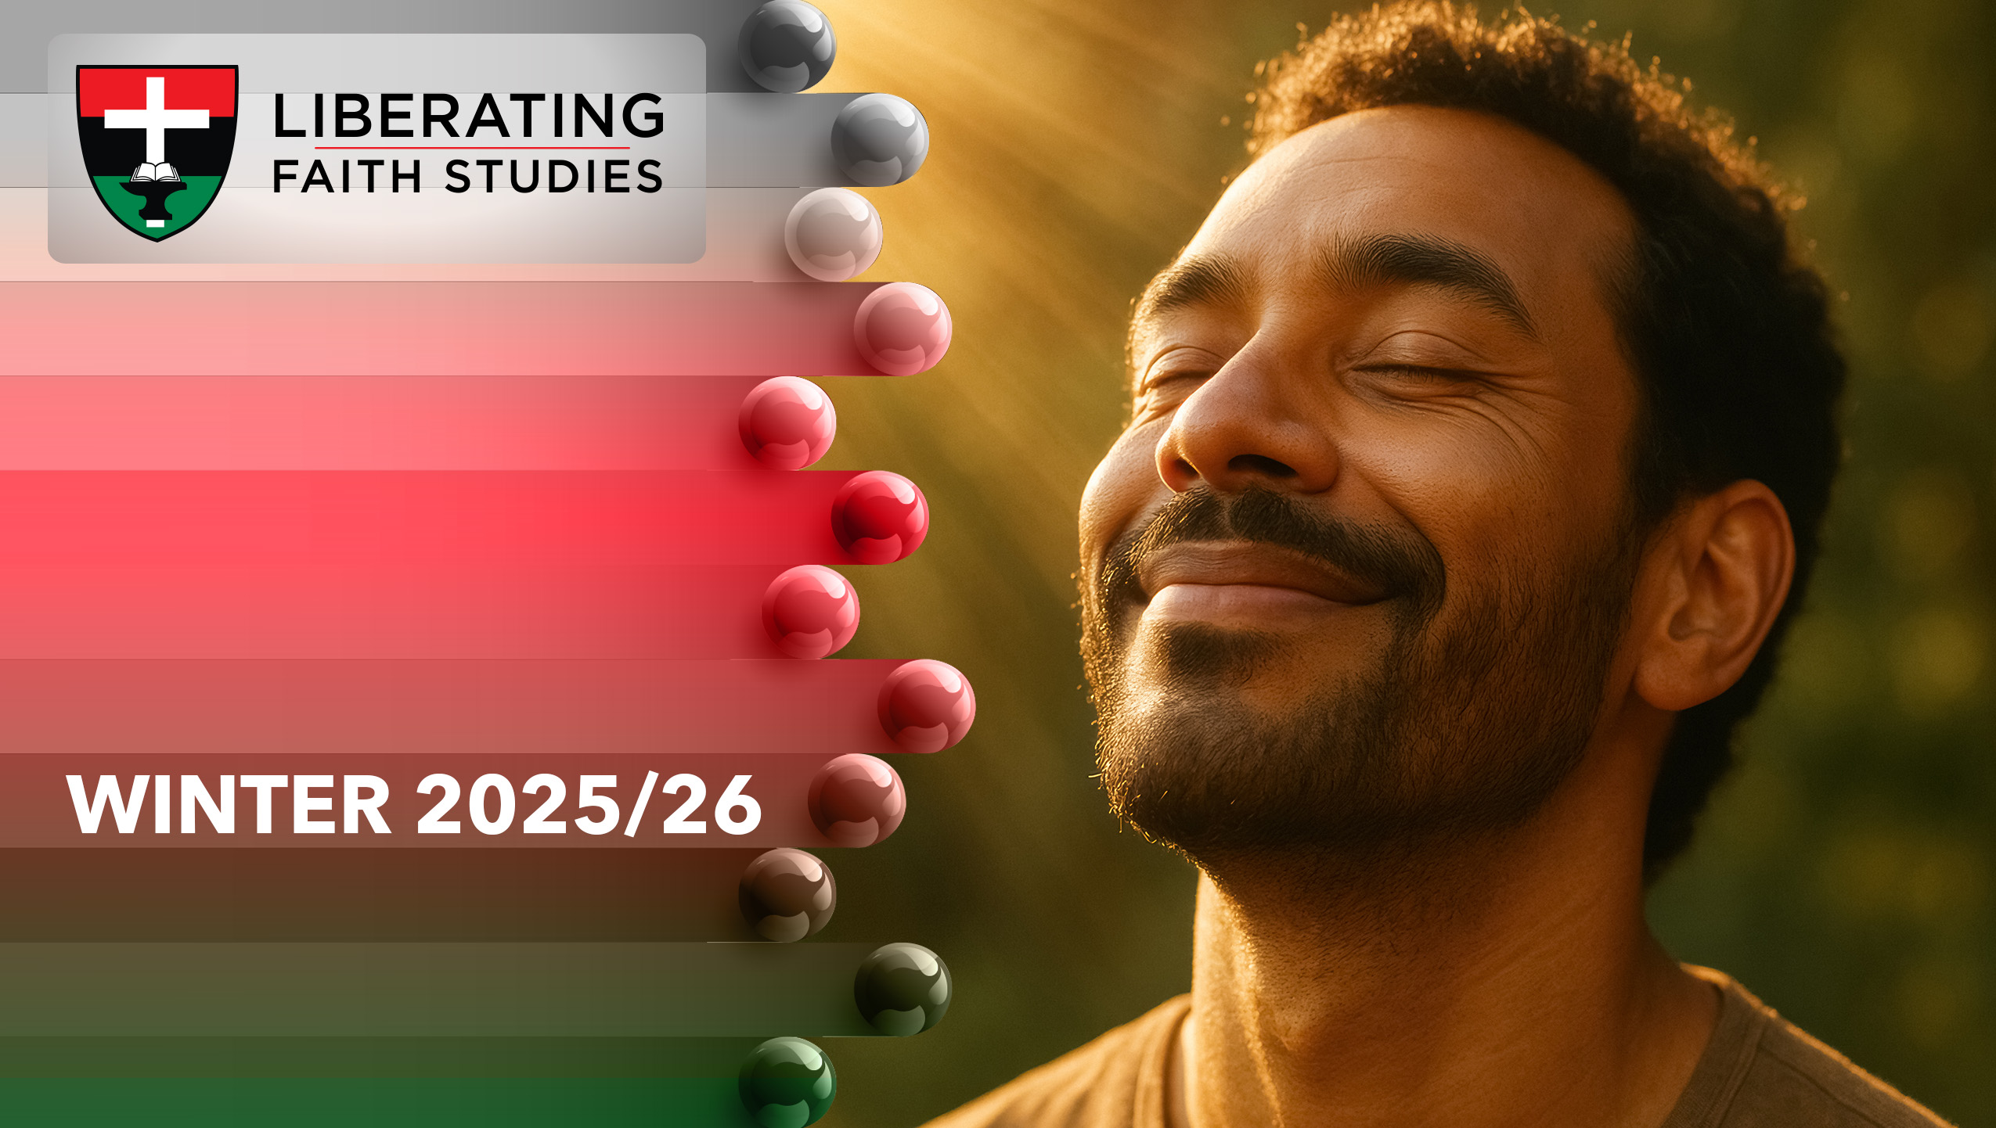
^{LESSON 5: JANUARY 4}

Slide 2
SIN
Focus Scripture: 1 John 1:5-2:6
Key Verse: If we say that we have no sin, we deceive ourselves, and the truth is not in us. If we confess our sins, he who is faithful and just will forgive us our sins and cleanse us from all unrighteousness. 1 John 1:8-9 (NRSV UE)

Slide 3
John 1:5–2:6(NRSV UE)
Jeremiah1:6-10
5 This is the message we have heard from him and proclaim to you, that God is light and in him there is no darkness at all.
6 If we say that we have fellowship with him while we are walking in darkness, we lie and do not do what is true;
7 but if we walk in the light as he himself is in the light, we have fellowship with one another, and the blood of Jesus his Son cleanses us from all sin.
8 If we say that we have no sin, we deceive ourselves, and the truth is not in us.
9 If we confess our sins, he who is faithful and just will forgive us our sins and cleanse us from all unrighteousness.
10 If we say that we have not sinned, we make him a liar, and his word is not in us.
2:1 My little children, I am writing these things to you so that you may not sin. But if anyone does sin, we have an advocate with the Father, Jesus Christ the righteous,

Slide 4
2 and he is the atoning sacrifice for our sins, and not for ours only but also for the sins of the whole world.
3 Now by this we know that we have come to know him, if we obey his commandments.
4 Whoever says, “I have come to know him,” but does not obey his commandments is a liar, and in such a person the truth does not exist;
5 but whoever obeys his word, truly in this person the love of God has reached perfection. By this we know that we are in him:
6 whoever says, “I abide in him,” ought to walk in the same way as he walked.

Slide 5
Key Terms
Sin (hamartia) – Missing the mark; failing to live as God intended.
Atonement – Restoration of broken relationships between God and humanity; “at-one-ment.”
Advocate (parakletos) – One who comes alongside to intercede; Jesus as our advocate with the Father.
Confession (homologeo) – Saying the same thing about sin as God does; acknowledgment and repentance.
Walking in the Light – Living ethically and faithfully, reflecting God’s presence.
Your title here

Slide 6


Slide 7
Sin has been part of the human story since the Garden of Eden. Adam and Eve’s disobedience (Genesis 3) introduced a rupture in God’s creation. Sin impacts not only individual actions but also communities and societies, producing injustice and oppression.

Slide 8


Slide 9
The epistle of 1 John was written to early Christian communities to strengthen their faith and provide guidance on living as followers of Christ. John emphasizes the reality of God as light, the importance of love, and the necessity of remaining faithful in the face of false teachings. He reminds believers that true fellowship with God is reflected in ethical living, honest confession, and reliance on Jesus Christ as the advocate. This context frames our passage, highlighting how the community is called to recognize sin, embrace forgiveness, and walk in the light.
A wonderful serenity has taken possession

Slide 10


Slide 11
In African and African American history, the church has often served as a sanctuary and a center of advocacy, embodying the biblical principle of walking in the light while opposing darkness. During the early 20th century, many African American churches acted as safe havens for those facing racial violence, economic exploitation, and social marginalization. For example, the Mother Bethel AME Church in Philadelphia not only provided spiritual guidance but also functioned as a community hub where leaders organized relief for the poor, defended the vulnerable in legal matters, and campaigned for civil rights.
A wonderful serenity has taken possession

Slide 12


Slide 13
In contemporary times, the church continues to serve as both a sanctuary and an advocate for those facing injustice. Consider the example of the Mother Emanuel African Methodist Episcopal Church in Charleston, South Carolina. Following the tragic shooting in 2015, the church became a center for community healing, advocacy, and action against racial violence. Leaders of the church, along with congregants and community leaders, organized vigils, engaged in dialogues with local authorities, and provided counseling and practical support for families affected by the tragedy.

Slide 14


Slide 15
Knowing God through the Gospel helps us see the difference between light and darkness. Acknowledging our sins, confessing them honestly, and relying on Jesus’ intercession draws us closer to God and to one another.

Slide 16


Slide 17
1. How does your understanding of Jesus as advocate affect your daily decisions?

Slide 18
2. What personal or societal “sins” call for your advocacy or intervention?

Slide 19
3. How can confessing our sins publicly or privately strengthen our communities?

Slide 20
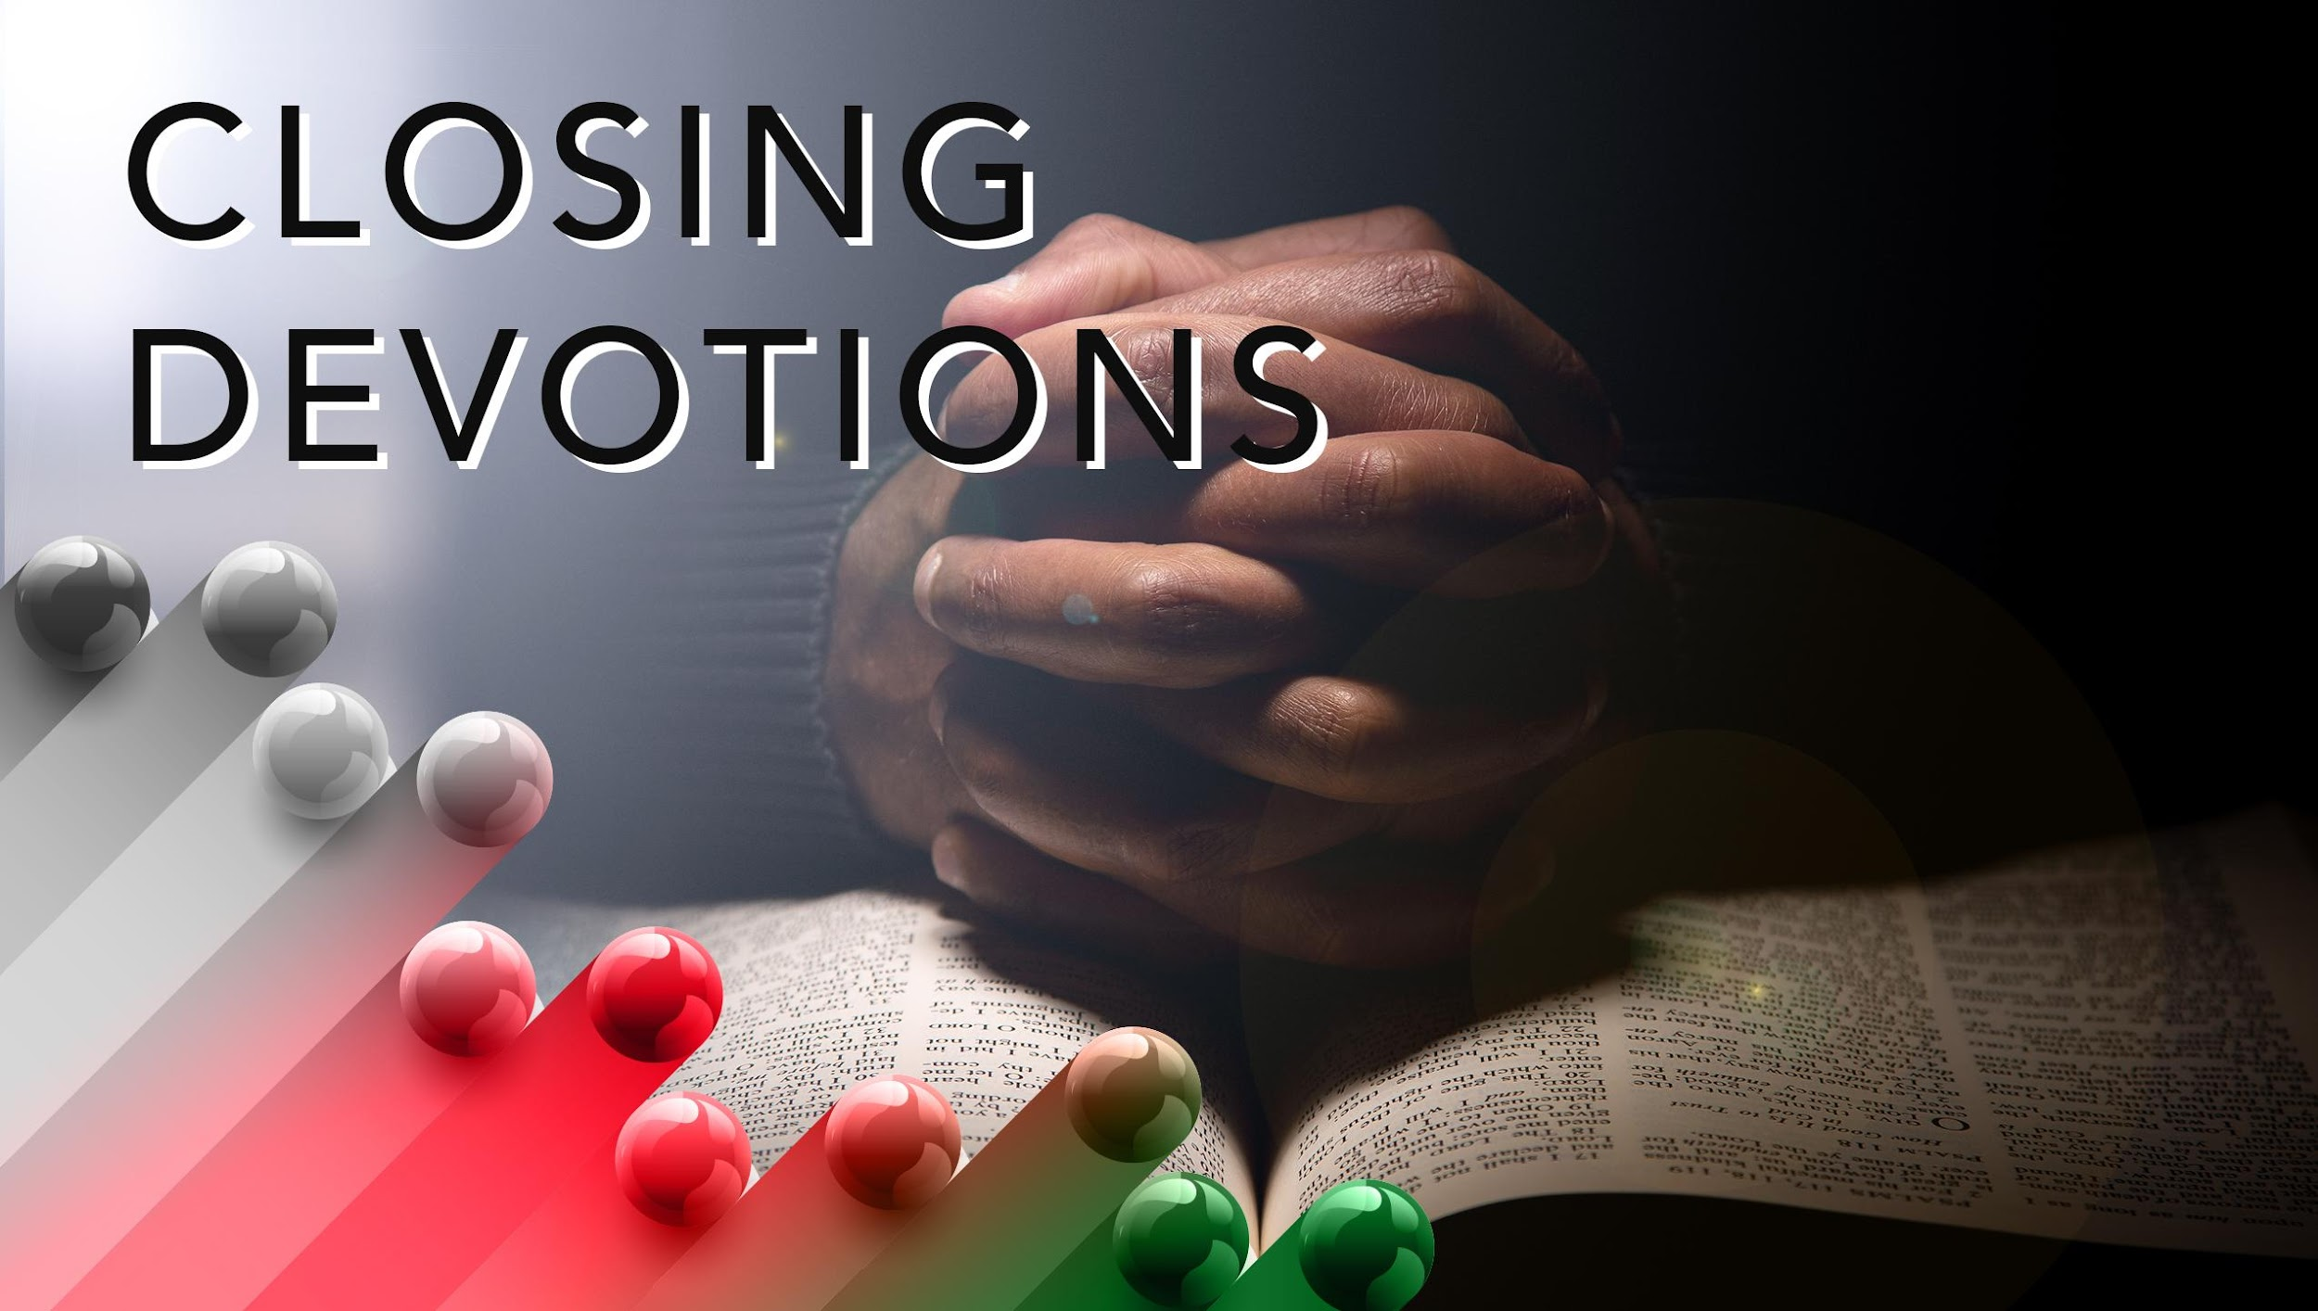

Slide 21
Hymn: “I Need Thee Every Hour,” AMECH #327
Prayer: Lord Jesus, our advocate and light, forgive us when we stumble and purify our hearts. Teach us to walk in the light, love our neighbors as ourselves, and intercede for those in need. Help us embody your justice and mercy in every aspect of our lives. Amen.

