Slide 1
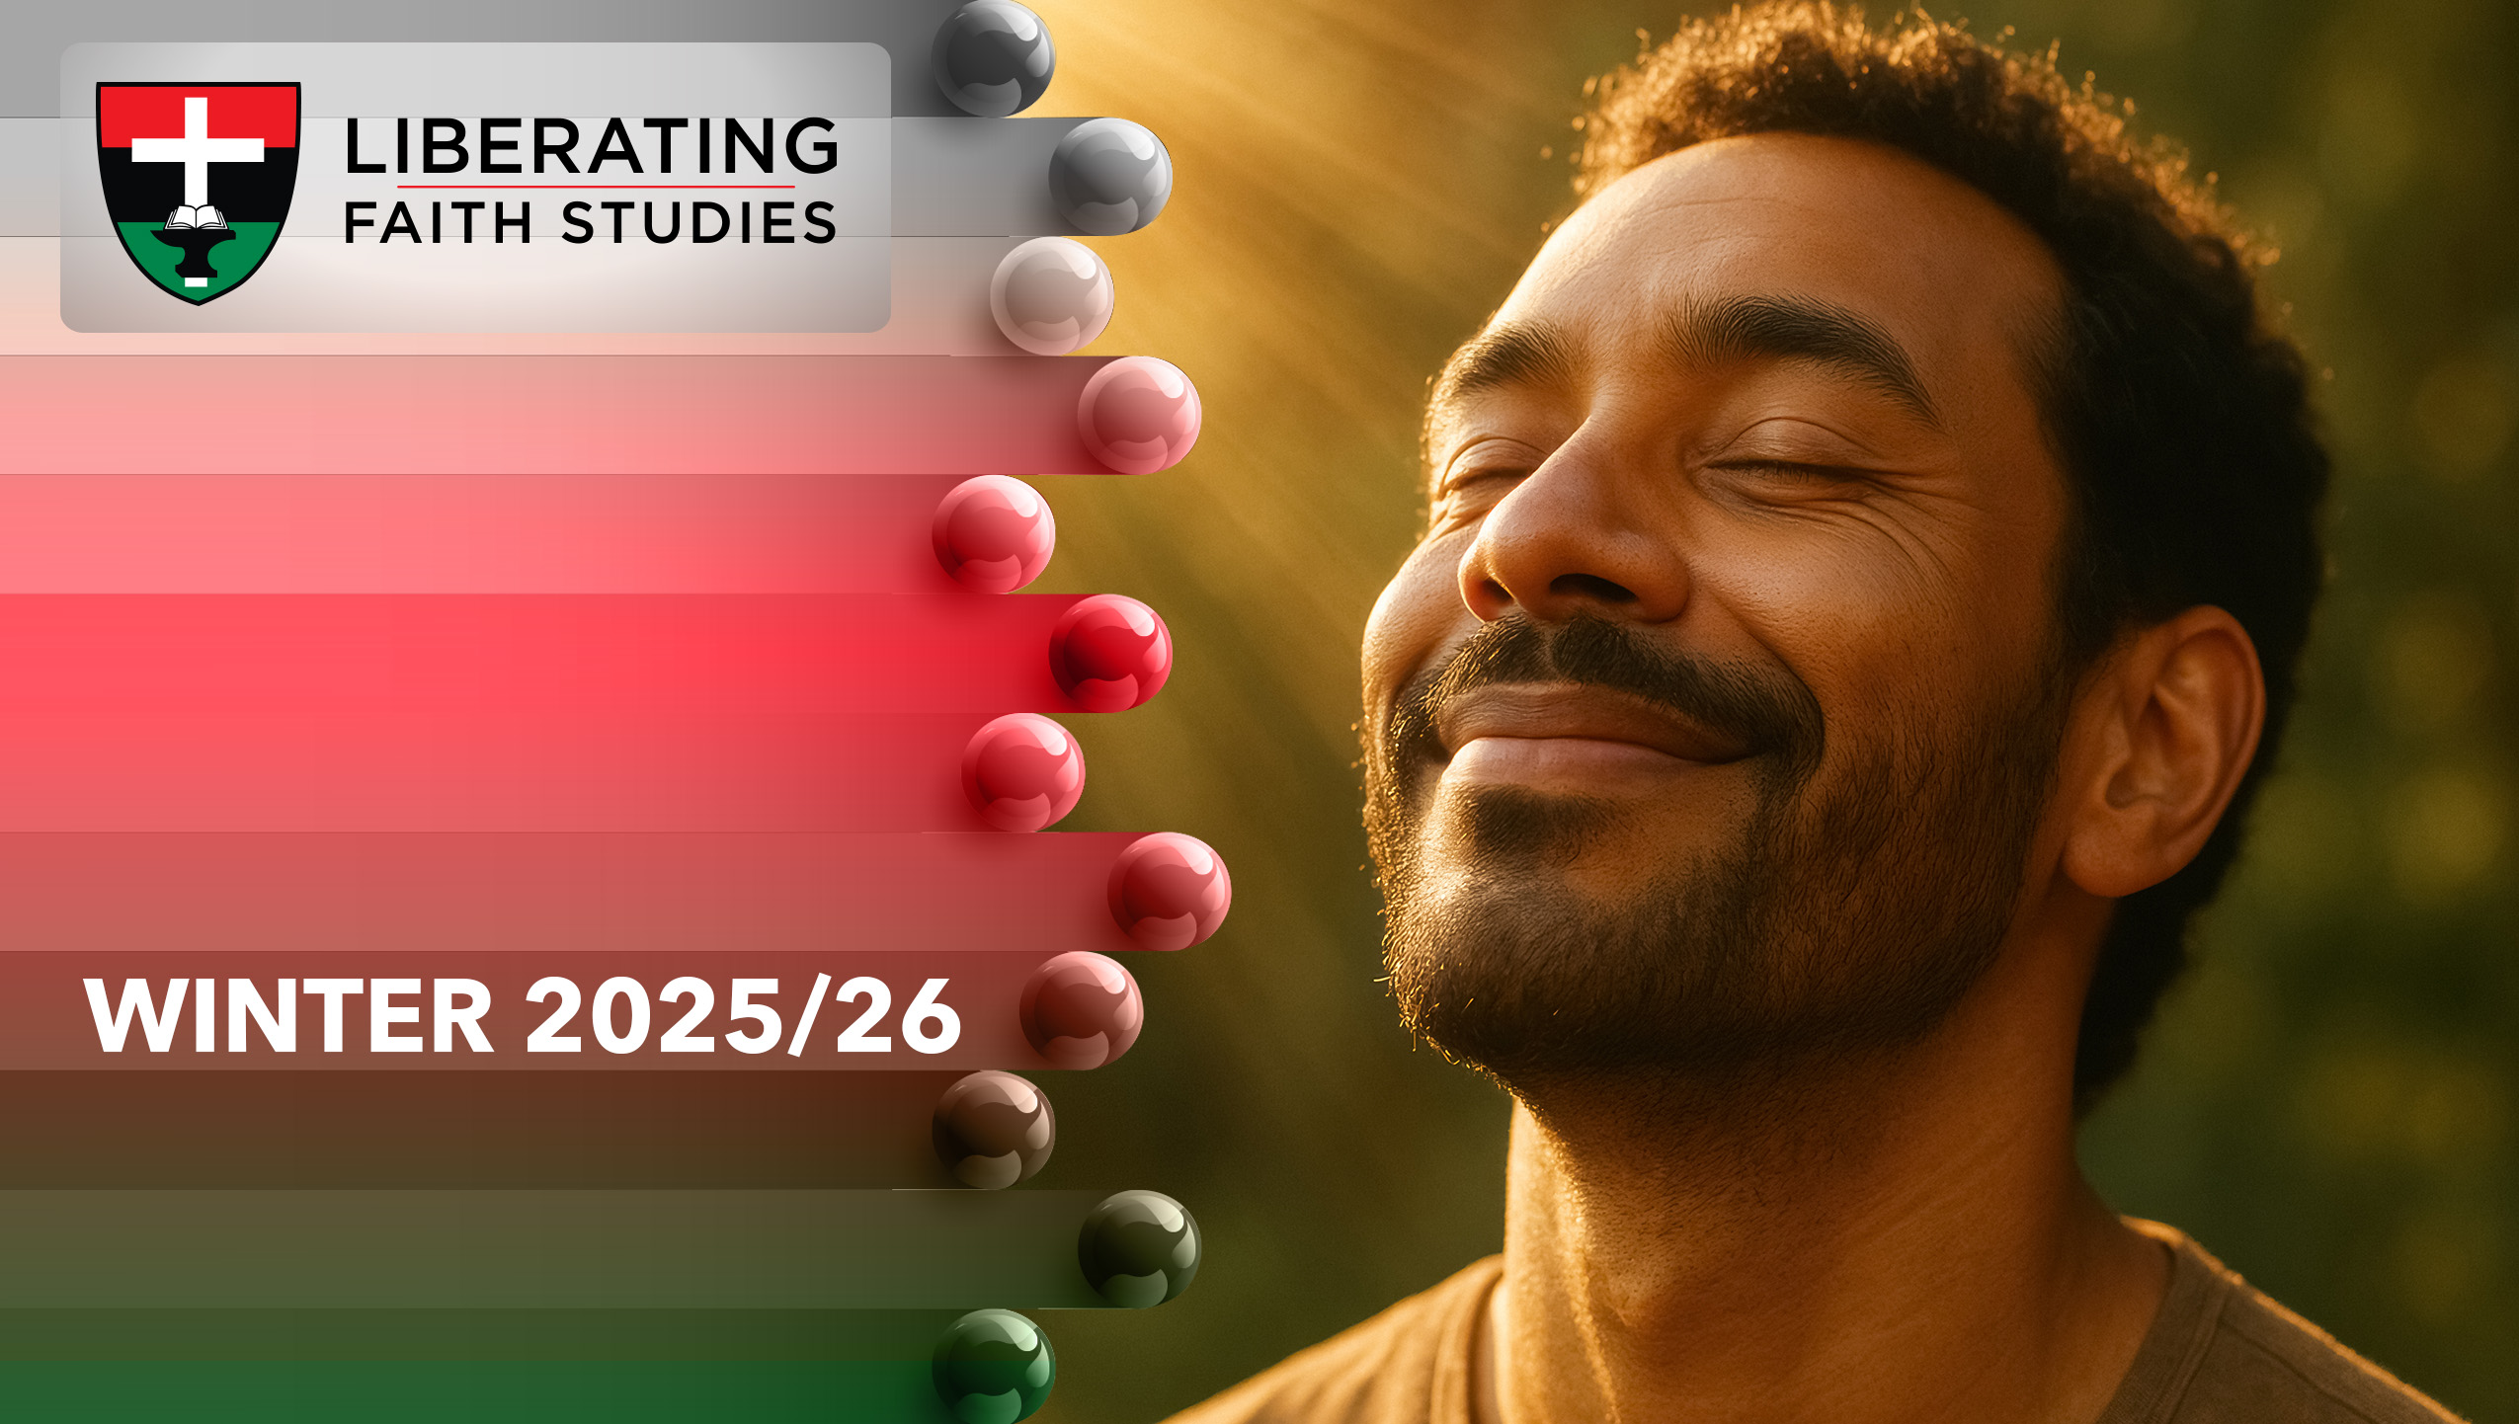
^{LESSON 4: DECEMBER 28}

Slide 2
The Holy Spirit
Focus Scripture: Romans 8:12-17, 26-27
KeyVerse: It is that very Spirit bearing witness with our spirit that we are children of God. Romans 8:16

Slide 3
Romans 8:12-17, 26-27(NRSV UE)
Romans 8:12-17
12 So then, brothers and sisters, we are obligated, not to the flesh, to live according to the flesh—
13 for if you live according to the flesh, you will die, but if by the Spirit you put to death the deeds of the body, you will live.
14 For all who are led by the Spirit of God are children of God.
15 For you did not receive a spirit of slavery to fall back into fear, but you received a spirit of adoption. When we cry, “Abba! Father!”
16 it is that very Spirit bearing witness with our spirit that we are children of God,
17 and if children, then heirs: heirs of God and joint heirs with Christ, if we in fact suffer with him so that we may also be glorified with him.
26-27
26 Likewise the Spirit helps us in our weakness, for we do not know how to pray as we ought, but that very Spirit intercedes with groanings too deep for words.

Slide 4
27 And God, who searches hearts, knows what is the mind of the Spirit, because the Spirit intercedes for the saints according to the will of God.

Slide 5
Key Terms
Spirit (Pneuma, πνεῦμα) – Breath, wind, or life-force; the empowering presence of God in believers.
Advocate/Paraclete (Paraklētos, παρακλητός) – One who comes alongside to help, comfort, or intercede; the Holy Spirit’s role in guiding and defending the believer.
Adoption – Legal and relational term for being made God’s child, heir to his promises.
Intercession – The act of praying or mediating on behalf of another; the Spirit helps express our deepest prayers.
Your title here

Slide 6


Slide 7
Have you ever felt torn between what you know is right and what fear tells you to do? Romans 8:12-17 and 26-27 describe a Spirit-led life where believers are not slaves to fear or sin but are adopted as God’s children. For enslaved Africans and their descendants, this promise of adoption was both radical and liberating: they were made children of the most high God, heirs to divine promises, despite being treated as property.

Slide 8


Slide 9
Romans 8:12-17 (Flesh vs. Spirit)
Paul contrasts life dominated by the flesh (sarx) with life led by the Spirit (pneuma). The flesh represents self-centered desires and habits that lead to spiritual death, while the Spirit produces life, peace, and alignment with God’s purposes. Verse 13 emphasizes this choice: “For if you live according to the flesh, you will die, but if by the Spirit you put to death the deeds of the body, you will live.”
A wonderful serenity has taken possession

Slide 10


Slide 11
The Watch Night Service has its roots in the historic gatherings of enslaved African Americans on the night of December 31, 1862, anticipating the enforcement of the Emancipation Proclamation on January 1, 1863. These services were a time of prayer, reflection, and praise, as people sought spiritual guidance and celebrated the hope of freedom (Floyd-Thomas, 2018).
A wonderful serenity has taken possession

Slide 12


Slide 13
At the time, much attention was given to the hashtag and the movement, Black Lives Matter; and rightly so. Some noted that church leaders were not the leaders of this movement. In Ferguson, Missouri, following the 2014 death of Michael Brown, local African American churches partnered with faith-based coalitions to advocate for justice and community healing.

Slide 14


Slide 15
Understanding who we are in God begins with reflection and honesty. By considering our identity as God’s children, we can recognize the ways fear, self-doubt, or ingrained habits of the flesh might be limiting our spiritual inheritance, and begin to open ourselves to the Spirit’s guidance. Trusting in God’s love allows us to experience the Spirit as a confirming presence, reminding us daily that we are adopted, beloved, and empowered to act with faith.

Slide 16


Slide 17
1. How does knowing the Spirit intercedes for you change the way you pray?

Slide 18
2. What fears might be hindering your spiritual growth, and how can you rely on the Spirit to overcome them?

Slide 19
3. The Spirit assures believers of adoption into God’s family. How does this affect your sense of purpose and belonging?

Slide 20
4. Share a story where you felt Spirit-led in a decision or action that brought peace or life to yourself or others.

Slide 21
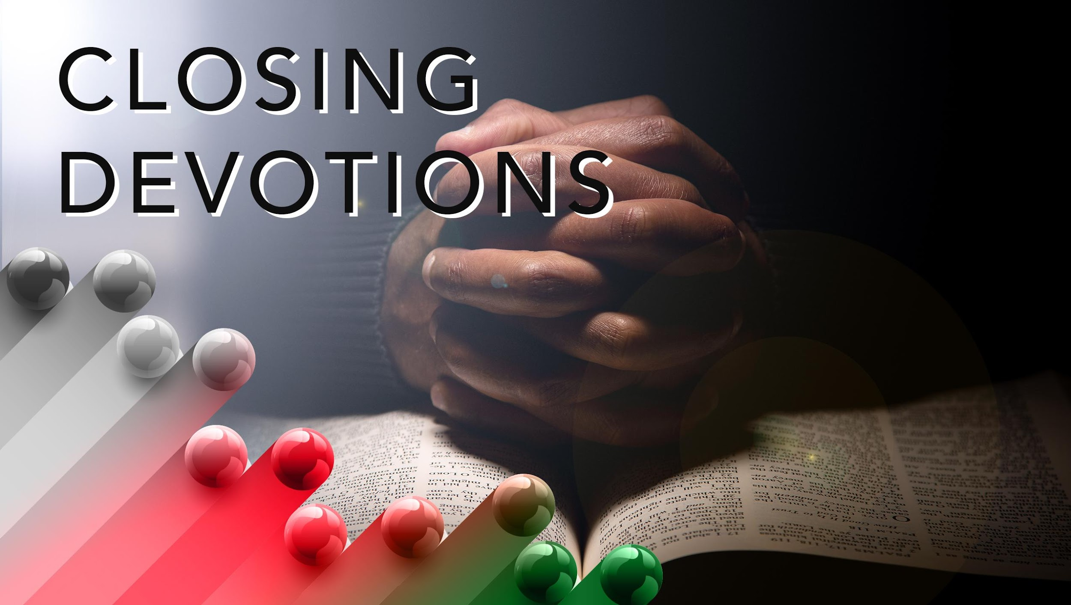

Slide 22
Hymn: “Spirit of the Living God,” AMECH #619
Prayer: Gracious God, we thank you for the gift of your Spirit, who affirms our identity as your children and intercedes for us in every moment of need. Strengthen our hearts to trust your guidance, grant us courage to act with love and justice, and help us reflect your presence in our communities. May we live boldly in faith, confident in your promises, and always attentive to the Spirit’s leading. In Jesus’ name. Amen.

