Slide 1
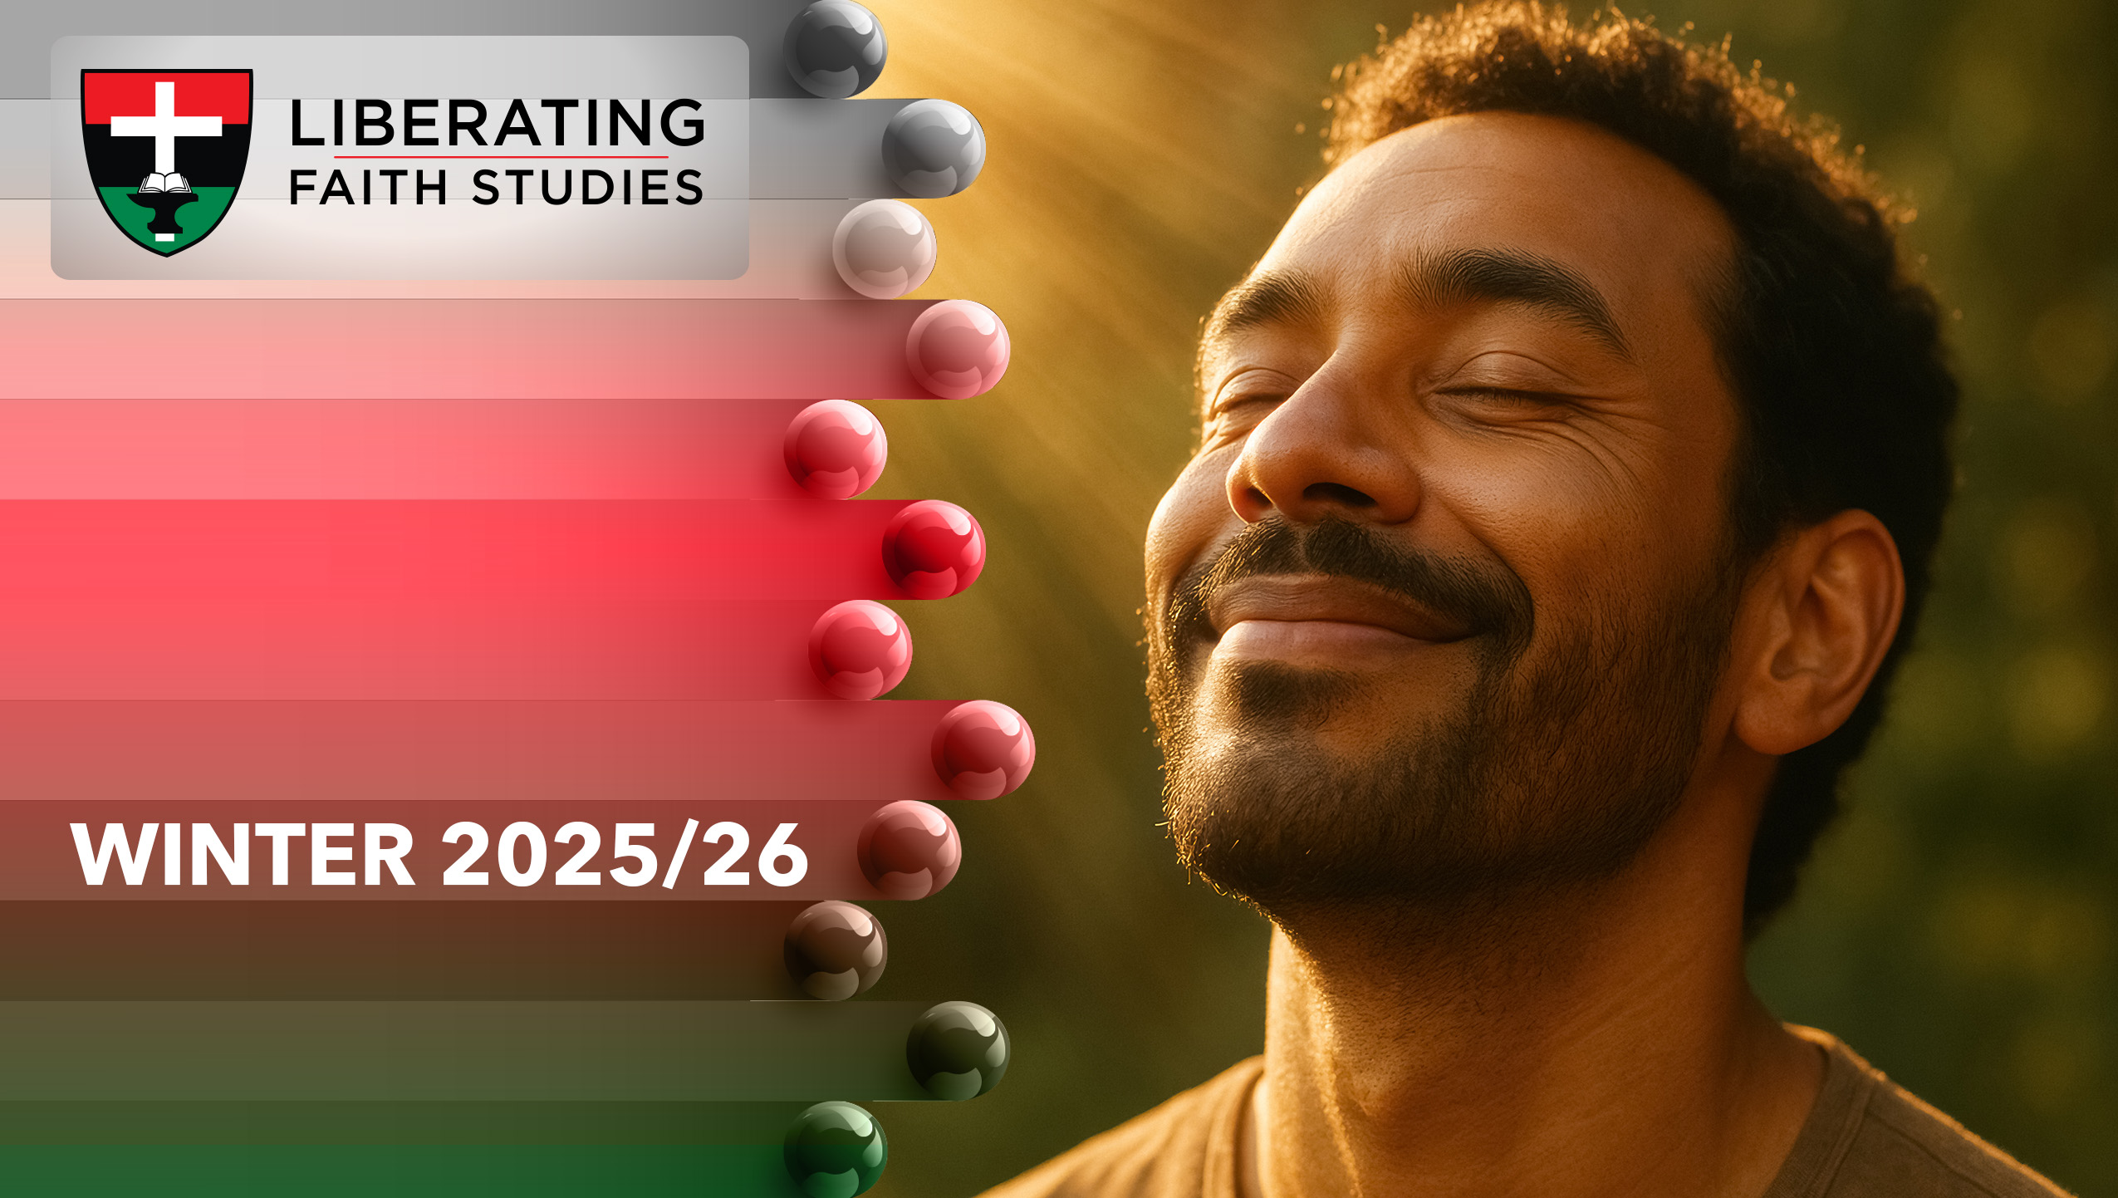
^{LESSON 3: DECEMBER 21}

Slide 2
Christ the Savior
Focus Scripture: Luke 15:3-7; Romans 5:6-10
Key Verse: If while we were enemies we were reconciled to God through the death of his Son, much more surely, having been reconciled, will we be saved by his life. Romans 5:10

Slide 3
Luke 15:3-7; Romans 5:6-10 (NRSV UE)
Luke15:3-7
3 So he told them this parable:
4 “Which one of you, having a hundred sheep and losing one of them, does not leave the ninety-nine in the wilderness and go after the one that is lost until he finds it?
5 And when he has found it, he lays it on his shoulders and rejoices.
6 And when he comes home, he calls together his friends and neighbors, saying to them, ‘Rejoice with me, for I have found my lost sheep.’
7 Just so, I tell you, there will be more joy in heaven over one sinner who repents than over ninety-nine righteous persons who need no repentance.”
Romans 5:6-10
6 For while we were still weak, at the right time Christ died for the ungodly.
7 Indeed, rarely will anyone die for a righteous person—though perhaps for a good person someone might actually dare to die.
8 But God proves his love for us in that while we still were sinners Christ died for us.

Slide 4
9 Much more surely, therefore, since we have now been justified by his blood, will we be saved through him from the wrath of God.
10 For if while we were enemies we were reconciled to God through the death of his Son, much more surely, having been reconciled, will we be saved by his life.

Slide 5
Key Terms
Paradox (PAH-ruh-doks) – A statement that appears contradictory but reveals a deeper truth.
Reconciliation (ree-KON-sil-ee-AY-shun) – Restoration of relationship between God and humanity.
Sacrificial Lamb (sak-RIH-fih-shuhl lam) – Image of Jesus’ atoning death for humanity’s sins.
Shepherd (SHEP-erd) – One who guides, protects, and seeks the lost (primarily sheep).
Justification (juhs-tih-fih-KAY-shun) – Being made right with God through faith.
Salvation (sal-VAY-shun) – Deliverance from sin and its
Your title here

Slide 6
consequences through Jesus Christ.
Incarnation (in-kar-NAY-shun) – God becoming human in the person of Jesus Christ, fully divine and fully human, to accomplish salvation for humanity.

Slide 7


Slide 8
Imagine wandering through a crowded city at night, feeling invisible, unseen, and unknown. You search for a friend, a familiar face, a sign that someone cares. Many people today experience this feeling of being lost – not merely geographically, but emotionally, socially, and spiritually.

Slide 9


Slide 10
Luke 15:3-7 – The Lost Sheep
Verse 3: Jesus’ teaching arises from criticism that he associates with “sinners.” Here, the stage is set for radical inclusion; it is a moment when societal norms of exclusion meet God’s expansive grace.
A wonderful serenity has taken possession

Slide 11


Slide 12
Fannie Lou Hamer, a civil rights activist and leader in the Mississippi Freedom Democratic Party, tirelessly advocated for disenfranchised black citizens, facing arrests and violence, yet never gave up on those “lost” in fear and oppression. Her work reflects the parable of the lost sheep: she sought out those marginalized, empowered them, and celebrated every victory toward justice.
A wonderful serenity has taken possession

Slide 13


Slide 14
In Cape Town, South Africa, community leaders have developed programs to reconcile youth involved in rival gangs. Leaders like Father Joseph Daniels have initiated dialogue circles, mentorship programs, and cultural activities to bridge divides, restore trust, and provide alternative pathways (Burke, 2020). These efforts reflect Luke 15: the pursuit of the lost, celebrating restoration rather than condemning failure.

Slide 15


Slide 16
hrist, as both shepherd and sacrificial lamb, comes seeking the lost, calling us into relationship even when we feel unworthy or far from God. Reflect on moments in your own life when God pursued you – times of doubt, fear, or isolation. Perhaps it was a comforting word from a friend, a timely prayer, or a sudden sense of peace amid chaos. Recognizing these moments helps us see that God’s love is relentless and personal, inviting us into reconciliation not only with him but also with ourselves and others.

Slide 17


Slide 18
1. How have you experienced God’s pursuit in your own life, times when you felt “lost” emotionally, spiritually, or socially, and how did that experience transform your understanding of God’s love?

Slide 19
2. Seeing Christ as both shepherd and sacrificial lamb, how does this dual role challenge or inspire you in the ways you pursue reconciliation in your relationships, community, or church?

Slide 20
3. Reflecting on the examples of Fannie Lou Hamer, Father Joseph Daniels, and the AME Church’s outreach, what practical steps can you take to embody God’s extravagant love for those who feel marginalized or forgotten?

Slide 21


Slide 22
Hymn: “Savior, Like a Shepherd Lead Us,” AMECH #379
Prayer: Gracious and Loving God, we thank you for pursuing us even when we feel lost, unseen, or far from your heart. Thank you for sending Christ, our shepherd and sacrificial lamb, who guides, protects, and rescues us while offering himself for our salvation. Help us to recognize your extravagant love in our daily lives and to mirror that love in our relationships, our communities, and the world around us. Teach us to seek reconciliation where there is division, to bring hope where there is despair, and to celebrate the return of the lost, just as you rejoice over each one restored. May our hearts be filled with courage, our hands with service, and our lives with the joy of being both loved and called to love in your name. In Jesus’ name, we pray. Amen.

