Slide 1
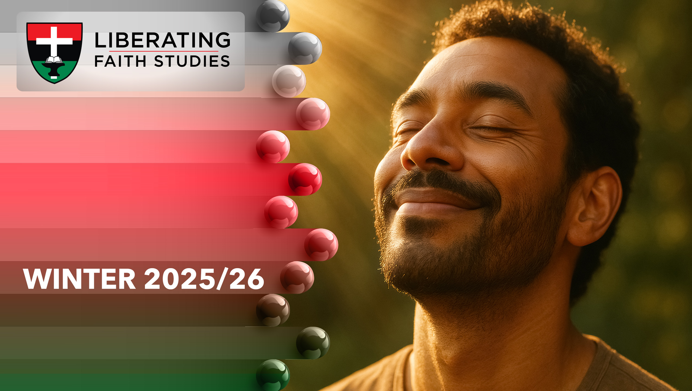
^{LESSON 12: FEBRUARY 22}

Slide 2
Stewardship and Mission
Focus Scripture: Acts 1:6-8; 2 Corinthians 8:3-9
Key Verse: You know the generous act of our Lord Jesus Christ, that though he was rich, yet for your sakes he became poor, so that by his poverty you might become rich. 2 Corinthians 8:9
(NRSV UE)

Slide 3
Acts 1:6-8; 2 Corinthians 8:3-9(NRSV UE
Acts 1:6-8
6 So when they had come together, they asked him, “Lord, is this the time when you will restore the kingdom to Israel?”
7 He replied, “It is not for you to know the times or periods that the Father has set by his own authority.
8 But you will receive power when the Holy Spirit has come upon you, and you will be my witnesses in Jerusalem, in all Judea and Samaria, and to the ends of the earth.”
2 Corinthians 8:3-9
3 For, as I can testify, they voluntarily gave according to their means and even beyond their means,
4 begging us earnestly for the favor of partnering in this ministry to the saints,
5 and not as we expected. Instead, they gave themselves first to the Lord and, by the will of God, to us,
6 so that we might urge Titus that, as he had already made a beginning, so he should also complete this generous undertaking among you.

Slide 4
7 Now as you excel in everything—in faith, in speech, in knowledge, in utmost eagerness, and in our love for you—so we want you to excel also in this generous undertaking.
8 I do not say this as a command, but I am, by mentioning the eagerness of others, testing the genuineness of your love.
9 For you know the generous act of our Lord Jesus Christ, that though he was rich, yet for your sakes he became poor, so that by his poverty you might become rich.

Slide 5
Key Terms
Stewardship – Responsible management of time, talents, and treasures in service to God.
Mission – God’s redemptive work in the world, especially as entrusted to the church.
Generosity – Willingness to give freely, reflecting God’s own giving nature.
Equity (Isotētos) – Fair balance in giving, ensuring communal needs are met without creating undue burden.
Your title here

Slide 6


Slide 7
Many of us pursue happiness and fulfillment through careers, education, or possessions. Yet the Bible calls us to measure life in eternal terms, not merely earthly gains. In Acts 1:6-8, the disciples ask Jesus if he will restore Israel’s kingdom in political or material ways. Jesus redirects their focus to mission and witness. In 2 Corinthians 8:1-9, Paul reframes giving as spiritual empowerment, showing how generosity serves God’s mission and blesses both giver and receiver.

Slide 8


Slide 9
Acts 1:6-8
Written by Luke, Acts chronicles the early church after Jesus’ resurrection. The disciples expected a political or military messiah who would restore Israel to national prominence. Jerusalem was under Roman occupation, and many Jews longed for liberation from oppressive taxation and foreign rule.
A wonderful serenity has taken possession

Slide 10


Slide 11
The Legacy of the Montgomery Bus Boycott and Faith-Driven Stewardship
In 1955, African American communities in Montgomery, Alabama, mobilized resources, time, and personal safety to sustain the Montgomery Bus Boycott, demonstrating extraordinary stewardship of God-given gifts for the pursuit of justice. Local churches, particularly those led by black clergy such as Dr. Martin Luther King, Jr., coordinated financial collections, provided transportation, and offered moral support, reflecting 2 Corinthians 8:3-9’s principle of giving beyond one’s means for the sake of a larger mission.
A wonderful serenity has taken possession

Slide 12


Slide 13
AME-SADA
The African Methodist Episcopal Church Service and Development Agency (AME-SADA) is a non-profit organization dedicated to improving the quality of life in Africa and the Caribbean. AME-SADA grew out of the collective efforts of five unique and pioneering individuals:

Slide 14


Slide 15
The principles of stewardship and mission call each of us to evaluate how we use our time, talents, and resources in service to God and neighbor. Like the Macedonian churches in 2 Corinthians 8, we are invited to give generously and cheerfully, not out of obligation, but as an expression of our faith and love.

Slide 16


Slide 17
1. God empowered ordinary people in scripture to witness and give sacrificially. How are you being called today?

Slide 18
2. How does your congregation embody Christ-centered mission and stewardship?

Slide 19
3. When have you experienced the paradox of becoming “richer” by giving?

Slide 20
4. What steps can your church take to ensure equity in mission and giving?

Slide 21
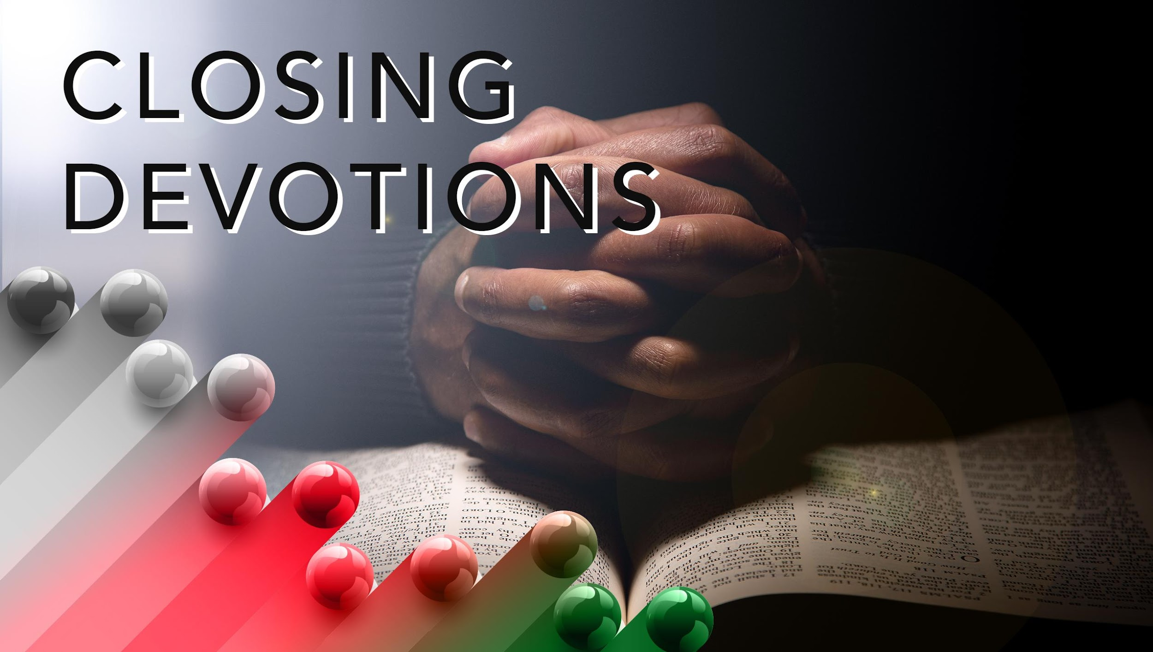

Slide 22
Hymn: “God of Grace and God of Glory,” AMECH #62
Prayer: Loving and Generous God, allow your Spirit to guide our stewardship and mission. May our hearts align with your priorities. In the name of the one who became poor so that we might be rich, Jesus Christ, we pray. Amen.

