Slide 1

^{LESSON 11: FEBRUARY 15}

Slide 2
The Lord’s Day
Focus Scripture: Exodus 20:8-11; Romans 14:4-6; Revelation 1:10
Key Verse: In six days the Lord made heaven and earth, the sea, and all that is in them, but rested the seventh day; therefore the Lord blessed the Sabbath day and consecrated it. Exodus 20:11 (NRSV UE)

Slide 3
Exodus 20:8-11; Romans 14:4-6; Revelation 1:10 (NRSV UE)
Exodus 20:8-11
8 “Remember the Sabbath day and keep it holy.
9 Six days you shall labor and do all your work.
10 But the seventh day is a Sabbath to the Lord your God; you shall not do any work—you, your son or your daughter, your male or female slave, your livestock, or the alien resident in your towns.
11 For in six days the Lord made heaven and earth, the sea, and all that is in them, but rested the seventh day; therefore the Lord blessed the Sabbath day and consecrated it.”
Romans 14:4-6
4 Who are you to pass judgment on slaves of another? It is before their own lord that they stand or fall. And they will be upheld, for the Lord is able to make them stand.

Slide 4
5 Some judge one day to be better than another, while others judge all days to be alike. Let all be fully convinced in their own minds.
6 Those who observe the day, observe it for the Lord. Also those who eat, eat for the Lord, since they give thanks to God, while those who abstain, abstain for the Lord and give thanks to God.
Revelation 1:10
10 I was in the spirit on the Lord’s day, and I heard behind me a loud voice like a trumpet…

Slide 5
^{Key Terms}
Sabbath (Shabbat) (shah-baht) – A Hebrew term meaning “rest” or “cessation.” In scripture, it refers to the seventh day, set apart for rest and worship.
Lord’s Day (Kyriake hemera) (koo-ree-ah-keh heh-meh-rah) – Greek term meaning “belonging to the Lord,” used in Revelation 1:10 to describe the first day of the week (Sunday), observed by early Christians as the weekly commemoration of Christ’s resurrection.
Creation – God’s act of bringing the universe into being (Genesis 1–2).
Resurrection – The rising of Jesus from the dead, demonstrating
Your title here

Slide 6
God’s victory over sin and death (Matthew 28:1-10; John 20:19).
Rest (Sabbatic rhythm) – A God-ordained pause in work to honor divine creation, reflect, and renew.
Liberation – In the context of Black Liberation Theology, freedom from oppression and participation in God’s ongoing redemptive work.

Slide 7


Slide 8
In today’s fast-paced world, many of us struggle to carve out intentional time for rest, reflection, and worship. Our lesson calls attention to the rhythm God established at creation: work and rest. In Exodus 20:8-11, God commands the Israelites to “remember the Sabbath day and keep it holy,” rooting Sabbath observance not only in freedom from labor but in recognition of God’s creative and liberating acts.

Slide 9


Slide 10
Exodus 20:8-11 – Remember the Sabbath Day
God gave the Israelites the commandment during their journey from slavery to freedom. Sabbath-keeping was both a spiritual practice and social revolution, ensuring that everyone, including servants, foreigners, and animals, received rest. In a world that measures worth by productivity, the Sabbath proclaimed that human value is rooted in creation, not labor.
A wonderful serenity has taken possession

Slide 11


Slide 12
African Origins of Sacred Time and Rest
Many African societies recognized cyclical rhythms of work and rest long before the transatlantic slave trade. Festivals, market days, and spiritual observances provided rest, renewal, and communal cohesion. For example, in the Yoruba tradition, the Orisha festivals marked sacred time, offering collective celebration, storytelling, and worship. Similarly, Akan communities (Ghana) observed weekly ritual days tied to gods and ancestors, ensuring community members had time for spiritual connection.
A wonderful serenity has taken possession

Slide 13


Slide 14
Tricia Hersey – The Nap Ministry
Tricia Hersey, founder of the Nap Ministry, frames rest as a form of resistance against a culture that glorifies overwork and devalues black lives. Hersey’s work emphasizes that intentional, restorative rest is a spiritual, political, and communal act, reclaiming time and bodily autonomy that oppressive systems try to control.

Slide 15


Slide 16
The biblical call to Sabbath-keeping reminds us that rest is a divine gift, not a human burden (Exodus 20:8-11). Just as God consecrated the seventh day, and early Christians set apart the Lord’s Day to honor the resurrection (Revelation 1:10; Romans 14:4-6), we too are called to intentionally carve out time for rest, worship, and reflection. Incorporating Sabbath practices into our weekly rhythm can restore our spiritual, mental, and physical well-being, while also providing a testimony of God’s creative and liberating work in our lives.

Slide 17


Slide 18
1. How does the idea of rest as a spiritual and social practice challenge your current understanding of productivity and success?

Slide 19
2. What barriers or challenges do you face in embracing rest, and how might faith, community support, or intentional practices help overcome them?

Slide 20
3. In what ways can communities reclaim collective rest practices to strengthen bonds and resist oppressive systems today?

Slide 21
4. How might integrating small, intentional pauses or rituals of reflection into your week change the way you experience God’s presence?

Slide 22
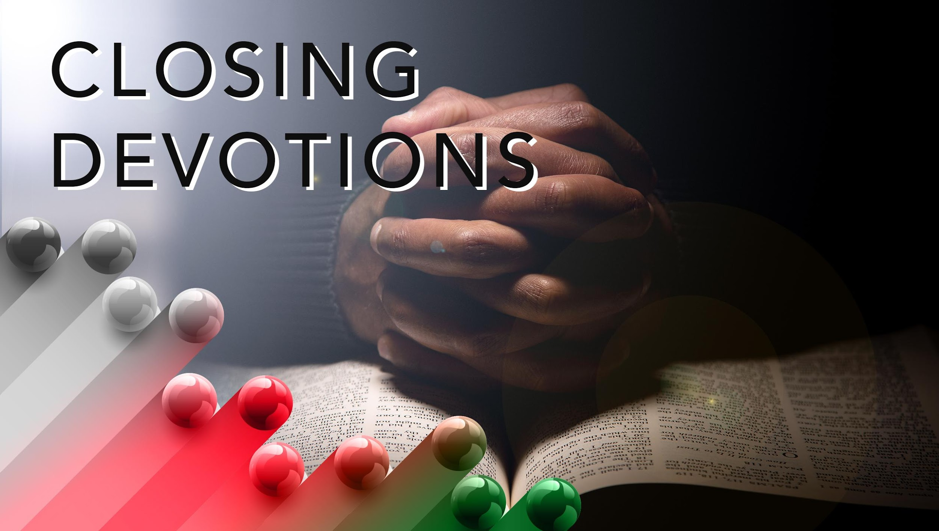

Slide 23
Hymn: “Take Time to Be Holy,” AMECH #286
Prayer: Good and gracious God, we thank you for the gift of rest and the rhythm of work and worship you established from creation. Teach us to honor the Sabbath and the Lord’s Day as sacred time for reflection, renewal, and devotion. Help us to resist the pressures of overwork and to embrace rest as an act of faith, restoration, and justice. May our hearts, minds, and bodies find peace in your presence, and may we carry your rest and love into our communities. Strengthen us to honor both your call and the sacred rhythms of our lives. In Jesus’ name, we pray. Amen.

Slide 24
Oh, bless me now, my Savior,
I come to Thee.
Prayer: Dear Lord, help us to hear your voice and heed warnings. Let us not assume that our religious buildings or items will save us from your wrath. Allow us to understand that we are your examples on earth and that our words and behaviors tell others that you are the Lord. In Jesus’ name we pray. Amen.

