Slide 1
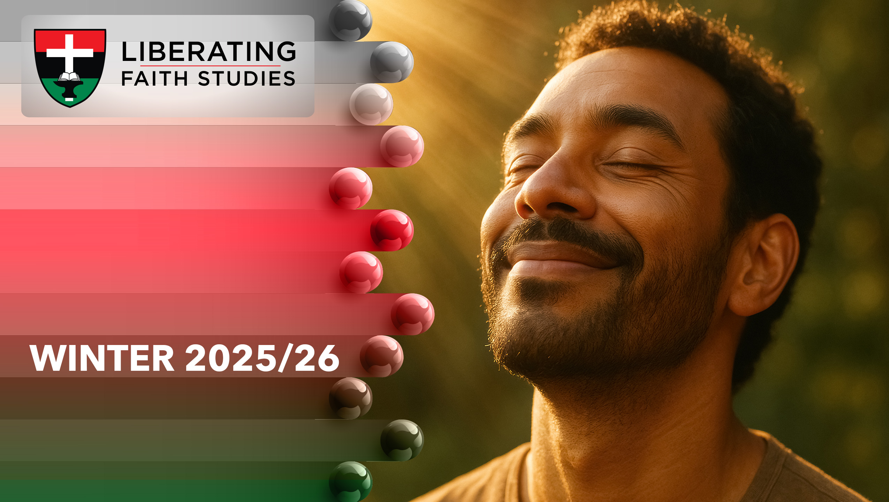
^{LESSON 10: FEBRUARY 8}

Slide 2
Baptism and the Lord’s Supper
Focus Scripture: Matthew 3:13-17; 28:19-20; 1 Corinthians 11:23-29
Key Verses: “Go therefore and make disciples of all nations, baptizing them in the name of the Father and of the Son and of the Holy Spirit and teaching them to obey everything that I have commanded you. And remember, I am with you always, to the end of the age.” Matthew 28:19-20 (NRSV UE)

Slide 3
Matthew 3:13-17; 28:19-20; 1 Corinthians 11:23-29(NRSV UE)
Matthew 3:13-17
13 Then Jesus came from Galilee to John at the Jordan, to be baptized by him.
14 John would have prevented him, saying, “I need to be baptized by you, and do you come to me?”
15 But Jesus answered him, “Let it be so now, for it is proper for us in this way to fulfill all righteousness.” Then he consented.
16 And when Jesus had been baptized, just as he came up from the water, suddenly the heavens were opened to him and he saw God’s Spirit descending like a dove and alighting on him.
17 And a voice from the heavens said, “This is my Son, the Beloved, with whom I am well pleased.”
28:19-20
19 “Go therefore and make disciples of all nations, baptizing them in the name of

Slide 4
the Father and of the Son and of the Holy Spirit
20 and teaching them to obey everything that I have commanded you. And remember, I am with you always, to the end of the age.”
1 Corinthians 11:23-29
23 For I received from the Lord what I also handed on to you, that the Lord Jesus on the night when he was betrayed took a loaf of bread,
24 and when he had given thanks, he broke it and said, “This is my body that is for you. Do this in remembrance of me.”
25 In the same way he took the cup also, after supper, saying, “This cup is the new covenant in my blood. Do this, as often as you drink it, in remembrance of me.”
26 For as often as you eat this bread and drink the cup, you proclaim the Lord’s death until he comes.
27 Whoever, therefore, eats the bread or drinks the cup of the Lord in an unworthy manner will be answerable for the body and blood of the Lord.
28 Examine yourselves, and only then eat of the bread and drink of the cup.
29 For all who eat and drink without discerning the body eat and drink judgment against themselves.

Slide 5
^{Key Terms}
Baptism – One of the two (2) sacraments. It is a sign of new life through Jesus Christ and unites the one baptized with Christ and his people as members of the church. The act is administered in the name of the Father, the Son, and the Holy Spirit. The three (3) modes are effusion (pouring of), aspersion (sprinkling with), and immersion (dipping in) water. In no case shall any person be re-baptized.
The Lord’s Supper (Holy Communion) – The sacrament instituted by Christ when he celebrated the Last Supper with his disciples consisting of bread and wine (juice), representing his body and blood as a sacrifice for the forgiveness of sin, and
Your title here

Slide 6
commonly observed among us on the first Sunday.
Love Feast – The service of preparation that precedes participation in the sacrament of Holy Communion. The elements of the love feast are water, symbolic of our desire for purification, and bread, symbolic of our desire for goodwill with one another. In this service, one forgives all and seeks forgiveness from all, so that one might present oneself acceptable before the Lord at his table.
Means of Grace – Spiritual channels or practices through which God imparts his grace to believers. In the AME tradition, the primary means of grace include the Word of God, the sacraments (Baptism and the Lord’s Supper), prayer, fasting, and Christian fellowship. These are not merely symbolic

Slide 7
and Christian fellowship. These are not merely symbolic actions; they are instruments through which God strengthens faith, nurtures holiness, and equips believers for service.
Ritual – The established form for the rites and ceremonies of the church for the purpose of conducting private and public worship.
Sacraments – Acts instituted by Jesus Christ as a means of grace. The two (2) in the AME Church are Holy Baptism and the Lord’s Supper (Holy Communion).

Slide 8


Slide 9
Rituals are a universal expression of human longing for connection and meaning. In African and African-descended cultures, rites of passage such as birth, naming, initiation, and communal feasts affirm identity, belonging, and purpose. Baptism and the Lord’s Supper similarly mark spiritual milestones, linking believers to God, Christ, and one another. Baptism identifies the believer with Jesus’ death and resurrection (Romans 6:1-14), while the Lord’s Supper memorializes Christ’s sacrificial love and fosters community.

Slide 10


Slide 11
The grouping of scriptures for today’s lesson give insight on the two sacraments of the church: Baptism and Holy Communion.
A wonderful serenity has taken possession

Slide 12


Slide 13
Articles of Religion Related to Baptism and Holy Communion
Many AME congreg- ations will observe Founder’s Day today. One of the founding and clarifying sets of doctrine for the church is the Articles of Religion, adapted from the Methodist Church and the Anglican Church before that.
A wonderful serenity has taken possession

Slide 14


Slide 15
The church’s sacraments, Baptism and the Lord’s Supper, have historically and contemporarily offered both spiritual grounding and communal identity for black Christians, especially in contexts of oppression, migration, and social struggle.

Slide 16


Slide 17
Baptism and the Lord’s Supper shape our spiritual lives in ways that extend beyond Sunday worship. They ground our identity in God’s love, offer reminders of our commitments, and guide ethical action. For example, baptism marks belonging, encouraging participation in church and community life. The Lord’s Supper cultivates empathy and solidarity, reminding us to care for those in need.

Slide 18


Slide 19
1. How do baptism and the Lord’s Supper strengthen your personal faith and sense of belonging?

Slide 20
2. In what ways can these sacraments inspire acts of justice and compassion in your community?

Slide 21
3. How can remembering Christ’s death and resurrection transform daily choices and relationships?

Slide 22
4. Considering global AME connection and experiences, how might your church more fully embody Baptism and the Lord’s Supper in mission and service?

Slide 23


Slide 24
Hymns: “Lord, I Want to Be a Christian,” AMECH #282 and “Let Us Break Bread Together,” AMECH #530
Prayer: Gracious and loving God, we thank you for the gift of your Son, Jesus, and for the ways he has shown us the path of life through his baptism and the sharing of his table. We thank you for Bishop Richard Allen and those foreparents of the faith and church. Strengthen our faith, deepen our love for you and for one another, and guide us to live as your faithful disciples. May the waters of baptism remind us of your cleansing and new life; and may the bread and cup of the Lord’s Supper nourish our spirits and unite us in your mission. Help us to serve others with

Slide 25
joy, to act justly, and to walk humbly with you each day. In the name of Jesus Christ, our Lord and savior, we pray. Amen.

