Slide 1

^{LESSON 1: DECEMBER} ⁷

Slide 2
The Holy Scriptures
Focus Scripture: Psalm 19:7-11; 2 Timothy 3:14-15
Key Verse: All scripture is inspired by God and is useful for teaching, for reproof, for correction, and for training in righteousness, so that the person of God may be proficient, equipped for every good work. 2 Timothy 3:16-17 (NRSV UE)

Slide 3
Psalm 19:7-11; 2 Timothy 3:14-15 (NRSV UE)
7 The law of the Lord is perfect, reviving the soul; the decrees of the Lord are sure, making wise the simple;
8 the precepts of the Lord are right, rejoicing the heart; the commandment of the Lord is clear, enlightening the eyes;
9 the fear of the Lord is pure, enduring forever; the ordinances of the Lord are true and righteous altogether.
10 More to be desired are they than gold, even much fine gold; sweeter also than honey and drippings of the honeycomb.
Moreover, by them is your servant warned; in keeping them there is great reward.
2 Timothy 3:14-15
14 But as for you, continue in what you have learned and firmly believed, knowing from whom you learned it
15 and how from childhood you have known sacred writings that are able to instruct you for salvation through faith in Christ Jesus.

Slide 4
^{Key Terms}
Scripture (skrip-chər) – The sacred writings of the Bible, divinely inspired and authoritative for faith and life.
Inspired (in-spīrd) – Breathed by God; conveying divine guidance through human authors.
Righteousness (rīt-chəs-nəs) – Living in right relationship with God and neighbor; moral integrity.
Meditate (med-i-tāt) – To thoughtfully reflect on God’s Word, internalizing its meaning for daily life.
Conduit (kän-do͞ot) – A channel through which something flows; here, scripture is the conduit of God’s voice.
Your title here

Slide 5
The Assyrian Empire – A collection of united city-states in power from 900 B.C.E. to 600 B.C.E.; the empire stretched from Mesopotamia (modern-day Iraq) through Asia Minor.

Slide 6


Slide 7
The first unit of this quarter is a study highlighting the holy nature of our God and God’s instrument and gift to us to aid us in our search and path toward holiness, God’s holy Word, the scriptures. It is appropriate that this study comes during this Advent season, as we await the coming of God’s perfect gift to the world, Jesus, the Word made flesh.

Slide 8


Slide 9
From the hymnal of the Bible, our study passage from Psalms takes on a more poetic form as it describes the value and virtues of scripture.
Psalm 19:7-11
Verse 7: The law of the Lord is perfect, restoring the soul. Here, “law” refers to God’s instructions, which renew our hearts and provide direction.
A wonderful serenity has taken possession

Slide 10


Slide 11
The study scriptures for this quarter (focus and lesson) are grouped in a way that they were grouped and studied by many Christians following the Uniformed Lesson outlines in 1929-1930. As we continue to follow the Uniformed Lesson outlines in our studies in church school, these particular 1929-1930 outlines are relevant just as God’s Word, while ancient, remains relevant and necessary.
A wonderful serenity has taken possession

Slide 12


Slide 13
Consider the story of Harriet Tubman, who relied on scripture as both comfort and guidance while leading enslaved people to freedom. Tubman (c. 1822–1913) was born into slavery in Maryland and escaped to freedom in 1849. She became a fearless conductor on the Underground Railroad, leading hundreds of enslaved people to liberty and relying on her Methodist faith and knowledge of scripture for courage.

Slide 14


Slide 15
God’s Word is not only meant to be read or studied, but to be lived, shaping the choices we make, the relationships we nurture, and the ways we serve others. As we reflect on Psalm 19:7-11 and 2 Timothy 3:14-17, we see that scripture equips us to act with wisdom, integrity, and faithfulness in our daily lives

Slide 16


Slide 17
1. How does scripture serve as a guide in your personal and professional life?

Slide 18
2. God appeared suddenly in the lives of Noah, Moses, and Mary, mother of Jesus. How did they respond? Would you respond in the same way? Why or why not?

Slide 19
3. Think of a time when scripture helped you make a difficult choice. What passage did you rely on, and what did it teach you?

Slide 20
4. In what ways can your understanding of scripture strengthen your community and the AME Church globally?

Slide 21
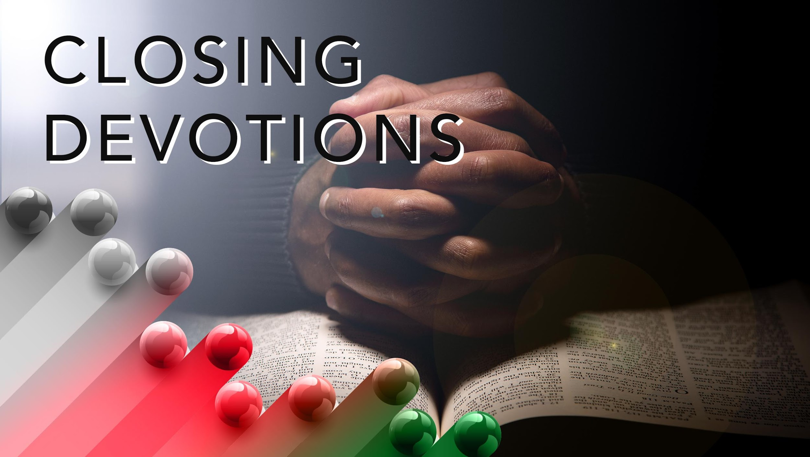

Slide 22
Hymn: “Break Thou the Bread of Life,” AMECH #209
Prayer: Almighty God, we thank you for the gift of your Word. May it guide our decisions, strengthen our faith, and inspire us to serve others. Help us to meditate on your Word day and night, to hear your voice in scripture, and to be transformed into Christ’s likeness. Amen.

