Slide 1
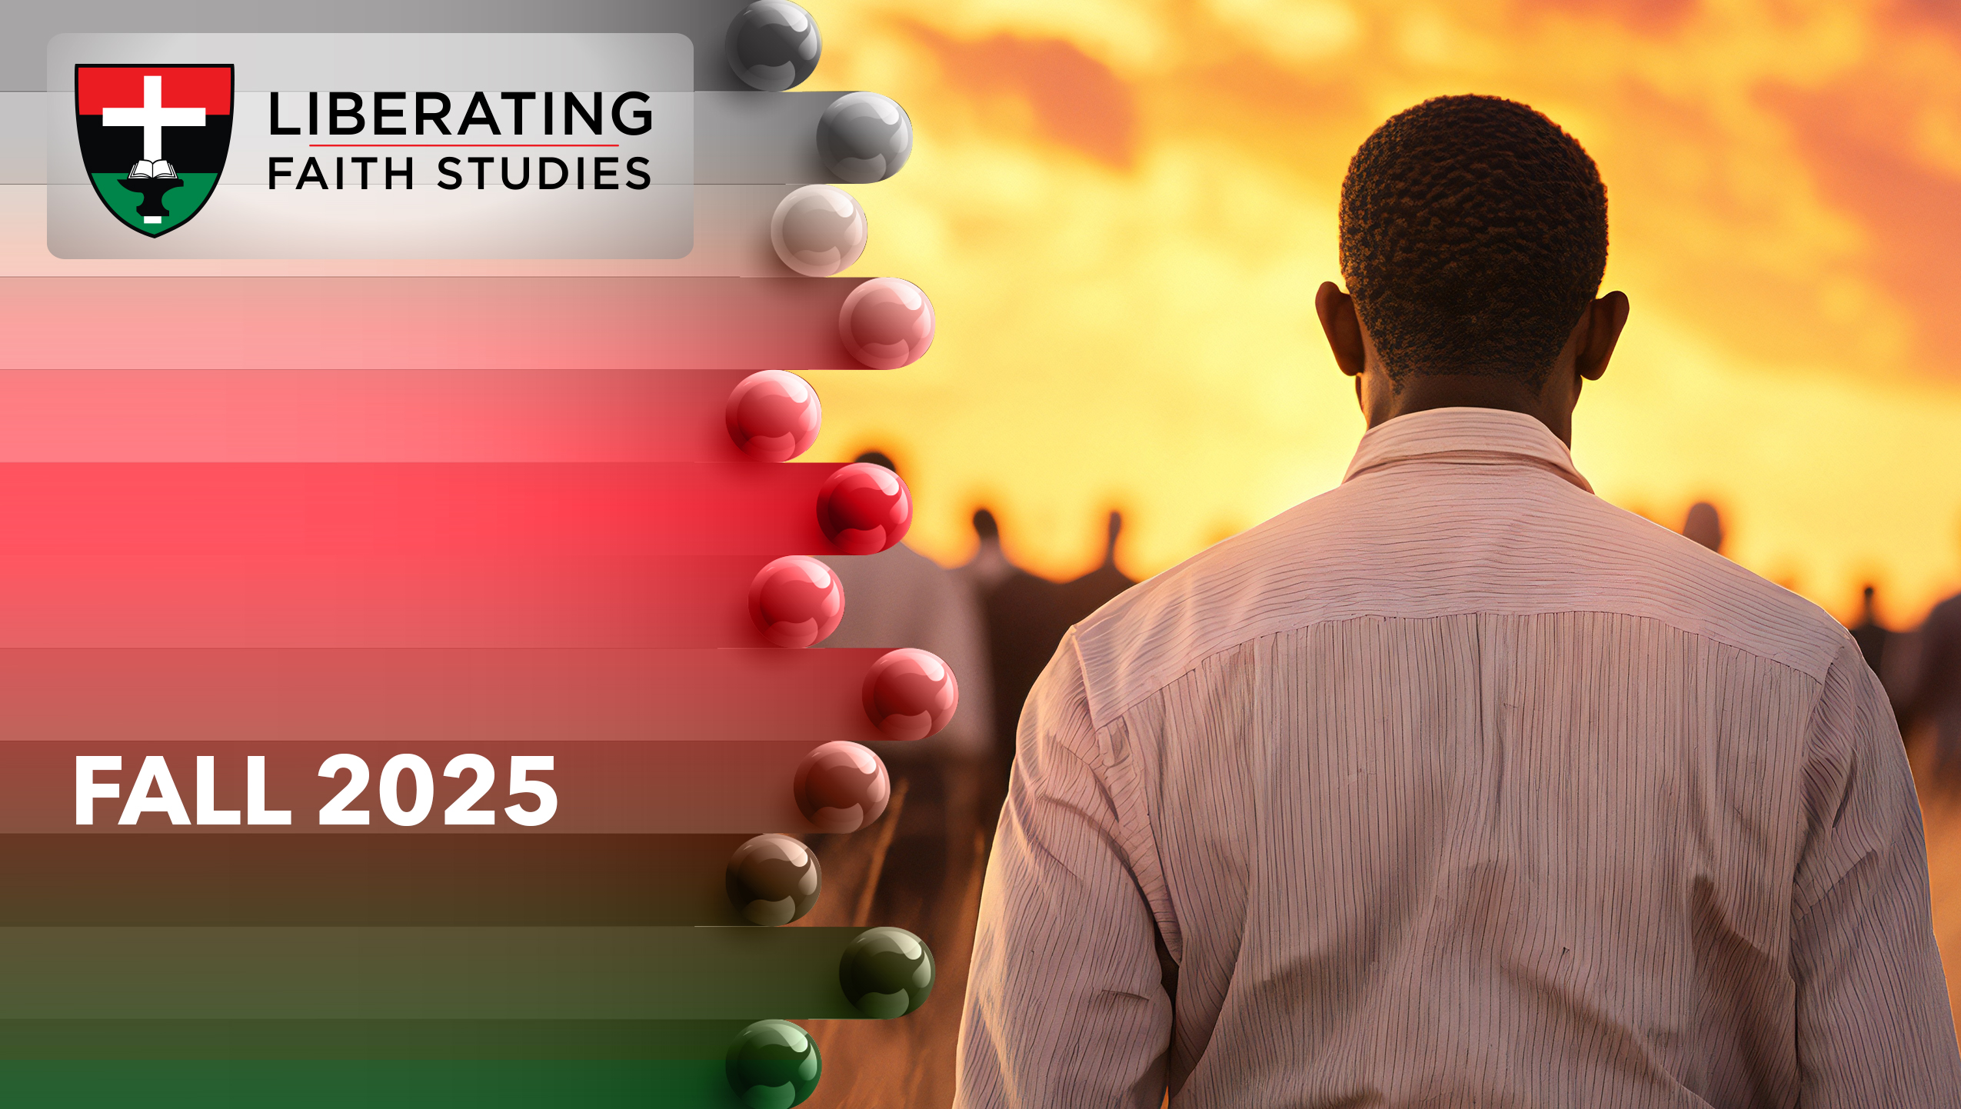
^{LESSON 9: NOVEMBER 2}

Slide 2
Later Experiences of Jeremiah
Focus Scripture: Jeremiah 38:7-13
Key Verse: The king commanded Ebed-melech the (Ethiopian), “Take three men with you from here, and pull the prophet Jeremiah up from the cistern before he dies.” Jeremiah 38:10 (NRSV UE)

Slide 3
Jeremiah 38:7-13 (NRSV UE)
7 Ebed-melech the Cushite, a eunuch in the king’s house, heard that they had put Jeremiah into the cistern. The king happened to be sitting at the Benjamin Gate,
8 So Ebed-melech left the king’s house and spoke to the king,
9 “My lord king, these men have acted wickedly in all they did to the prophet Jeremiah by throwing him into the cistern to die there of hunger, for there is no bread left in the city.”
10 Then the king commanded Ebed-melech the Cushite, “Take three men with you from here, and pull the prophet Jeremiah up from the cistern before he dies.”
11 So Ebed-melech took the men with him and went to the house of the king, to a wardrobe of the storehouse, and took from there old rags and worn-out clothes, which he let down to Jeremiah in the cistern by ropes.
12 Then Ebed-melech the Cushite said to Jeremiah, “Just put the rags and clothes between your armpits and the ropes.” Jeremiah did so.
13 Then they drew Jeremiah up by the ropes and pulled him out of the cistern. And Jeremiah remained in the court of the guard.

Slide 4
^{Key Terms}
Ebed-melech – Combines two Hebrew words, “servant” and “king”; this may have been a title instead of a name.
Zedekiah – Hebrew meaning “Yah is righteousness”; derived from verb “sadeq” (“to be just”) and “yah”, the name of the Lord.
Cistern – A large water storage tank usually dug into the ground or rock.
Malchiah – Hebrew meaning “Yah (Jehovah) is king.”
Eunuch – Usually a minister of state who was castrated; Jesus identified three types: born that way, made that way, or chose to live that way (Matthew 19:11-12).
Your title here

Slide 5


Slide 6
Jeremiah encountered insults, assaults, and slander. This mistreatment kept intensifying to the point where it could have resulted in his death. After Jeremiah delivered a greatly disturbing message, the king agreed to have Jeremiah interred in a water cistern.

Slide 7
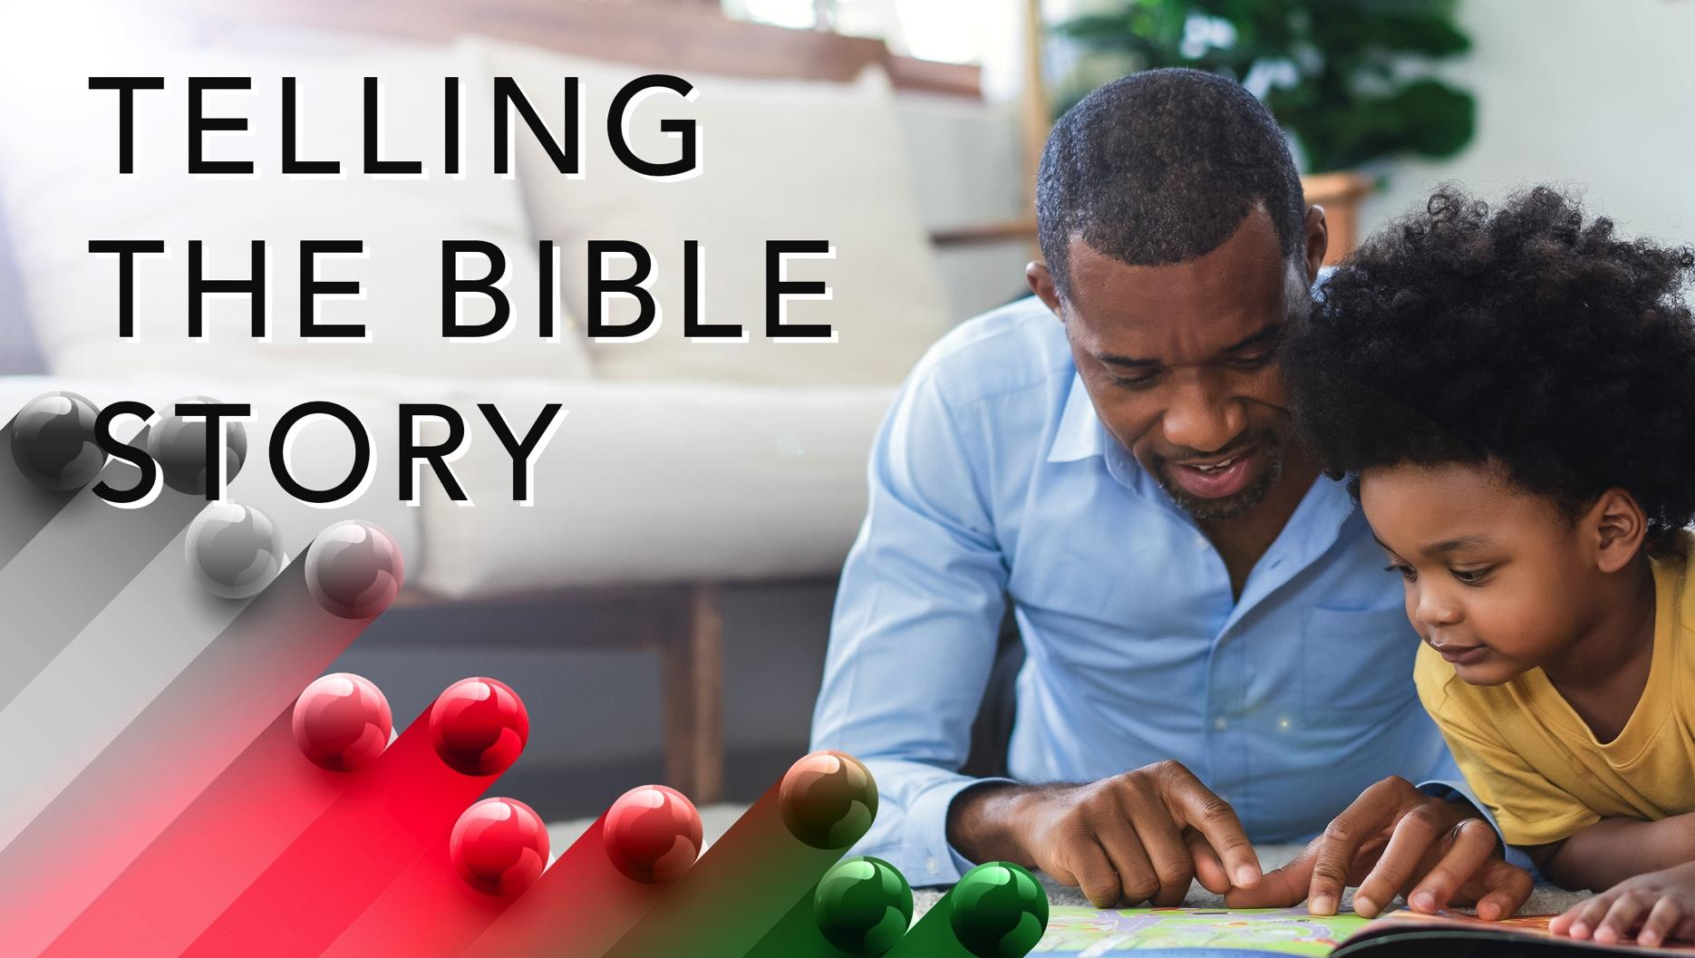

Slide 8
Jeremiah 38:7-13
Jeremiah had a message for Israel: surrender to the Babylonians. If they did, they would be exiled to Babylon, but they would live. But if they refused, they would die. This news did not sit well with some of Zedekiah’s officers. They thought Jeremiah’s words were treasonous.
A wonderful serenity has taken possession

Slide 9


Slide 10
When people are imprisoned unjustly, an opportunity arises. The choice to act depends upon each of you. Will you stand idly by knowing that an innocent person was incarcerated?
A wonderful serenity has taken possession

Slide 11


Slide 12
A movie, Just Mercy, featured Bryan Stevenson’s commitment to righting injustices. He founded the Equal Justice Institute (EJI) in Montgomery, Alabama. Through this organization, Stevenson has challenged unfair sentencing imposed upon the innocent. His leadership confronted abusive practices aimed at prisoners and children unfairly tried as adults.

Slide 13
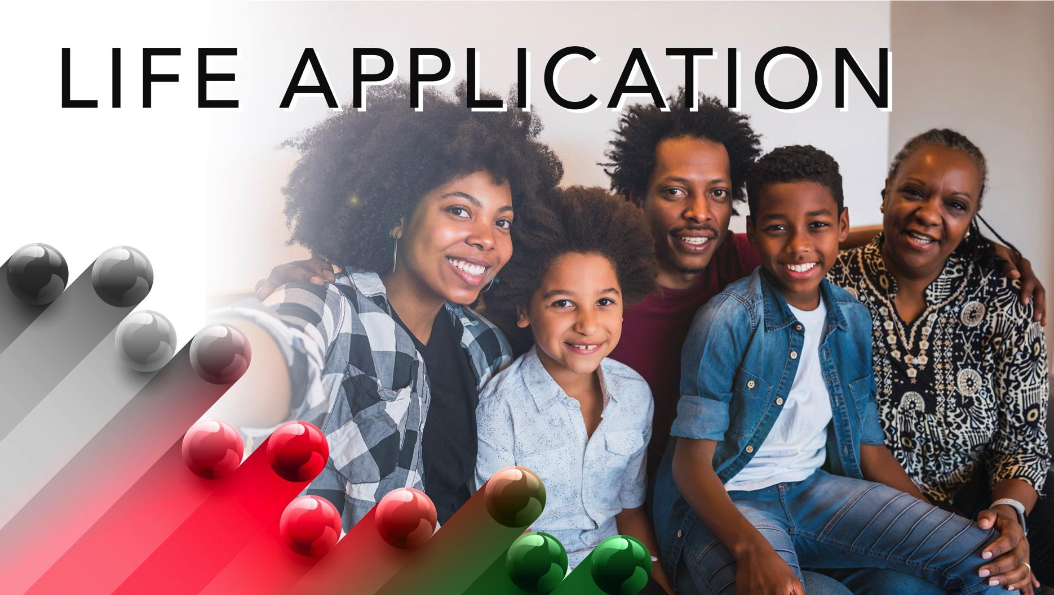

Slide 14
When people are imprisoned unjustly, an opportunity arises. The choice to act depends upon each of you. Will you stand idly by knowing that an innocent person was incarcerated?

Slide 15


Slide 16
1. How can the church help people who are unfairly imprisoned?
2. How can the church become involved in sentencing decisions?
3. Where did you see Jesus in today’s lesson?
4. How will you apply what you learned to your life?

Slide 17
2. How can the church become involved in sentencing decisions?

Slide 18
3. Where did you see Jesus in today’s lesson?

Slide 19
4. How will you apply what you learned to your life?

Slide 20
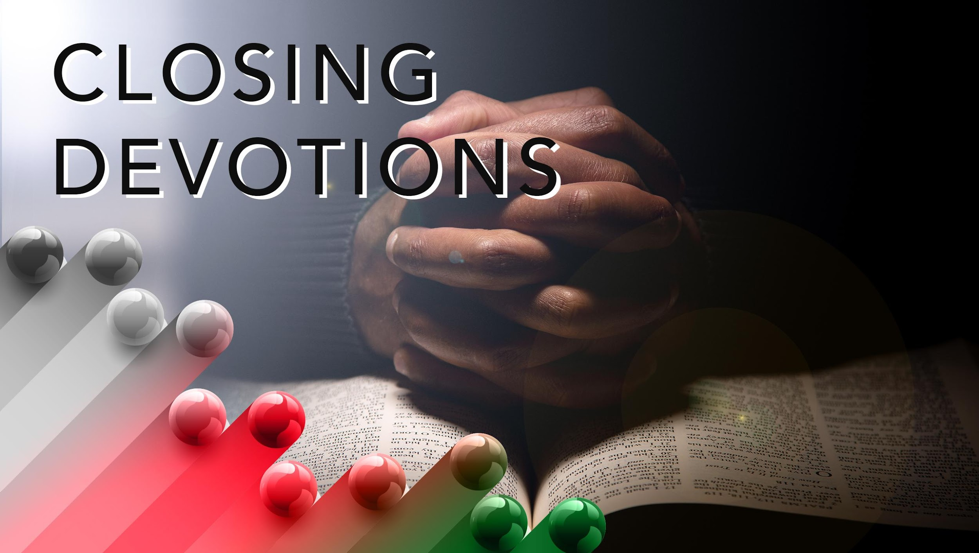

Slide 21
Think about Jeremiah and how this hymn, “Love Lifted Me” (AMECH #461) could pertain to his time in the cistern:
I was sinking deep in sin,
Far from the peaceful shore,
Very deeply stained within,
Sinking to rise no more;
But the Master of the sea
Heard my despairing cry,
From the waters lifted me,
Now safe am I.
Love lifted me!

Slide 22
Love lifted me!
When nothing else could help,
Love lifted me.
Prayer: Lord, give us bold tongues so that we may speak against injustice. Let us know what we should do to help those who have been wronged. We pray that your justice be done and that you protect people who are working for you. In Jesus’ name. Amen.

