Slide 1
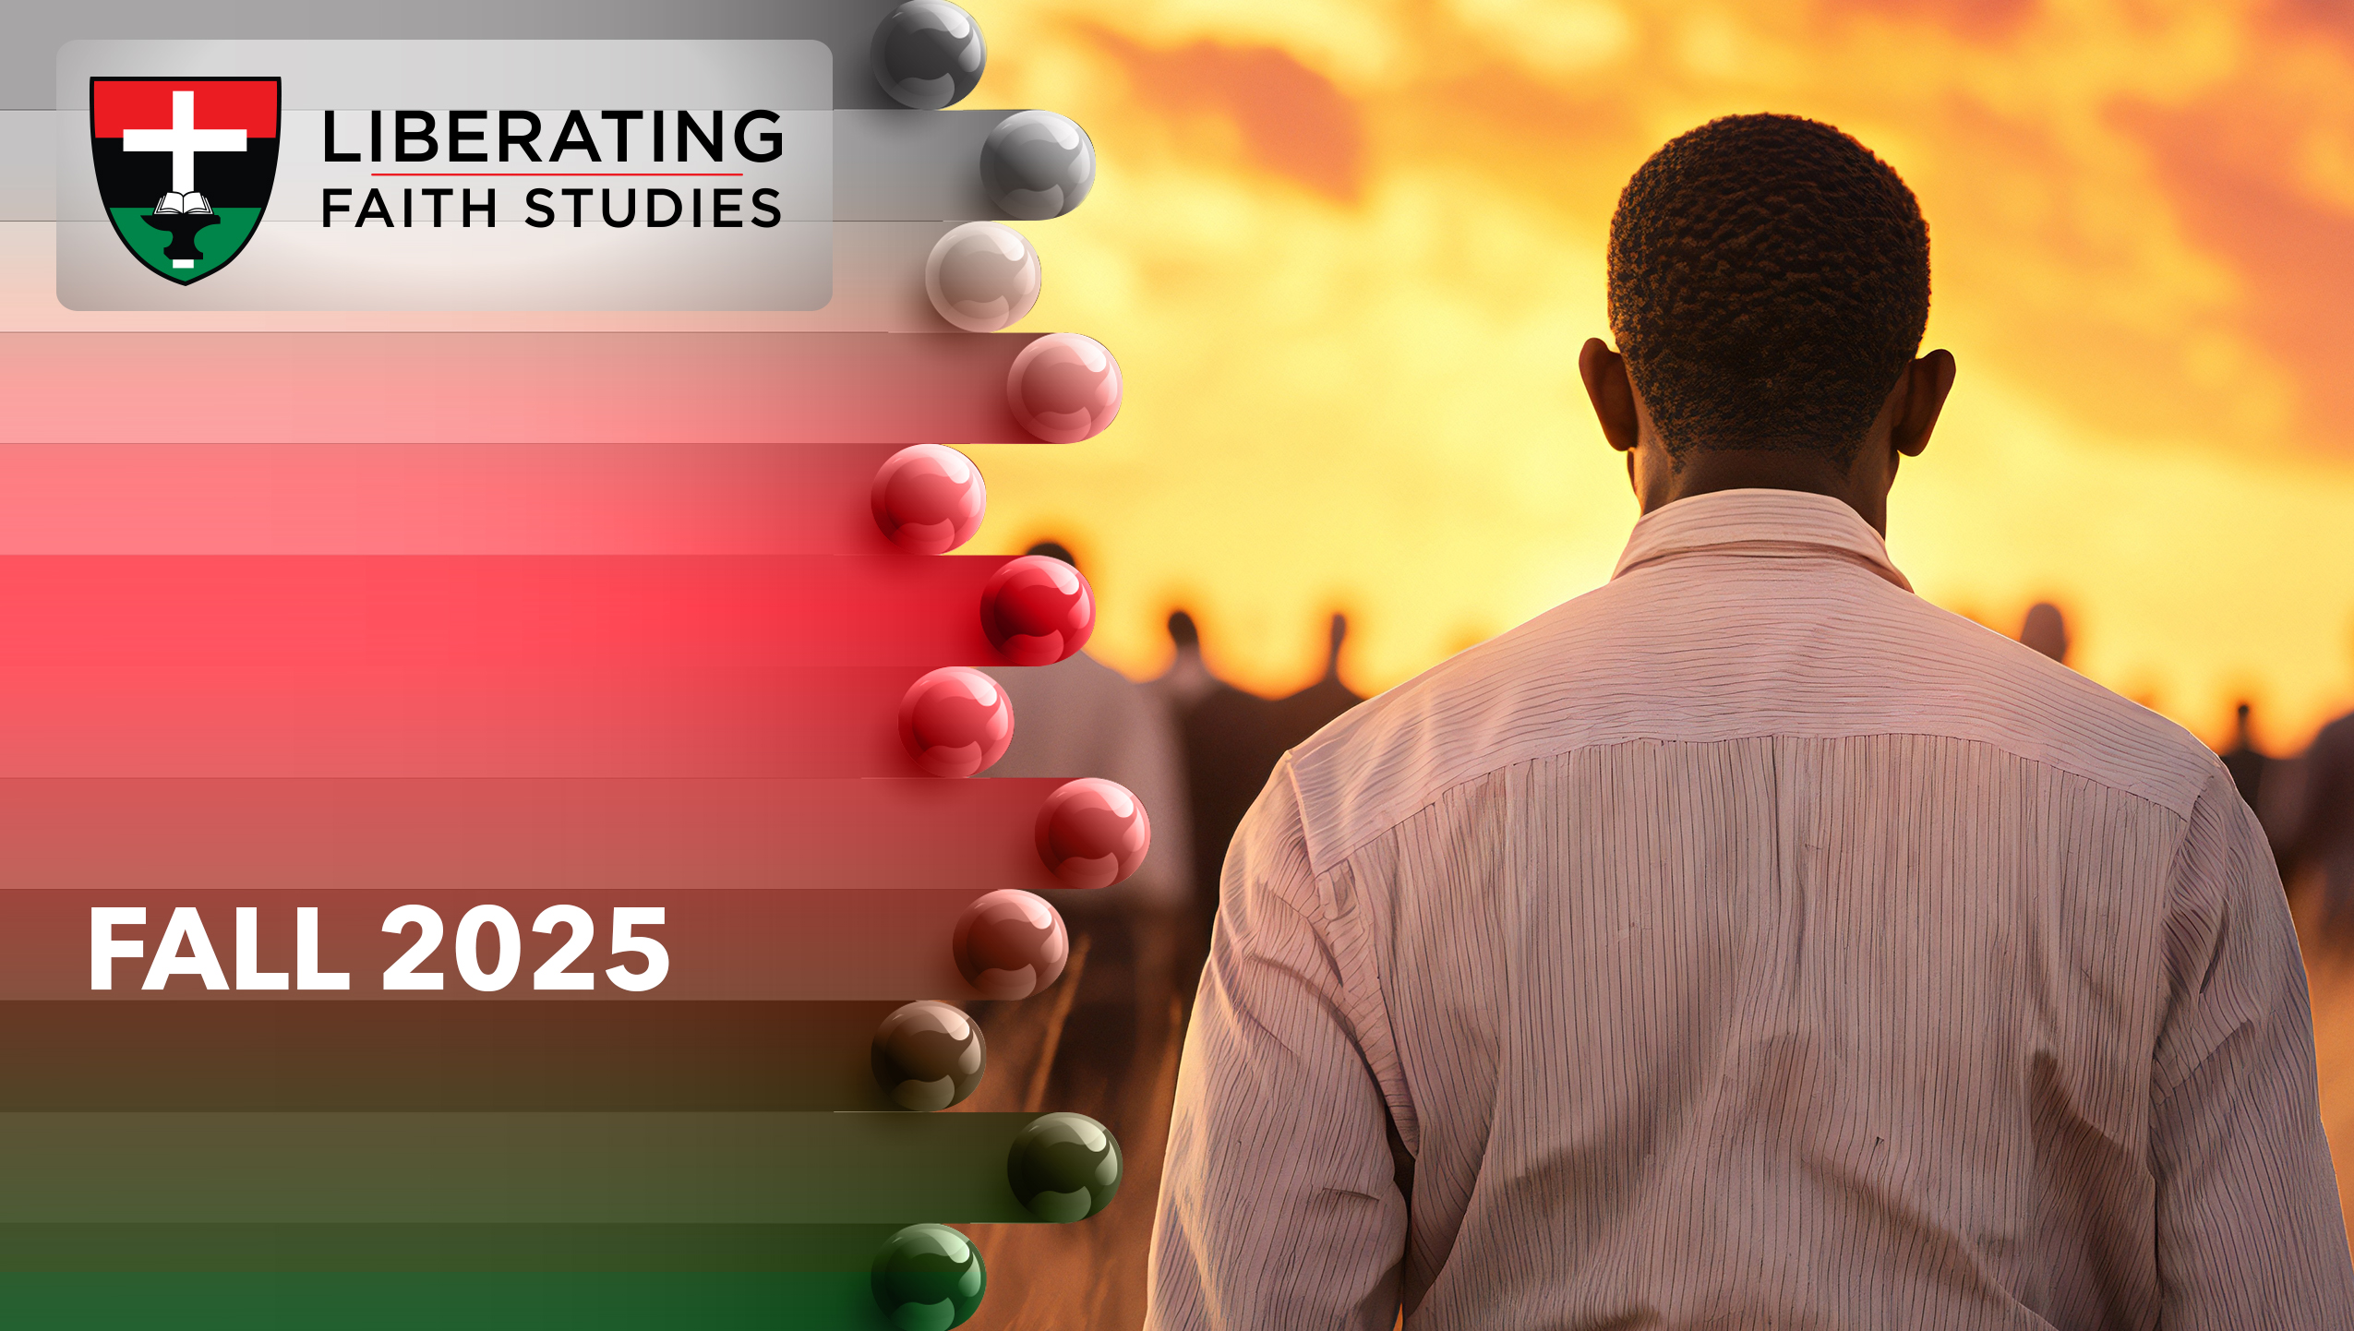
^{LESSON 7: OCTOBER 19}

Slide 2
The Story of the Rechabites
Focus Scripture: Jeremiah 35:5-11
Key Verse: They drink (no wine) to this day, for they have obeyed their ancestor’s command. Jeremiah 35:14b (NRSV UE)

Slide 3
Jeremiah 35:5-11 (NRSV UE)
5 Then I set before the Rechabites pitchers full of wine and cups, and I said to them, “Have some wine.”
6 But they answered, “We will drink no wine, for our ancestor Jonadab son of Rechab commanded us, ‘You shall never drink wine, neither you nor your children,
7 nor shall you ever build a house or sow seed, nor shall you plant a vineyard or even own one, but you shall live in tents all your days, that you may live many days in the land where you reside.’
8 We have obeyed the charge of our ancestor Jonadab son of Rechab in all that he commanded us, to drink no wine all our days, ourselves, our wives, our sons, or our daughters,
9 and not to build houses to live in. We have no vineyard or field or seed,
10 but we have lived in tents and have obeyed and done all that our ancestor Jonadab commanded us.
11 But when King Nebuchadrezzar of Babylon came up against the land, we said, ‘Come, and let us go to Jerusalem for fear of the army of the Chaldeans and the army of the Arameans.’ That is why we are living in Jerusalem.”

Slide 4
Key Terms
Rechabites (also known as Kenites) – A nomadic group of people who lived in tents and were known for adherence to strict rules given by their ancestors.
Jonadab – A Kenite who opposed Baal worship and aided Jehu in destroying Ahab’s family.
Your title here

Slide 5


Slide 6
God used the Kenites, a people not in covenant with the Lord of Israel, to teach Judah about obedience. Because their ancestors had instructed the Rechabites not to drink wine, they did not drink it. Jeremiah shares that Judah, God’s chosen people, could learn a lesson by following the Rechabite’s example. Not only were they faithful to the prohibition against wine, they also did not build houses or plant crops.

Slide 7


Slide 8
^{Jeremiah 35:5-6}
God instructed Jeremiah to go and bring the Rechabites to a chamber in the Lord’s house. This invitation may have seemed inexplicable. God’s chambers housed Levites (1 Chronicles 9:33) who were Jews consecrated for temple service, and the Rechabites were not Jewish. Once they arrived in the chambers, God told Jeremiah to offer them wine to drink.
A wonderful serenity has taken possession

Slide 9


Slide 10
Archeologists discovered that winemaking began in Egypt around 3000 BCE. Noah produced grapes that he then fermented to become wine. Jesus’ first recorded miracle was turning water into wine at a wedding. Wine was often included in religious rituals and cultural ceremonies. For example, during the Last Supper, Jesus blessed and then gave wine to the apostles. Scripture describes other uses for wine.
A wonderful serenity has taken possession

Slide 11


Slide 12
Kevin Elijah Burgess, born July 21,1988 in St. Petersburg, Florida, grappled with severe depression. Burgess self-medicated, using a variety of drugs. He did this in an attempt to alleviate feelings of sadness and hopelessness. Because substance abuse was not a remedy for depression, his depression deepened to the point where he contemplated suicide. Fortunately, following high school, Burgess enrolled in a Bible college where he met some rappers.

Slide 13


Slide 14
There are people who provide examples on how to live an obedient life. Some religious groups such as Jehovah’s Witnesses, Seventh Day Adventists, or Mormons canvas door-to-door. Though Christians may disagree with their messages, these groups’ faithfulness to evangelism cannot be denied.

Slide 15


Slide 16
1. What is the meaning of wine served during communion?

Slide 17
2. Which lessons should we learn from other groups/families/neighbors?

Slide 18
3. Where did you see Jesus in today’s lesson?

Slide 19
4. How will you apply what you learned to your life?

Slide 20


Slide 21
Pray for people and families affected by substance abuse.
Meditate on the following lyrics of “Let Us Break Bread Together” (AMECH #530) and apply today’s lesson to your life:
Let us drink wine together on our knees.
Let us drink wine together on our knees.
When I fall on my knees with my face to the rising sun,
^{O Lord, have mercy on me.}
Prayer: Thank you, God. We want to learn from our ancestors what is most important by putting you first. Open our eyes to see the examples of those who placed you first as we remember your faithfulness. Allow us to be light and salt to those around us. In Jesus’ name. Amen.

