Slide 1
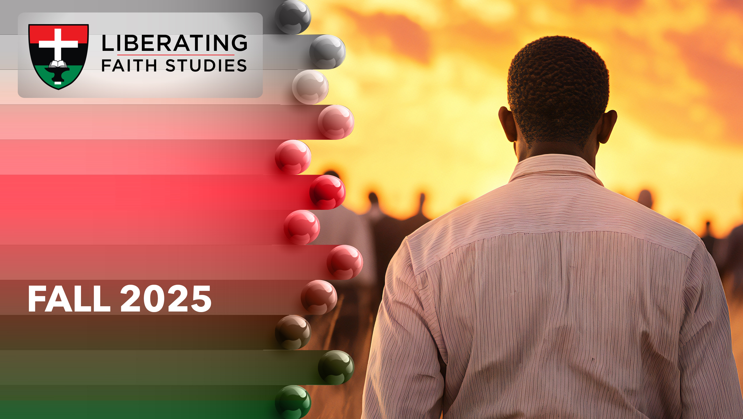
^{LESSON 6: OCTOBER 12}

Slide 2
Jeremiah Calls the
People to Obedience
Focus Scripture: Jeremiah 7:1-11, 21-23
Key Verse: This command I gave them, “Obey my voice, and I will be your God, and you shall be my people; walk only in the way that I command you, so that it may be well with you.” Jeremiah 7:23 (NRSV UE)

Slide 3
Jeremiah 7:1-11, 21-23 (NRSV UE)
^{Jeremiah 7:1-11}
1 The word that came to Jeremiah from the Lord:
2 Stand in the gate of the Lord’s house, and proclaim there this word, and say, Hear the word of the Lord, all you people of Judah, you who enter these gates to worship the Lord.
3 Thus says the Lord of hosts, the God of Israel: Amend your ways and your doings, and let me dwell with you in this place.
4 Do not trust in these deceptive words: “This is the temple of the Lord, the temple of the Lord, the temple of the Lord.”
5 For if you truly amend your ways and your doings, if you truly act justly one with another,
6 if you do not oppress the alien, the orphan, and the widow or shed innocent blood in this place, and if you do not go after other gods to your own hurt,
7 then I will dwell with you in this place, in the land that I gave to your ancestors forever and ever.
8 Here you are, trusting in deceptive words to no avail.
9 Will you steal, murder, commit adultery, swear falsely, make offerings to Baal, and go after other gods that you have not known

Slide 4
10 and then come and stand before me in this house, which is called by my name, and say, “We are safe!”—only to go on doing all these abominations?
11 Has this house, which is called by my name, become a den of robbers in your sight? I, too, am watching, says the Lord.
²¹⁻²³
21 Thus says the Lord of hosts, the God of Israel: Add your burnt offerings to your sacrifices, and eat the flesh.
22 For in the day that I brought your ancestors out of the land of Egypt, I did not speak to them or command them concerning burnt offerings and sacrifices.
23 But this command I gave them, “Obey my voice, and I will be your God, and you shall be my people; walk only in the way that I command you, so that it may be well with you.”

Slide 5
Key Terms
Judah – The southern kingdom where Judah and Benjamin resided after Israel split into kingdoms following Solomon’s reign.
Baal – A false Canaanite god believed to control fertility and rain.
Shiloh – Israel’s capital where the tabernacle was located for 369 years.
Your title here

Slide 6


Slide 7
Judah believed a false report, that the Jerusalem temple of the Lord would provide them protection even if they failed to obey God. Jeremiah, tasked with dismantling this myth, warned Judah of this erroneous thinking. Israel, the northern kingdom, served as an example. God’s original temple was located at Shiloh in Israel.

Slide 8


Slide 9
^{Jeremiah 7:1-11}
Jeremiah stands at the temple gate delivering God’s message. Surely, people entering the temple would recognize God’s prophetic plea. After all, these people were coming to worship; wouldn’t they expect God to speak? Perhaps they did not realize it was God because of Jeremiah’s message. Instead of being praised because they were worshipers, Judah hears God’s rebuke. How could God ask them to amend their ways; weren’t they coming to the temple?
A wonderful serenity has taken possession

Slide 10


Slide 11
Born on July 10, 1875, Mary Jane McLeod Bethune, the last of seventeen children, benefited from efforts to educate the newly emancipated black people. She graduated from Scotia Seminary and attended Dwight Moody’s Institute for Home and Foreign Missions. Her career as an educator led Bethune to open a boarding school, the Daytona Beach Literary and Industrial School for Training Negro Girls. Eventually, this school evolved into a college and later merged with an all-male school which became the Bethune-Cookman College in 1929.
A wonderful serenity has taken possession

Slide 12


Slide 13
Tarana Burke, the founder of the “Me Too” movement, was born September 12, 1973, in the Bronx, New York. Her devotion to grassroots organizing and activism began at an early age. While a teen, Burke brought attention to social justice issues such as housing inequities, racial discrimination, and economic disparities through public campaigns. While at Alabama State University, Burke convened an all-girl bonding session.

Slide 14


Slide 15
Churches often use the mantra “speak truth to power.” Much of the church’s power lies in its members. Congregations are tasked to do the greater work, to be one with God, and to make disciples. This is dangerous work. According to scripture, the church is sent out like sheep among wolves (Matthew 10:16).

Slide 16


Slide 17
1. Which ways are our current churches like a den of thieves?

Slide 18
2. Why do some people prefer to believe lies?

Slide 19
3. How easy/difficult is it to change beliefs and behaviors?

Slide 20
4. Where do you see Jesus in today’s lesson?

Slide 21
5. How will you apply what you learned to your life?

Slide 22
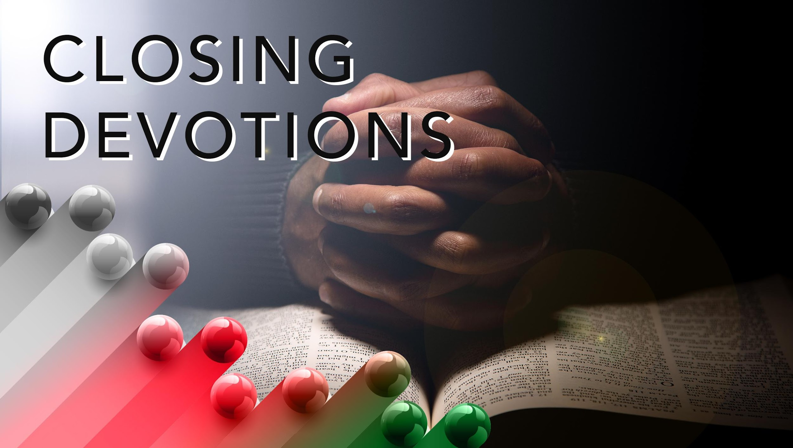

Slide 23
Have a few moments of quiet self-reflection on how these words from “Go, Preach My Gospel” (AMECH #220) pertain to you:
Go, preach my gospel,” saith the Lord.
“Bid the whole earth my grace receive.
Explain to them my sacred word;
Bid them believe, obey, and live.”
Listen to the spiritual, “Lord, I Want to Be a Christian in My Heart”: https://www.youtube.com/watch?v=xe yHNo4tABA
Prayer: Lord, help us remember that our church buildings cannot contain your glory. We are grateful you have made us your temples, and we desire to reflect your light and love. Please help us stay focused and faithful to you. In Jesus’ name. Amen.

