Slide 1
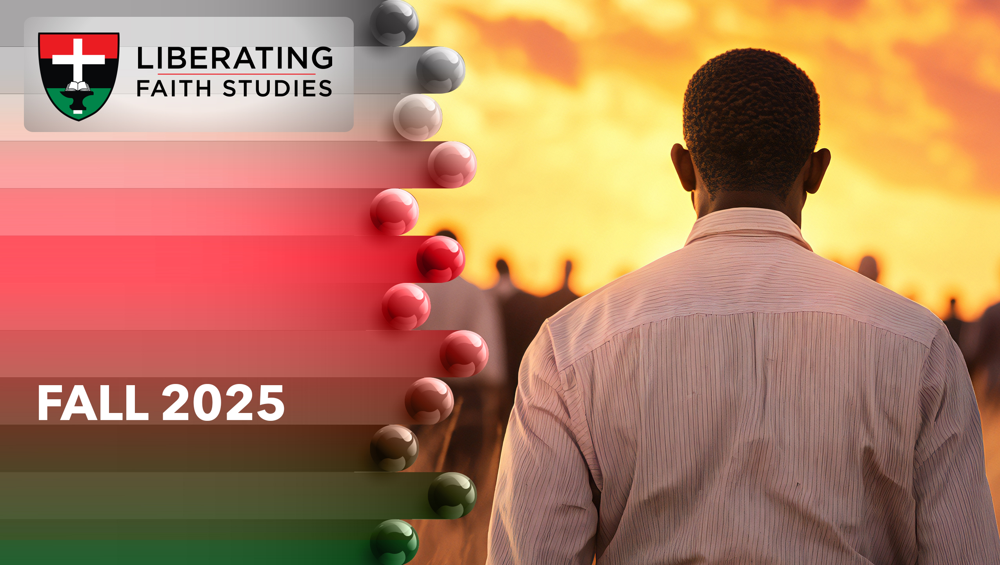
^{LESSON 5: OCTOBER 5}

Slide 2
The Early
Ministry of Jeremiah
Focus Scripture: Jeremiah 1:6-10; 26:8-9, 12-1
Key Verse: The Lord said to me, “Do not say, ‘I am only a boy,’ for you shall go to all to whom I send you, and you shall speak whatever I command you.” Jeremiah 1:7
(NRSV UE)

Slide 3
Jeremiah 1:6-10; 26:8-9, 12-16
(NRSV UE)
^{Jeremiah1:6-10}
6 Then I said, “Ah, Lord God! Truly I do not know how to speak, for I am only a boy.”
7 But the Lord said to me, “Do not say, ‘I am only a boy,’ for you shall go to all to whom I send you, and you shall speak whatever I command you.
8 Do not be afraid of them, for I am with you to deliver you, says the Lord.”
9 Then the Lord put out his hand and touched my mouth, and the Lord said to me, “Now I have put my words in your mouth.
10 See, today I appoint you over nations and over kingdoms, to pluck up and to pull down, to destroy and to overthrow, to build and to plant.”
^{26:8-9}
8 And when Jeremiah had finished speaking all that the Lord had commanded him to speak to all the people, then the priests and the prophets and all the people laid hold of him, saying, “You shall die!

Slide 4
9 Why have you prophesied in the name of the Lord, saying, ‘This house shall be like Shiloh, and this city shall be desolate, without inhabitant’?” And all the people gathered around Jeremiah in the house of the Lord.
¹²⁻¹⁶
12 Then Jeremiah spoke to all the officials and all the people, saying, “It is the Lord who sent me to prophesy against this house and this city all the words you have heard.
13 Now therefore amend your ways and your doings, and obey the voice of the Lord your God, and the Lord will change his mind about the disaster that he has pronounced against you.
14 But as for me, here I am in your hands. Do with me as seems good and right to you.
15 Only know for certain that if you put me to death, you will be bringing innocent blood upon yourselves and upon this city and its inhabitants, for in truth the Lord sent me to you to speak all these words in your ears.”
16 Then the officials and all the people said to the priests and the prophets, “This man does not deserve the sentence of death, for he has spoken to us in the name of the Lord our God.”

Slide 5
^{Key Terms}
Jeremiah – Hebrew meaning: “Whom Jehovah has appointed.”
Anathoth — Israelite city located about 3-5 miles from Jerusalem; given to the Levites located in Benjamin’s territory; Hebrew meaning: “answers to prayer.”
Shiloh — The ark of the covenant was located in Shiloh and captured by the Philistines; the town was destroyed subsequently in battle with the Philistines.
Repent— Hebrew word “naham”; definition, “moved to pity, feel compassion.”
Your title here

Slide 6


Slide 7
A most challenging task was given to a young man, Jeremiah. He was keenly aware of the apostasy and idolatry ingrained in Judah. Jeremiah knew that previous warnings proved to be of insignificant effect. Isaiah, Amos, Hosea, Micah, Joel, Habakkuk, and Zephaniah – all sent by God – could not persuade Judah to repent, to turn from idol worship. Surely, if these prophets’ lives had made a difference and caused them harm even for some unto death, God could not expect Jeremiah to fare any better.

Slide 8
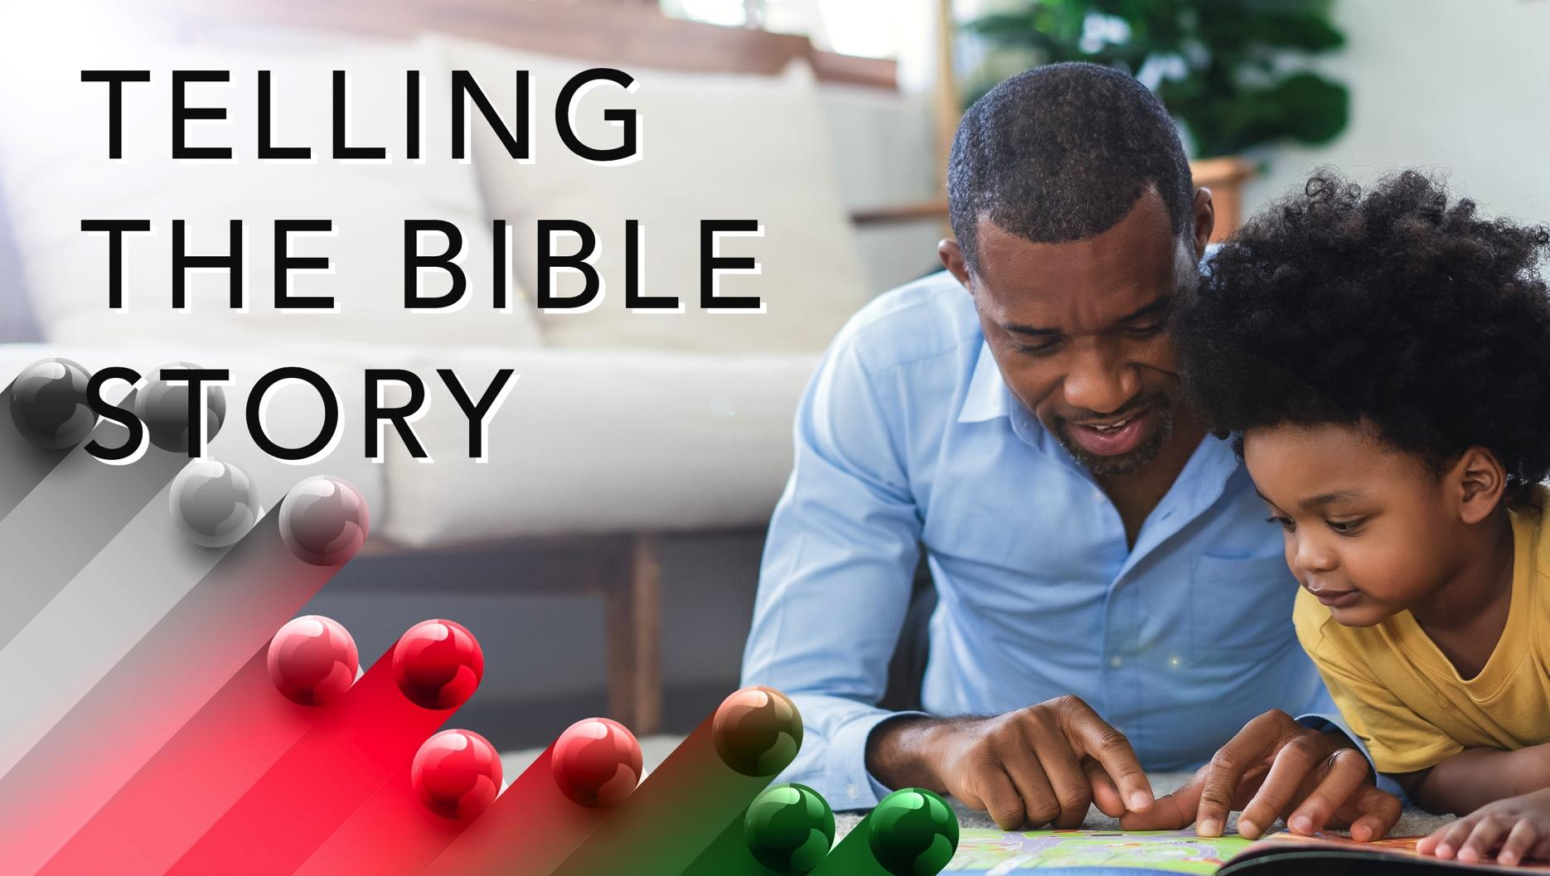

Slide 9
Jeremiah 1:6-10
Jeremiah lived during a time of great upheaval. Judah was under constant attack – the people did not adhere to covenantal commands, they spurned the prophets, injustice prevailed, and – most abhorrent – they worshiped idols. God remained true to the promise “that if you (Israel) fully obey the Lord your God and carefully follow all God’s commands I give you today, the Lord your God will set you high above all the nations on earth” (Deut. 28:1 NIV).
A wonderful serenity has taken possession

Slide 10


Slide 11
Zora Hurston, born in Notasulga, Alabama on January 7, 1891, became known for her writing. She authored several novels and short stories that usually focused on southern black life. Early in her life, Hurston’s family moved to Eatonville, Florida. Her education included finishing high school at Morgan College, completing an Associate of Arts degree at Howard University, and earning a Bachelor of Arts degree in anthropology from Barnard College. Her dedication to advancing black culture led her to travel to Haiti and Jamaica.
A wonderful serenity has taken possession

Slide 12


Slide 13
Amanda Gorman became known at President Joe Biden’s inauguration. She was the youngest inaugural poet in the history of the United States. Reciting her poem, The Hill We Climb, Gorman raised a thought-provoking question, “When day comes, we ask ourselves, where can we find light in this never-ending shade?” She graduated cum laude from Harvard University.

Slide 14
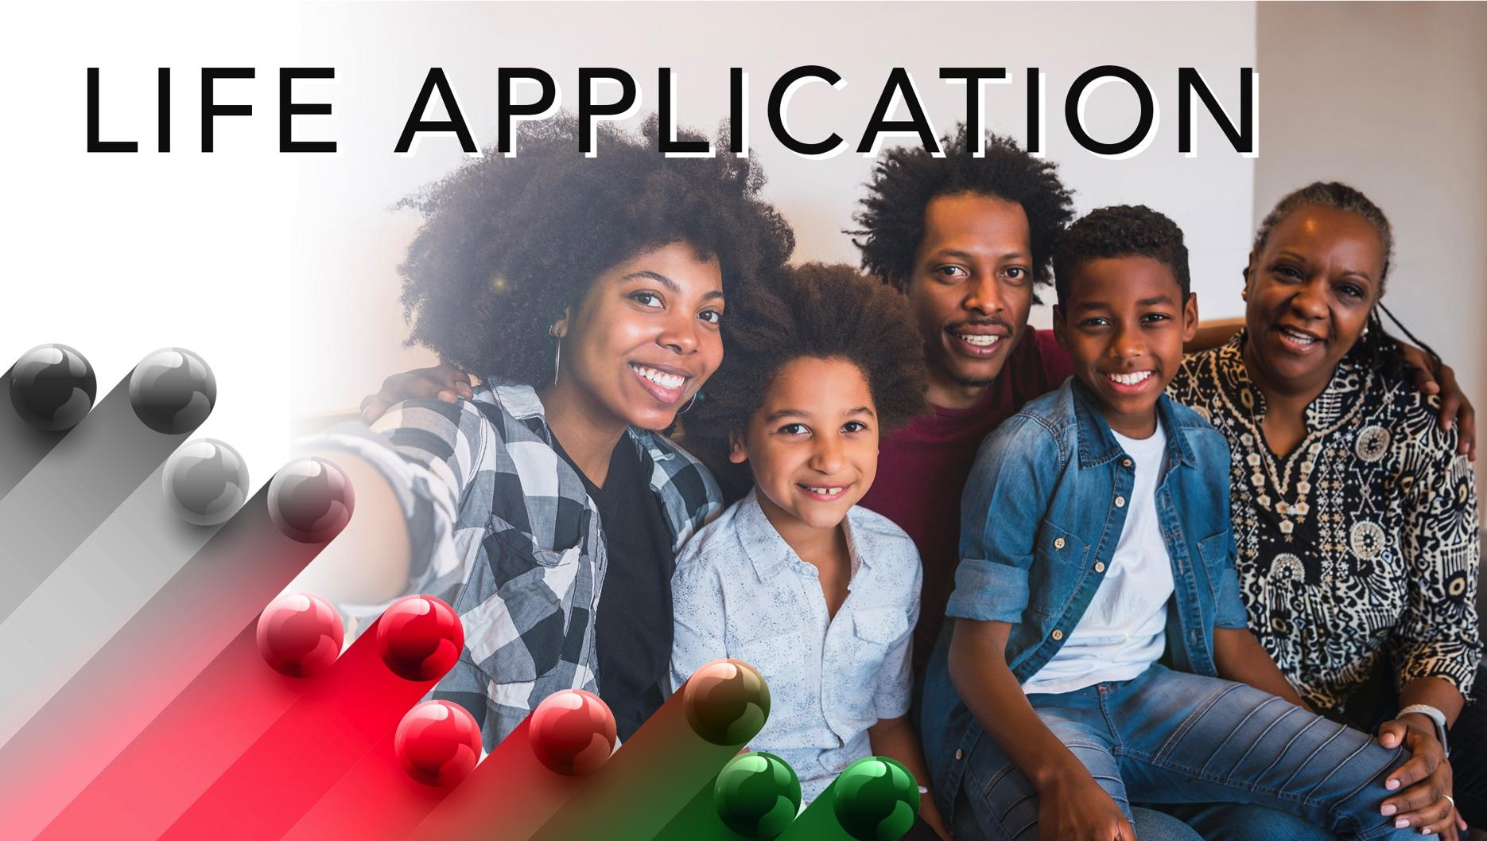

Slide 15
God places gifts in each person. These gifts for God’s glory, which, when used by people, can have unanticipated consequences. While it would be considered a blessing to be applauded and praised, God intends your works to point people to Jesus. Your footsteps may send you to unexpected places.

Slide 16


Slide 17
1. How old should a person be before assuming a leadership position in the church? clergy? lay?

Slide 18
2. What gifts do you think God gave you before you were born?

Slide 19
3. What is the hardest thing God has asked you to do?

Slide 20
4. Where did you see Jesus in today’s lesson?

Slide 21
5. How will you apply what you learned today?

Slide 22
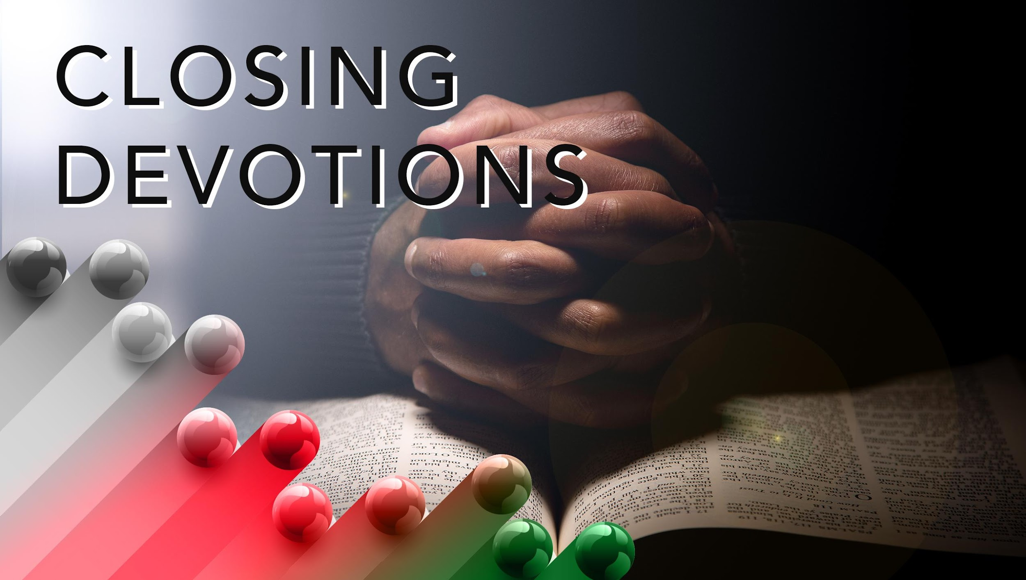

Slide 23
“Yes, God Is Real” – Hymn #361, African Methodist Episcopal Church (AMEC) Hymnal
Closing Prayer: Dear Lord, we live in a time of misinformation and falsehoods, where evil doers strategize ways to make false claims and damage the character of good people. We live in a time where people seek to steal our identities and scam us out of money. We are constantly on guard from predators. We know this is not pleasing to you. Yet, you have mercy on even the most sinful and dishonest individuals if they are willing to repent and turn to Jesus. We know this is your agape love. We pray that you will first protect us from those who can inflict harm upon us through their words and deeds. We pray for restitution and

Slide 24
restoration for those who are victims. And we pray for righteous souls that strive for honesty for ourselves, our families, and our friends. Guard our hearts, Lord, that we are not led astray or tempted to act unscrupulously but to always be a positive representative of Christ. This we pray in Jesus’ name. Amen.

