Slide 1
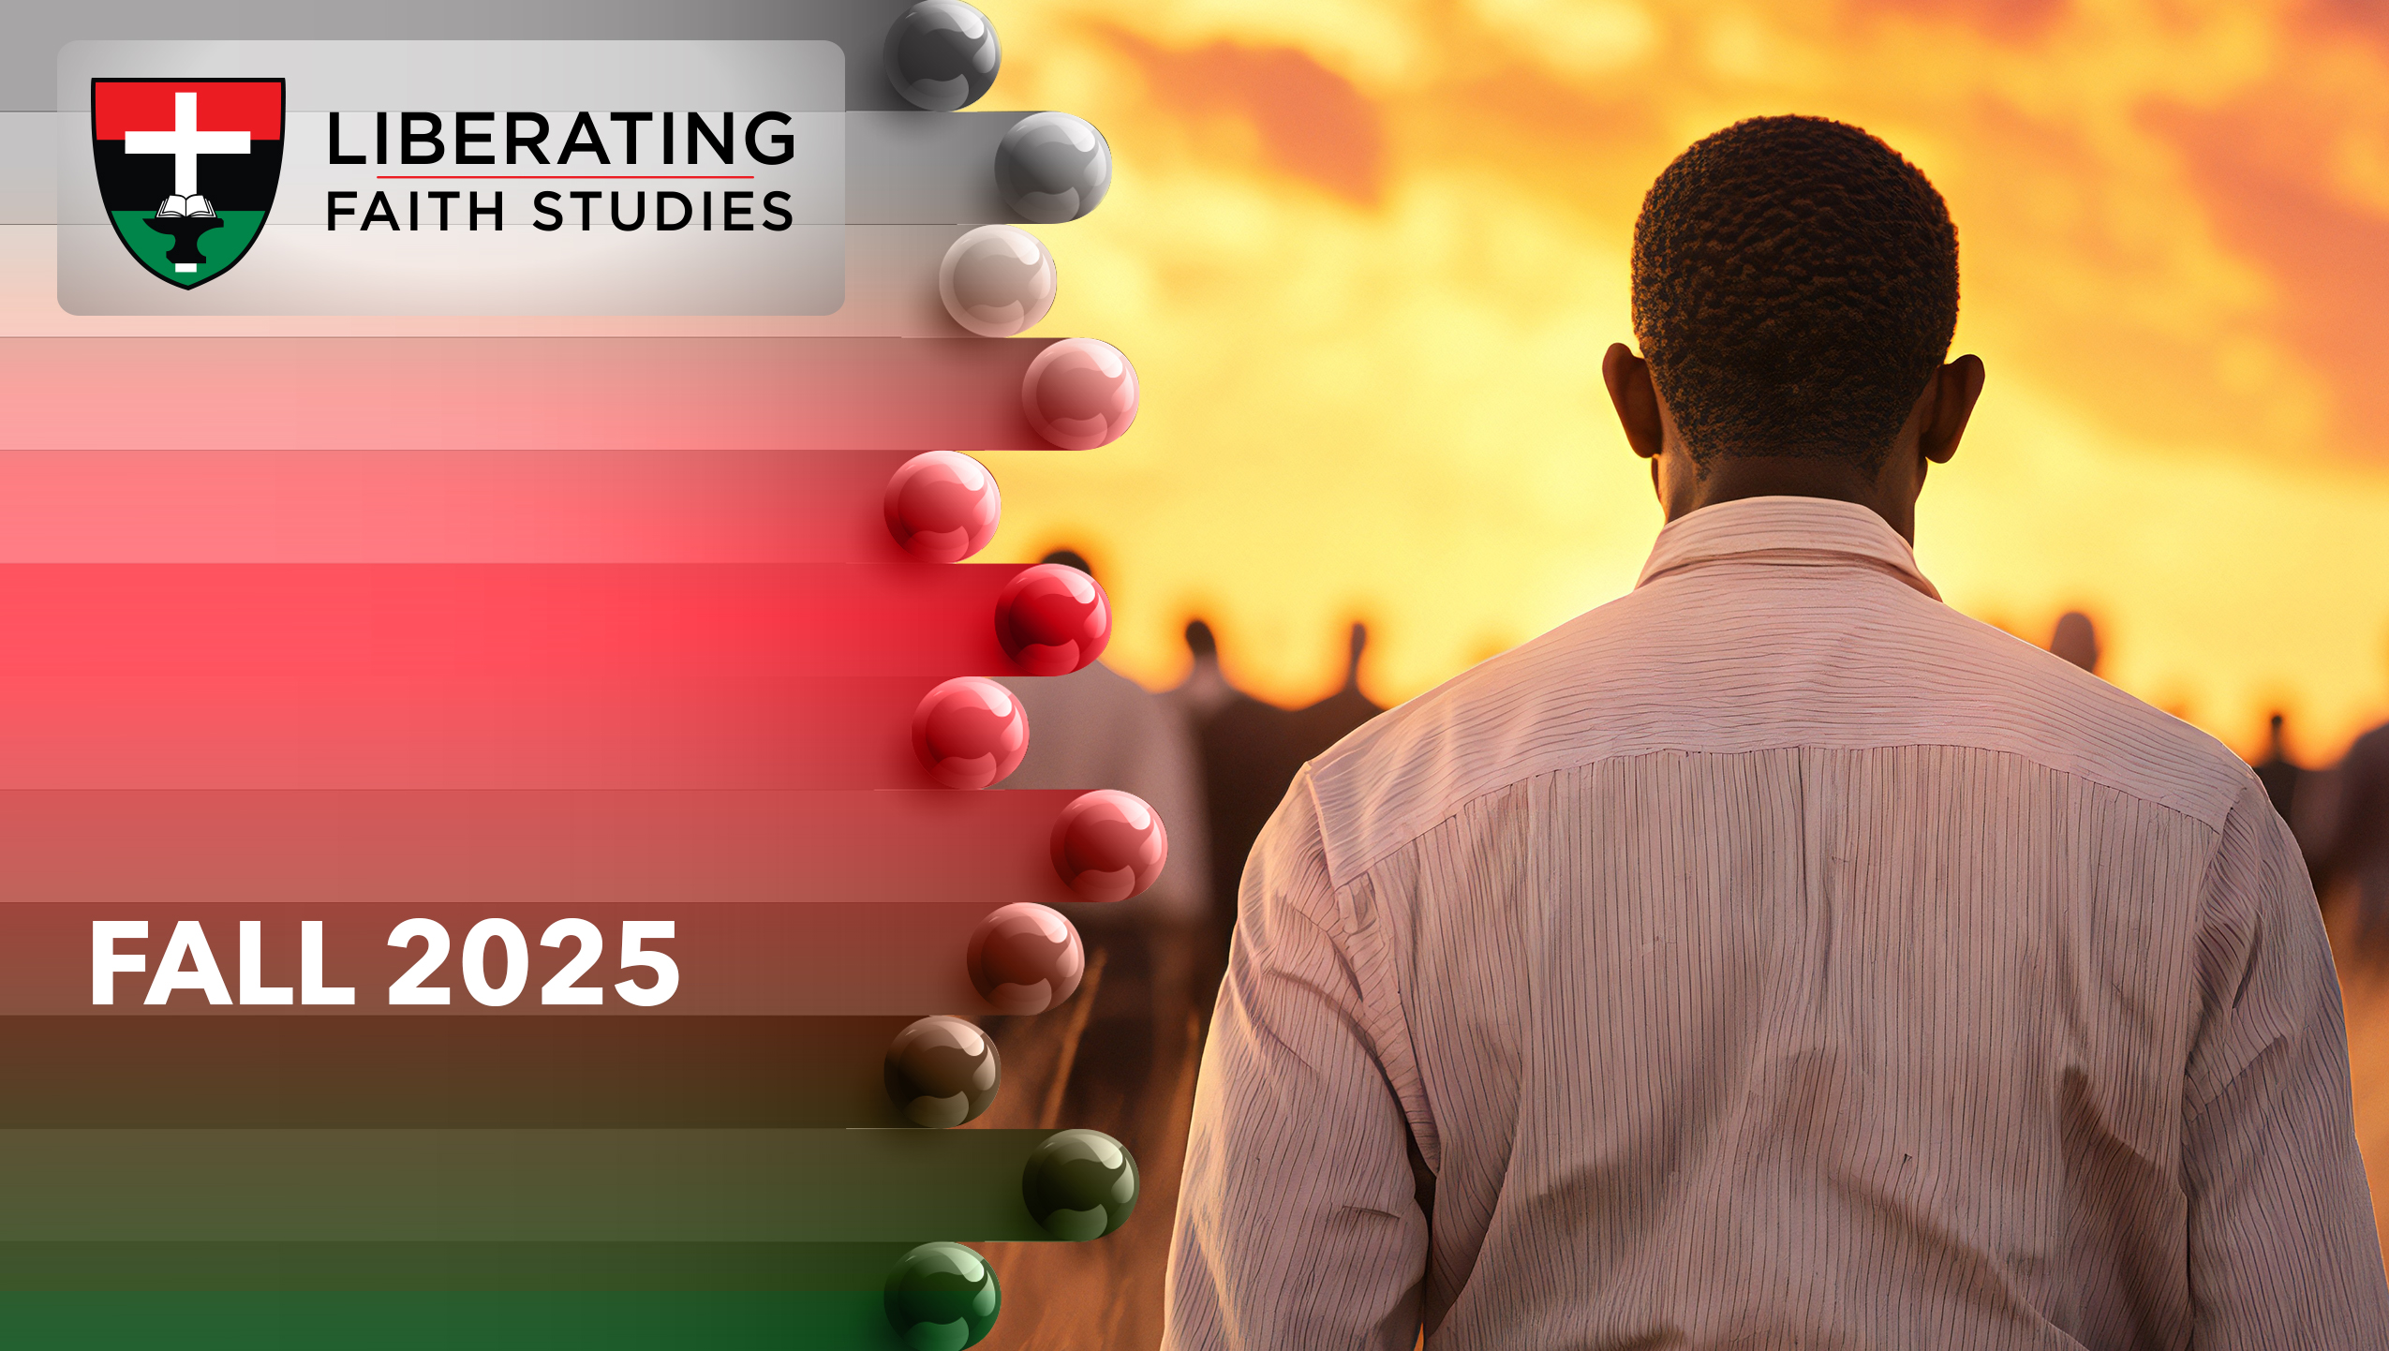
^{LESSON 4: SEPTEMBER 28}

Slide 2
The Suffering Servant
of the Lord
Focus Scripture: Isaiah 53:1-7
Key Verse: (All we like sheep have gone astray; we have all turned to our own way, and the Lord has laid on him the iniquity of us all. Isaiah 53:6 (NRSV UE)

Slide 3
Isaiah 53:1-7 (NRSV UE)
1 Who has believed what we have heard? And to whom has the arm of the Lord been revealed?
2 For he grew up before him like a young plant and like a root out of dry ground; he had no form or majesty that we should look at him, nothing in his appearance that we should desire him.
3 He was despised and rejected by others; a man of suffering and acquainted with infirmity, and as one from whom others hide their faces he was despised, and we held him of no account.
4 Surely he has borne our infirmities and carried our diseases, yet we accounted him stricken, struck down by God, and afflicted.
5 But he was wounded for our transgressions, crushed for our iniquities; upon him was the punishment that made us whole, and by his bruises we are healed.
6 All we like sheep have gone astray; we have all turned to our own way, and the Lord has laid on him the iniquity of us all.
7 He was oppressed, and he was afflicted, yet he did not open his mouth; like a lamb that is led to the slaughter and like a sheep that before its shearers is silent, so he did not open his mouth.

Slide 4
^{Key Terms}
Arm – Symbolizes power, military might.
Despised – Hebrew word “baza” means “to regard with contempt, despise.”
Wounded – Hebrew word “halal” means “to fatally bore through, to profane, make common.”
Transgressions – Hebrew word “pesa” means “rebellion against, moral or religious revolt.”
Heal – Hebrew word “rapa” definition: repaired completely, to make healthy, restored, cured.
Judah – The southern kingdom after the nation of Israel divided following Solomon’s reign.
Your title here

Slide 5


Slide 6
Isaiah 40–55, referred to as Deutero-Isaiah, is often attributed to a second anonymous writer. These passages use poetry to paint vivid pictures. Known as “the servant’s song,” today’s lesson includes one such poem. God used people’s various gifts to convey messages to Judah. Prophets, like Isaiah, had the responsibility of conveying God’s heart to the people and relaying the people’s words to God.

Slide 7


Slide 8
Judah found themselves in difficulty. Assyrian war efforts had expanded. Intent upon dominating nations to their west, Assyria had conquered Israel, the northern kingdom, and exiled its inhabitants. Under constant Assyrian assault, Judah had few war resources. Military aid from other countries was nonexistent; and though the Assyrian kingdom had diminished, the Babylon empire’s war machine had begun to rise. Things seem to be going from bad to worse. After a succession of several idolatrous kings, Judah was beginning to see God’s anger manifested in the natural. Babylon placed Judah under siege. Israel’s turn to Egypt for military assistance proved futile.
A wonderful serenity has taken possession

Slide 9


Slide 10
Aaron Douglas, an African American painter and graphic artist, received his education at Douglas High School in Topeka, Kansas, University of Nebraska, and Columbia University’s Teachers College. As a Barnes Foundation fellow in Philadelphia, Pennsylvania, Douglas studied African and modern art.
A wonderful serenity has taken possession

Slide 11


Slide 12
Born legally blind, Lateefah Simon dedicates her life to fighting for justice. At sixteen, she became an outreach coordinator for the Young Women’s Freedom Center. Being a young mother, Simon understood the challenges and opportunities these women faced. She advocates for young women who stand on the fringes of society. She has had innumerable appointments including Board of Trustees, a member for the California State University and senior advisor on police reform in California.

Slide 13


Slide 14
The promised Messiah’s return can seem far off. How long before Jesus returns is not an issue. What does matter is that the Messiah will return. He may not look like what you expect or do what you expect. Because God promised the Messiah’s return, there will be a new heaven and a new earth.

Slide 15


Slide 16
1. How do you envision Jesus’ return to earth?

Slide 17
2. How would you explain Isaiah 53 to a non-believer?

Slide 18
3. Why do you think believers fall away from the faith?

Slide 19
4. Where do you see Jesus in today’s lesson?

Slide 20
5. How will you apply what you learned to your life?

Slide 21
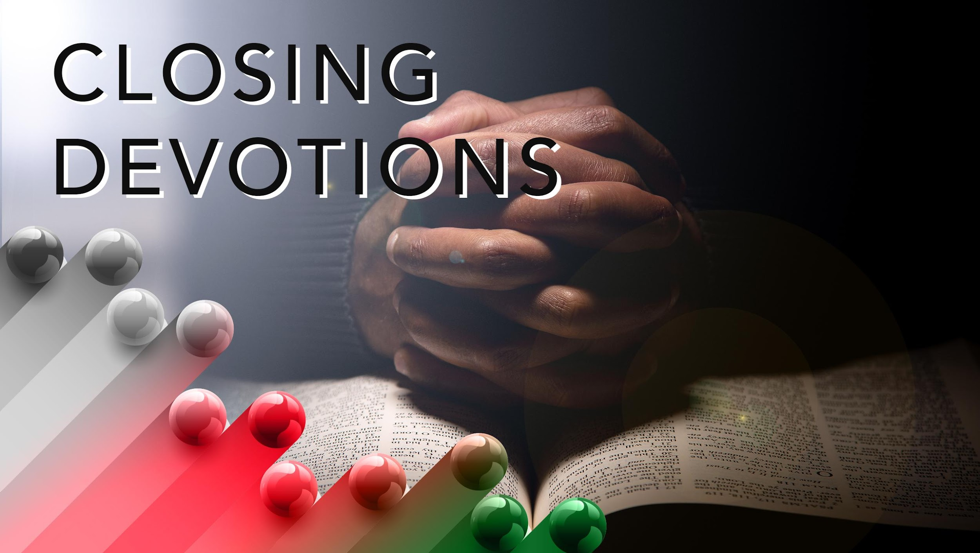

Slide 22
Read the lyrics of the below hymn, “What a Fellowship” (AMECH #525). What does it tell us about God’s arms?
What a fellowship, what a joy divine,
Leaning on the everlasting arms,
What a blessedness, what a peace is mine,
Leaning on the everlasting arms
Leaning, leaning,
Safe and secure, from all alarms,
Leaning, leaning,
Leaning on the, everlasting arms.
Based on today’s lesson, write one or two sentences that you can read whenever you need to be healed.

Slide 23
Prayer: God, may we gain new insights and understanding about how much you love us. Thank you for giving us life and healing in ways we did not anticipate. We are grateful that though we stray, you are faithful bringing us back to you. In Jesus’ name. Amen.

