Slide 1

^{LESSON 3: SEPTEMBER 21}

Slide 2
What Hilkiah Found
in the Temple
Focus Scripture: 2 Chronicles 34:15-22, 26-27
Key Verse: Hilkiah said to the secretary Shaphan, “I have found the book of the law in the house of the Lord,” and Hilkiah gave the book to Shaphan. 2 Chronicles 34:15 (NRSV UE)

Slide 3
2 Chronicles 34:15-22, 26-27 (NRSV UE)
^{2 Chronicles 34:15-22}
15 Hilkiah said to the secretary Shaphan, “I have found the book of the law in the house of the Lord,” and Hilkiah gave the book to Shaphan.
16 Shaphan brought the book to the king and further reported to the king, “All that was committed to your servants they are doing.
17 They have emptied out the silver that was found in the house of the Lord and have delivered it into the hand of the overseers and the workers.”
18 The secretary Shaphan informed the king, “The priest Hilkiah has given me a book.” Shaphan then read it aloud to the king.
19 When the king heard the words of the law, he tore his clothes.
20 Then the king commanded Hilkiah, Ahikam son of Shaphan, Abdon son of Micah, the secretary Shaphan, and the king’s servant Asaiah,
21 “Go, inquire of the Lord for me and for those who are left in Israel and in Judah, concerning the words of the book that has been found, for the wrath of the Lord that is poured out on us is great, because our ancestors did not keep the word of the Lord, to act in accordance with all that is written in this book.”
22 So Hilkiah and those whom the king had sent went to the prophet Huldah, the wife of

Slide 4
Shallum son of Tokhath son of Hasrah, keeper of the wardrobe (who lived in Jerusalem in the Second Quarter) and spoke to her to that effect.
²⁶⁻²⁷
26 “But as to the king of Judah, who sent you to inquire of the Lord, thus shall you say to him: Thus says the Lord, the God of Israel: ‘Regarding the words that you have heard,
27 because your heart was penitent and you humbled yourself before God when you heard his words against this place and its inhabitants, and you have humbled yourself before me and have torn your clothes and wept before me, I also have heard you, says the Lord.’”

Slide 5
^{Key Terms}
Hilkiah – The high priest has a popular priestly name; his name has two Hebrew origins from the verb (halaq) and an abridged form of YHWH, which means “the inheritance of Yahweh” (God’s formal name first mentioned in Exodus 6:2-3).
Huldah – A female prophet; name means “weasel” (a burrowing animal); like her name, she had to unearth and reveal God’s meaning to the people.
Josiah – Means “YHWH heals me.”
Shaphan – Means “a coney”; a scribe or secretary of King Josiah (2 Kings 22:3-7).
Your title here

Slide 6
Torah – The first five books of the Bible or Pentateuch (Genesis, Exodus, Leviticus, Numbers, and Deuteronomy) which Moses gave to Israel as instruction from God. From a Hebrew root that probably meant to throw or shoot an arrow. From this definition comes the idea that sin means to miss the mark
Scroll – Paper made of glued together parchment made from animal skin or papyrus sheets.

Slide 7


Slide 8
Imagine the joy of finding a long-lost treasure. How would you feel? Depending upon what was found you may want everyone to know about your discovery. Now suppose that what you found could change history’s course, by moving people closer to God-centered worship. Who would you tell first? What would you expect society to change? In today’s lesson, a copy of the entire Torah (Pentateuch) or at least a portion of it was discovered in the temple.

Slide 9


Slide 10
2 Chronicles 34:15-22, 26-27
Josiah, Amon’s son and Manasseh’s grandson, unlike his fathers, did what was right in God’s eyes (2 Kings 22:1). He sought God. During the eighteenth year of his reign, he ordered restoration of the temple. Israel’s unfaithfulness to the covenant, often led by idolatrous kings, resulted in neglect of the temple. Funds were raised for materials placed in the temple such as timber and stone to repair roofs and wall openings. According to 2 Chronicles 34:11, the carpenters and the builders received these monies to purchase whatever was needed to repair the temple. Sometime during the repair work, Hilkiah found the Book of the Law.
A wonderful serenity has taken possession

Slide 11


Slide 12
Julia A. J. Foote, a former enslaved person whose father bought her freedom, was born in Schenectady, New York. Her belief in God and worship began early in life. She wanted to read the Bible; however, because of his limited education, her father could not teach her to read. Julia’ great desire to read the Bible resulted in her, at the age of ten, moving in with the Prime family as an indentured servant. While living with the Prime family, Julia’s was able to attend school.
A wonderful serenity has taken possession

Slide 13


Slide 14
James Rucker, a native of Monterey County, California, co-founded two activist groups: Color of Change and Citizen Engagement Lab. He attended Stanford University for two years. Rucker served as a grassroots director for Move On. In that position he strongly dissuaded President George W. Bush from using racist means to win the 2004 election.

Slide 15


Slide 16
Age does not determine a person’s commitment to following God. And age does not decide if a person can lead others in worship and spiritual revival. To quote the Lord in Jeremiah’s call, “Do not say, ‘I am a youth,’ because everywhere I send you, you shall go, And all that I command you, you shall speak” (Jeremiah 1:7). Josiah gives an example that God calls whoever is needed whenever that person is needed – and that is not age dependent.

Slide 17


Slide 18
1. In this age of electronics, what is the role of hard-copy Bibles?

Slide 19
2. How long are you willing to listen to Bible readings?

Slide 20
3. What value is there in reading the Bible aloud?

Slide 21
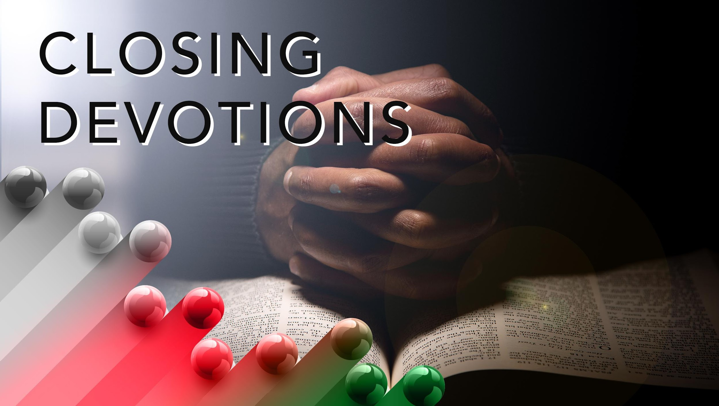

Slide 22
Read Psalm 51:1-12. Think about how these words apply to the church, community, and you
Have mercy on me, O God,
according to your unfailing love;
according to your great compassion
blot out my transgressions.
² Wash away all my iniquity
and cleanse me from my sin.
³ For I know my transgressions,
and my sin is always before me.
⁴ Against you, you only, have I sinned
and done what is evil in your sight;

Slide 23
so you are right in your verdict
and justified when you judge.
⁵ Surely I was sinful at birth,
sinful from the time my mother conceived me.
⁶ Yet you desired faithfulness even in the womb;
you taught me wisdom in that secret place.
⁷ Cleanse me with hyssop, and I will be clean;
wash me, and I will be whiter than snow.
⁸ Let me hear joy and gladness;
let the bones you have crushed rejoice.
⁹ Hide your face from my sins
and blot out all my iniquity.

Slide 24
and renew a steadfast spirit within me.
¹¹ Do not cast me from your presence
or take your Holy Spirit from me.
¹² Restore to me the joy of your salvation
and grant me a willing spirit, to sustain me.
Prayer: Dear God, help us to keep our hearts and minds fixed on you. May we take care of your temple, our bodies, and your physical buildings, our churches, as part of our worship. May our desire to read and hear your Word lead us to do those things you command. And may we repent and grieve whenever we miss the mark, so we receive your mercy, and not your anger. In Jesus’ name. Amen.

