Slide 1
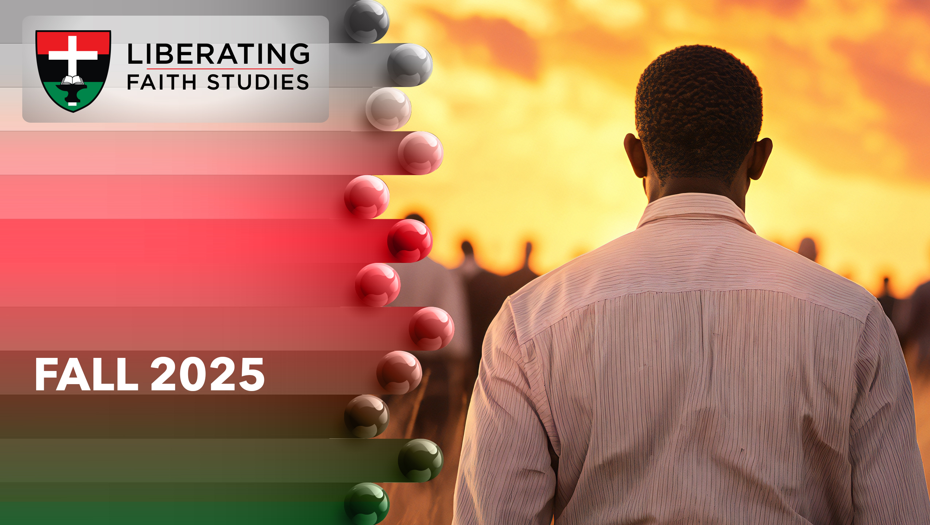
^{LESSON 2: September 14}

Slide 2
Hezekiah Leads the People Back to God
Focus Scripture: 2 Chronicles 30:1-9, 26-27
Key Verse: There was great joy in Jerusalem, for since the time of Solomon son of King David of Israel there had been nothing like this in Jerusalem. 2 Chronicles 30:26 (NRSV UE)

Slide 3
2 Chronicles 30:1-9, 26-27 (NRSV UE)
^{2 Chronicles 30:1-9}
1 Hezekiah sent word to all Israel and Judah and wrote letters also to Ephraim and Manasseh, that they should come to the house of the Lord at Jerusalem, to keep the Passover to the Lord the God of Israel.
2 For the king and his officials and all the assembly in Jerusalem had taken counsel to keep the Passover in the second month
3 (for they could not keep it at its proper time because the priests had not sanctified themselves in sufficient number, nor had the people assembled in Jerusalem).
4 The plan seemed right to the king and all the assembly.
5 So they decreed to make a proclamation throughout all Israel, from Beer-sheba to Dan, that the people should come and keep the Passover to the Lord the God of Israel, at Jerusalem, for they had not kept it in great numbers as prescribed.
6 So couriers went throughout all Israel and Judah with letters from the king and his officials, as the king had commanded, saying, “O people of Israel, return to the Lord, the God of Abraham, Isaac, and Israel, so that he may turn again to the remnant of you who have escaped from the hand of the kings of Assyria.

Slide 4
7 Do not be like your ancestors and your kindred, who were faithless to the Lord God of their ancestors, so that he made them a desolation, as you see.
8 Do not now be stiff-necked as your ancestors were, but yield yourselves to the Lord and come to his sanctuary, which he has sanctified forever, and serve the Lord your God, so that his fierce anger may turn away from you.
9 For as you return to the Lord, your kindred and your children will find compassion with their captors and return to this land. For the Lord your God is gracious and merciful and will not turn away his face from you, if you return to him.”
²⁶⁻²⁷
26 There was great joy in Jerusalem, for since the time of Solomon son of King David of Israel there had been nothing like this in Jerusalem.
27 Then the priests and the Levites stood up and blessed the people, and their voice was heard; their prayer came to his holy dwelling in heaven.

Slide 5
^{Key Terms}
Chronicles – In the Jewish Bible (the Tankah), Chronicles is the last and concluding book – it gives a summary of Israel’s history and provides hope for a better future.
Hezekiah – Derived from the Hebrew root “chazak” (be strong) which means “YHWH strengthens.”
Idol – Hebrew “elohim acheirim,” literally “other gods.”
Passover – Hebrew “Pesach” which means “skipping”; the celebration is an eight-day festival beginning on the 14th day of the Jewish month of Nisan.
From Dan to Beersheba – Dan was the northernmost area where Israel settled, and Beersheba was the southernmost
Your title here

Slide 6
area of settlement; the expression “from Dan to Beersheba” is equivalent to our phrases “from east to west,” or “from north to south.”
Assyria – Known for its powerful military, arts, culture, medicine, and education.
Nisan (or Nissan) – The first month on Jewish calendar.

Slide 7


Slide 8
God established Passover, a festival celebrating deliverance and liberation. After over 400 years in Egypt, Israel became an independent nation. Initially, Pharoah welcomed Israel to Egypt. But after Joseph’s death and a new Pharoah began to rule, Israel was forced into servitude.

Slide 9
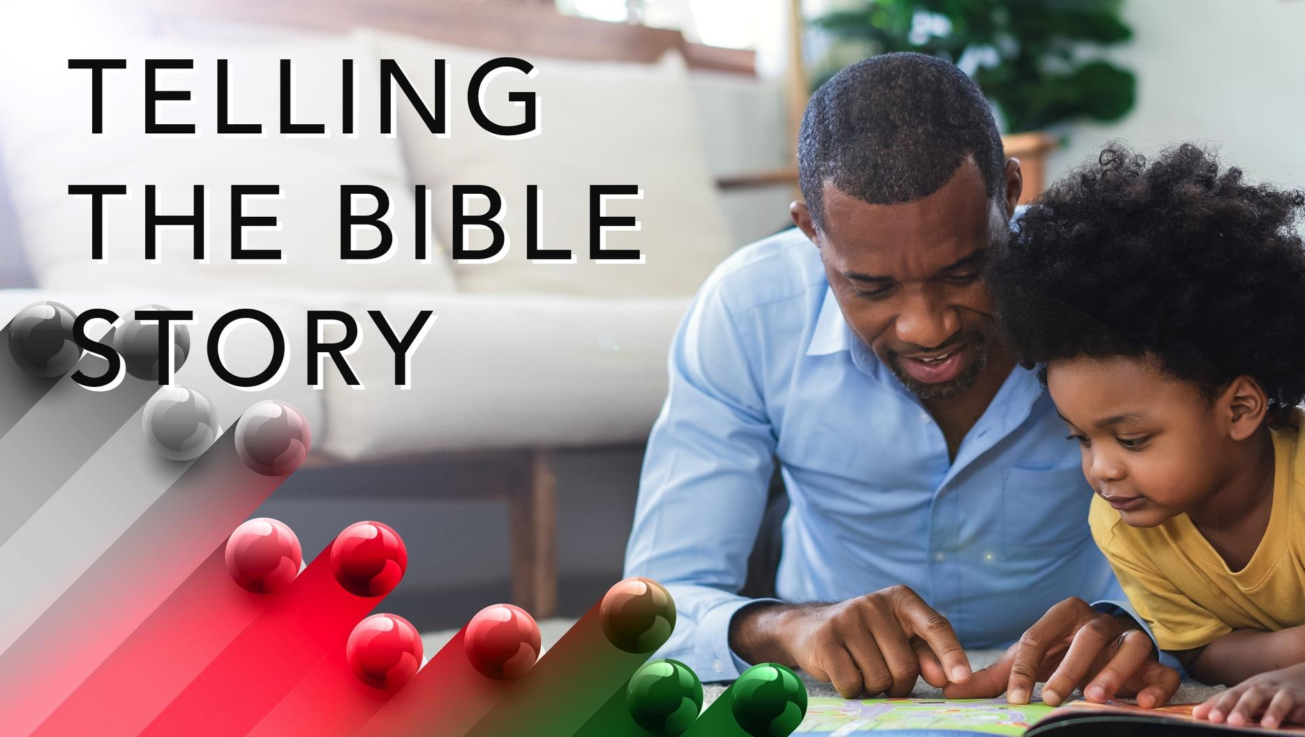

Slide 10
^{2 Chronicles 30:1-9}
When Hezekiah was twenty-five, he became Judah’s, the southern kingdom’s, king. Unlike Ahaz, his father, Hezekiah was not a wicked king. Maybe Hezekiah’s remembrance of his father’s deeds, and the consequences (continued Assyrian attacks against Judah) that followed, led him to act differently.
A wonderful serenity has taken possession

Slide 11


Slide 12
Emancipation celebrations in the United States date back to the 19th century. Juneteenth, now a national holiday, commemorates enslaved Texans’ freedom. However, there were other communities and cities where black residents celebrated emancipation. In 1865, black farmers in Tampa, Florida borrowed American flags to celebrate their freedom.
A wonderful serenity has taken possession

Slide 13


Slide 14
April 27 is Freedom Day which is the South African celebration of the country’s first democratic election. This day reminds the country of its announced official end of apartheid. The day – filled with parades, visits to monuments, and street parties – symbolizes what should have been a complete end to unjust policies.

Slide 15
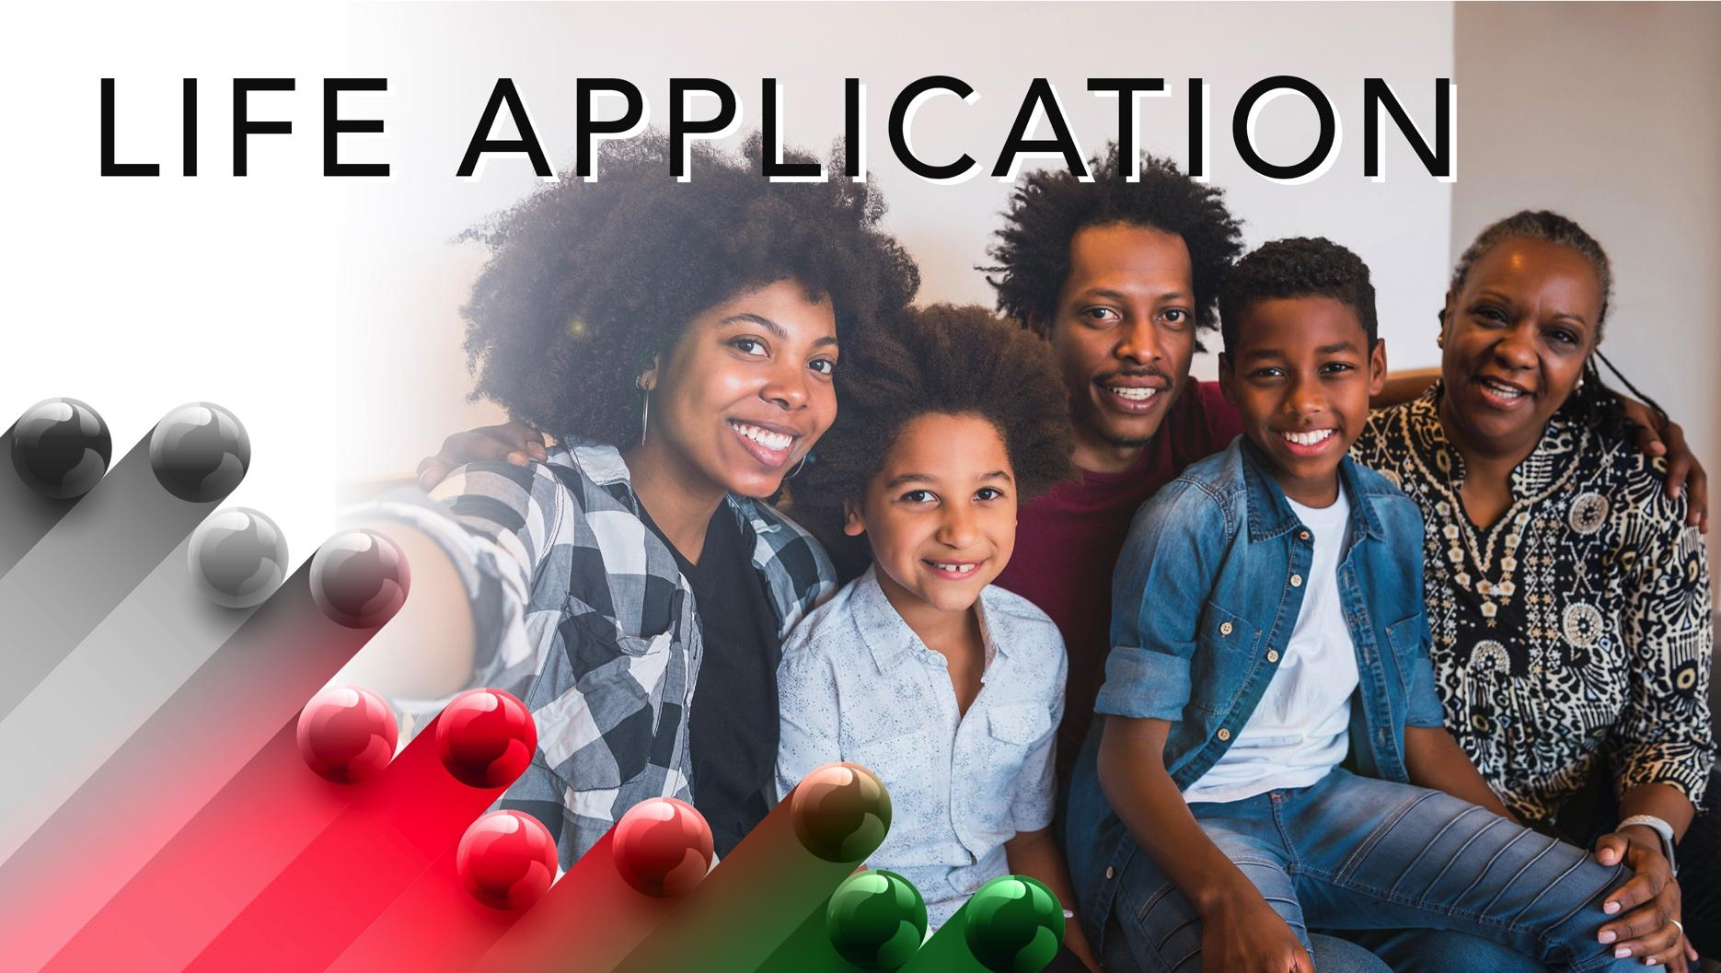

Slide 16
Celebrations have significance. The church calendar has seasons, i.e., Advent, Lent, and Pentecost. Each year, Christians have the opportunity to remember what God has done, is doing, and will do in building the Lord’s kingdom. Too often, like Israel, God’s holidays have lost their significance. Christmas trees, wreaths, and gifts, Easter eggs and baskets, and for some turkey, gravy, and cranberry sauce have shifted the focus from God to things.

Slide 17


Slide 18
1. What special days does the church celebrate? How important is it to participate in these celebrations?

Slide 19
2. What celebrations remind Christians of the freedom Jesus offers? (so, if the Son sets you free, you will be free indeed, John 8:36)

Slide 20
3. Why do you think after praise and worship celebrations people turn from God?

Slide 21
4. Where do you see Jesus in today’s lesson?

Slide 22
5. How will you apply what you learned to your life?

Slide 23
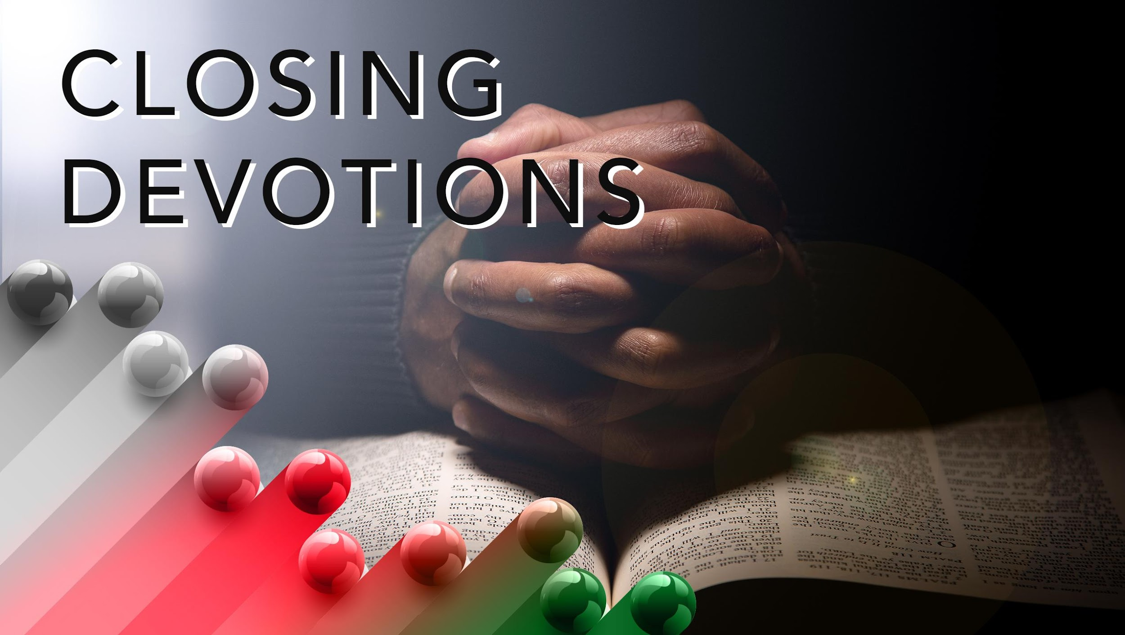

Slide 24
Meditate on the words from this hymn, “Sing the Wondrous Love of Jesus” (AMECH #511)
Sing the wondrous love of Jesus,
^{Sing his mercy and his grace;}
In the mansions bright and blessed
^{He’ll prepare for us a place.}
Refrain: When we all get to heaven,
What a day of rejoicing that will be!
^{When we all see Jesus,}
We’ll sing and shout the victory!

Slide 25
Prayer: Lord, thank you for the many ways you demonstrate your power on earth. Help us to see and hear with our spiritual senses. Please give us the courage to share the miraculous we experience every time a new life enters the world. In Jesus’ name. Amen.

