Slide 1
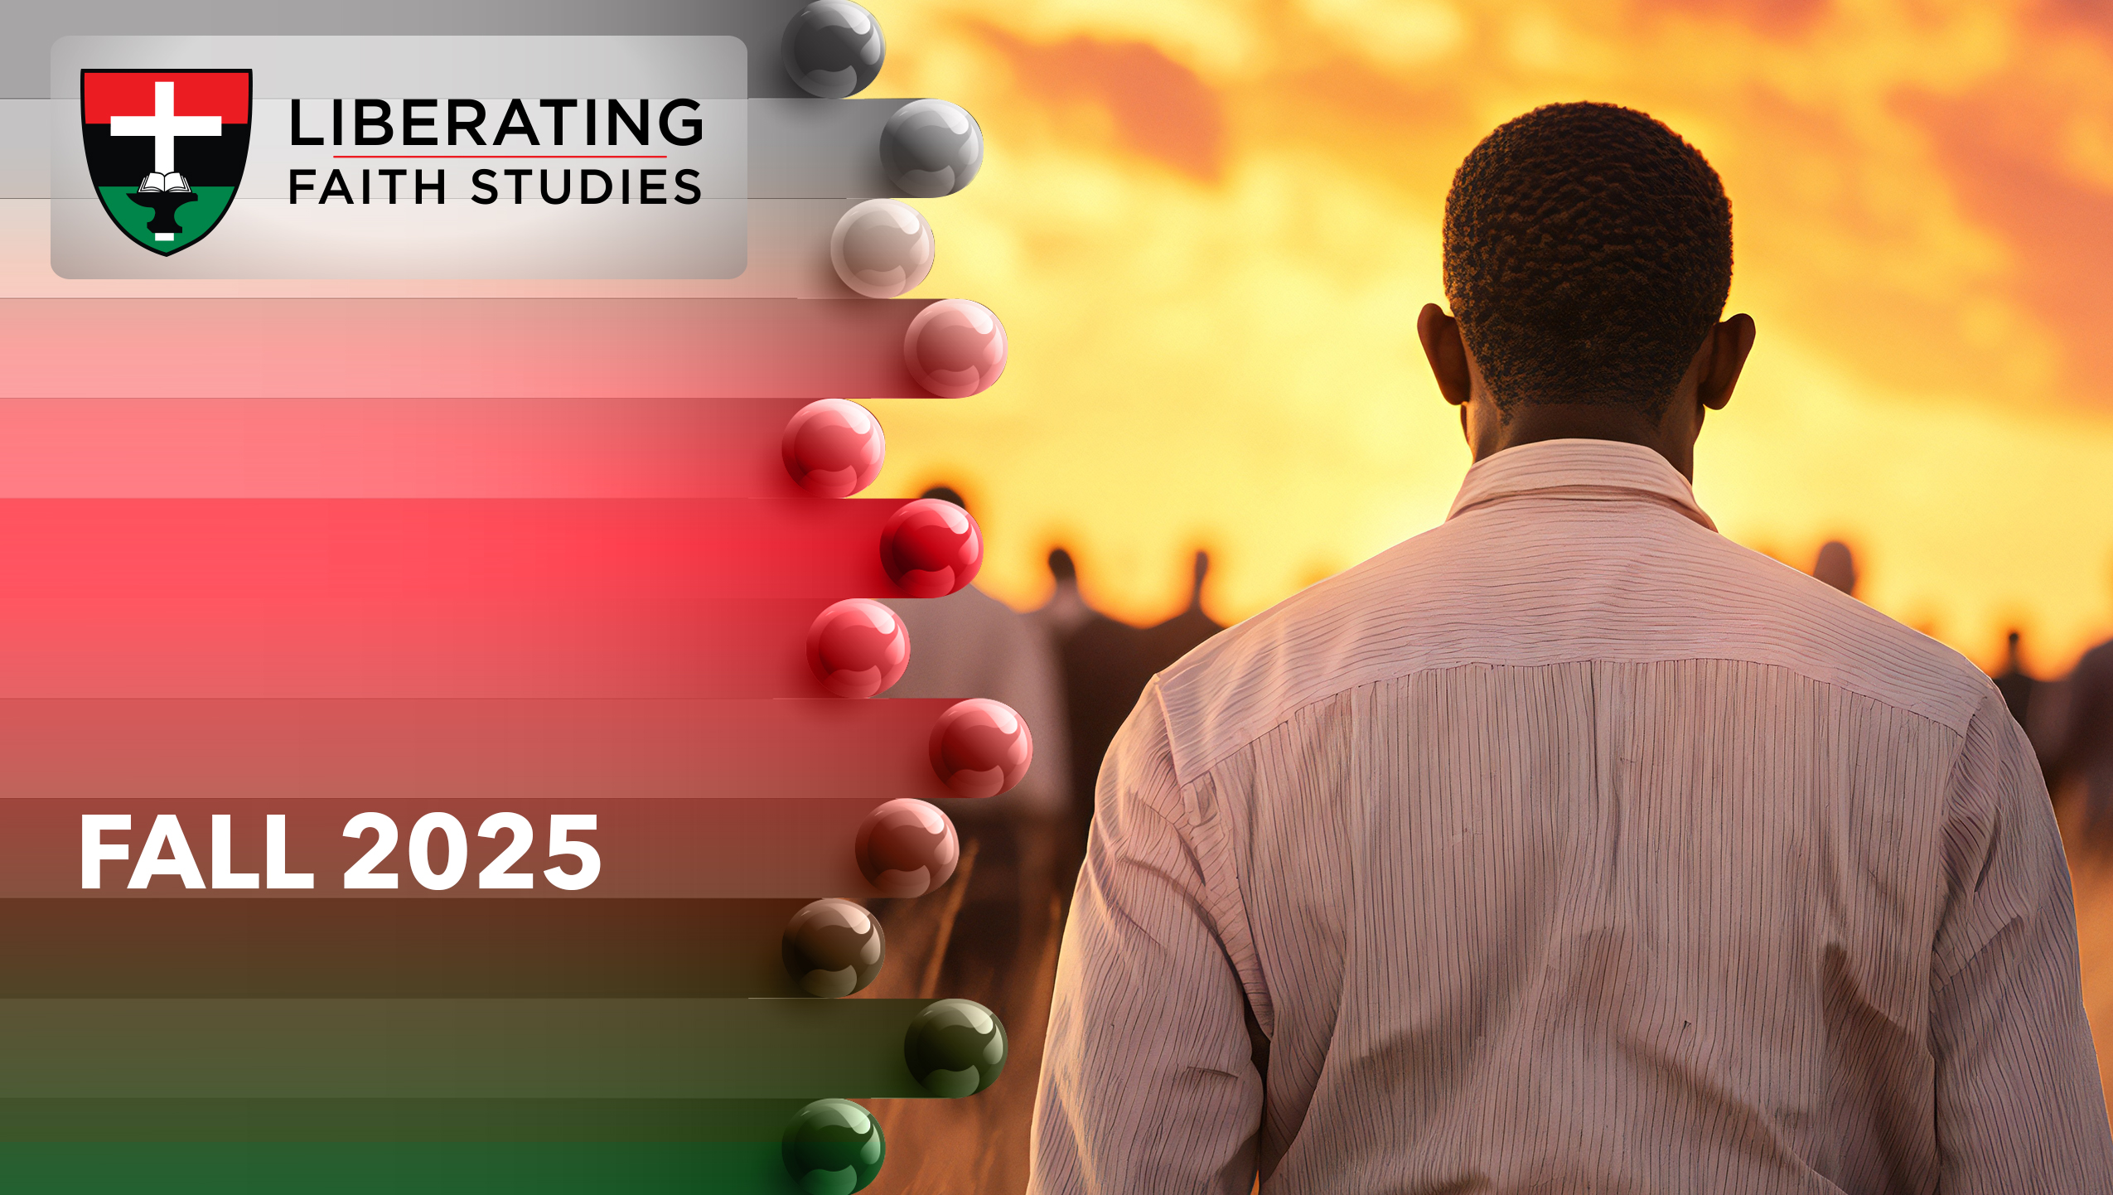
^{LESSON 13: NOVEMBER} ³⁰

Slide 2
Ezekiel’s Vision of Hope
Focus Scripture: Ezekiel 47:1-9, 12
Key Verse: On the banks, on both sides of the river, there will grow all kinds of trees for food. Their leaves will not wither nor their fruit fail, but they will bear fresh fruit every month, because the water for them flows from the sanctuary. Their fruit will be for food and their leaves for healing. Ezekiel 47:12 (NRSV UE)

Slide 3
Ezekiel 47:1-9, 12 (NRSV UE)
^{Ezekiel 47:1-9}
1 Then he brought me back to the entrance of the temple; there water was flowing from below the entryway of the temple toward the east (for the temple faced east), and the water was flowing down from below the south side of the temple, south of the altar.
2 Then he brought me out by way of the north gate and led me around on the outside to the outer gate that faces toward the east, and the water was trickling out on the south side.
3 Going on eastward with a cord in his hand, the man measured one thousand cubits and then led me through the water, and it was ankle-deep.
4 Again he measured one thousand and led me through the water, and it was knee-deep. Again he measured one thousand and led me through the water, and it was up to the waist.
5 Again he measured one thousand, and it was a river that I could not cross, for the water had risen; it was deep enough to swim in, a river that could not be crossed.
6 He said to me, “Mortal, have you seen this?” Then he led me back along the bank of the river.
7 As I came back, I saw on the bank of the river a great many trees on the one side and on the other.

Slide 4
8 He said to me, “This water flows toward the eastern region and goes down into the Arabah, and when it enters the sea, the sea of stagnant waters, the water will become fresh.
9 Wherever the river goes, every living creature that swarms will live, and there will be very many fish once these waters reach there. It will become fresh, and everything will live where the river goes.”
¹²
12 “On the banks, on both sides of the river, there will grow all kinds of trees for food. Their leaves will not wither nor their fruit fail, but they will bear fresh fruit every month, because the water for them flows from the sanctuary. Their fruit will be for food and their leaves for healing.”

Slide 5
^{Key Terms}
En-gedi – Hebrew definition, “spring of the kid” or “spring of the young goat”; the name of a Judaean wilderness town on the western shore of the Dead Sea.
En-eglaim – Hebrew definition, “fountain of the two calves”; a place in Palestine near the Dead Sea, exact site of the location uncertain.
Your title here

Slide 6


Slide 7
Water, a much-needed commodity in land–locked Judah, oozed from under the temple. Starting as a small trickle, the water increased until it became impassable on foot so that Ezekiel had to swim in it.

Slide 8


Slide 9
Background
Ezekiel continued a guided tour that had begun in chapter 40. Twenty-five years after Judah’s exile and fourteen years after Jerusalem’s destruction, God gave Ezekiel a vision for a renewed and restored Israel. In Ezekiel’s vision there was a man standing in the temple’s gateway whose appearance shone like bronze, with a linen cord and a measuring reed in his hand. This man took Ezekiel on a visionary tour and instructed him to share the vision with Israel. Ezekiel was shown a new temple including its nave, doorposts, chambers, walls, altar, weights, and measures, and, most importantly, the divine glory’s return to the temple.
A wonderful serenity has taken possession

Slide 10


Slide 11
Dr. George Washington Carver, born enslaved, was a botanist and educator. His faith combined with his intellect resulted in the discovery of more than 300 ways to use peanuts and 100 uses for sweet potatoes.
A wonderful serenity has taken possession

Slide 12


Slide 13
Dr. Tanisha Williams, a Washington, D.C. native, devotes her career to plants. The creation of Black Botanists Week resulted from Williams’ commitment to providing a new space for black people who are plant lovers. As a botanist and plant ecologist, Williams encourages attention to climate change, promotes rare plant conservation, and recognizes how indigenous people assist plant health worldwide.

Slide 14


Slide 15
Churches have a responsibility to care for the environment and to share the world’s resources. Living water flowed from the temple out to all of the world. As members evangelize, it would be helpful to organize a plant and garden beautification project in your church and community.

Slide 16


Slide 17
1. How can churches promote environmental justice? (AME Church’s Climate Justice work: https:// ameced.com/ climate justice/)

Slide 18
2. What does water symbolize in the church?

Slide 19
3. How can you conserve water?

Slide 20
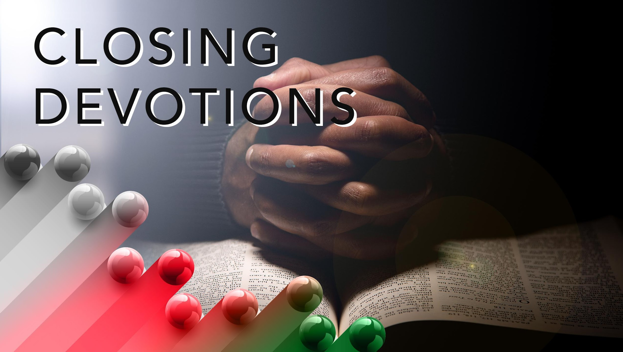

Slide 21
Pray for countries that have water shortages.
Listen to song: “As the Deer Panteth for the Water.” Think about how you need living water for your soul.
First Sunday in Advent: Sing “My Hope Is Built” (AMECH #364) and meditate on how these words apply to Jesus’ birth.
My hope is built on nothing less
Than Jesus’ blood and righteousness
I dare not trust the sweetest frame
But wholly lean on Jesus’ name.
On Christ the solid rock I stand
All other ground is sinking sand

Slide 22
All other ground is sinking sand.
Prayer: Lord, Thank you for the promise of eternal life. We are grateful for healing and for hope. May we remember that even when things seem to be at their worst, you will restore by your Spirit. In Jesus’ name, we pray. Amen.

