Slide 1
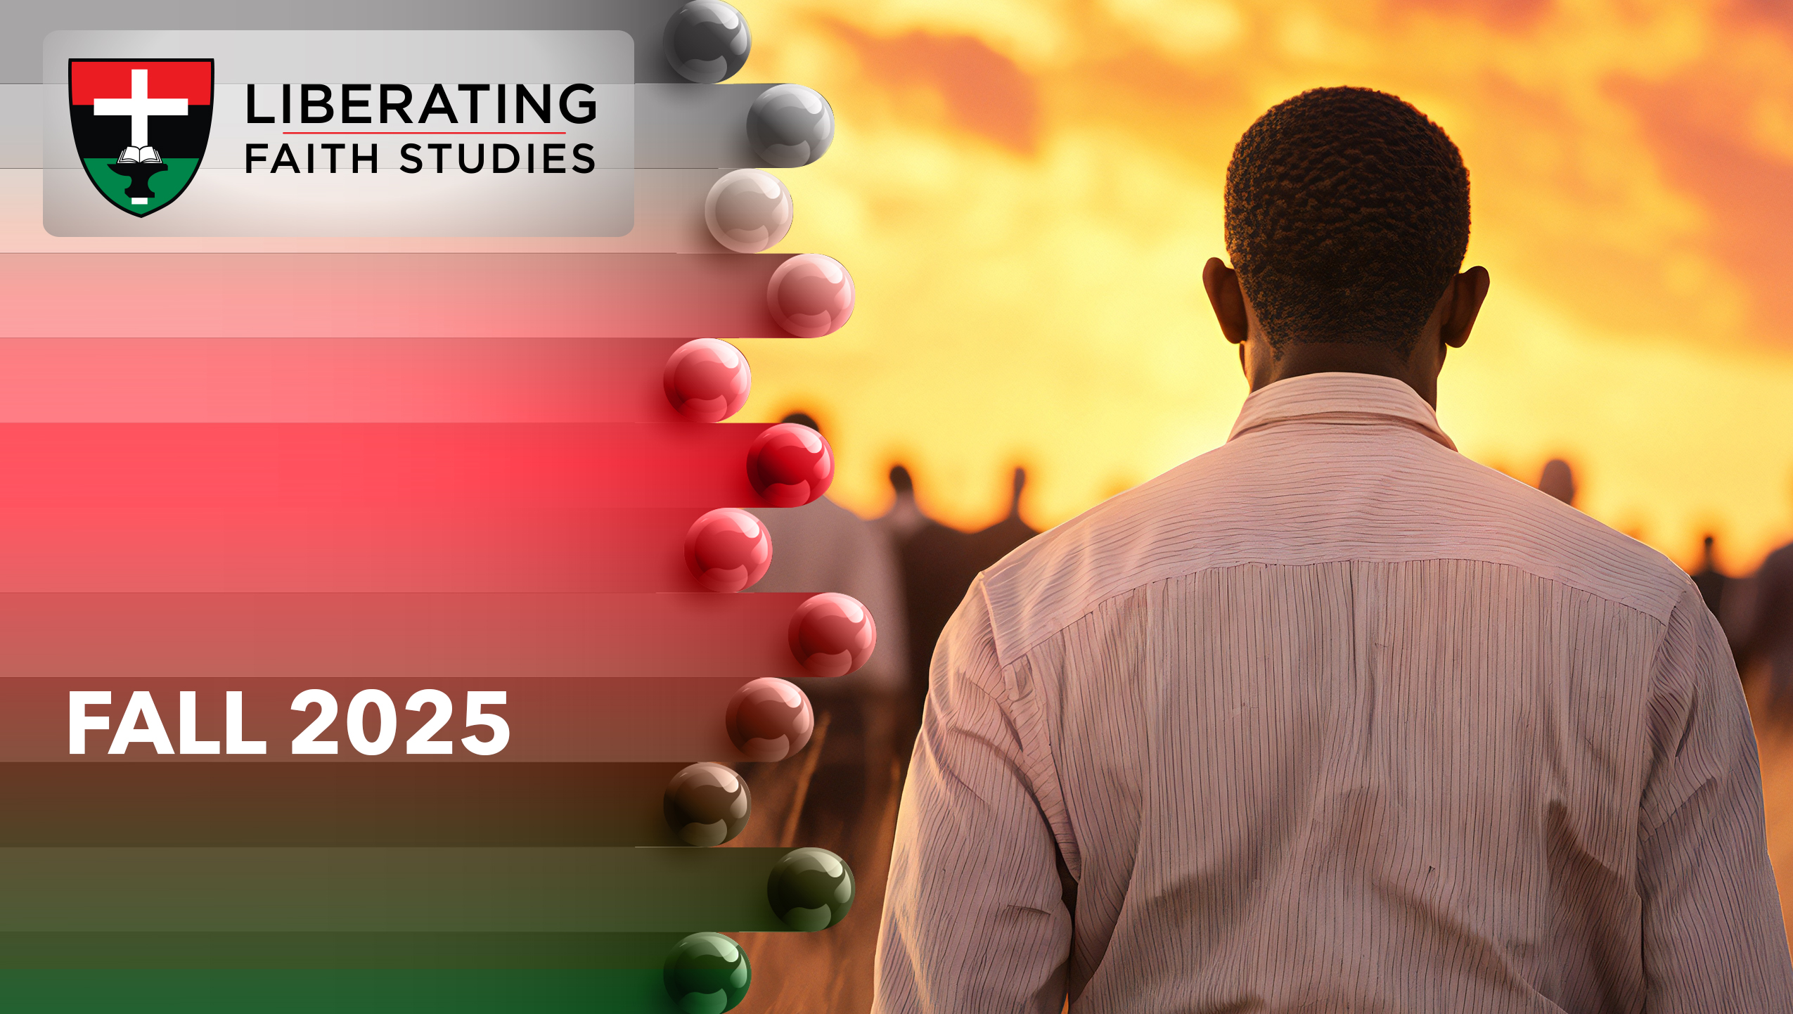
^{LESSON 12: NOVEMBER 23}

Slide 2
Ezekiel Teaches Personal Responsibility
Focus Scripture: Ezekiel 33:7-16a
Key Verse: You, mortal, I have made a sentinel for the house of Israel; whenever you hear a word from my mouth, you shall give them warning from me. Ezekiel 33:7 (NRSV UE)

Slide 3
Ezekiel 33:7-16a (NRSV UE)
7 So you, mortal, I have made a sentinel for the house of Israel; whenever you hear a word from my mouth, you shall give them warning from me.
8 If I say to the wicked, “O wicked ones, you shall surely die,” and you do not speak to warn the wicked to turn from their ways, the wicked shall die in their iniquity, but their blood I will require at your hand.
9 But if you warn the wicked to turn from their ways and they do not turn from their ways, the wicked shall die in their iniquity, but you will have saved your life.
10 Now you, mortal, say to the house of Israel: Thus you have said: “Our transgressions and our sins weigh upon us, and we waste away because of them; how then can we live?”
11 Say to them: As I live, says the Lord God, I have no pleasure in the death of the wicked but that the wicked turn from their ways and live; turn back, turn back from your evil ways, for why will you die, O house of Israel?
12 And you, mortal, say to your people: The righteousness of the righteous shall not save them when they transgress, and as for the wickedness of the wicked, it shall not make them stumble when they turn from their wickedness, and the righteous shall not be able to live by their righteousness when they sin.
13 Though I say to the righteous that they shall surely live, yet if they trust in their

Slide 4
righteousness and commit iniquity, none of their righteous deeds shall be remembered, but in the iniquity that they have committed they shall die.
14 Again, though I say to the wicked, “You shall surely die,” yet if they turn from their sin and do what is lawful and right—
15 if the wicked restore the pledge, give back what they have taken by robbery, and walk in the statutes of life, committing no iniquity—they shall surely live; they shall not die.
16a None of the sins that they have committed shall be remembered against them;…

Slide 5
^{Key Terms}
Watchman – Hebrew definition: to peer into the distance, observe; watchmen were stationed in a free-standing tower located many miles from a city.
Wicked – Hebrew “râshâ” means “morally wrong”; an ungodly or bad person.
Your title here

Slide 6


Slide 7
Suppose God gave you an assignment that could result in death for you and/or others. This was Ezekiel’s dilemma. He was to tell righteous people when they erred, and tell unrighteous people how they erred. Failure to give God’s warning would result in Ezekiel’s death. However, if Ezekiel warned Judah and they failed to heed the warning, then they could die. Bottom line – each person will be held accountable for their own decisions and actions.

Slide 8
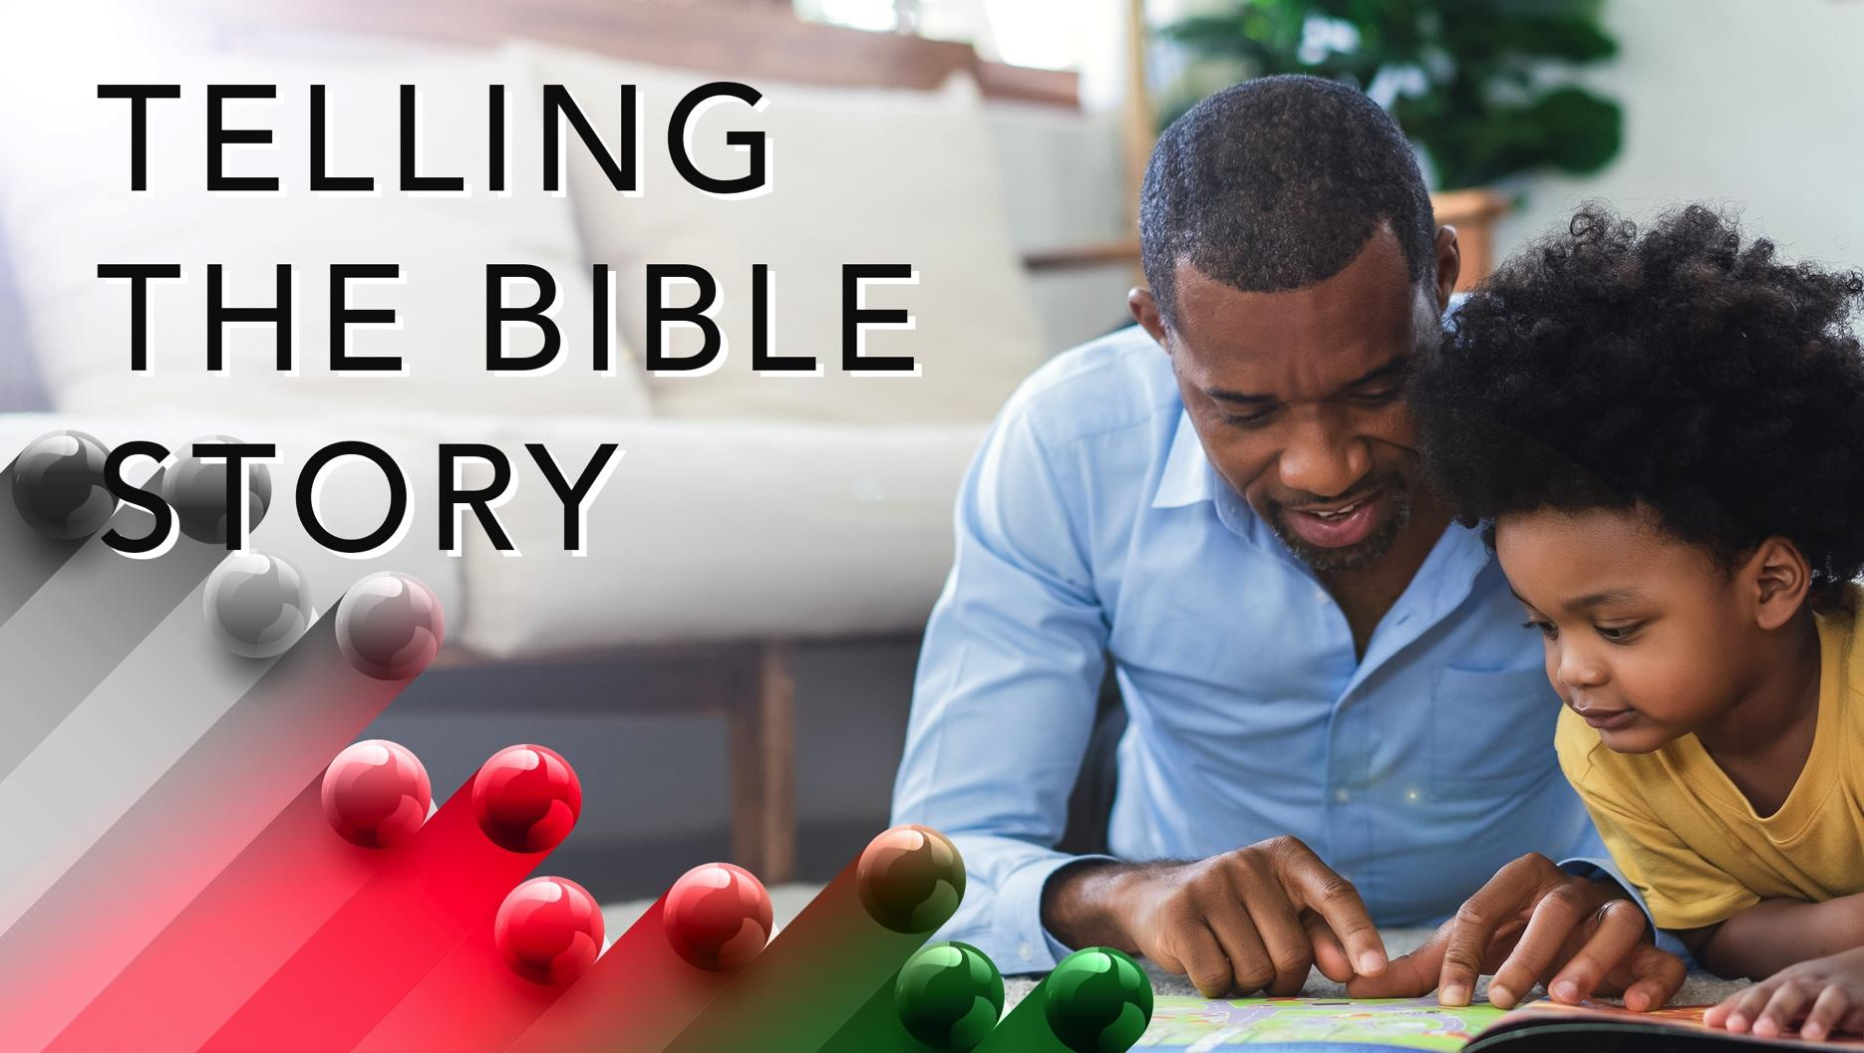

Slide 9
Ezekiel 33:7-16a
Watchmen served a crucial role in Judah. Every city built several towers in proximity to one another. These towers were staffed by watchmen who constantly looked out for threats. The watch towers were close enough for one watchman to see from his assigned tower to the watchman assigned to the next tower. Signals were sent from the watch person in the farthest tower to the watch person in the next closest tower. This process of relaying communication from one tower to the next continued until the message reached the tower closest to the city.
A wonderful serenity has taken possession

Slide 10


Slide 11
A prominent and eloquent 19th century speaker, William Wells Brown was born on a Kentucky plantation. Brown escaped to freedom and proclaimed he was a free man on January 1, 1834. The Brown’s, a Quaker family, helped him move to safety. After settling his family in Buffalo, New York, Brown worked on a steamboat and was an underground railroad conductor. He lectured for the Western New York Anti-Slavery Society about his experience as an enslaved person.
A wonderful serenity has taken possession

Slide 12


Slide 13
Women’s voices seem absent in theological conversations. At an American Academy of Religion (AAR) annual meeting, Katie Geneva Cannon reportedly fainted. The majority of attendees were white people, and Cannon’s subject matter was provocative, which may have accounted for Cannon’s reaction.

Slide 14
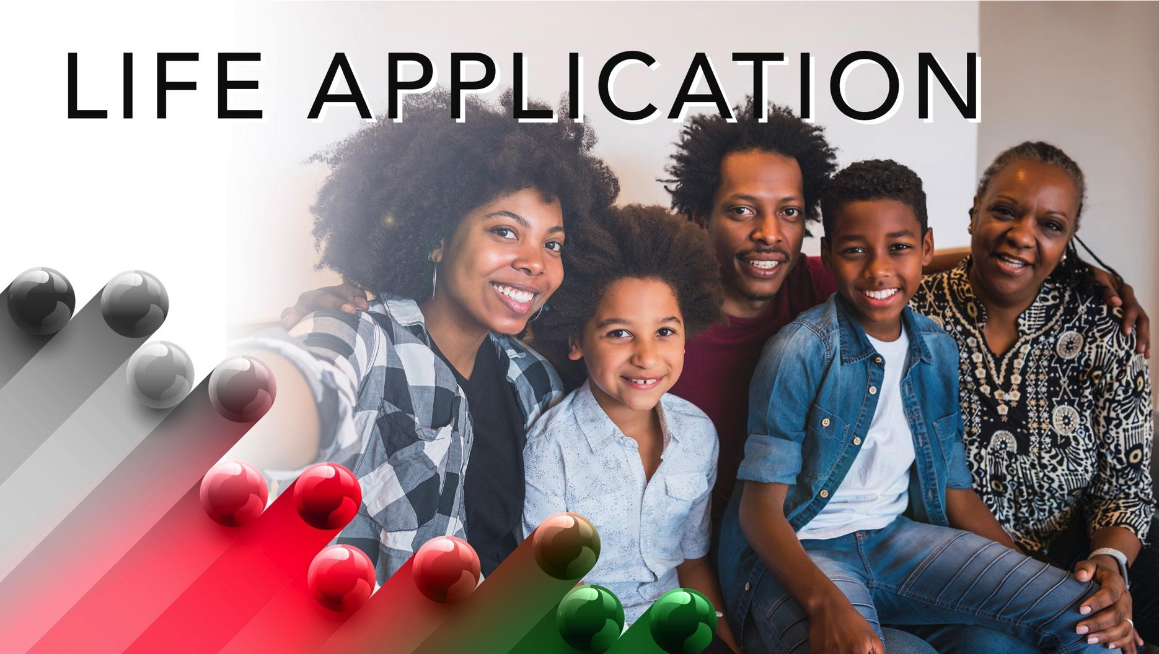

Slide 15
Today’s lesson demonstrates the importance of teaching and preaching about sin and repentance. Church members, clergy and lay, are charged with a challenging message – repent or face death. However, the church has good news. God desires all people to live. The choice of living or dying belongs to individuals.

Slide 16


Slide 17
1. What makes teaching or preaching about sin a challenge?

Slide 18
2. How would you correct someone who was not obeying God’s law?

Slide 19
3. What impact do warnings of impending doom have on people?

Slide 20
4. What did you learn about Jesus in today’s lesson?

Slide 21
5. How will you apply what you learned to your life?

Slide 22
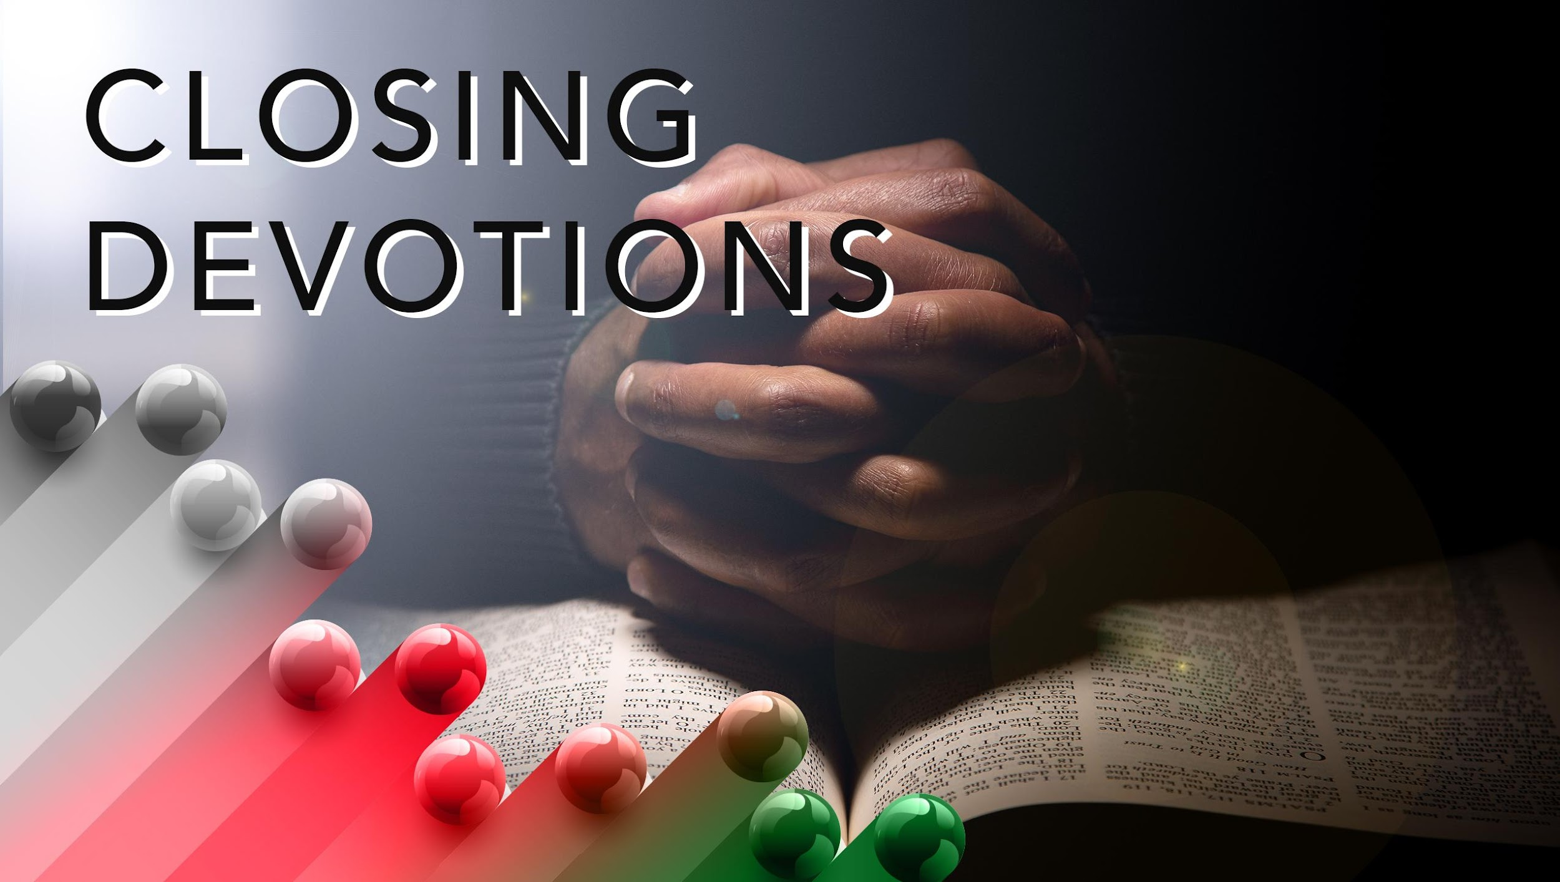

Slide 23
Think about what God wants you to say to people who refuse to repent as you meditate on these lyrics from “Lead Me, Lord”:
Lead me, Lord, lead me in thy righteousness; make thy way plain before my face.
For it is thou, Lord, thou Lord only, that makest me dwell in safety.
Listen: https://www.youtube.com/watch?v= eM03MsJUGSI
Prayer: Dear God, open my ears that I may hear and follow your commands. Teach me how I may become your voice, your watchperson. Allow me to sound your alarm with boldness and without fear. Teach me not to give final judgments as I share the need for repentance. In Jesus’ name. Amen.

