Slide 1
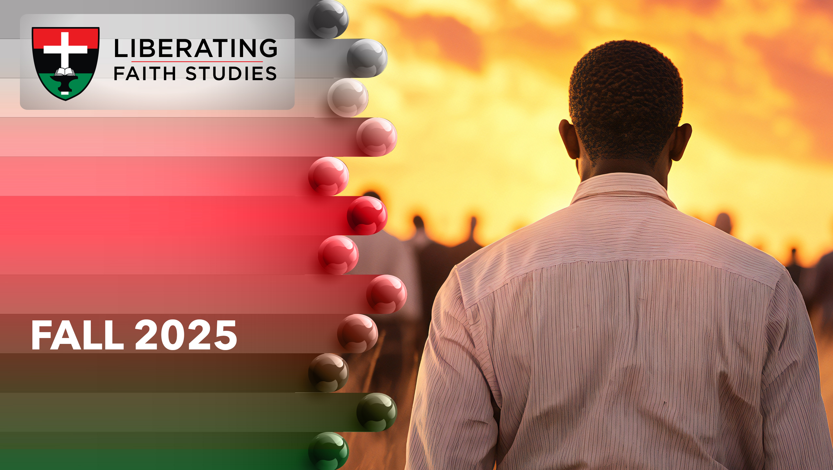
^{LESSON 11: NOVEMBER 16}

Slide 2
The Story of Ezekiel
Focus Scripture: Ezekiel 3:10-11; 24:15-24, 27
Key Verse: (The Lord God) said to me, “Mortal, all my words that I shall speak to you receive in your heart and hear with your ears.” Ezekiel 3:10 (NRSV UE)

Slide 3
Ezekiel 3:10-11; 24:15-24, 27(NRSV UE)
^{Ezekiel 3:10-11}
10 He said to me, “Mortal, all my words that I shall speak to you receive in your heart and hear with your ears;
11 then go to the exiles, to your people, and speak to them. Say to them, ‘Thus says the Lord God,’ whether they hear or refuse to hear.”
^{24:15-24}
15 The word of the Lord came to me:
16 Mortal, with one blow I am about to take away from you the delight of your eyes, yet you shall not mourn or weep, nor shall your tears run down.
17 Groan quietly; make no mourning for the dead. Bind on your turban, and put your sandals on your feet; do not cover your upper lip or eat the bread of mourners.
18 So I spoke to the people in the morning, and at evening my wife died. And on the next morning I did as I was commanded.
19 Then the people said to me, “Will you not tell us what these things mean for us, that you are acting this way?”
20 Then I said to them, “The word of the Lord came to me:
21 Say to the house of Israel: Thus says the Lord God: I will profane my sanctuary, the pride

Slide 4
of your power, the delight of your eyes, and your heart’s desire, and your sons and your daughters whom you left behind shall fall by the sword.
22 And you shall do as I have done; you shall not cover your upper lip or eat the bread of mourners.
23 Your turbans shall be on your heads and your sandals on your feet; you shall not mourn or weep, but you shall pine away in your iniquities and groan to one another.
24 Thus Ezekiel shall be a sign to you; you shall do just as he has done. When this comes, then you shall know that I am the Lord God.”
²⁷
27 On that day your mouth shall be opened to the one who has escaped, and you shall speak and no longer be silent. So you shall be a sign to them, and they shall know that I am the Lord.

Slide 5
^{Key Terms}
Ezekiel – Derived from the Hebrew name “Yechezkel” which means “God will strengthen.”
Mourn – In Hebrew “sāp̄aḏ” which means “to tear the hair and beat the breasts.”
Pine Away – In Hebrew “maqaq” which means “to melt; dissolve away, decay, rot.”
Your title here

Slide 6


Slide 7
When a loved one dies, people usually mourn. Ezekiel’s wife, who he loved dearly, died, but God told Ezekiel not to mourn. How difficult this directive not to grieve must have been. God used Ezekiel’s response to his wife’s death to teach Judah. Judah would discover that Ezekiel had provided a visual lesson.

Slide 8
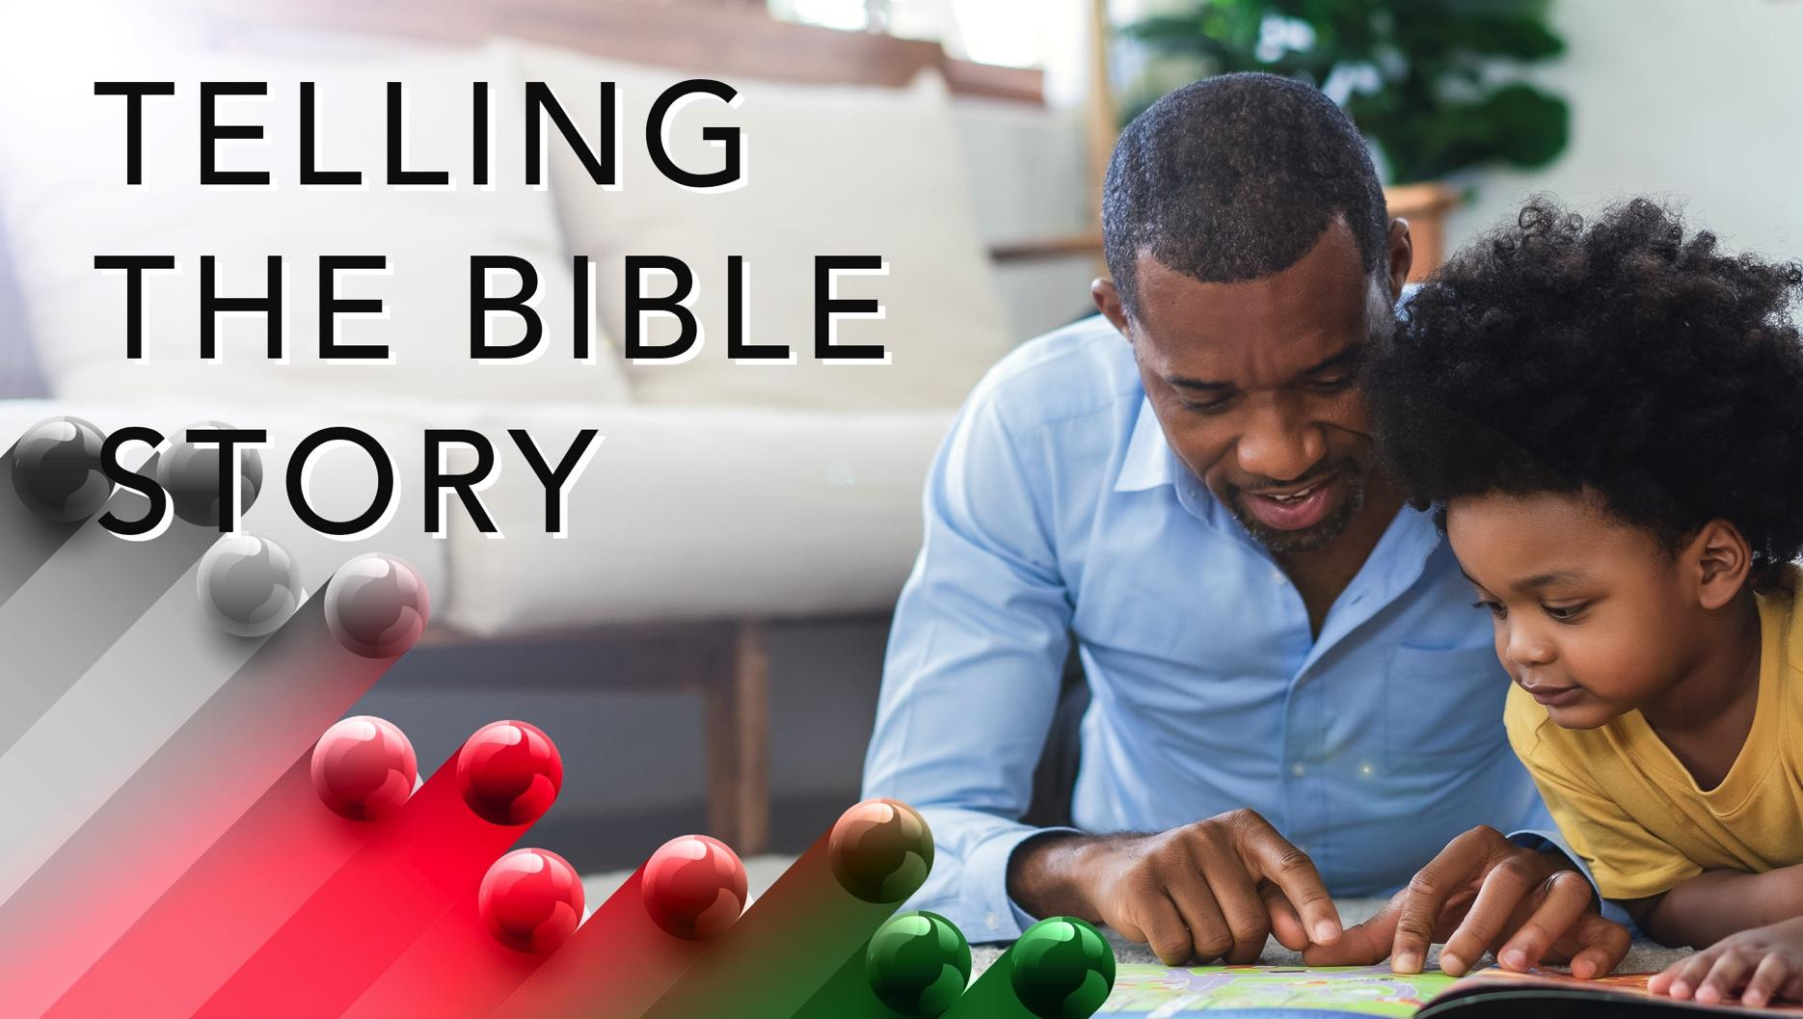

Slide 9
Ezekiel 3:10-11
God called and sent Ezekiel to the Babylonian exiles. Given Israel’s history of ignoring God’s prophets, it is not surprising they would continue that trend. Ezekiel was commanded to speak God’s Word, regardless of how it would or would not be received. God had not given up on Israel. Even in exile, God continued sending prophetic messages. Once again, Israel had a choice. They could listen, which meant to adhere to or follow God’s commands, or Judah could decide they did not want to hear what God said.
A wonderful serenity has taken possession

Slide 10


Slide 11
Spirituals sung by enslaved Africans originated from their hearts. One song with the repeated lyric, “Lord, how come me here?”, resounds with anguish and grief. Songs such as “Sometimes I Feel Like a Motherless Child,” “Nobody Knows the Trouble I See,” and “Balm in Gilead” brought some measure of comfort from slavery’s cruel realities. Family members sold; children torn from parents’ hands; lashings, rapes, and threats created heartaches. And despair. Deep lament, mourning, and grief were heard as these songs were written and sung.
A wonderful serenity has taken possession

Slide 12


Slide 13
Traditionally, Thanksgiving, an American holiday celebrated on the fourth Thursday in November, brings family and friends together. Celebrations include feasts, prayers, and television. Myths designated Thanksgiving as a time when Pilgrims (English invasive settlers) and Native Americans ate a meal together. However, the actual story is more complicated.

Slide 14
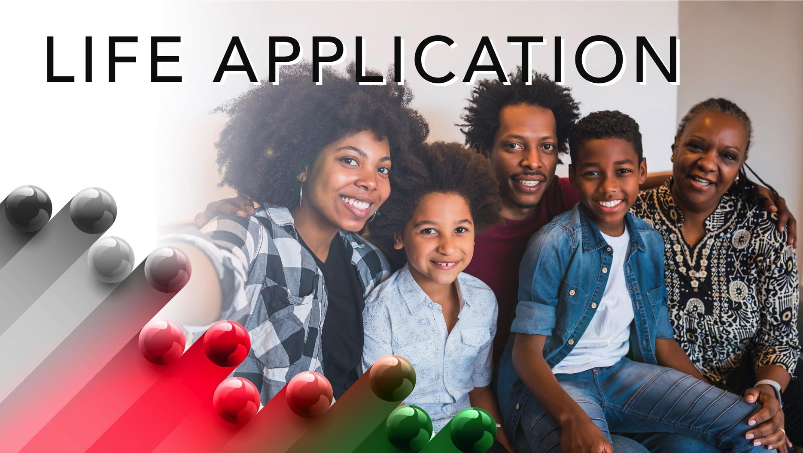

Slide 15
Tears can signal immense grief when a loved one dies. Christians’ grieving should reflect their beliefs. Scripture challenges Christians to display their grief differently than those who do not believe in Jesus…we do not want you to be uninformed, brothers and sisters, about those who have died, so that you may not grieve as others do who have no hope (1 Thessalonians 4:13 NRSV UE).

Slide 16


Slide 17
1. How does the church mourn over people who turn from Jesus?

Slide 18
2. What did you learn about Jesus from this lesson?

Slide 19
3. How will you apply today’s lessons to your life?

Slide 20
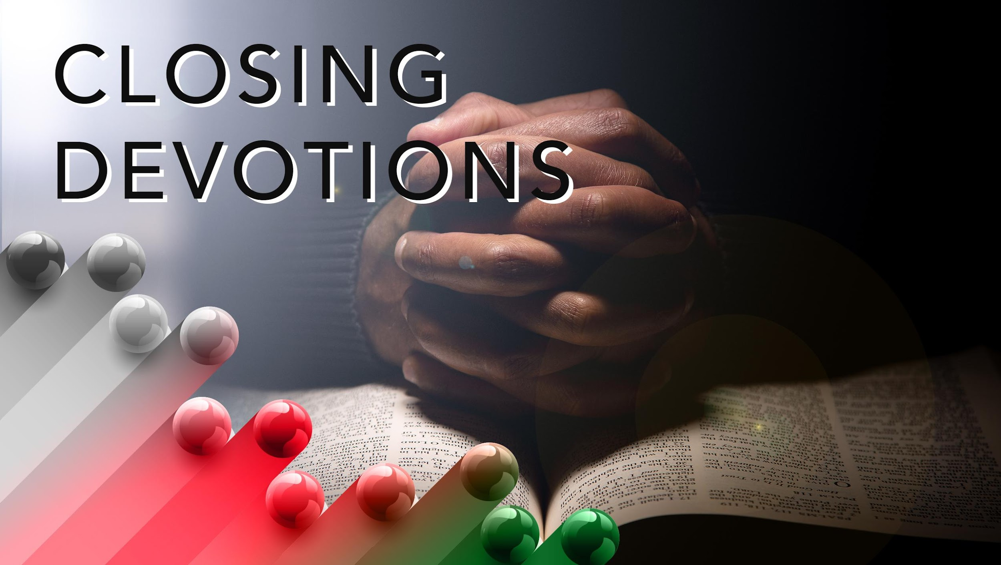

Slide 21
Remember loved ones who have died and share how God intervened in those situations.
Sing the song: “I Need Thee Every Hour” (AMECH #327) and meditate on how this hymn applies during times of sorrow.
I need Thee ev’ry hour,
In joy or pain;
Come quickly and abide,
Or life is vain
Refrain:
I need Thee, oh, I need Thee;
Ev’ry hour I need Thee;

Slide 22
Oh, bless me now, my Savior,
I come to Thee.
Prayer: Dear Lord, help us to hear your voice and heed warnings. Let us not assume that our religious buildings or items will save us from your wrath. Allow us to understand that we are your examples on earth and that our words and behaviors tell others that you are the Lord. In Jesus’ name we pray. Amen.

