Slide 1
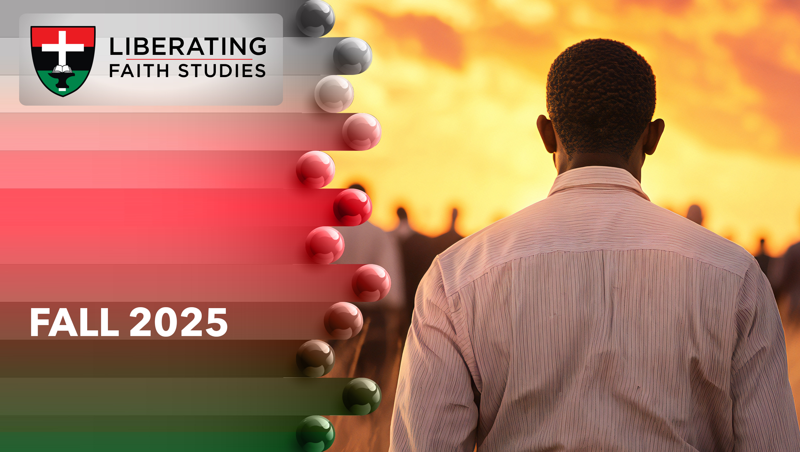
^{LESSON 1: SEPTEMBER} ⁷

Slide 2
The Ministry of Isaiah
Focus Scripture: Isaiah 6:1-8; 38:1-5
Key Verse:I heard the voice of the Lord saying, “Whom shall I send, and who will go for us?” And I said, “Here am I; send me!” Isaiah 6:8 (NRSV UE)

Slide 3
Isaiah 6:1-8; 38:1-5 (NRSV UE)
1 In the year that King Uzziah died, I saw the Lord sitting on a throne, high and lofty, and the hem of his robe filled the temple.
2 Seraphs were in attendance above him; each had six wings: with two they covered their faces, and with two they covered their feet, and with two they flew.
3 And one called to another and said, “Holy, holy, holy is the Lord of hosts; the whole earth is full of his glory.”
4 The pivots on the thresholds shook at the voices of those who called, and the house filled with smoke.
5 And I said, “Woe is me! I am lost, for I am a man of unclean lips, and I live among a people of unclean lips, yet my eyes have seen the King, the Lord of hosts!”
6 Then one of the seraphs flew to me, holding a live coal that had been taken from the altar with a pair of tongs.
7 The seraph touched my mouth with it and said, “Now that this has touched your lips, your guilt has departed and your sin is blotted out.”
8 Then I heard the voice of the Lord saying, “Whom shall I send, and who will go for us?” And I said, “Here am I; send me!”

Slide 4
^{38:1-5}
1 In those days Hezekiah became sick and was at the point of death. The prophet Isaiah son of Amoz came to him and said to him, “Thus says the Lord: Set your house in order, for you shall die; you shall not recover.”
2 Then Hezekiah turned his face to the wall and prayed to the Lord:
3 “Remember now, O Lord, I implore you, how I have walked before you in faithfulness with a whole heart and have done what is good in your sight.” And Hezekiah wept bitterly.
4 Then the word of the Lord came to Isaiah:
5 “Go and say to Hezekiah, Thus says the Lord, the God of your ancestor David: I have heard your prayer; I have seen your tears; I will add fifteen years to your life.”

Slide 5
^{Key Terms}
Isaiah – Salvation of the Lord.
Uzziah – The Lord is my strength or tower.
Train – The tail or end of a robe or garment; the longer the train the more important the person who wore it.
Seraphim – Six winged, celestial beings who continually worship God.
Hezekiah – God strengthens (derived from the verb (hazaq), to be strong, and (yah), the shortened name of the Lord).
Sennacherib – Sin has replaced the brothers.
Your title here

Slide 6
The Assyrian Empire – A collection of united city-states in power from 900 B.C.E. to 600 B.C.E.; the empire stretched from Mesopotamia (modern-day Iraq) through Asia Minor.

Slide 7


Slide 8
Every Liberating Faith adult lesson includes a Sankofa section. But have you ever thought about sankofa’s meaning and significance? A Twi word, sankofa, “Se wo were fi na wosan kofa a yenkyiri,” originates in Ghana’s Akan tribe. When put into action, sankofa encourages us to know our history (look back). And from what the past taught us, we will be enlightened about our future. Symbolizing sankofa, a bird with its head turned backwards, represents a quest for past knowledge leading to wisdom, a desire to understand how our roots equip us for the future.

Slide 9
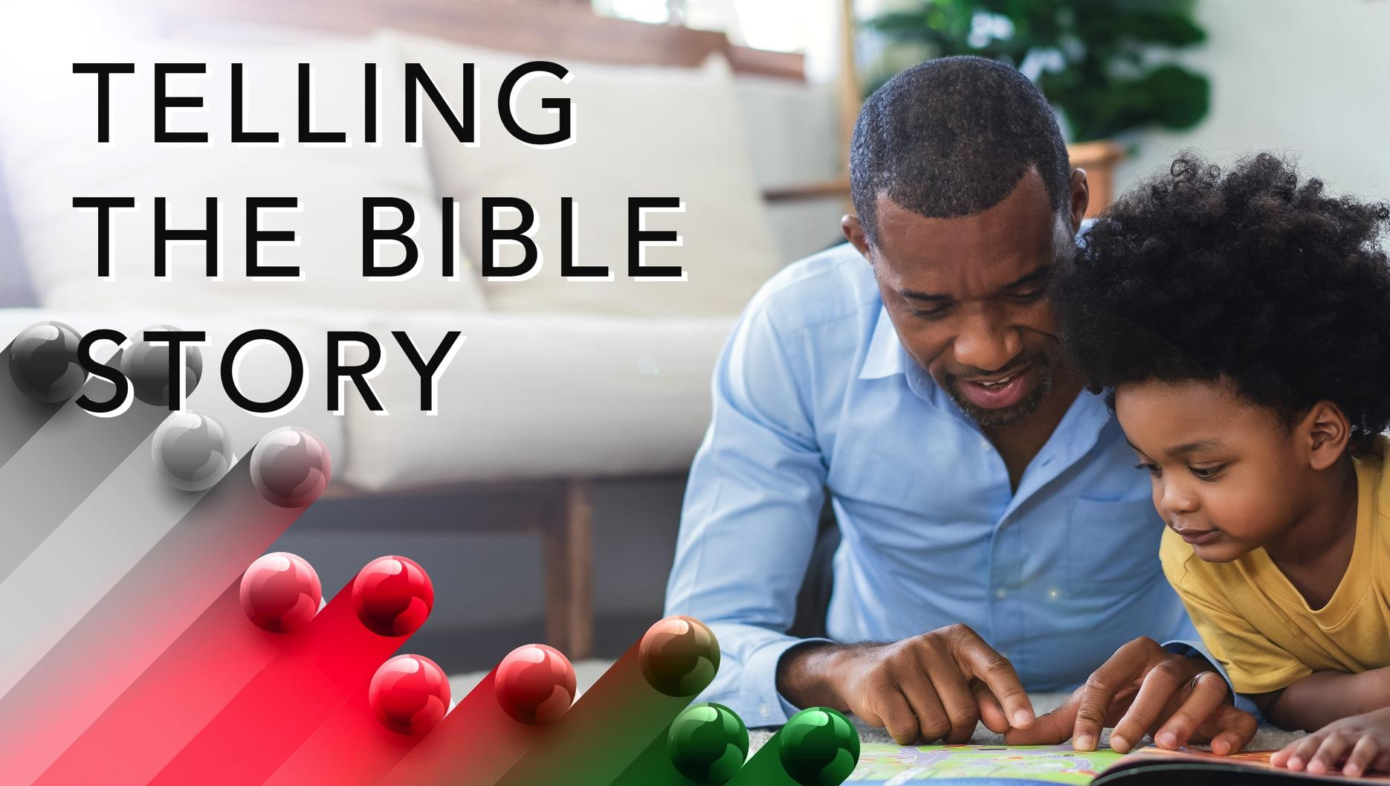

Slide 10
^{Isaiah 6:1-8}
Isaiah believes this part of his prophecy happened during the time of King Uzziah’s death. Some scholars think the events in Isaiah 6 happened before events in the first five chapters because it talks about Isaiah’s call. The same year Uzziah, Judah’s king, died, Isaiah says he saw the Lord. Uzziah was a good king, but his successes made him want to do things his own way instead of following God’s rules.
A wonderful serenity has taken possession

Slide 11


Slide 12
Maria W. Stewart, born a free person in 1803 in Hartford, Connecticut, became an outspoken abolitionist and women’s rights advocate. During the 19th century, women in the United States rarely had a voice; however, this did not deter Stewart. She became one of the first American women public speakers.
A wonderful serenity has taken possession

Slide 13


Slide 14
Michelle Alexander, a black writer and civil rights advocate, was born in 1967. A graduate of Vanderbilt University, she later earned her Juris Doctorate from Stanford Law School. She has dedicated her career to advancing justice. As part of her commitment to racial justice, Alexander has brought national attention to racial profiling by law enforcement.

Slide 15
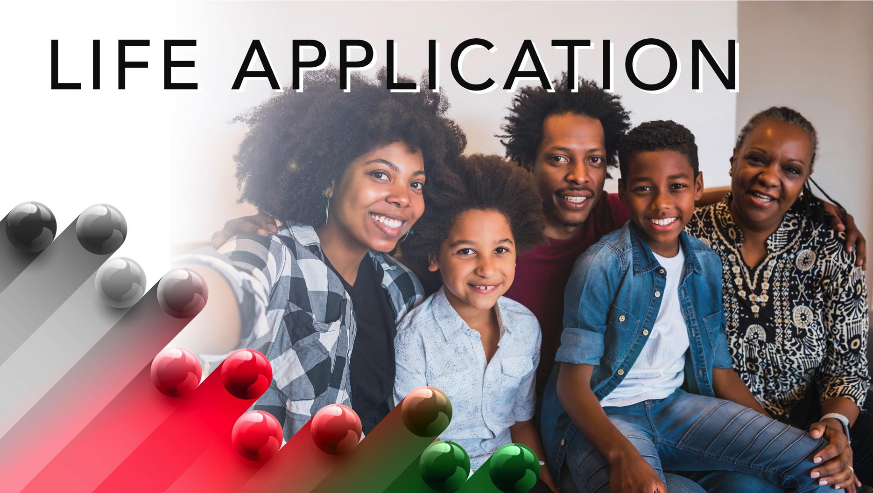

Slide 16
An idiom often heard, “Speak truth to power,” does not specify whose truth.

Slide 17


Slide 18
1. What prophetic voices exist today? (This is not future telling. Israel’s prophets speak to the people about God and to God about the people.)

Slide 19
^{2. How do you envision God?}

Slide 20
3. Where did you see Jesus in this lesson?

Slide 21
4. How will you apply what you learned to your life?

Slide 22
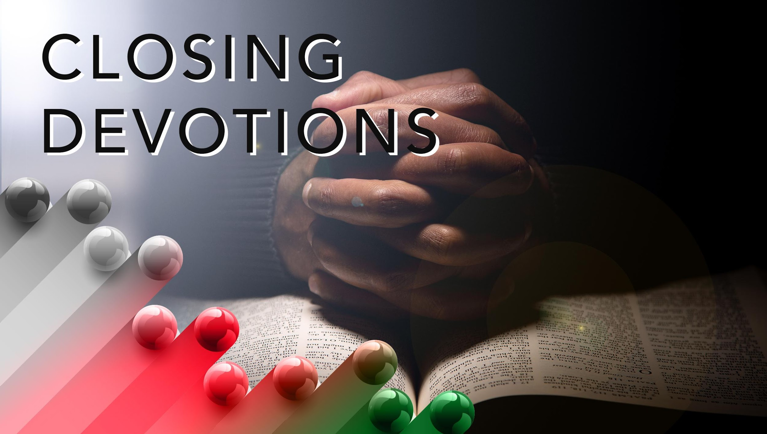

Slide 23
Silent Moments: What has the Holy Spirit told you – about fear, death, illness, enemies, or worship? Write your thoughts down; then share them with others.
Prayer: Lord, we are so grateful for leaders who will follow you wholeheartedly. May we be your instruments, your messengers, whenever we hear your voice telling us to speak. Help us to show appreciation for all that you do. During times of stress, please hear our voices as we cry out to you. When you answer our prayers, please remind us that you are our life-giving source. May we be ever humble and remember that every success comes from your hand. In Jesus’ name we pray. Amen.

