Slide 1
LESSON 7: April 17, 2022 (Easter)

Slide 2
^{The Paschal Lamb Lives!}
Focus Scripture: Matthew 28:1-10
Key Verse: Jesus said to them, “Do not be afraid; go and tell my brothers to go to Galilee; there they will see me.” Matthew 28:10 (NRSV)

Slide 3
^{Matthew 28:1-10 (NRSV)}
1 After the sabbath, as the first day of the week was dawning, Mary Magdalene and the other Mary went to see the tomb.
2 And suddenly there was a great earthquake; for an angel of the Lord, descending from heaven, came and rolled back the stone and sat on it.
3 His appearance was like lightning, and his clothing white as snow.
4 For fear of him the guards shook and became like dead men.
5 But the angel said to the women, “Do not be afraid; I know that you are looking for Jesus who was crucified.
6 He is not here; for he has been raised, as he said. Come, see the place where he lay.
7 Then go quickly and tell his disciples, ‘He has been raised from the dead, and indeed he is going ahead of you to Galilee; there you will see him.’ This is my message for you.”
8 So they left the tomb quickly with fear and great joy, and ran to tell his disciples.
9 Suddenly Jesus met them and said, “Greetings!” And they came to him, took hold of his feet, and worshiped him.
10 Then Jesus said to them, “Do not be afraid; go and tell my brothers to go to Galilee; there they will see me.”

Slide 4
^{Key Term}
Earthquake – A sudden and violent shaking of the ground; earthquakes are symbolic of change; also used figuratively to illustrate God’s power.
Lightning – Thunder is often spoken of as a token of God’s wrath; lightning denotes brilliance, enlightenment.
Your title here

Slide 6
Most adults have experienced a tragedy or loss that has caused them great sadness or disappointment. These moments in life can bring great heartache and pain. That is what these three women were experiencing as they approached the tomb of Jesus. Yet, they were determined to go to the grave and anoint his body. Their faithfulness and steadfast commitment to the Lord led them to be the first witnesses of the empty tomb and the theophany encounter of an angelic being followed by the appearance of Jesus himself.

Slide 8
When reading this account of the resurrection, there are points we should observe. The women could not go to the tomb during the Sabbath – they waited until the new day dawned. They were unsure of how to gain access to the grave with the stone blocking the entrance. With only two women identified in Matthew’s text, this task would be extremely difficult, leaving them to rely on the guards to assist them. Their determination was evident. The combination of the earthquake and lightning may have been events occurring simultaneously, increasing their fears. The women’s report of an angel’s presence caused further alarm. Fear and shock are to be expected. Their minds struggled to absorb these events and understand what was happening.
A wonderful serenity has taken possession

Slide 10
A wonderful serenity has taken possession
On a hot summer evening, when the skies appear threatening, and the rumbling of thunder warns of an approaching storm, many will seek shelter. Although most people are attempting to avoid the rain, the true threat in these thunderstorms, is the lightning.

Slide 12
The 21st century has included great accomplishments for humanity. These great accomplishments have led to major medical breakthroughs, engineering brilliance, and incredible creative genius.

Slide 13
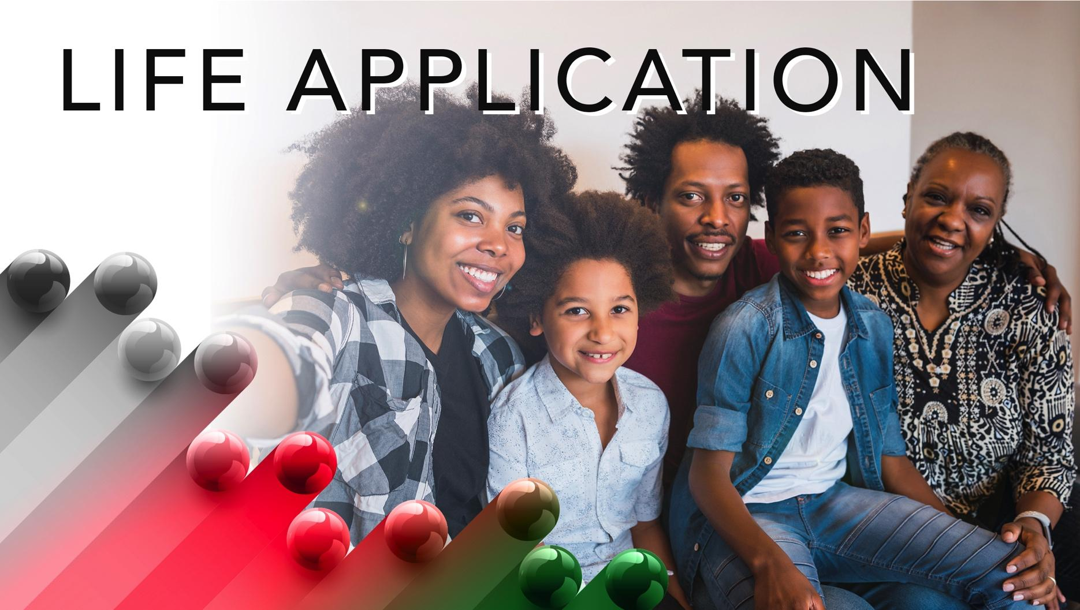

Slide 14
The celebration of Easter is the greatest of all holy days in the Christian faith. There are many commercialized activities that occur such as Easter egg hunts, baskets, and candy. The most important day of our faith has been reduced to bunny rabbits and jellybeans. Despite these distractions, there are still opportunities to recognize the true meaning of this day. Use it as a teaching moment to inform others about the beauty of God’s love and the power of the resurrection.

Slide 16
1. Many people are still unaware that Jesus is the way to eternal life. What will you do today to share the gospel so that others may decide to celebrate his resurrection with you?

Slide 18
Closing Hymn or Song of Praise: “Victory Is Mine” – African American Heritage Hymnal #489
Closing Prayer: God, we gather this morning with our hearts full of praise; lift us. We honor you; we thank you; we glorify your holy name. You have blessed us from last Sunday till this very moment. Thank you. You have helped us climb mountains, survive the valley, and defeat giants. God, your presence has been evident in every moment from the opening of our eyes till the close of the same. You are the merciful, grace-granting, hope-providing, God of yesterday and today. Lead us this morning into a place of healing, a place of peace, a place of purpose. We hand this time to you. We have come to glorify you, praise you, worship you, and hear from you. Use each of us. Amen.

Slide 19
Adapted from “Congregational Prayers”
By Rev. Florence M. McElroy, 16th District
The Anvil; Sankofa: Worshipping God Yesterday, Today and Forever Annual Resource Guide; 2019-2020

